Slide 1


Tutor Time Collective Worship
Click to go to Day 1
Click to go to Day 2
The Lord be with you…

Slide 2

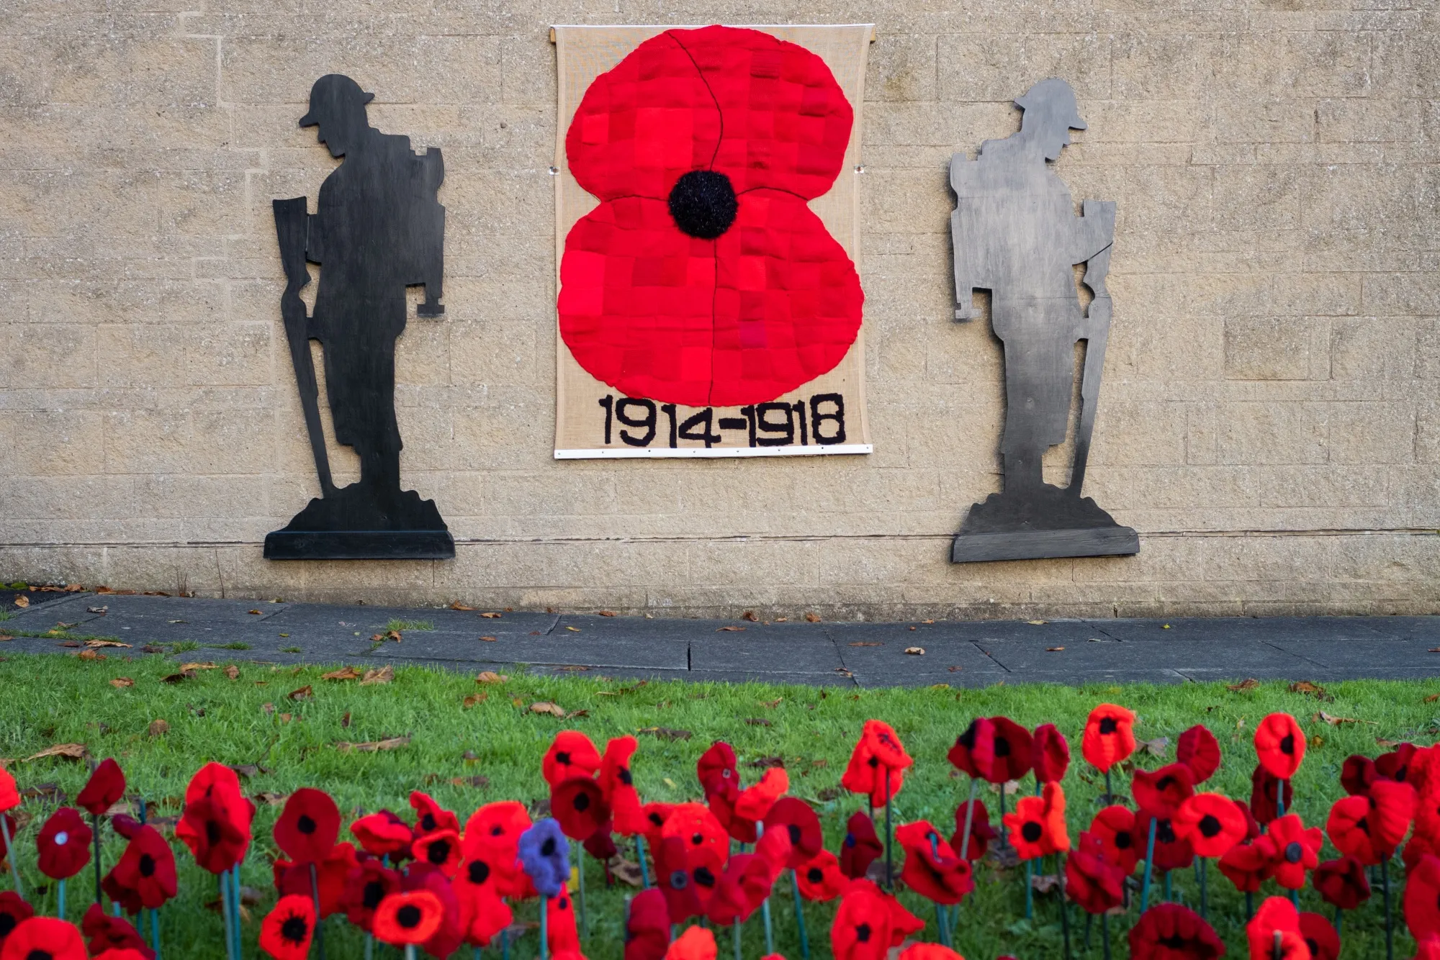
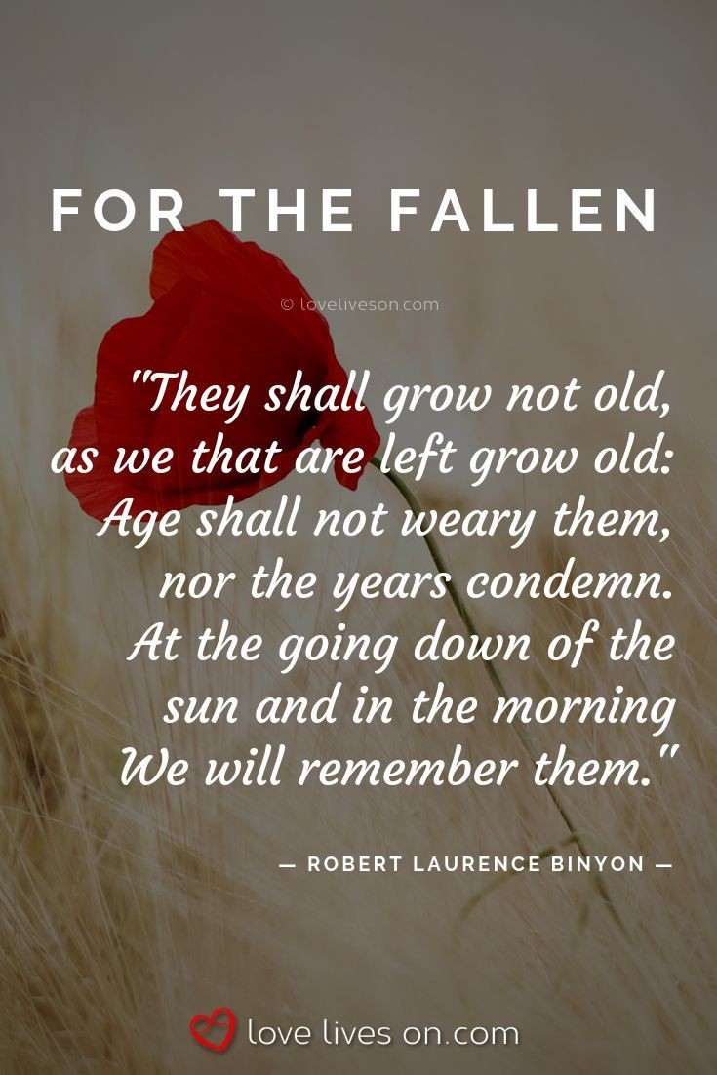

The theme for this half term: School Mission Statement: Deeply Christian; Open to All
The Equality and Diversity theme for this half term: Religion/Belief
The theme for this week: Remembrance
Click for the challenge of the day
Click for the verses of the day
Click
Click for a prayer
Click for a prayer
Watch: Remembrance
Bing Videos

Slide 3


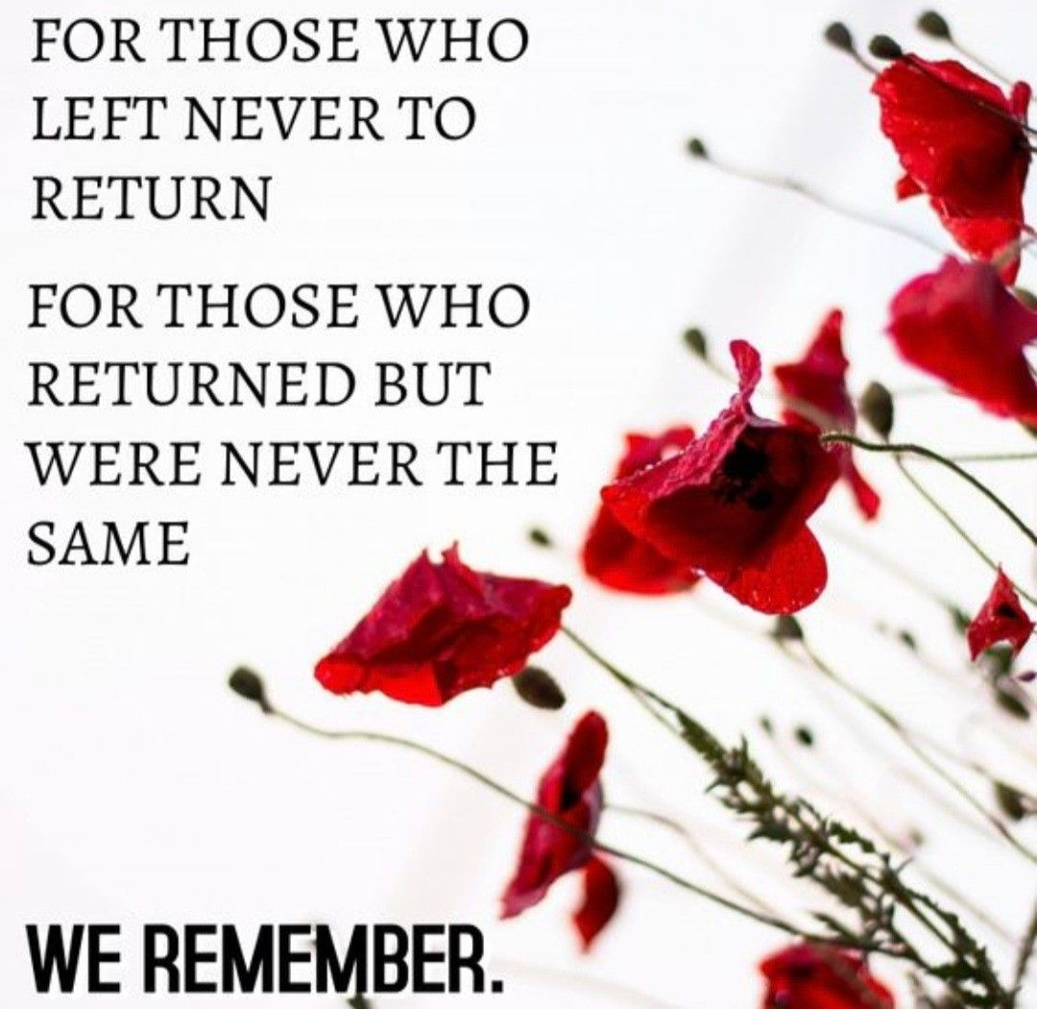
The theme for this half term: School Mission Statement: Deeply Christian; Open to All
The Equality and Diversity theme for this half term: Religion/Belief
The theme for this week: Remembrance
Click for the challenge of the day
Click for the verses of the day
Word of the Day
Merriam-Webster
Click for a prayer
Click for a prayer
Watch: More on Remembrance…
https://youtu.be/oBTJyT6y6UA

Slide 4
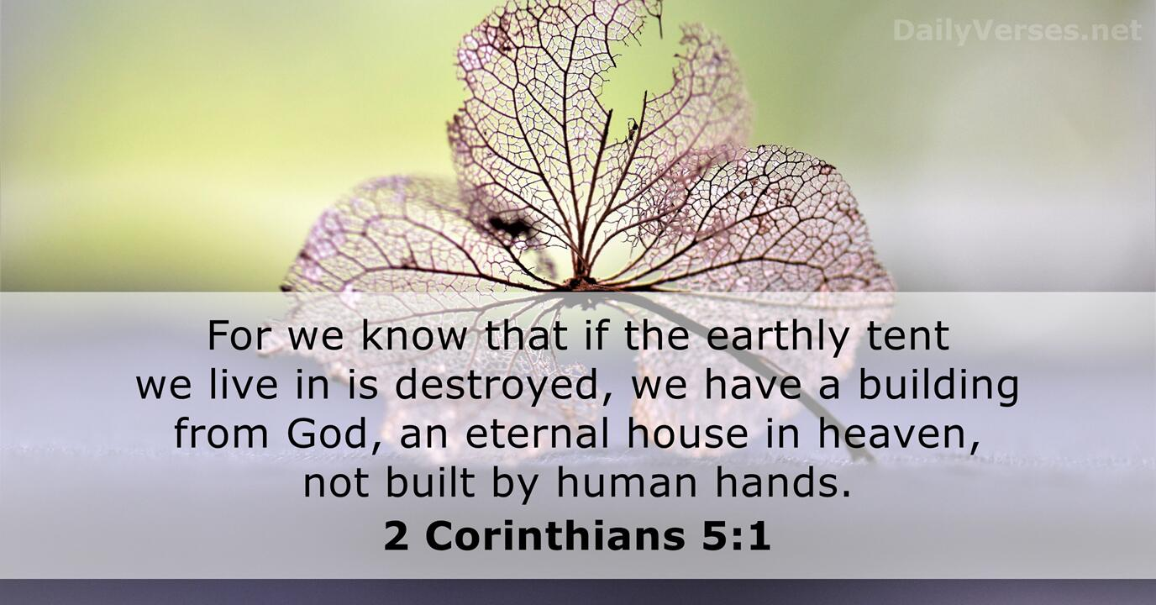
Click to go back
This verse, written to the people living in Corinth, reminded them that our time on earth is temporary. There is also no guarantee that we will live long, healthy lives. Paul encourages them (and us) that we can look forward to an eternity built by God; i.e. something that will last forever and not perish!
The One Big Question:
If we live a maximum of 120 years on earth but live on for eternity after that, should this have an impact on what we do now?

Slide 5
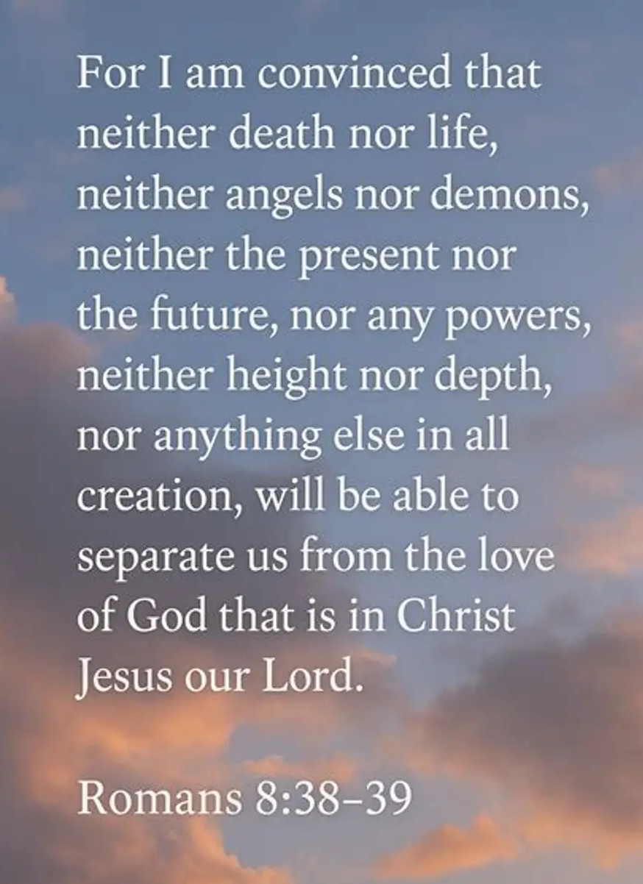
Click to go back
This encouragement was written to those living in Rome. Pretend it was written to you now here in Crawley. Paul was so convinced by God’s love for him that he knew that nothing was strong enough to separate him from it. Nothing.
Question of the day
Our love for people is usually conditional.
What does this mean?

Slide 6
These dates are significant. Do you know of an event related to them?
Click to go back
11th September 2001
1st September 1939
4th July
1776
Click for answers
(9/11)Terrorist attack in USA
Start of Second World War
USA Declaration of Independence
1914 - 1918
14th October
1066
18th June
1815
20th July
1969
The First World War
The Battle of Hastings
The Battle of Waterloo
Moon Landing

Slide 7
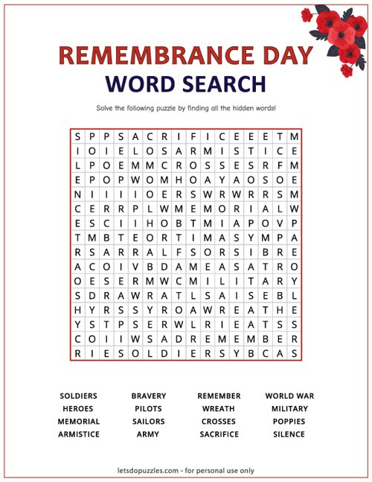

Can you find the words listed below in this Remembrance Day wordsearch?
Click for answers
Click to go back

Slide 8
Prayer 1: Remembering Those Who Served
Loving God
Today we pause to remember all those who served their countries during times of war and conflict. We give thanks for their courage, sacrifice, and determination to protect others. Help us to honour their memory not only with words, but by living lives of kindness, respect, and peace. Teach us to value the freedoms we enjoy and to work towards a world where understanding is greater than hatred. May we never forget those who gave so much for others.
Amen
Click to go back

Slide 9
Prayer 2: Learning from the Past
God of wisdom
As we remember the events of the past, help us to learn from history. Remind us of the pain that war brings to individuals, families, and communities across the world. Give us the courage to stand up against injustice, prejudice, and division. Help us to be peacemakers in our school, our homes, and our communities. May remembrance inspire us to build a better future for everyone.
Amen
Click to go back

Slide 10
Prayer 3: Remembering All Victims of Conflict
Compassionate God
Today we remember all those whose lives have been affected by war and conflict. We think of soldiers, civilians, families, refugees, and all who have suffered loss. Bring comfort to those who grieve and hope to those who continue to face uncertainty. Help us to recognise our shared humanity and to care deeply for one another, regardless of our differences. May our remembrance lead us to acts of kindness and reconciliation.
Amen
Click to go back

Slide 11
Prayer 4: A Commitment to Peace
Faithful God
As we gather in remembrance, we thank you for the people who have shown bravery, selflessness, and resilience in the face of great difficulty. Help each of us to play our part in creating a more peaceful world. Teach us to listen before we judge, to forgive when we are hurt, and to seek understanding when we disagree. May the memories we honour today encourage us to be people of hope, compassion and peace.
Amen
Click to go back

Slide 12
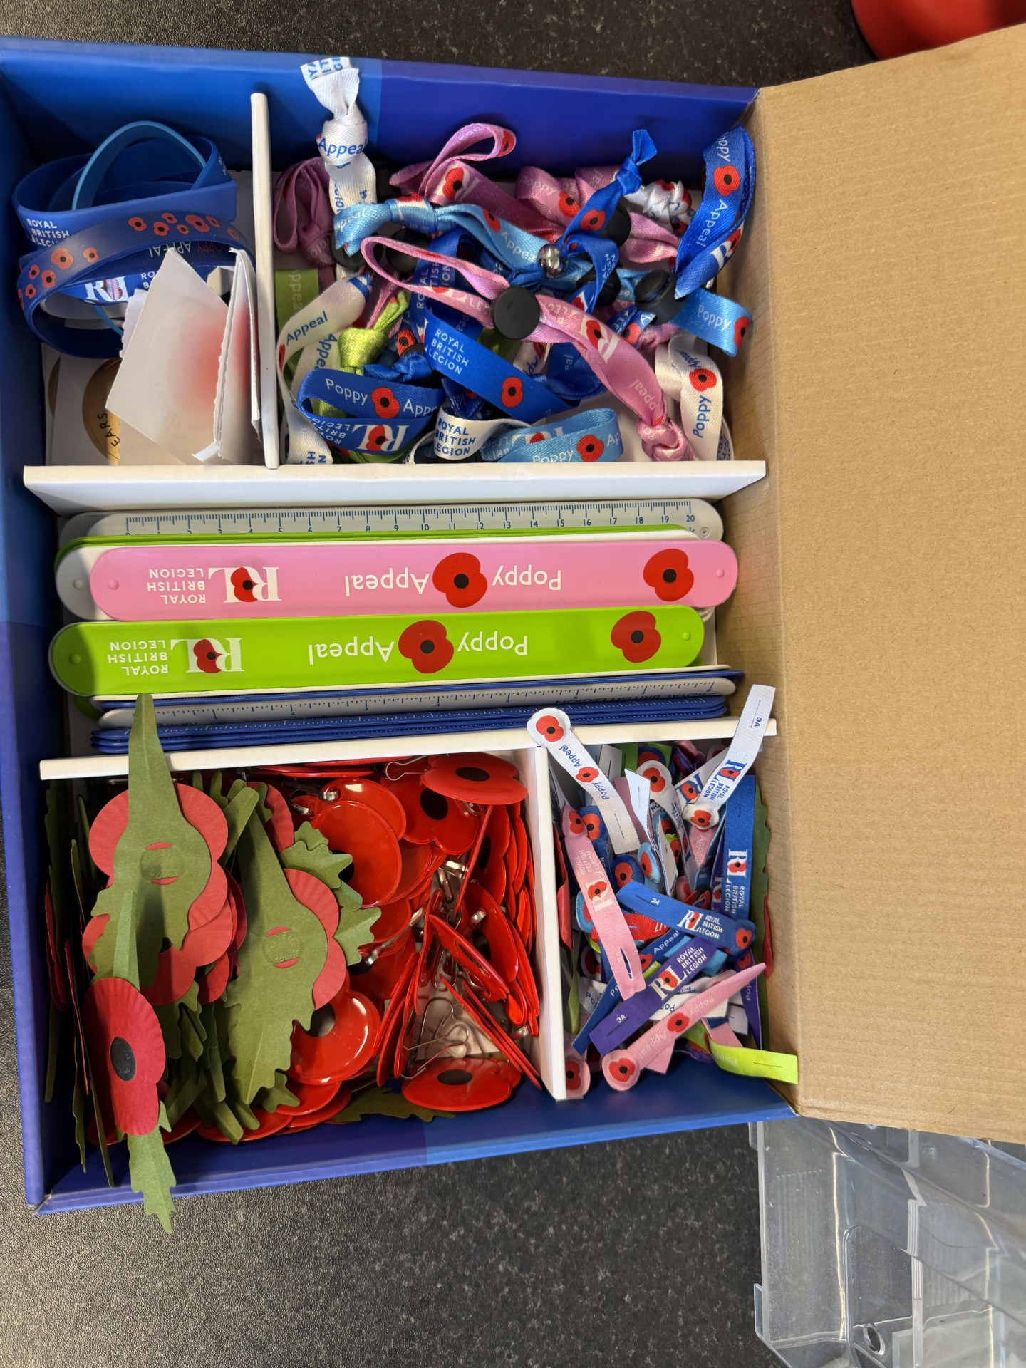
From Monday 2nd November to Wednesday 11th November there will be poppies and other Remembrance related items available for purchase. Students will be visiting your tutor groups and you can also buy from the chapel
Click to go back

