Slide 1


Tutor Time Collective Worship
Click to go to Day 1
Click to go to Day 2
The Lord be with you…

Slide 2

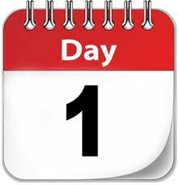
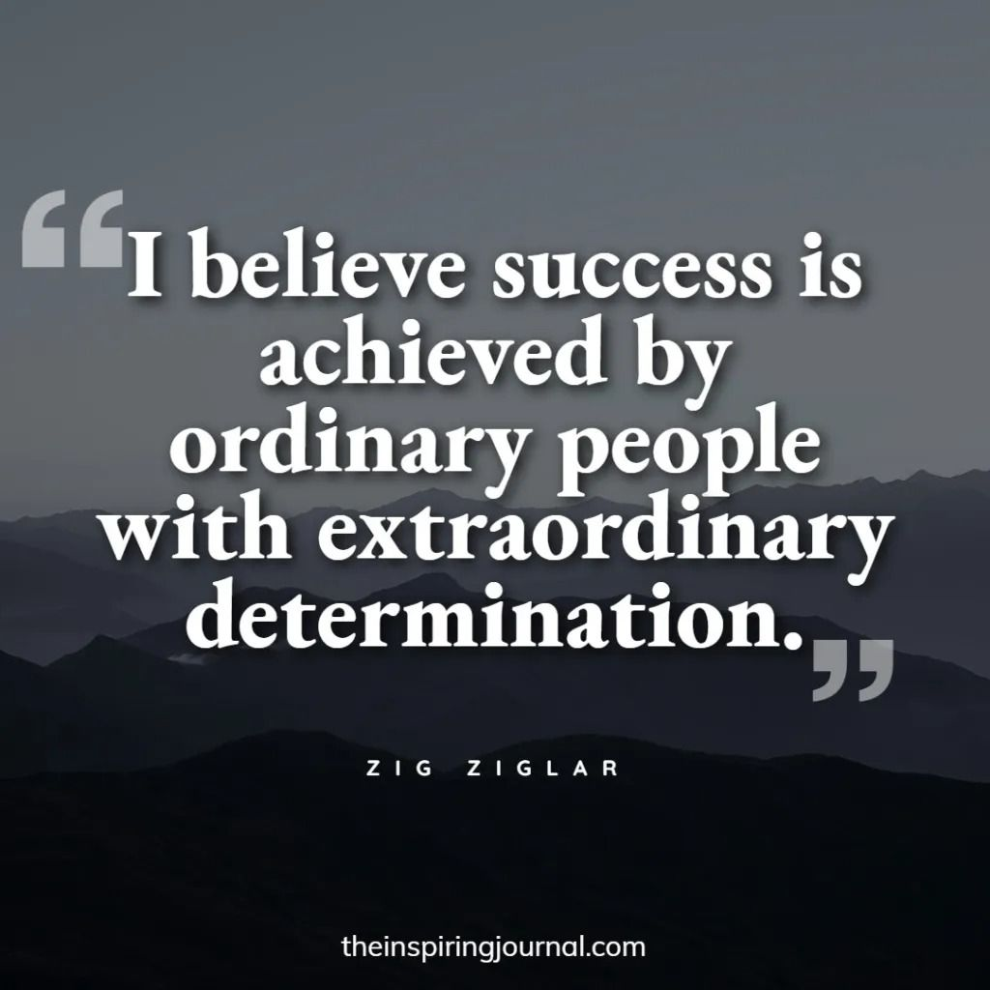

The theme for this half term: Hope
The Equality and Diversity theme for this half term: Inclusion
The theme for this week: Celebration of Success
Click for the challenge of the day
Click for the verses of the day
A message from the Green Ambassadors
Watch:
It’s a group effort…
Click for a prayer
Click for a prayer

Slide 3

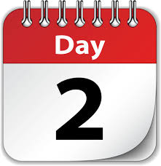
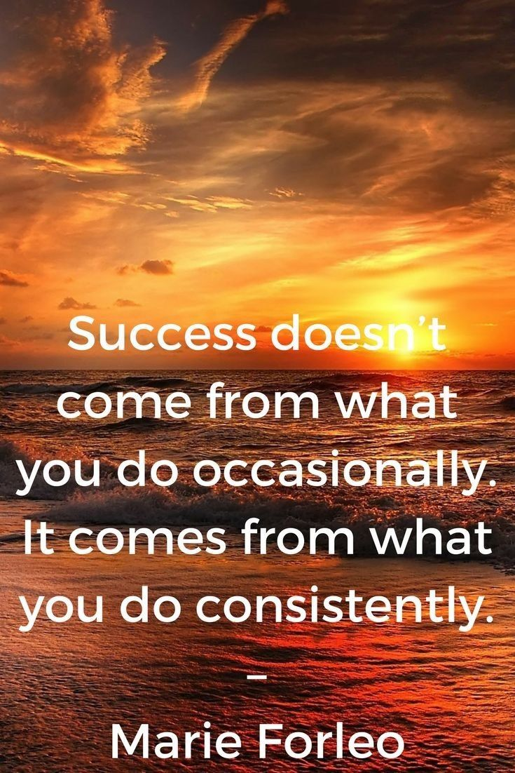
The theme for this half term: Hope
The Equality and Diversity theme for this half term: Inclusion
The theme for this week: Celebration of Success
Click for the challenge of the day
Click for a prayer
Click for the verses of the day
Word of the Day
Merriam-Webster
Click for a prayer
Watch: People with serious skills… Be inspired!
https://youtu.be/Bmoe7aB1s5o#

Slide 4
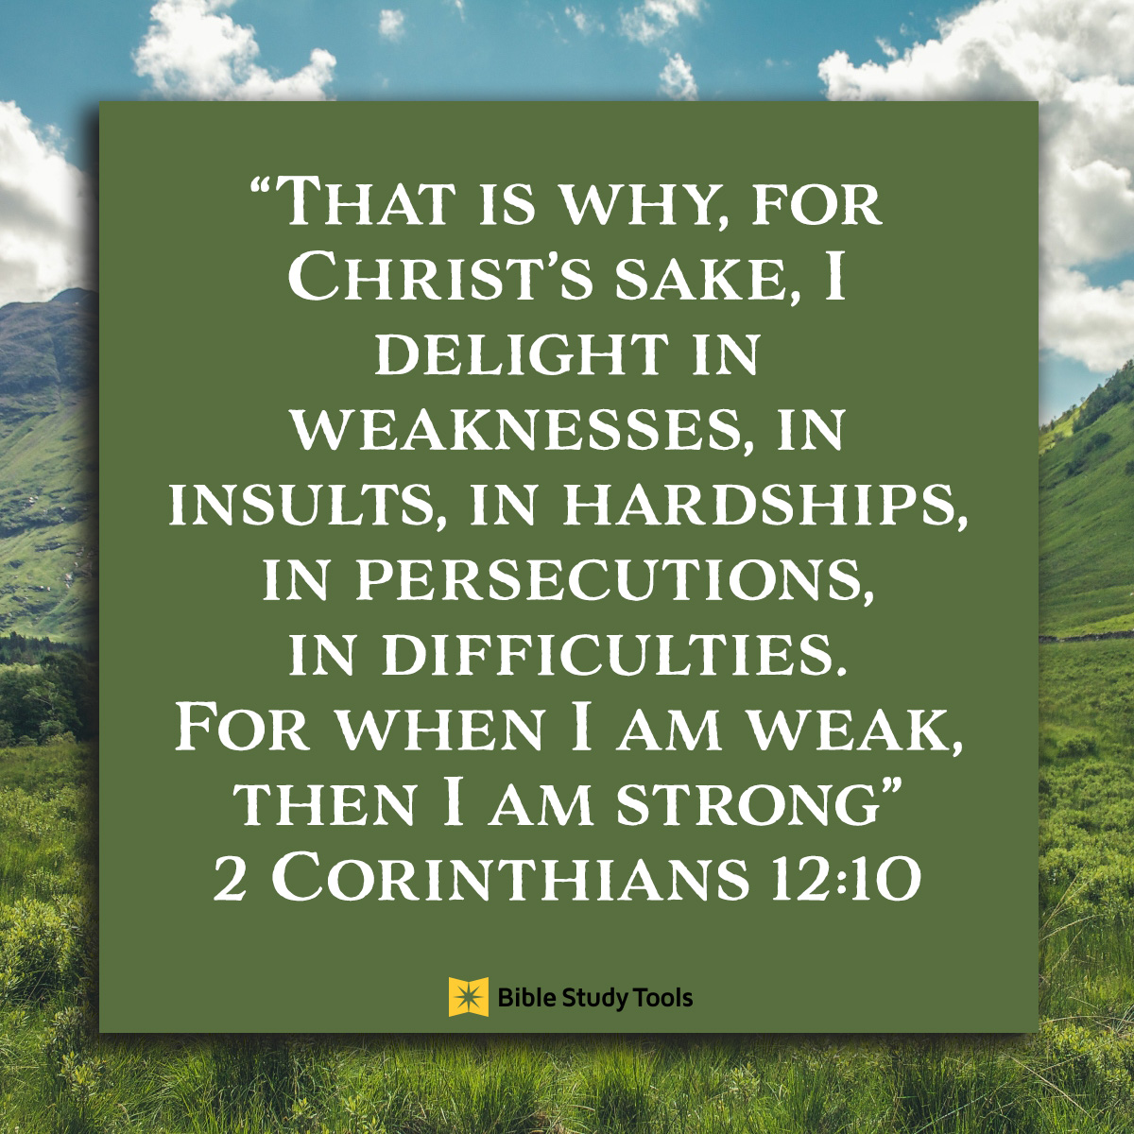
Click to go back
Questions of the day:
How can my weaknesses make me better?
How can I turn insults from others into a positive for me?

Slide 5
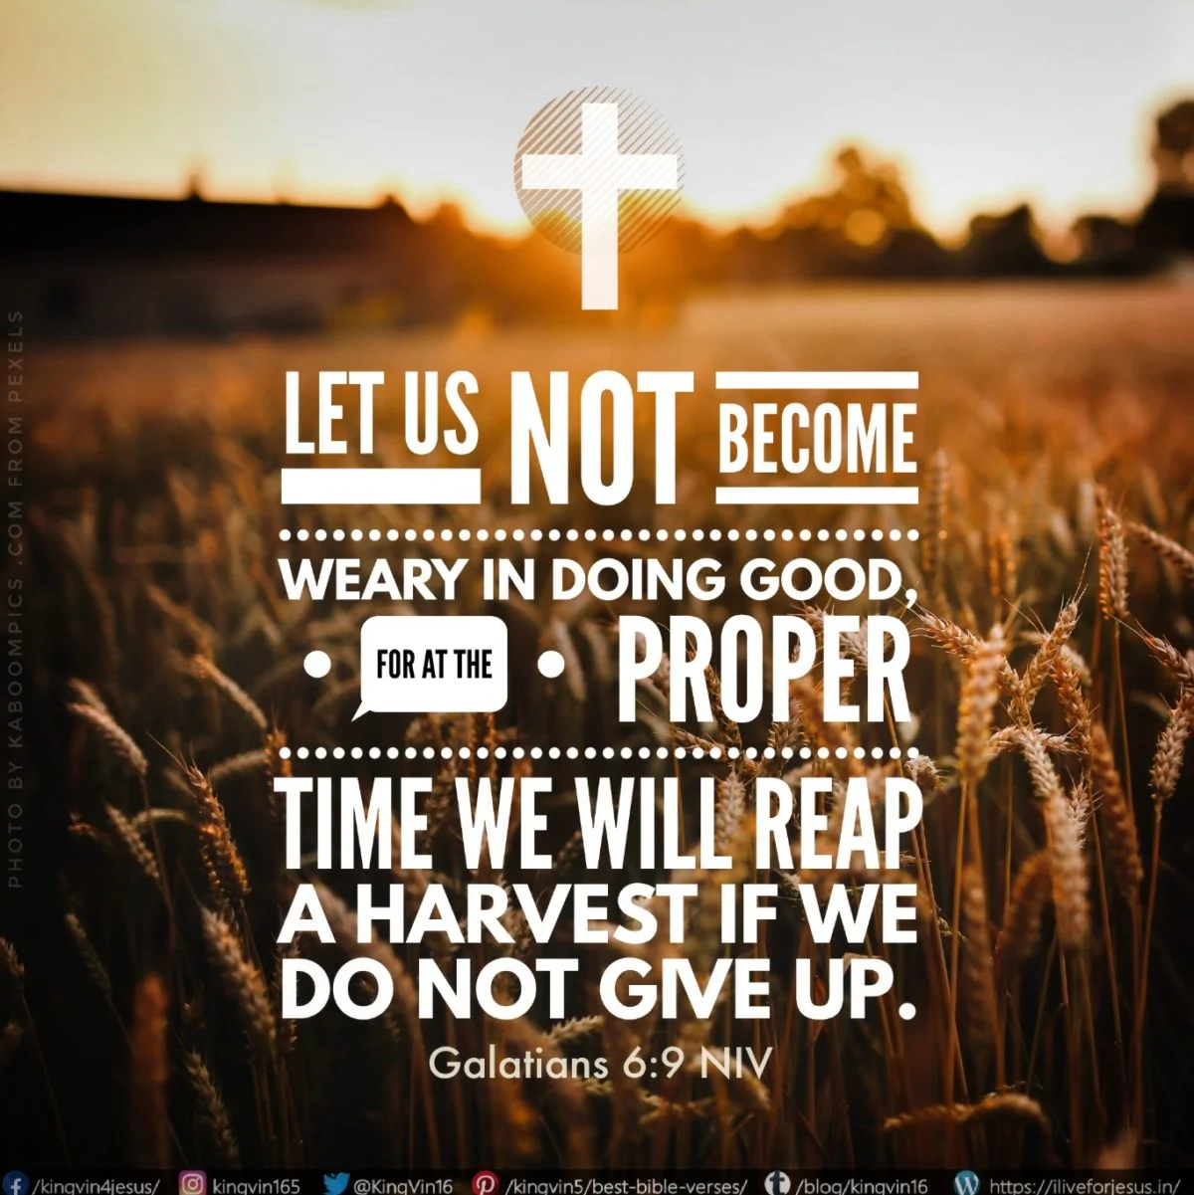
Click to go back
Questions of the day:
What do you think this verse means when it says ‘proper time’?
Can you think of a specific action you can introduce to your life that will definitely lead to a ‘harvest’? What is that action and what would the harvest be?

Slide 6
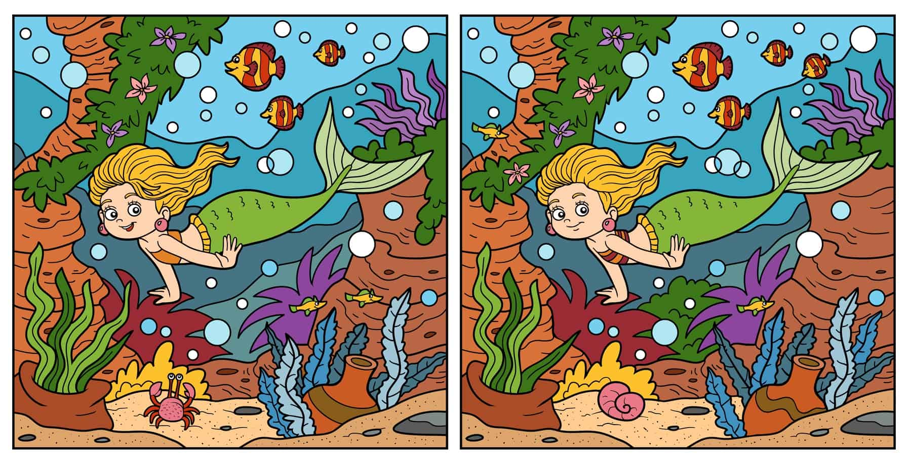

Click for answers
Can you spot the 14 differences?
Click to go back

Slide 7
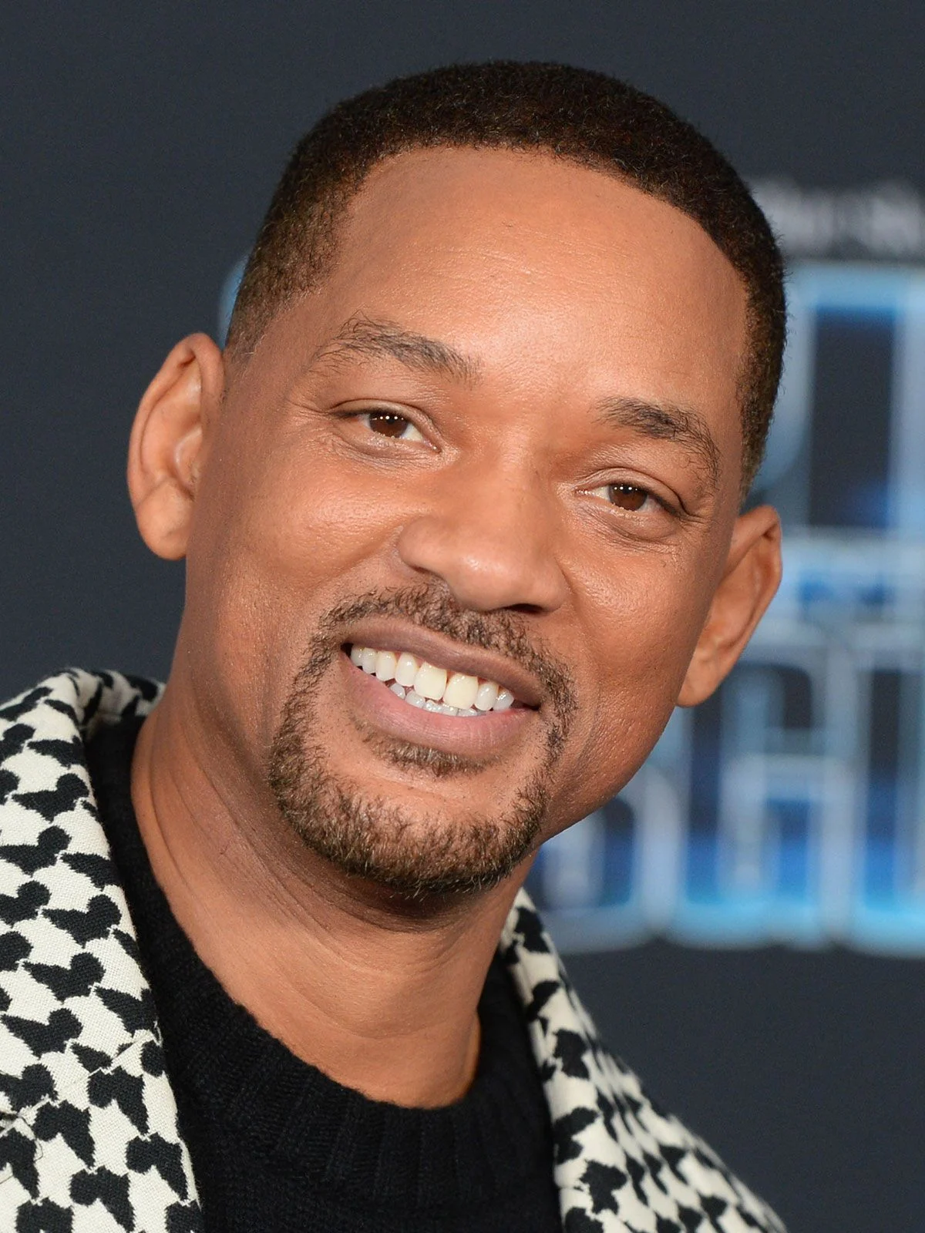
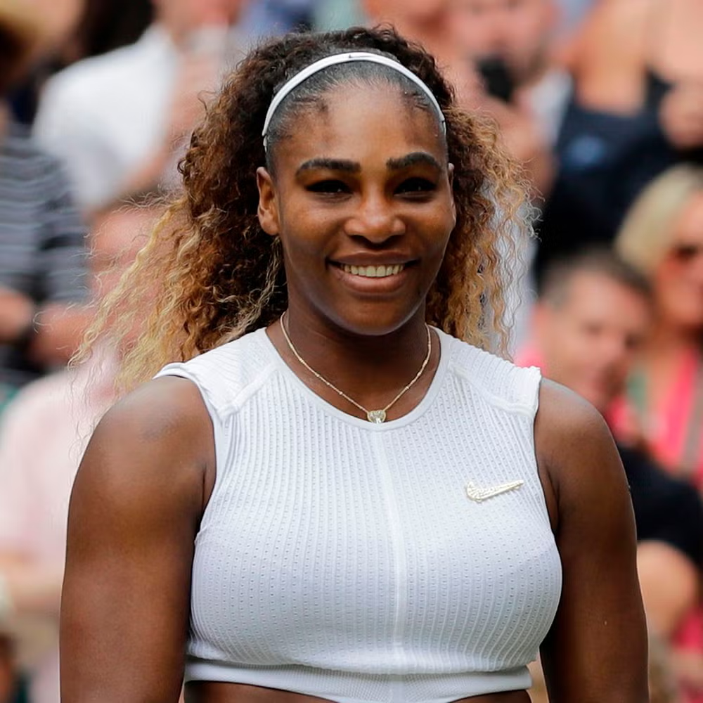
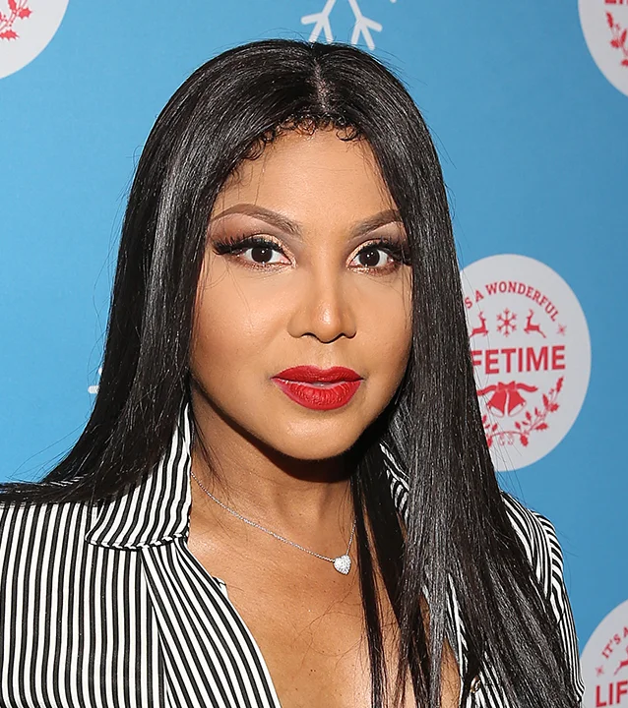
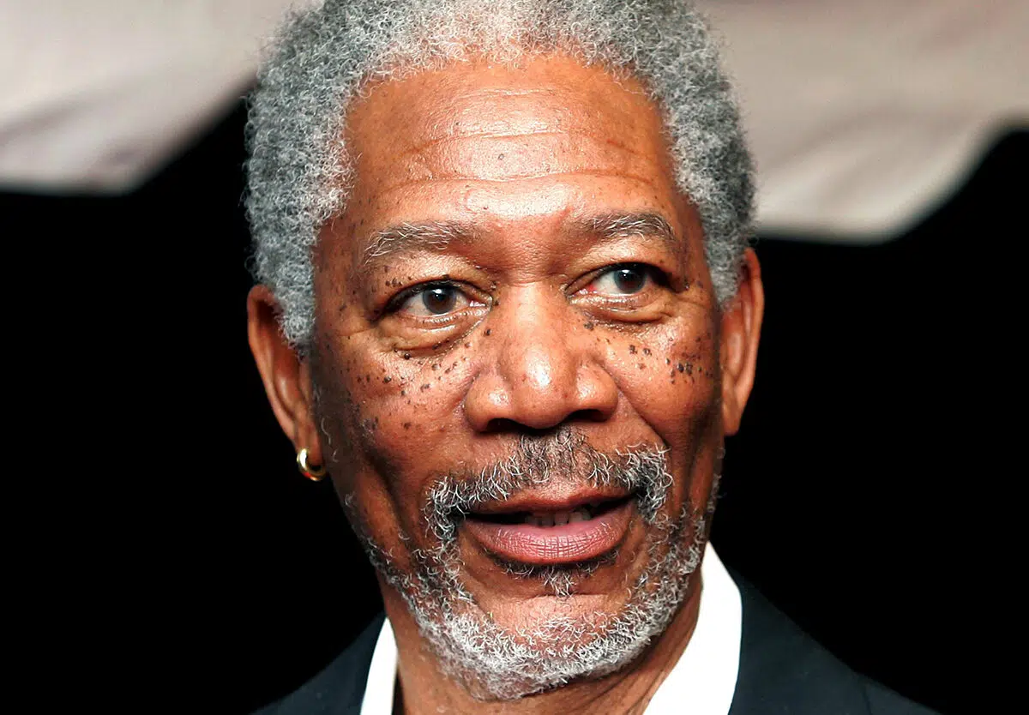
Can you identify these famous people from the anagrams of their names?
Click for hints (photos)
swim thill
laws mineralise
barton toxin
foreman german
Will Smith
Serena Williams
Toni Braxton
Morgan Freeman
Click for answers
Click to go back

Slide 8
Celebrating Together
Loving God
Today we thank You for the successes we have achieved, both big and small. We are grateful for the hard work, determination, and support that helped us reach our goals. Remind us that none of us succeeds alone. Help us to appreciate our friends, teachers, families, and all who encourage us along the way. May we celebrate with humility, share our joy with others, and continue to work together as one community.
Amen
Click to go back

Slide 9
United in Achievement
Lord
Thank You for the talents and abilities You have given each one of us. Today we celebrate our achievements and the progress we have made. Help us to recognise that every person has gifts worth celebrating. When others succeed, may we rejoice with them. When we succeed, may we remain kind and grateful. Strengthen the bonds within our school community so that we support one another, encourage one another, and grow together
Amen
Click to go back

Slide 10
Prayer 3: A Community of Support
Faithful God
We thank You for the many successes we have experienced this year. We are grateful for the opportunities to learn, develop, and discover our strengths. Help us to remember that our achievements are made possible through the care and support of others. Teach us to value teamwork, friendship, and respect. May our successes inspire us to help those around us and use our gifts to build a stronger, more caring community
Amen
Click to go back

Slide 11
Prayer 4: Growing Together
Generous God
As we celebrate our accomplishments, we pause to thank You for guiding us through challenges and helping us to persevere. May we never measure our worth only by our successes, but by the kindness we show, the friendships we build, and the positive difference we make in our community. Help us to encourage one another, celebrate one another's achievements, and continue growing together in unity, respect, and hope
Amen
Click to go back

Slide 12
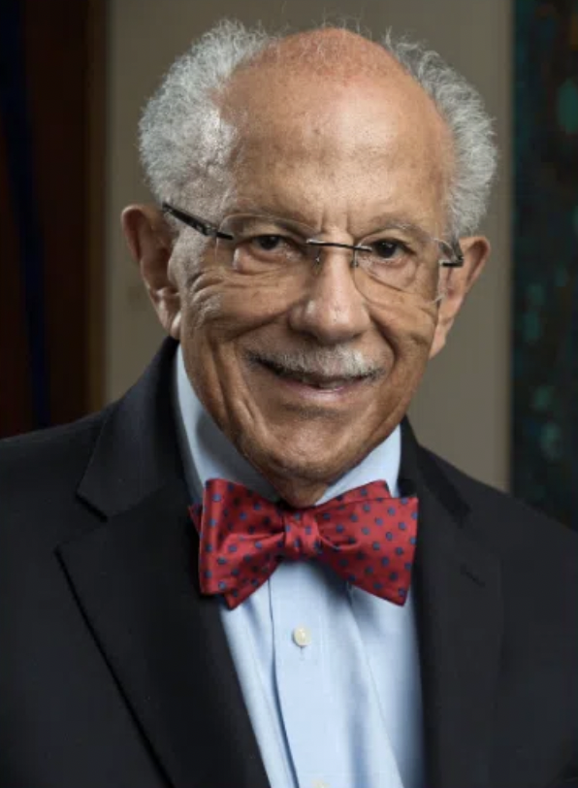
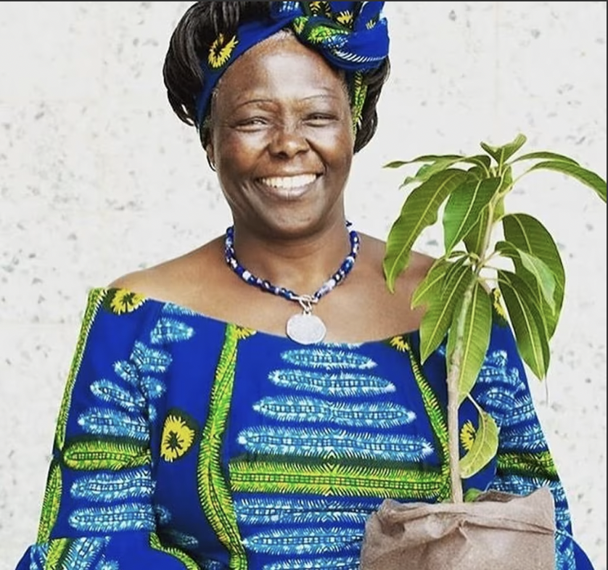
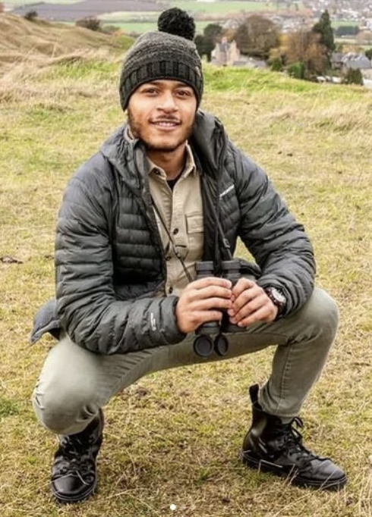
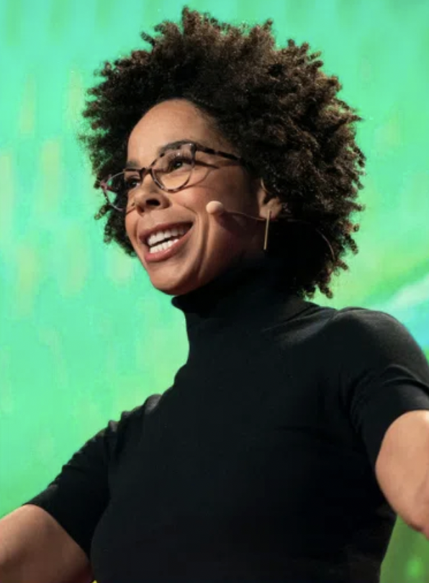
Click to go back
Green Ambassadors
Climate change and black history
Globally, non-white people experience the effects of climate change disproportionately to white people.
To celebrate black history month here are some change-making pioneers in the environmental sustainability field.
Dr. Warren Washington
Climate scientist who used computer modelling to predict the future.
Wangari Maathi
Planted over 51 million trees to ensure climate resilience and food security in Kenya. First black African woman to win a Nobel prize.
Tolga Aktas
Bird watcher and biological conservationist
Dr. Ayana Elizabeth Johnson
Marine biologist, climate policy expert, writer and campaigner

