Slide 1


Tutor Time Collective Worship
Click to go to Day 1
Click to go to Day 2
The Lord be with you…

Slide 2
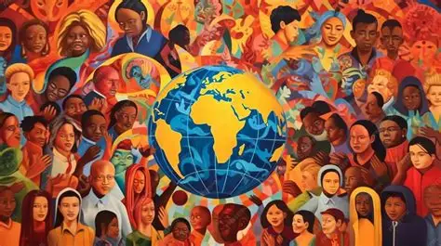


The theme for this half term: Hope
The Equality and Diversity theme for this half term: Inclusion
The theme for this week: Diversity
Click for the challenge of the day
Click for the verses of the day
Word of the Day
Merriam-Webster
Watch Extra:
Show Racism The Red Card
https://youtu.be/XwFXOV4KDD8
Click for a prayer
Click for a prayer
Watch: Some reminders from your chaplain…

Slide 3


The theme for this half term: Hope
The Equality and Diversity theme for this half term: Inclusion
The theme for this week: Diversity
Click for the challenge of the day
Click for a prayer
Click for the verses of the day
Click for info on Show Racism the Red Card Day
Click for a prayer
Watch: The richness of diversity…
https://youtu.be/g0WMXBhSYdI

Slide 4


Click to go back
When we come to God, He accepts us as we are. We do not have to be perfect, in fact, God already knows we’re not and He knew we would never be. But if we come to Him with a humble attitude willing to admit to our faults and accept His forgiveness and love, He welcomes us! We should do the same with others.
The One Big Question:
Why didn’t God make us perfect in the first place?

Slide 5

Click to go back
An encouragement from Paul to the Christians living in Rome
Questions of the day:
What do you think it means to live in harmony with one another?
Which of these suggestions do you feel you need to work on the most?

Slide 6
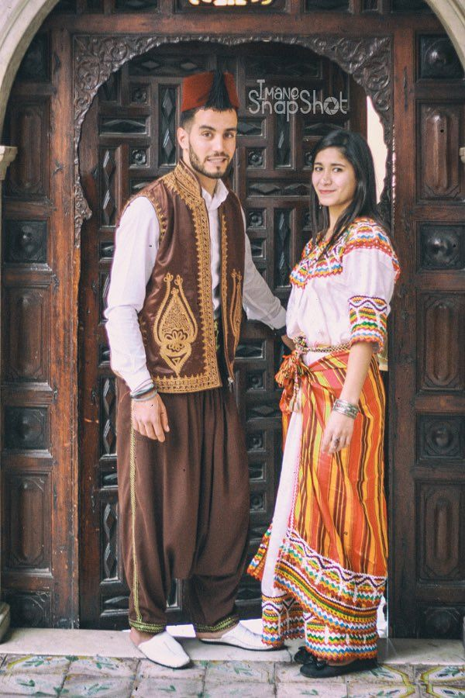
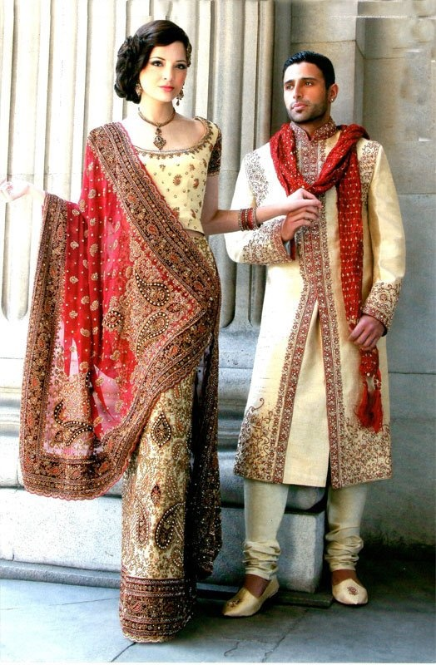
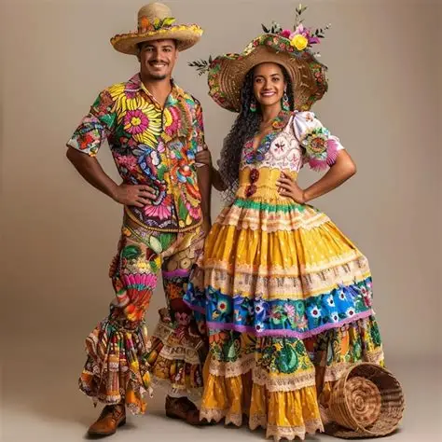
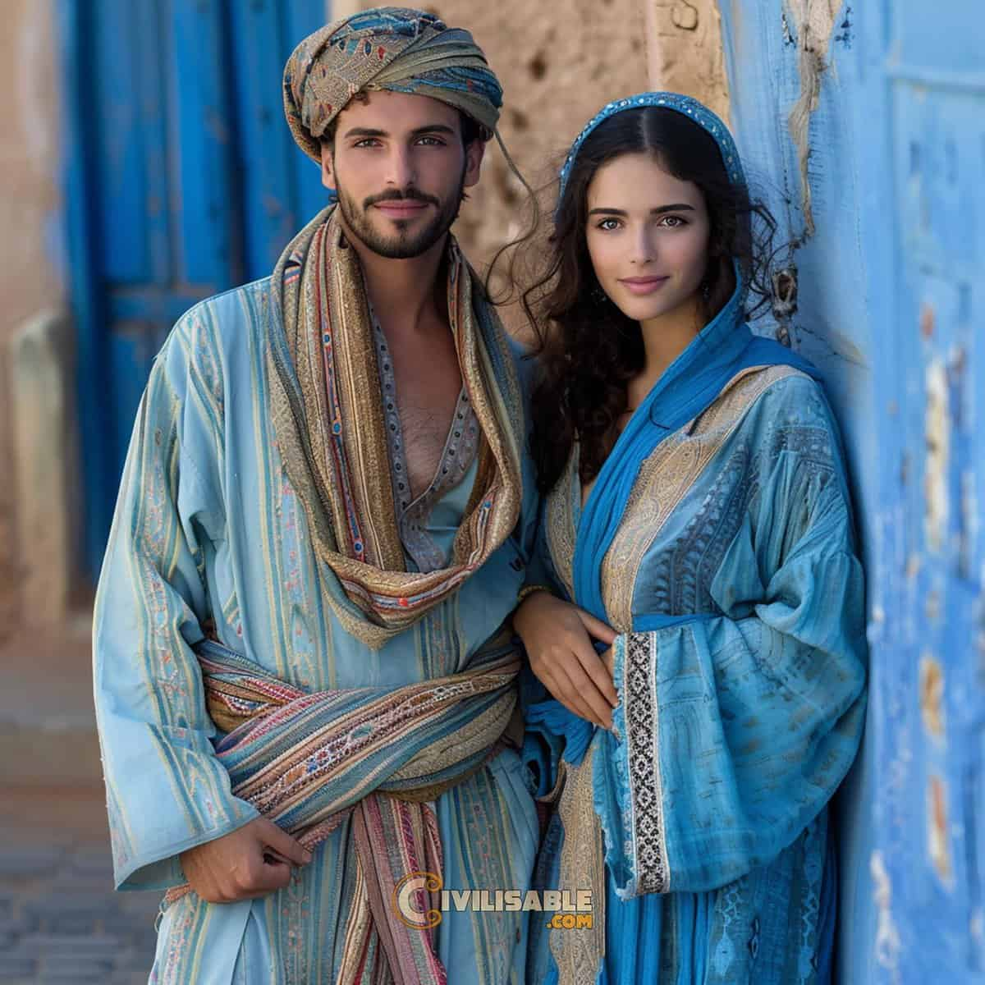
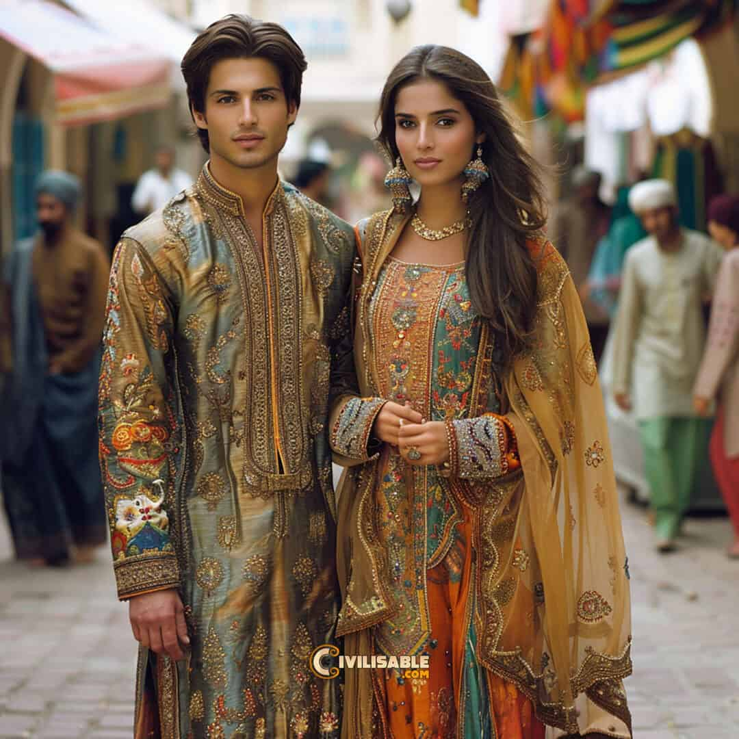
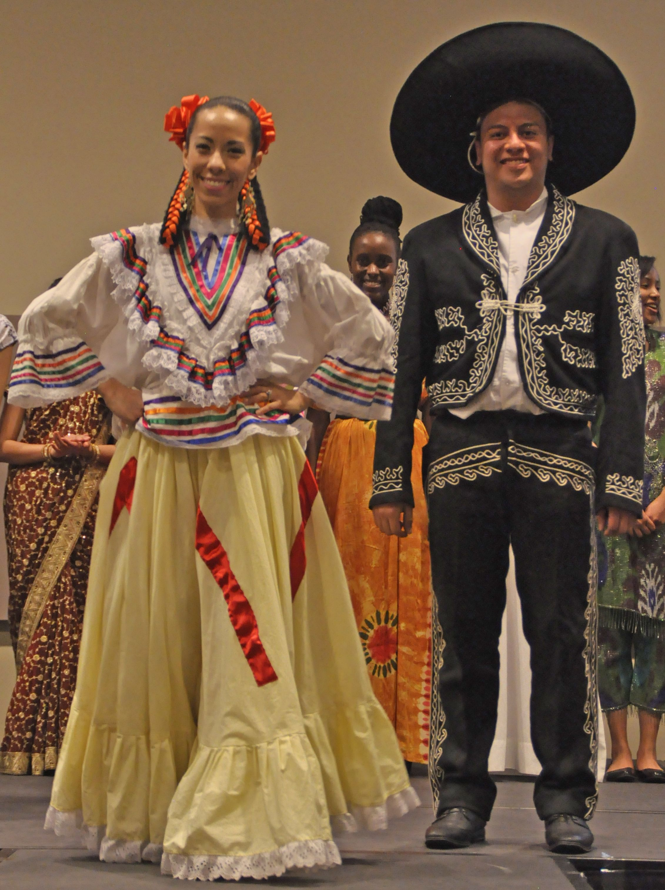
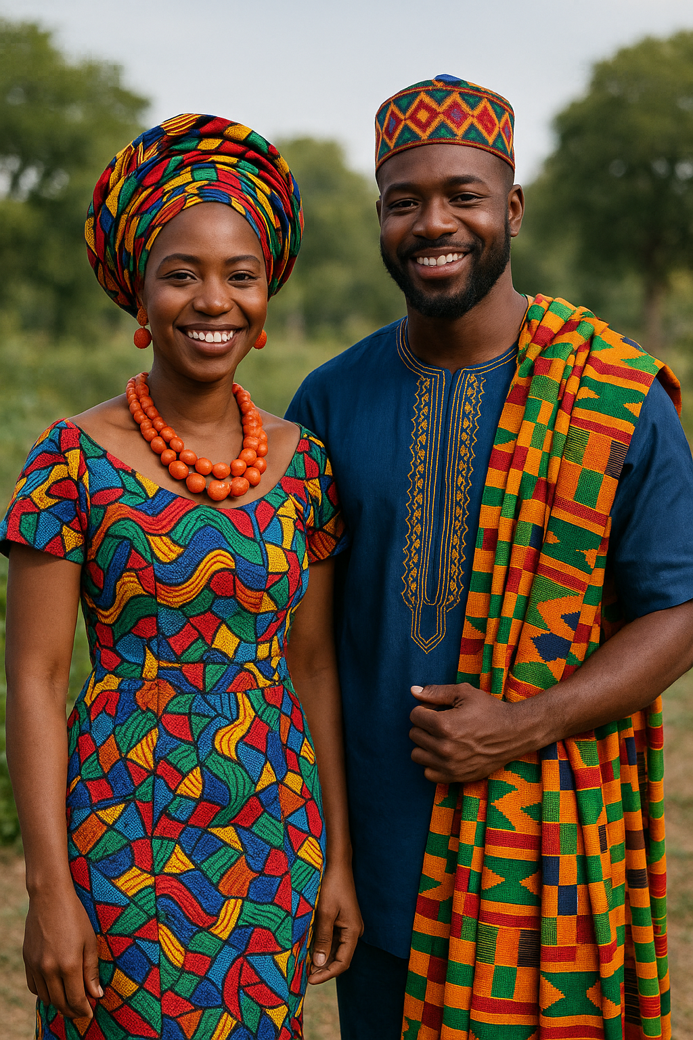
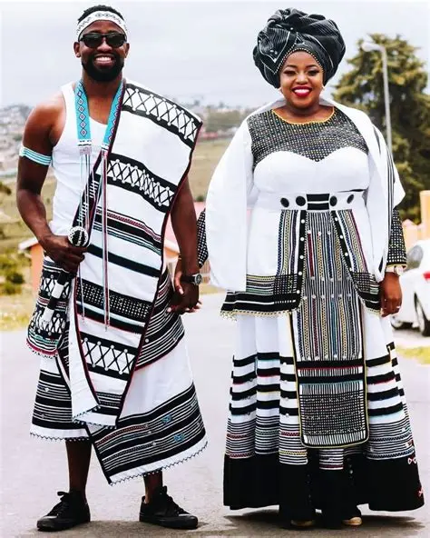
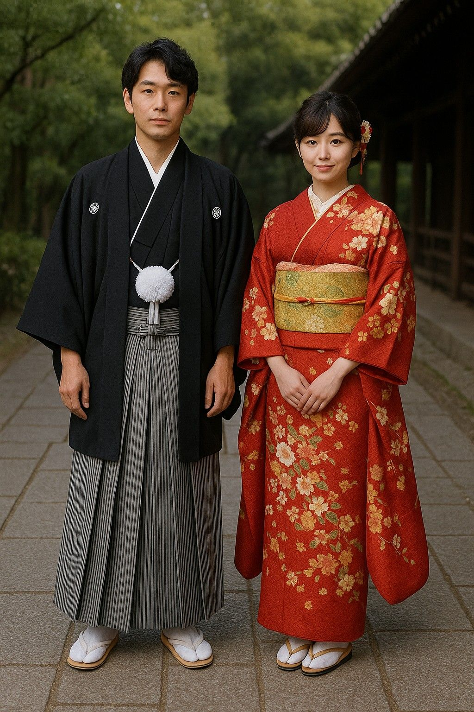
Can you identify each of these countries by their traditional dress?
Click for answers
Algeria
India
Brazil
Morocco
Click this box to go back
Pakistan
Mexico
Nigeria
South Africa
Japan

Slide 7
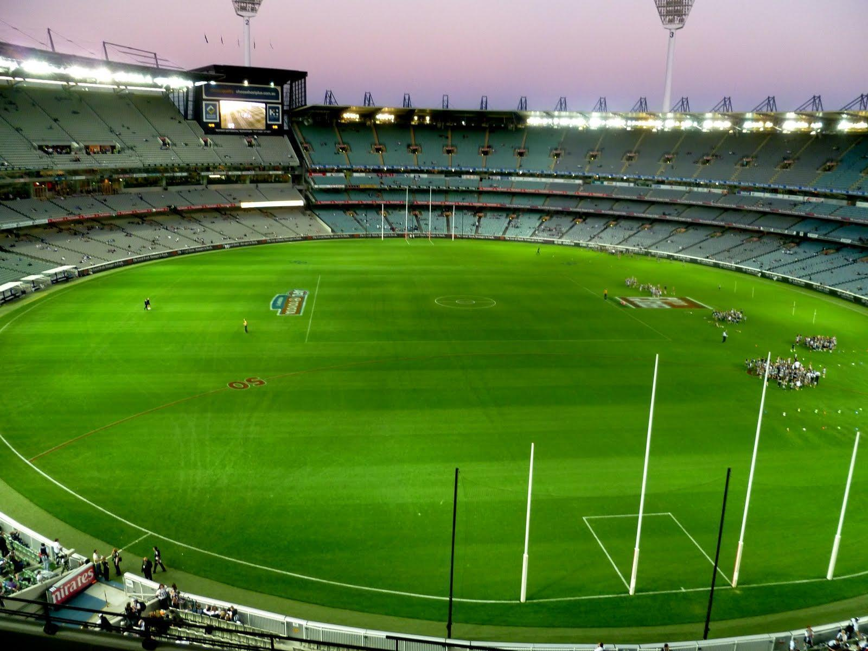
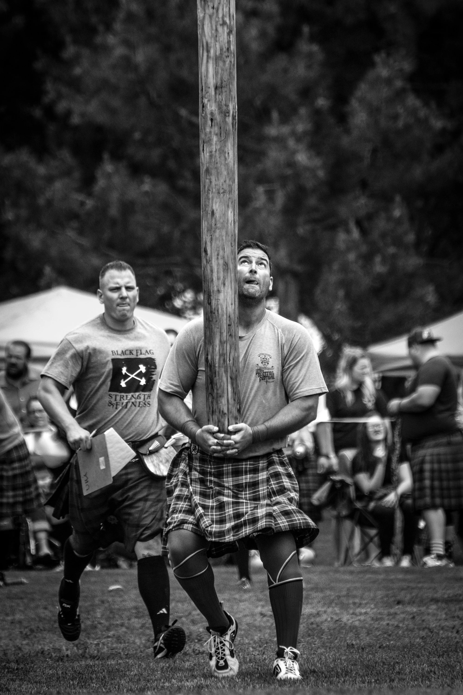
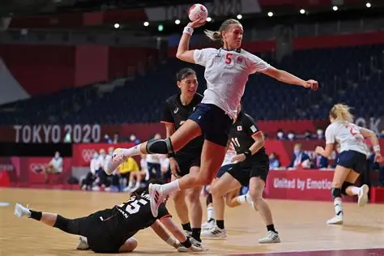
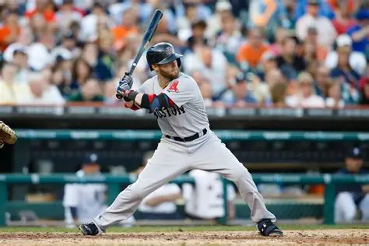

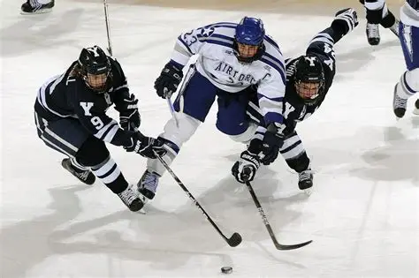
Can you identify each of these sports? I’ve also included the countries often associated with them
Aussie Rules
Australia
Caber Toss
Scotland
Handball
Iceland
Click for answers
Click this box to go back
Baseball
USA
Cuba
Ice Hockey
Canada
Latvia
Taekwondo
South Korea

Slide 8
Celebrating Our Differences
Loving God
Thank You for creating each of us uniquely. Thank You for the different cultures, languages, talents, personalities, and experiences that make our school community special. Help us to celebrate our differences rather than fear them. Teach us to listen to one another with open hearts and open minds. May we learn from each other and recognise the value and dignity in every person. Help us to build a community where everyone feels welcomed, respected and appreciated
Amen
Click to go back

Slide 9
A Prayer for Inclusion
Heavenly Father
Thank You that every person matters and has a place in Your world. Open our eyes to those who may feel left out, lonely or unnoticed. Give us the courage to be kind, to include others and to reach out in friendship. Help us to create a school where everyone feels safe, accepted and valued, regardless of their background, abilities, or circumstances. May our words and actions reflect compassion, understanding and respect
Amen
Click to go back

Slide 10
Respect for All
God of Love
Help us to see each person as someone worthy of respect and kindness. When we are tempted to judge others by appearances, remind us to look deeper. When we disagree, help us to speak with grace and listen with understanding. When we encounter people whose experiences differ from our own, help us to learn from them. May our school be a place where everyone is treated fairly and where every voice can be heard. Guide us to be peacemakers who build bridges rather than walls
Amen
Click to go back

Slide 11
One Community
Gracious God
Thank You for bringing us together as one school community. Although we come from different backgrounds and have different stories, help us to recognise what unites us. Teach us to support one another, encourage one another and stand alongside those in need. May we reject prejudice, challenge unkindness, and choose respect. Help us to create an environment where everyone can flourish and become the person You created them to be. May our diversity be a source of strength, and may our inclusion reflect Your love for all people
Amen
Click to go back

Slide 12


Show Racism The Red Card
Click to go back
This Friday
16th October
Wear something red to show your support for Show Racism The Red Card Day
Examples:
Socks
Tie
Hat
Hairband

