Slide 1





The theme for this half term: Hope
The Equality and Diversity theme for this half term: Inclusion
The theme for this week: Harvest and Black History
Click for the challenge of the day
Click for the verses of the day
Word of the Day
Merriam-Webster
Watch: As we think about Black History, this week’s video is one of our own students singing
Click this box to listen to her…
Click for a prayer
Click for a prayer

Slide 2

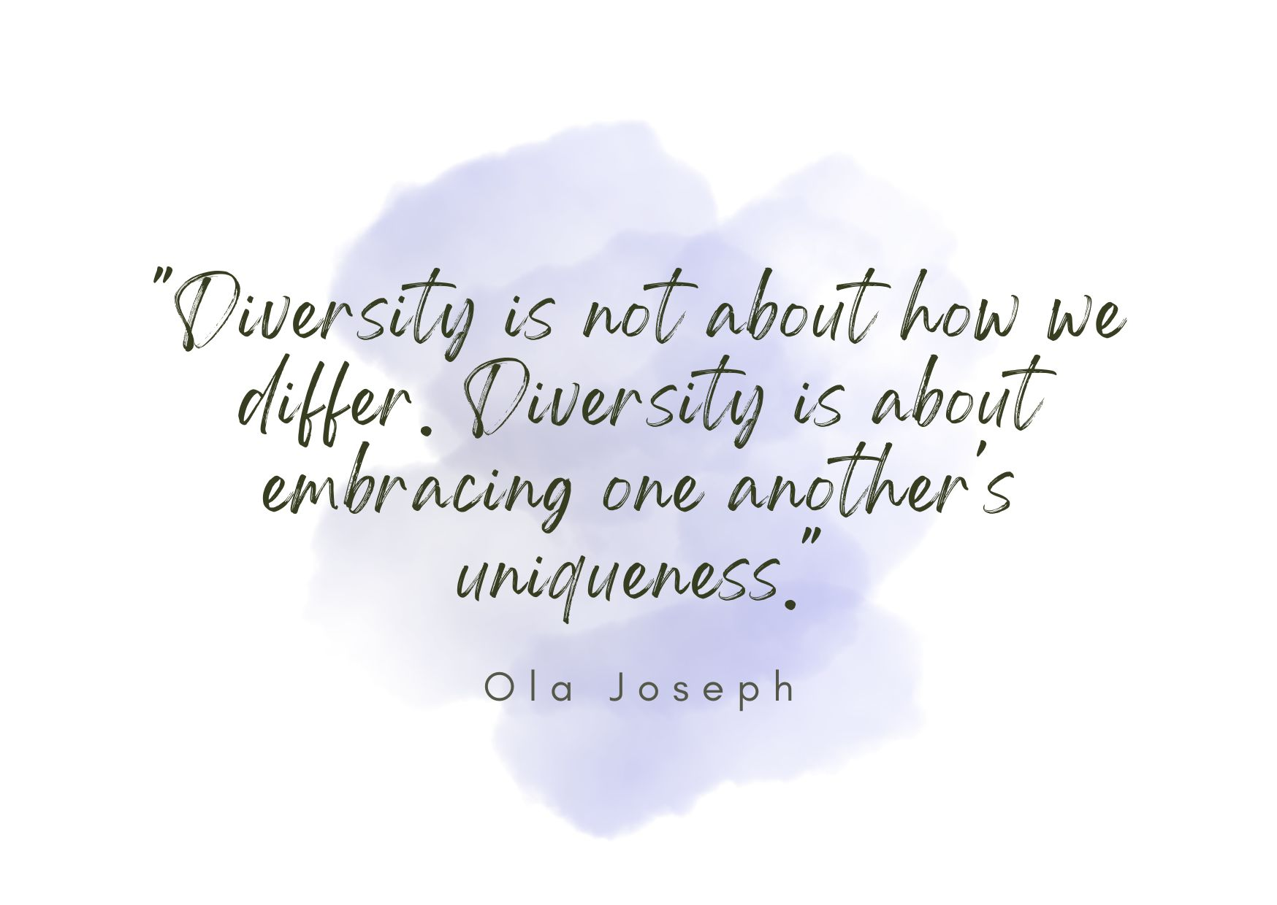
The theme for this half term: Hope
The Equality and Diversity theme for this half term: Inclusion
The theme for this week: Harvest and Black History
Click below for the challenge of the day
Black History Month Questions & Answers 2026
Click for the verses of the day
Watch Extra: We are collecting for Crawley Open House during the Harvest Festival (October). Look at what another school has done:
https://youtu.be/M9L_kaxWrgI
Click for a prayer
Click for a prayer
We give our Harvest donations to Crawley Open House. Here is some info on what they do…
https://youtu.be/3m6YVWuYPxM

Slide 3


Click to go back
Paul was addressing the believers living in Rome. His encouragement was clear: love and honour others ABOVE ourselves. This ties in well with both HARVEST and BLACK HISTORY MONTH where we consider valuable those less fortunate and those different from ourselves
Question of the day:
Will you take time during the month of October to give to those in need and to pause and invest in those from different backgrounds?

Slide 4
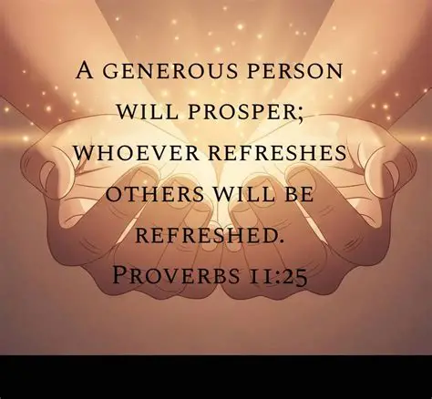
Click to go back
Our nature as people can often be one of selfish ambition. We are quick to look after ourselves and sometimes need reminders to look out for those less fortunate. Here in the book of Proverbs, King Solomon suggests that when we refresh others, it has a positive impact on us. We are more blessed when we give than when we receive.
Question of the day:
When did you last intentionally look to bless someone else with a gift or an encouraging word, and, if it hasn’t been for a while, could you look for an opportunity today?

Slide 5





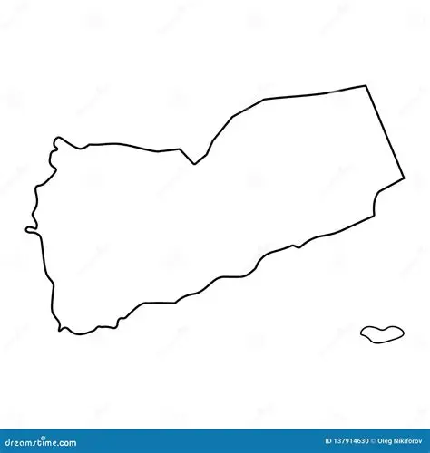






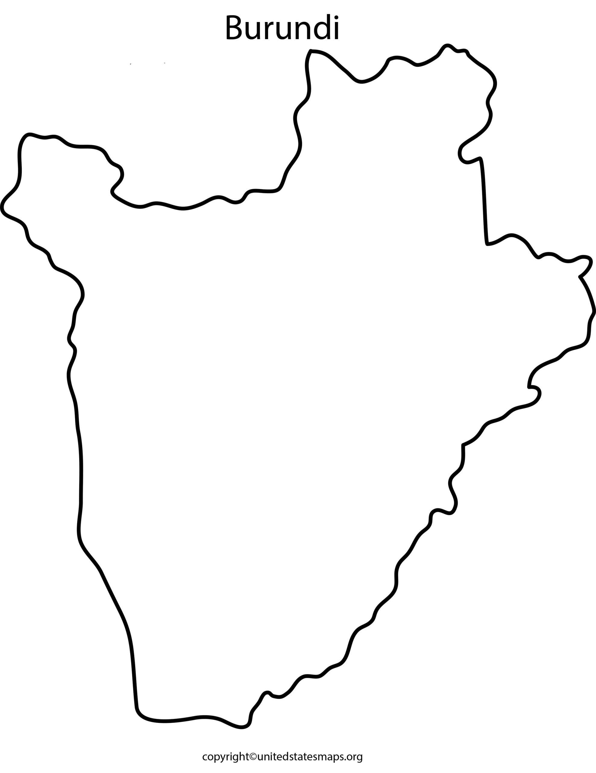

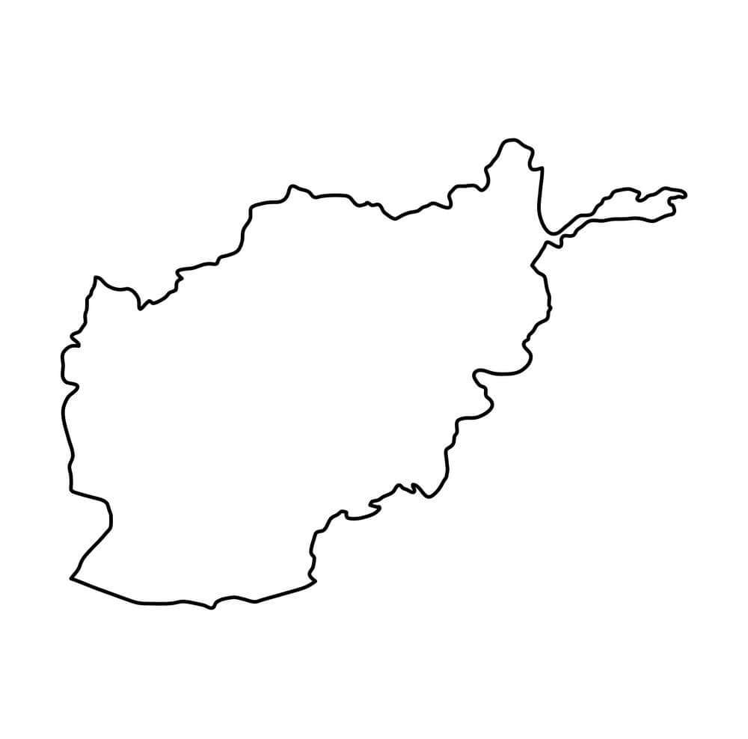
Here are seven of the poorest countries in the world. Can you identify them from their flags and outlines?
South Sudan
Yemen
Venezuela
Click for answers
Click to
go back
Central African Republic
Afghanistan
Madagascar
Burundi

Slide 6
A Prayer for Generosity
Loving God
Thank You for all the blessings You have given us: our families, friends, homes, opportunities and talents. Help us to notice those who are struggling or in need. Open our eyes to see when someone is lonely, hungry, worried, or left out. Give us generous hearts that are willing to share our time, kindness, and resources with others. Teach us to think of others before ourselves and to treat everyone with dignity and respect. May our actions bring hope and encouragement to those around us, and may we always remember that by helping others, we are showing Your love in the world
Amen
Click to go back

Slide 7
Respect for Every Person
Loving God
Thank You for creating each of us unique and valuable. Help us to remember that every person deserves respect, no matter their culture, background, beliefs, appearance, or circumstances. Teach us to listen with kindness, speak with understanding, and treat others as we would like to be treated. When we are tempted to judge others, help us instead to see the good in them and to appreciate the gifts they bring. Give us the courage to stand against prejudice, bullying, and exclusion. May our school be a place where everyone feels welcomed, accepted, and valued. Help us to be peacemakers who build friendships and bring people together
Amen
Click to go back

Slide 8
A Prayer to Serve Others
Heavenly Father
Today we pray for all those who are facing difficulties. We remember people who are poor, hungry, homeless, sick, or struggling with challenges that we cannot always see. Help us to be generous, not only with what we have, but with who we are. Give us the courage to stand up for what is right, to include those who feel excluded, and to support those who need a helping hand. Guide us to use our gifts and talents to make a positive difference in our school, our community, and our world. May we never take our blessings for granted, and may we always be willing to share them with others. We ask this in Your name
Amen
Click to go back

Slide 9
Celebrating Our Differences
Heavenly Father
We thank You for the diversity of our world and for the many different people we meet each day. Help us to celebrate our differences and to recognise that every person has worth and dignity. When we encounter people whose experiences are different from our own, give us open minds and compassionate hearts. Help us to learn from one another and to grow in understanding and respect. May we never leave anyone feeling isolated or unwanted. Instead, help us to include others, show kindness, and create a community where everyone belongs. Guide our words and actions so that we reflect Your love and care for all people
Amen
Click to go back

