Slide 1



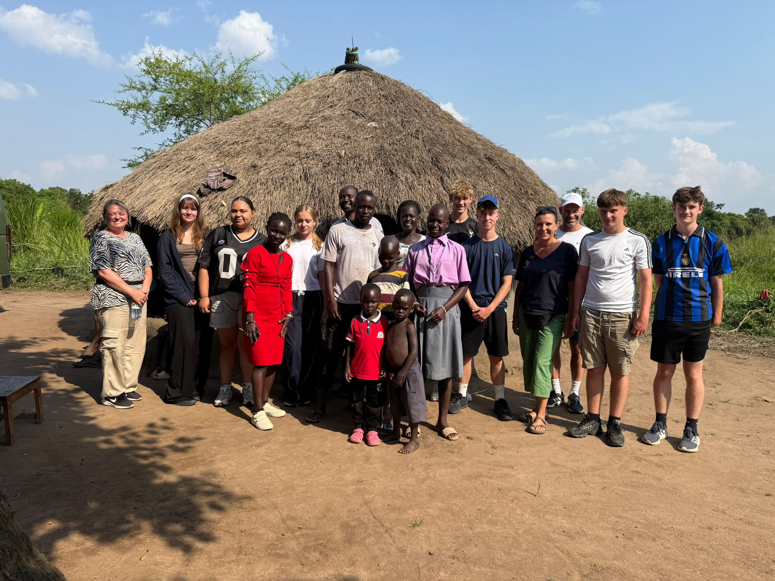
The theme for this half term: Hope
The Equality and Diversity theme for this half term: Inclusion
The theme for this week: Uganda
Click for the challenge of the day
Click for the verses of the day
See a message about HARVEST
Watch: Click to watch Uganda videos
Click for a prayer
Click for a prayer

Slide 2


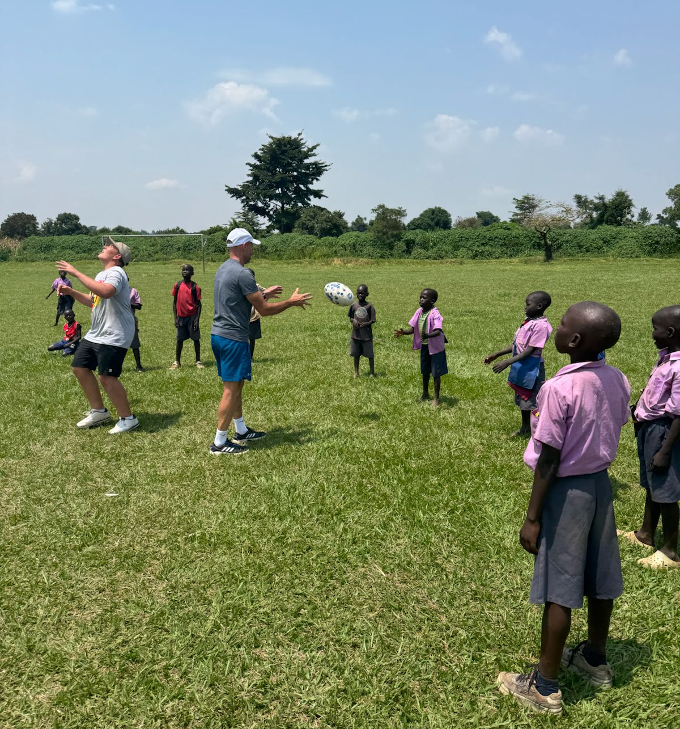
The theme for this half term:
School Mission Statement: Deeply Christian; Open to All
The Equality and Diversity theme for this half term: Inclusion
The theme for this week: Uganda
Click below for the challenge of the day
Uganda Take This Quiz? | Uganda | 10 Questions
Click for the verses of the day
Word of the Day
Merriam-Webster
Click for a prayer
Click for a prayer
Watch: Edukid’s charity work
https://youtu.be/_VoEUmHjYgY

Slide 3
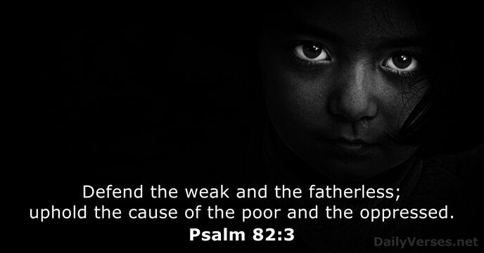
Click to go back
So often, when we think of those who are poor or under-privileged, we default to third world countries. But, if we were to simply stop and look around us, we would notice that people in our everyday lives – at school and in our hometown - are also struggling. In this Psalm we are encouraged to help them
Questions of the day:
1. Who do you know today that could do with a kind word or a helping hand?
2. Would you consider giving to Crawley Open House this year during the month of HARVEST (October)? Or signing up to join us in Uganda next year?

Slide 4
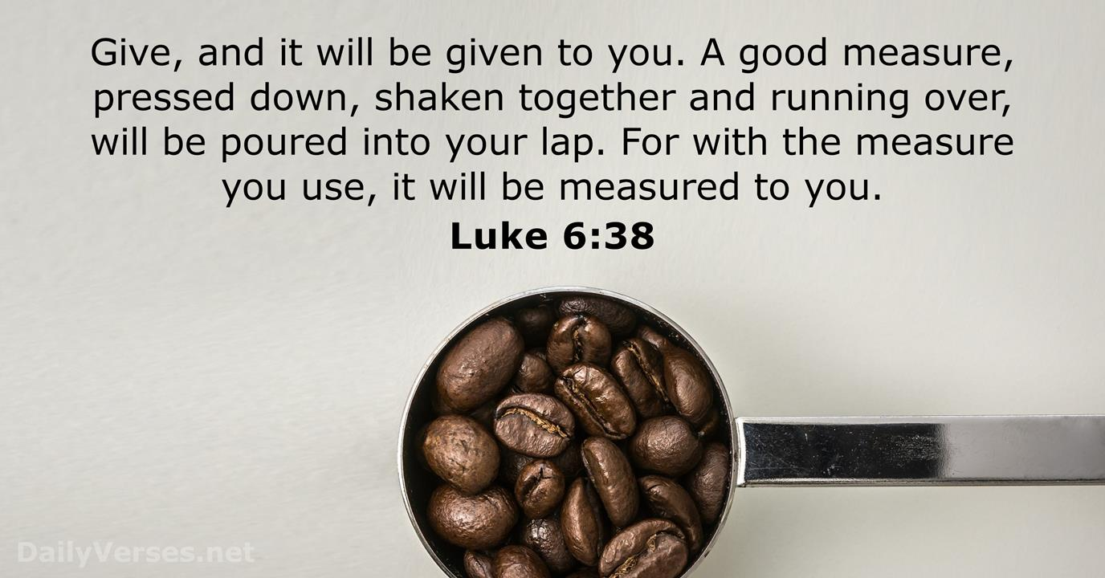
Click to go back
This verse is not to encourage us to build up wealth for ourselves by giving to receive, but to remind us that being generous has an automatic payback. Have a heart of generosity and God will repay you – in lots of different ways!
Questions of the day:
Would you say you are a naturally generous person?
Are people born generous or do you have to work at it?

Slide 5
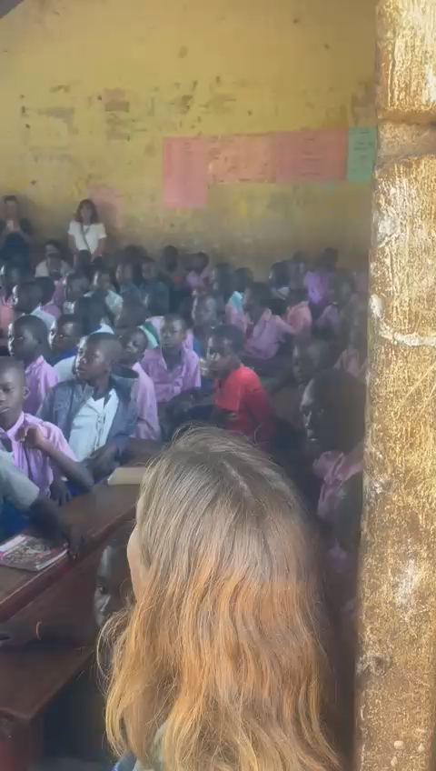
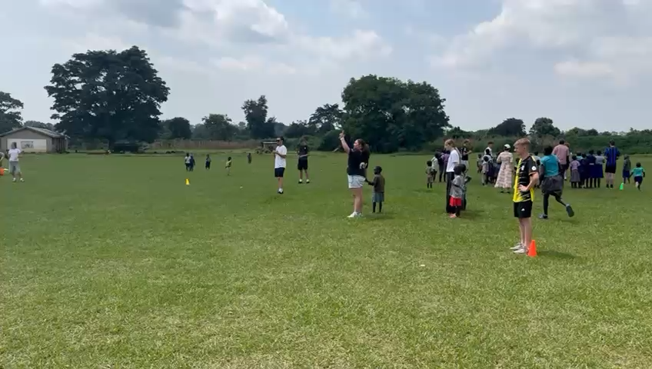
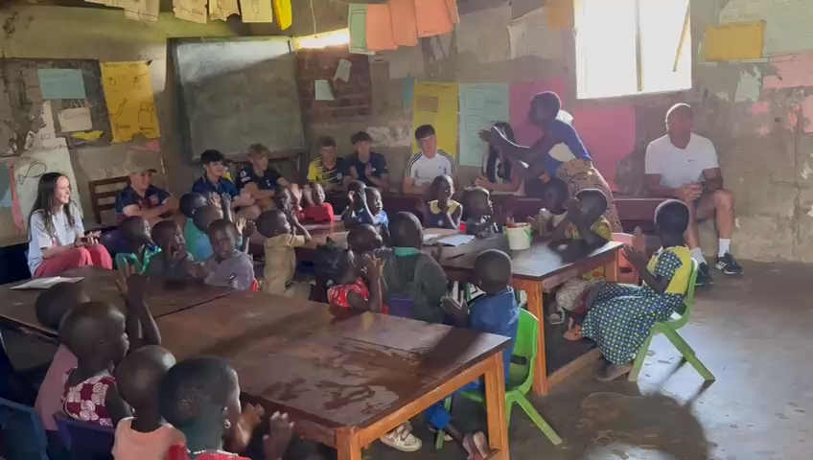
Click to go back

Slide 6
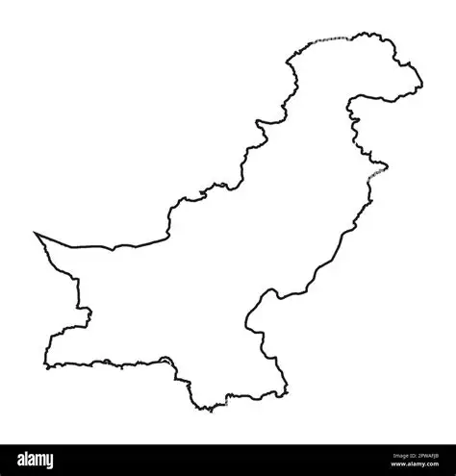
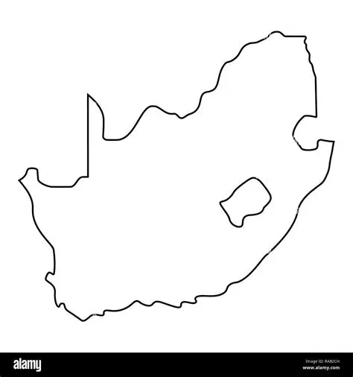
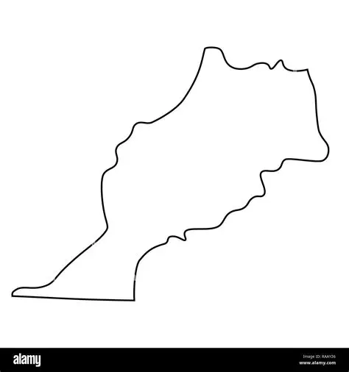


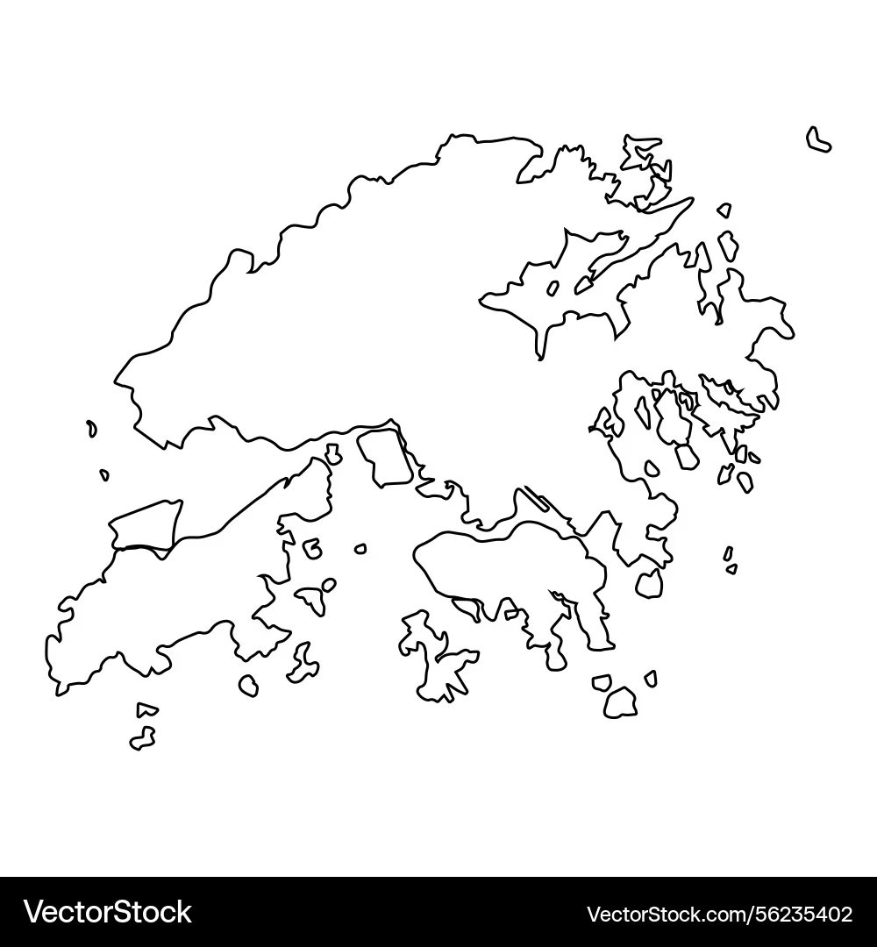
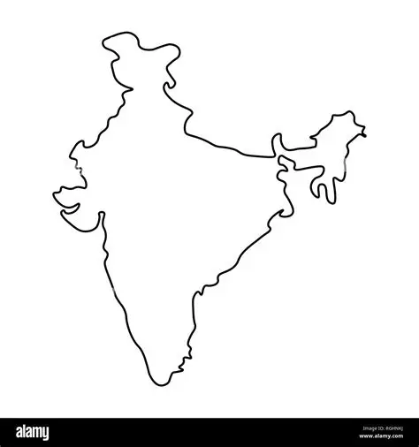
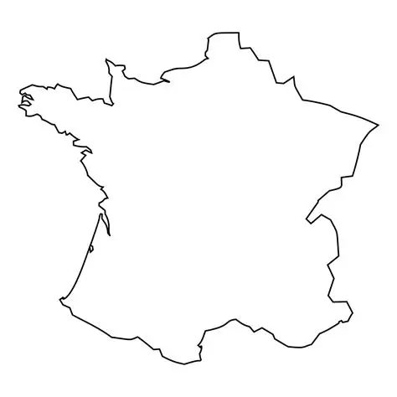
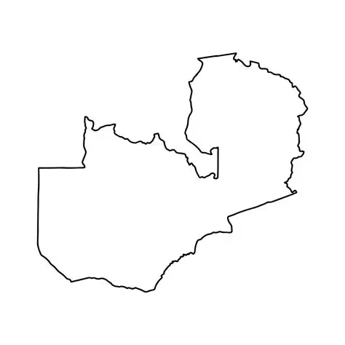
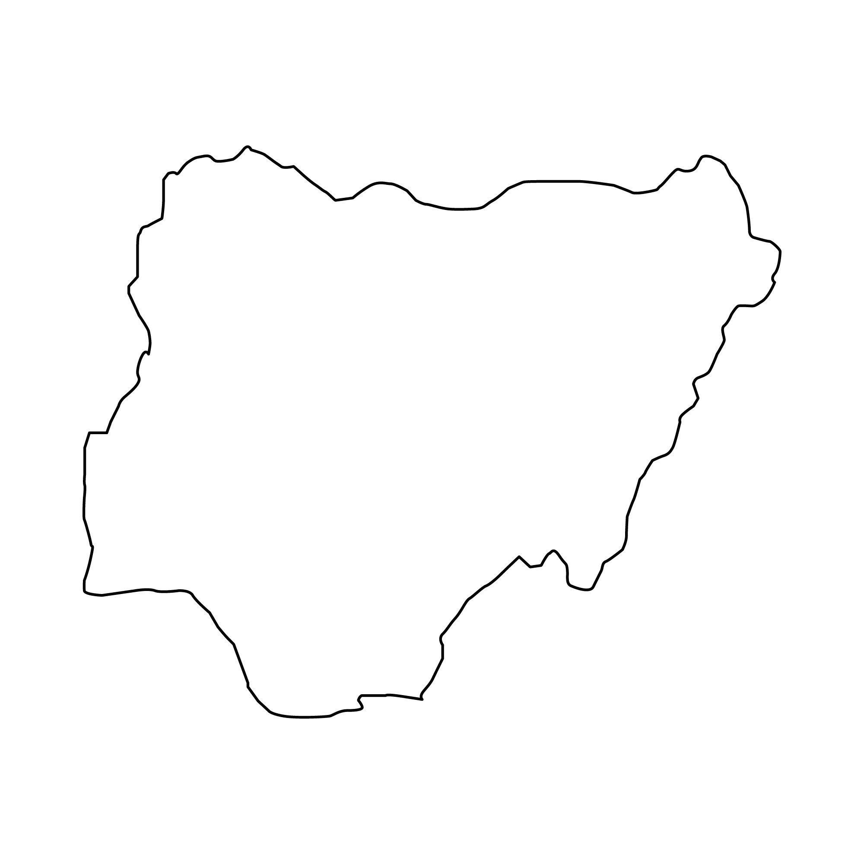

Can you identify these countries by their outlines?
Pakistan
South
Africa
Morocco
Click for answers
Click this box to go back
Zimbabwe
Algeria
Hong
Kong
India
France
Zambia
Nigeria
Brazil

Slide 7
For Children and Families in Need
Loving God
We pray for children and families in other nations who do not have enough food, clean water, or safe homes. Help them to find hope in difficult times and provide them with people who can support and care for them.Teach us not to take our own blessings for granted. Help us to be generous, kind, and willing to help those who are less fortunate than ourselves.
Amen
Click to go back

Slide 8
For Peace and Opportunity
Heavenly Father
We remember those in poorer communities around the world who face challenges every day. We pray that they may have opportunities for education, healthcare, and a brighter future.Guide leaders, charities, and communities to work together for justice and peace. Help us to play our part by showing compassion and treating everyone with dignity and respect.
Amen
Click to go back

Slide 9
For Young People Around the World
Dear God
Today we pray for young people in other countries who do not have the same opportunities that we enjoy. Be with those who struggle with poverty, hunger, conflict, or lack of education.Give them courage, strength, and hope. Inspire us to learn about their lives and remember that we are all part of one global family.
Amen
Click to go back

Slide 10
A Prayer for Compassion and Action
Gracious God
Thank you for the blessings we receive each day. As we think of people in underprivileged communities around the world, help us to open our hearts to their needs. Show us ways to make a difference through kindness, generosity, and prayer. May those who are suffering find comfort, support, and the chance to build a better future. We ask this in your name.
Amen
Click to go back

Slide 11
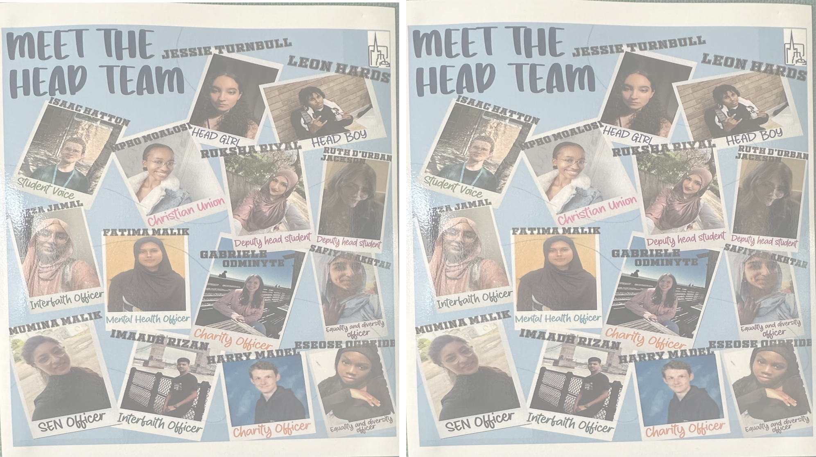


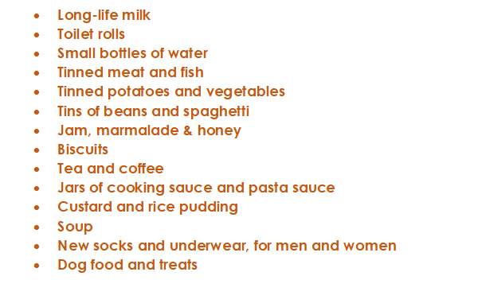




This is a message from Crawley Open House. They are looking for donations for the month of Harvest (October) and we as Holy Trinity always do what we can to assist. On the left is a list of items they require. We are asking that you consider buying something on the list – or even looking in your cupboards for spare items. You can bring them directly to the chapel and then I will deliver them with the help of a small group of students the week after half term
Start thinking about this now but we will only start collecting in October
Click to go back

