Slide 1






The theme for this half term: School Vision Statement: To be a centre of excellence, inspired by Christian values, where every member of our school community fulfils their potential
The Equality and Diversity theme for this half term: Celebrating Diversity
The theme for this week: Celebration of Success
Click below for a quiz
Wimbledon Quiz Questions & Answers 2026
Click for the verses of the day
Click for a prayer
Click for an extra prayer
Watch: Feel good stories from the World Cup…
https://youtu.be/UT98Ei9L_VQ

Slide 2



The theme for this half term: School Vision Statement: To be a centre of excellence, inspired by Christian values, where every member of our school community fulfils their potential
The Equality and Diversity theme for this half term: Celebrating Diversity
The theme for this week: Celebration of Success
Click for the challenge of the day
Click for the verses of the day
Word of the Day:
Merriam-Webster
Click for an extra prayer
Click for a prayer
Watch: Celebrate good times!
Come on!

Slide 3
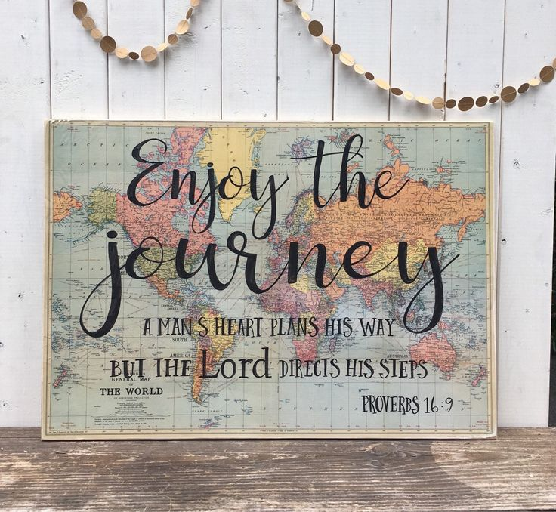

Click to go back
At first glance, this verse can seem like a contradiction. Although we plan our lives, God directs us. It is, actually, a wonderful juxtaposition. That is, both our plans and God’s plans can come together and work for our good. If we submit our lives to God, He says he will direct and lead us. So, while we go about making decisions, God can open and close doors for us. It’s a collaboration! It’s like the relationship you have with your teachers. They teach you but you still have to work…
Question of the day:
What do you want your life journey to look like?

Slide 4
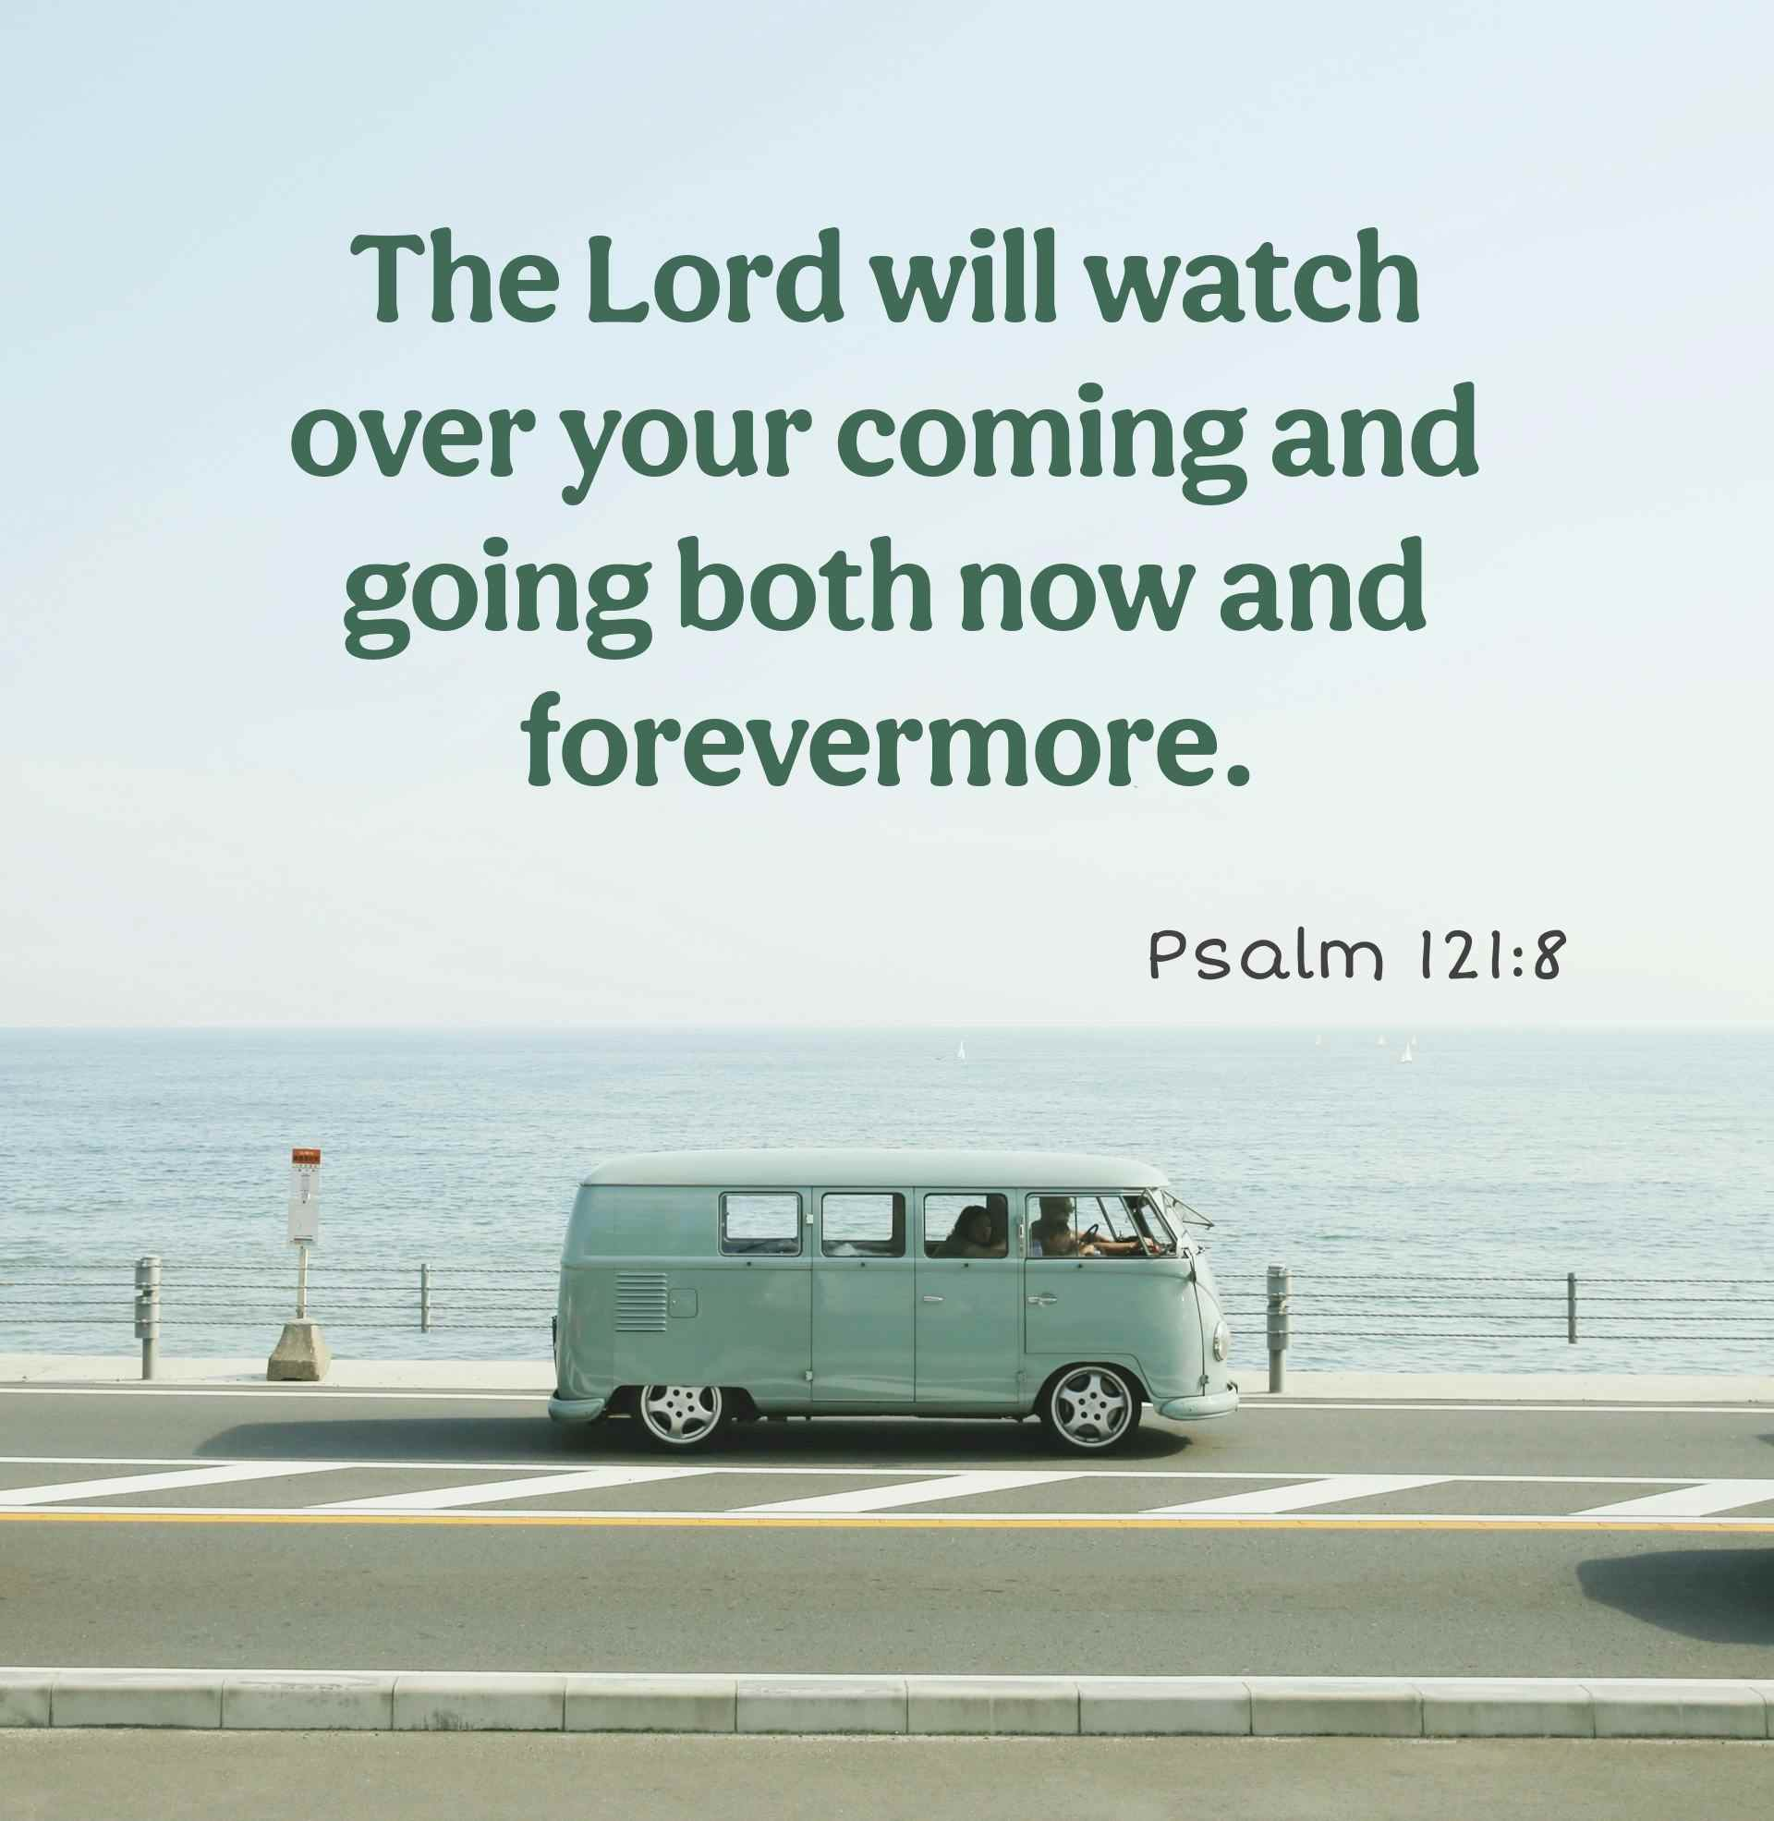
Click to go back
This verse compliments the verse from the other day. I have found it extremely reassuring and comforting to know that there is someone (God) who is not only watching over me now, but sees my whole life from beginning to end and knows my future. So even though I continue to make decisions and make mistakes, God allows me to do so and helps me when I’m stuck. I’m human, so I get things wrong. That’s fine. But ultimately, God’s in my corner!
Question of the day
Do you think that if there is a God who made everything including you, that it would be comforting to know He has everything in control?

Slide 5
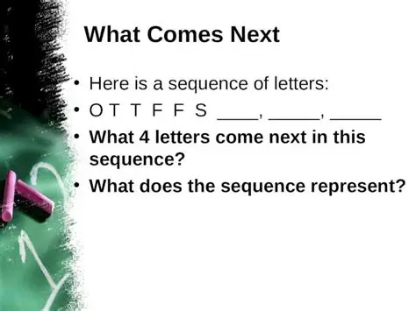
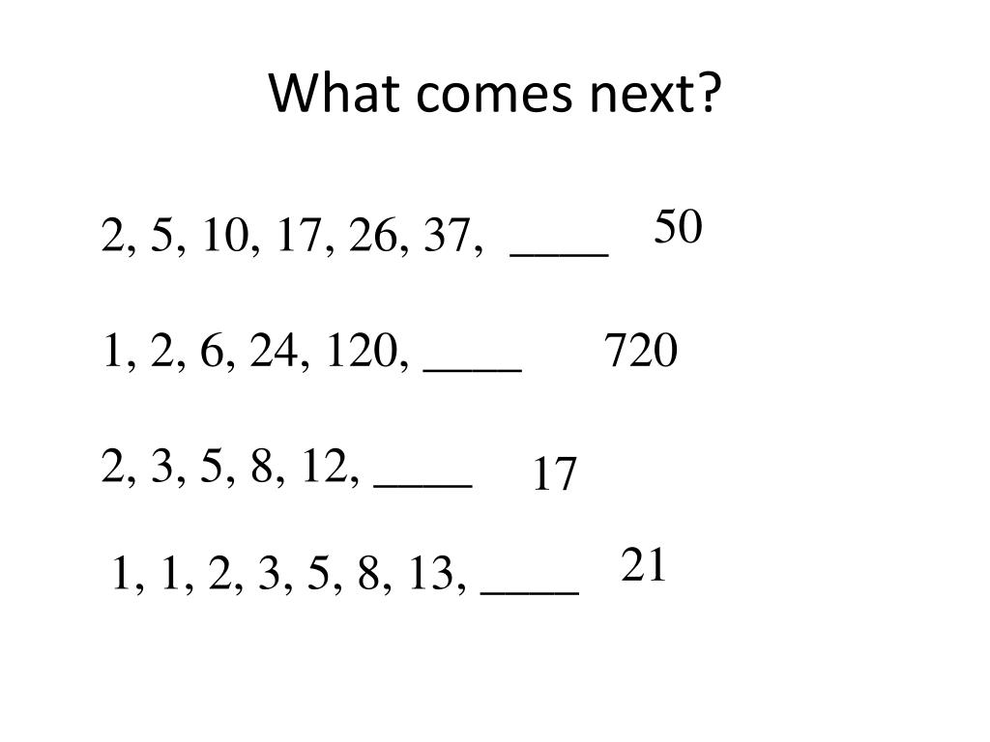
What comes next?
Click for answers
Click to go back
S
E
N
First letter of each the first nine numbers:
One, Two, Three, Four, Five, Six, Seven, Eight, Nine

Slide 6
Prayer for Achievement
Loving God
Thank You for the gifts and abilities You have given us. As we learn, grow, and work towards our goals, help us to do our best in everything we undertake. Give us confidence when we face challenges, determination when tasks seem difficult, and humility when we succeed. May our achievements bring honour to You and benefit those around us.
Amen
Our School Vision:
To be a centre of excellence, inspired by Christian values, where every member of our school community fulfils their potential
Click to go back

Slide 7
Prayer for Success
Heavenly Father
As we strive for success in our studies, sports, friendships, and future ambitions, guide our thoughts and actions. Help us to remember that true success is not only measured by results but by kindness, integrity, and perseverance.Give us the courage to keep trying, even after setbacks, and help us celebrate the successes of others as well as our own.
Amen
Our School Vision:
To be a centre of excellence, inspired by Christian values, where every member of our school community fulfils their potential
Click to go back

Slide 8
Prayer for Achievement, Success, and Sacrifice
Gracious God
As members of this school community, help us to work hard, aim high, and never give up on our dreams. Remind us that achievement comes through effort, success requires perseverance, and worthwhile goals often involve sacrifice.When we succeed, keep us humble. When we struggle, make us resilient. When we are called to make sacrifices, give us generous hearts. May all that we do help us become the people You created us to be.
Amen
Click to go back

Slide 9

Prayer for Sacrifice
God of love
Thank You for those who make sacrifices for us—our families, teachers, friends, and all who support and encourage us. Help us to appreciate the effort and dedication that often go unseen.Teach us to make sacrifices for the good of others, giving our time, talents, and energy generously. May we learn that through serving others we grow in compassion, character, and faith.
Amen
Click to go back

