Slide 1

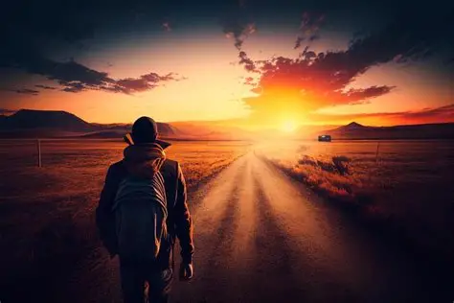

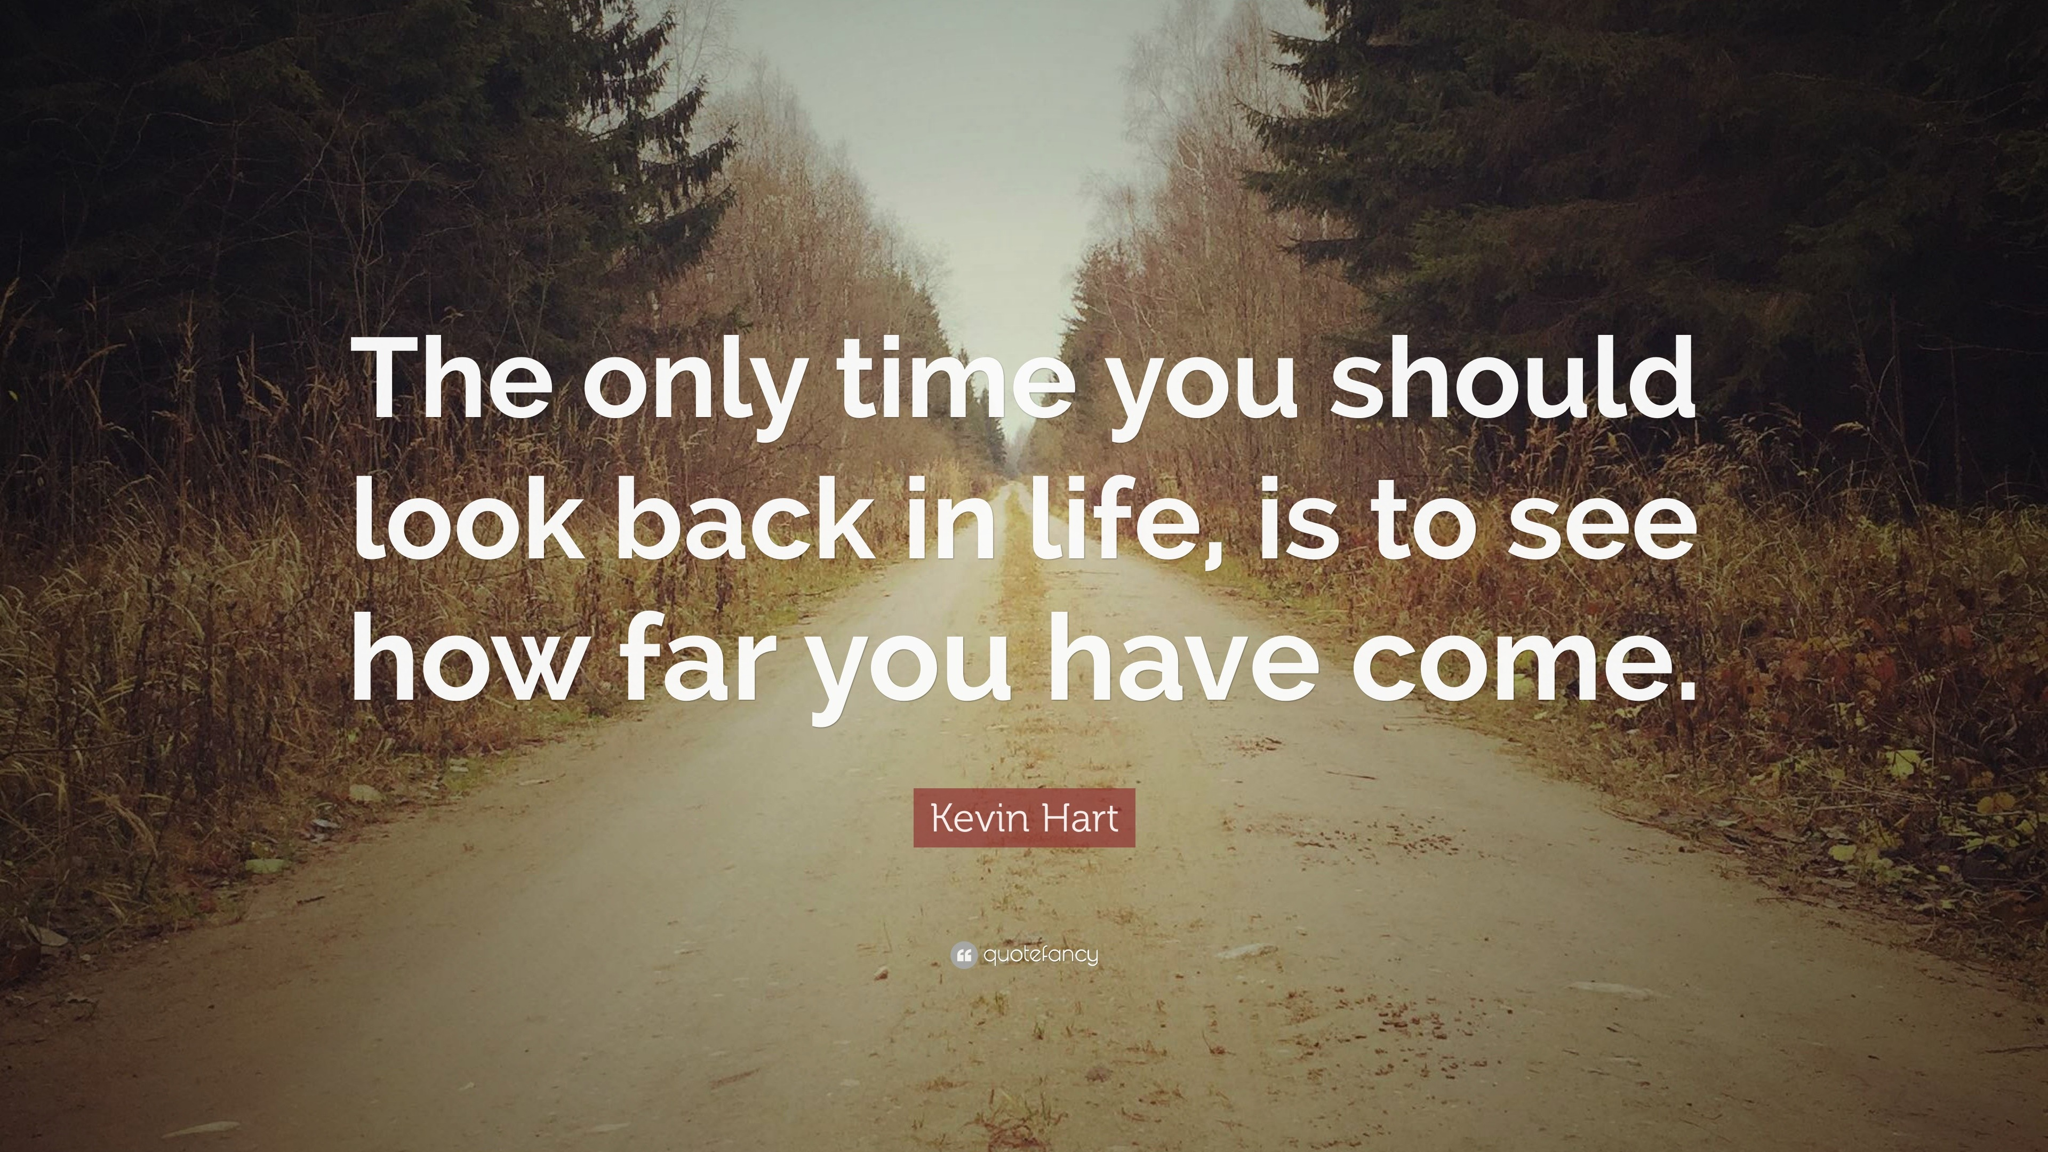

The theme for this half term: School Vision Statement: To be a centre of excellence, inspired by Christian values, where every member of our school community fulfils their potential
The Equality and Diversity theme for this half term: Celebrating Diversity
The theme for this week: Looking back (Reflecting)
Click below for a World Cup Quiz
The FIFA World Cup quiz
Click for the verses of the day
Click for a prayer
Click for an extra prayer
Watch: Some tips for moving forward with confidence:
https://youtu.be/sn2_Te1qAjU

Slide 2



The theme for this half term: School Vision Statement: To be a centre of excellence, inspired by Christian values, where every member of our school community fulfils their potential
The Equality and Diversity theme for this half term: Celebrating Diversity
The theme for this week: Looking Back (Reflecting)
Click below for the challenge of the day
20 History Quiz Questions Multiple Choice Histirocal Trivia
Click for the verses of the day
Word of the Day:
Merriam-Webster
Click for an extra prayer
Click for a prayer
Watch: Click for an interesting analogy….

Slide 3
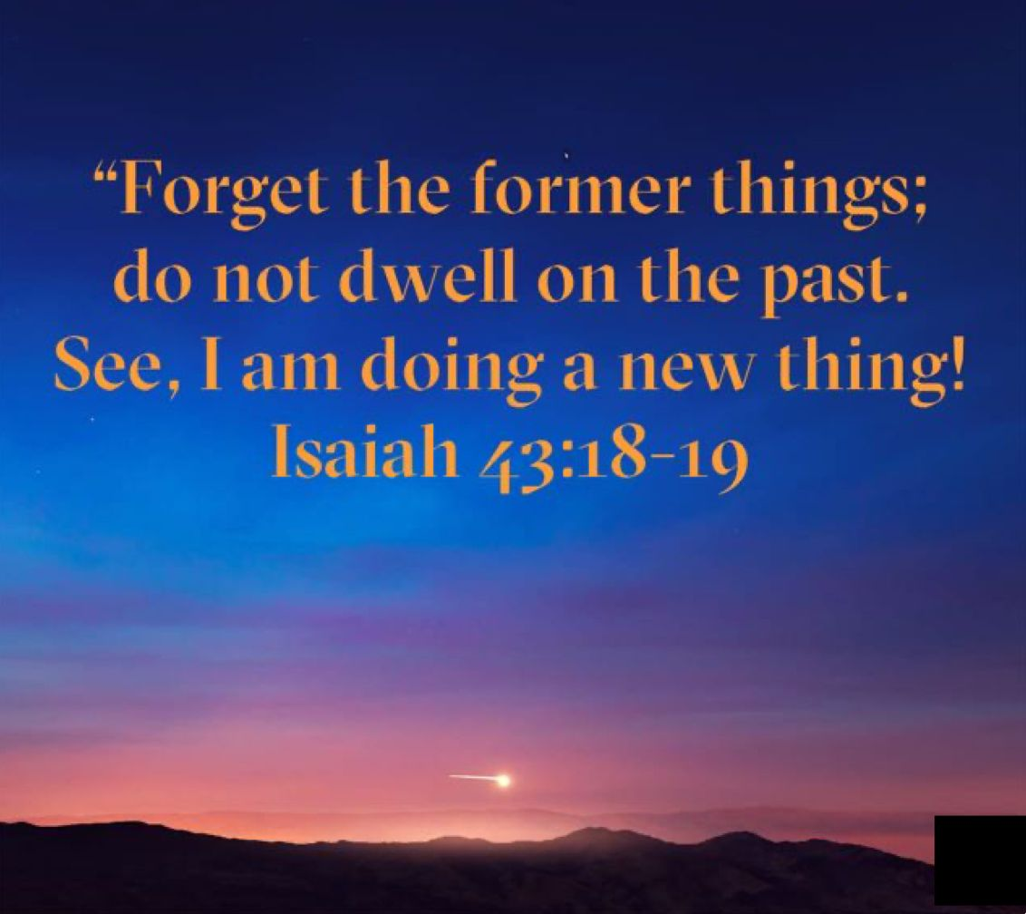
Click to go back
This verse is part of God’s message to the Israelites during their exile in Babylon, a time of hardship and uncertainty. God encourages His people not to dwell on past failures because He is about to do something new in their lives
Question of the day:
What is one thing in your past you can learn from to change your future?

Slide 4
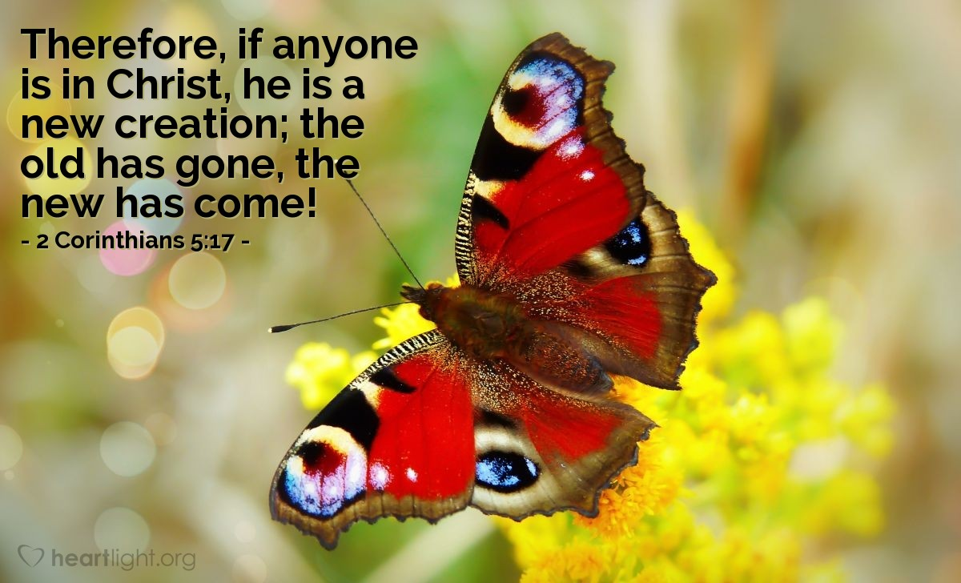
Click to go back
God is clear that once we turn to Him and accept Him, choosing to believe His word, we become new ‘creations’. That is, our spirits and minds will think and react differently to other people and world around us.
Question of the day:
What do you think you would expect to change if you either believe in God, or started to believe in God?

Slide 5
Think about this. (This is not an exact science but an indication…)
A book contains 1000 pages all in black ink. One of the dots on one of the ‘i’s is red. Could you find it? Yes. Just read the book. What about if there were 2 books? What about 10 books. That’s 10 000 pages. Could you find it? Yes. It would just take a long time. 1000 books? What about 1 million books and still only one red dot? Still achievable but extremely time consuming. Let’s fill the earth with books – that’s around 200 000 000 000 000 000 000 (two hundred million trillion). Keen on finding the one red dot now? What about two earths filled with books? One thousand earths? One million earths? 1.3 million earths would fill the sun. Find the dot now? What about two suns filled with earths? 1000 suns? One million suns? What about 66 billion suns (which would fill the largest black hole). 66 billion suns, each with 1.3 million earths; each earth filled with two hundred million trillion books and only one red dot? What about two black holes? 1000 black holes? What about enough black holes to fill the universe – that’s more than 450 trillion. What about two universes? 1000 universes? 1 million universes? 10 billion universes? Oh, and you only have a few billion years so you would have to read trillions and trillions of books every second to succeed. What is the probability you will find the one red dot?
Scientists say it is more likely that you will find that one, red dot in the time given than for the universe and life to have started from a random, undirected process…
Click to go back

Slide 6
Prayer of Gratitude for the Past
Loving God
As we look back on the days behind us,
we thank You for the good moments—
for laughter with friends,
for things we achieved,
and for times we felt supported and loved.
Help us to remember these blessings
when life becomes difficult,
and to carry gratitude in our hearts
as we move forward.
Amen
Our School Vision:
To be a centre of excellence, inspired by Christian values, where every member of our school community fulfils their potential
Click to go back

Slide 7
Prayer for Learning from Mistakes
God of patience
When we look back, we see times
when we made mistakes or chose the wrong path.
Help us not to feel stuck in regret,
but to learn and grow from those moments.
Give us the courage to say sorry,
the strength to do better next time,
and the wisdom to keep moving forward with hope.
Amen
Our School Vision:
To be a centre of excellence, inspired by Christian values, where every member of our school community fulfils their potential
Click to go back

Slide 8
Prayer for Healing and Letting Go
God of Healing
Some memories we carry are painful,
and looking back can sometimes hurt.
Help us to release what weighs us down,
to forgive others and ourselves,
and to trust that You are with us
even in the hard parts of our story.
Bring us peace as we look back,
and hope as we look ahead.
Amen
Our School Vision:
To be a centre of excellence, inspired by Christian values, where every member of our school community fulfils their potential
Click to go back

Slide 9
Prayer for Growth and Purpose
Faithful God
when we look back over our journey,
we see how much we have changed and grown.
Thank You for guiding us,
even when we didn’t realise it.
Help us to see how our past
shapes who we are becoming,
and guide us to use our experiences
to make a difference in the world.
Lead us forward with purpose and confidence.
Amen
Our School Vision:
To be a centre of excellence, inspired by Christian values, where every member of our school community fulfils their potential
Click to go back

