Slide 1
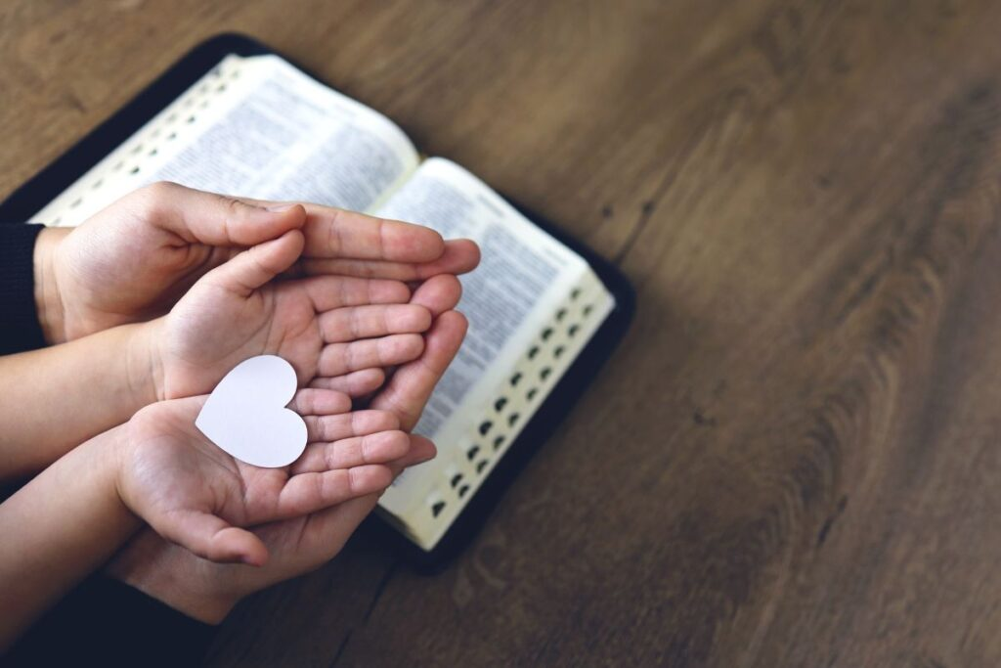


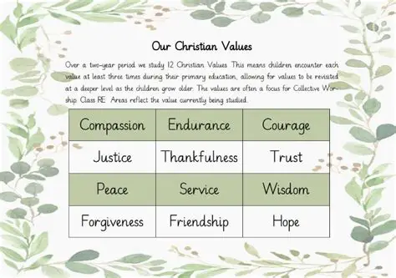

The theme for this half term: School Vision Statement: To be a centre of excellence, inspired by Christian values, where every member of our school community fulfils their potential
The Equality and Diversity theme for this half term: Celebrating Diversity
The theme for this week: Christian Values
Click for the challenge of the day
Click for the verses of the day
Click for an extra prayer
Click for a prayer
Watch: What things does God consider important?
https://youtu.be/IDiTlVE2Tls

Slide 2


Click to go back
These days, importance is placed on very different things to what is displayed in that list. Here, Paul is writing to the believers in Philippi and encouraging them to think about things which build character and last forever.
Question of the day:
Can you make up a list which is opposite to the list displayed? E.g. Instead of ‘Whatever is true’ you could write, ‘Whatever is gossip or rumour’

Slide 3
Can you work out the missing words in this bible verse?
______ 10:10
The ______ (the ______) comes to ______, kill and ________ but I (_______) have come to give you ____ and life in all it’s __________
J
ohn
Click for hints and then answers
t
hief
d
evil
d
s
teal
estroy
Click to go back
J
esus
l
ife
f
ullness

Slide 4
Living with Kindness and Respect
Dear God
Thank you for bringing us together today.
Help us to live out Your love in our school and in our lives.
Teach us to be kind in our words,
respectful in our actions,
and patient with one another, even when things are difficult.
Guide us to stand up for what is right,
to forgive when we are hurt,
and to include those who feel left out.
May we reflect Your light in everything we do,
so that others may see Your goodness through us.
Amen
Our School Vision:
To be a centre of excellence, inspired by Christian values, where every member of our school community fulfils their potential
Click to go back

Slide 5
Courage, Honesty, and Faith
Loving God
As we face the challenges of each day,
give us courage to do what is right, even when it’s hard.
Help us to be honest in our choices,
faithful in our friendships,
and responsible in our learning.
Remind us that we are all valued and loved by You,
and help us to treat others with the same care and dignity.
Strengthen our faith,
so that we may trust in You and grow into the people You created us to be.
Amen
Our School Vision:
To be a centre of excellence, inspired by Christian values, where every member of our school community fulfils their potential
Click to go back

