Slide 1



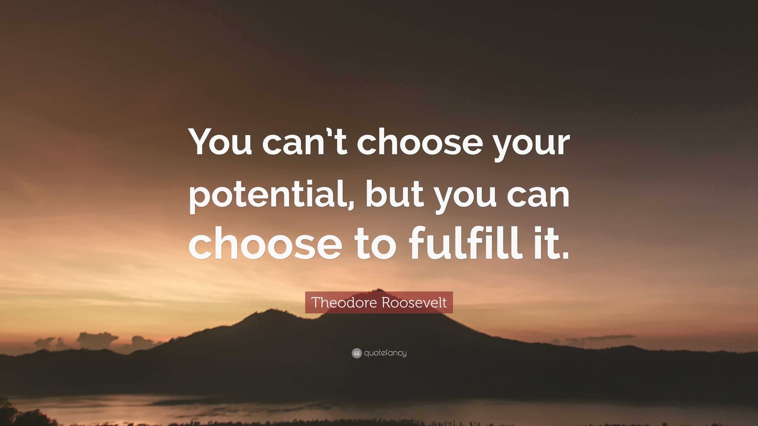

The theme for this half term: School Vision Statement: To be a centre of excellence, inspired by Christian values, where every member of our school community fulfils their potential
The Equality and Diversity theme for this half term: Celebrating Diversity
The theme for this week: Yes, YOU can!
Click for the challenge of the day
Click for the verses of the day
Click for a prayer
Click for an extra prayer
Watch: Dream big!
https://youtu.be/pIUOdrWl-ts

Slide 2



The theme for this half term: School Vision Statement: To be a centre of excellence, inspired by Christian values, where every member of our school community fulfils their potential
The Equality and Diversity theme for this half term: Celebrating Diversity
The theme for this week: Yes, YOU can!
Click below for the challenge of the day
World Cup quiz: Name every team to have taken part at a World Cup - BBC Sport
Click for the verses of the day
Word of the Day:
Merriam-Webster
Click for an extra prayer
Click for a prayer
Watch: Click for some further thoughts on ‘Values’

Slide 3
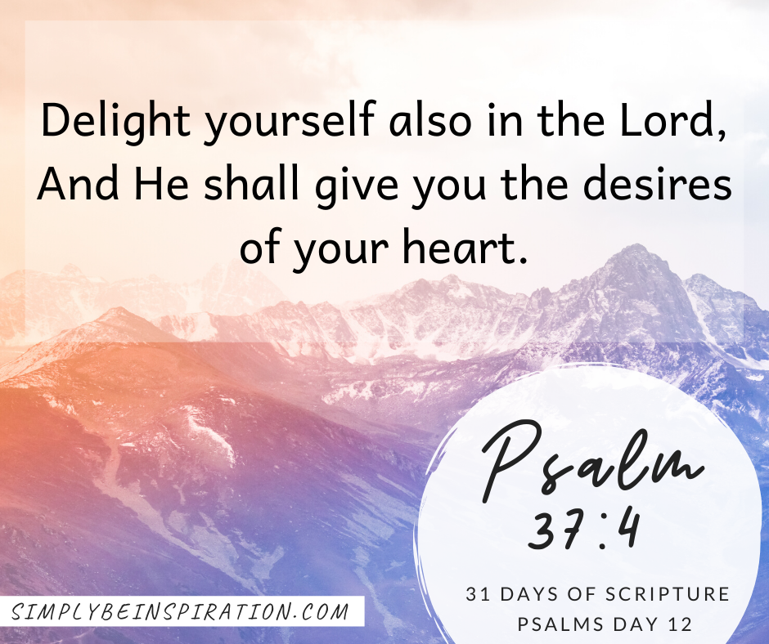
Click to go back
We all have potential. We know that. But who knows this even better? God. He made us on purpose and placed that potential within us. This is what gives us the desire to do what we do. In this Psalm, David is communicating something he has learnt – that aligning ourselves with God means we will fulfil the desires and aspirations that He placed in us in the first place. We can trust He has the best for us!
Question of the day:
What ultimate goal do you have for your life? Tell the person next to you!

Slide 4

Click to go back
This verse is a follow on from the last one where we are encouraged to seek God and He will work in us. (Delight in God and He will give you the desires of your heart - (which are actually His desires)). This verse confirms this. If we allow Him, God will work in us. Allow it! His purposes and plans for us are always good! Often what we think is good and what God thinks is good are different or conflicting. God’s desire is that we have an eternal perspective. That way, our view of this life on earth changes. We live for God and others rather than just for ourselves. We become humble and kind.
Question of the day:
In what way do you think God’s plans for us and our own plans for us differ?

Slide 5
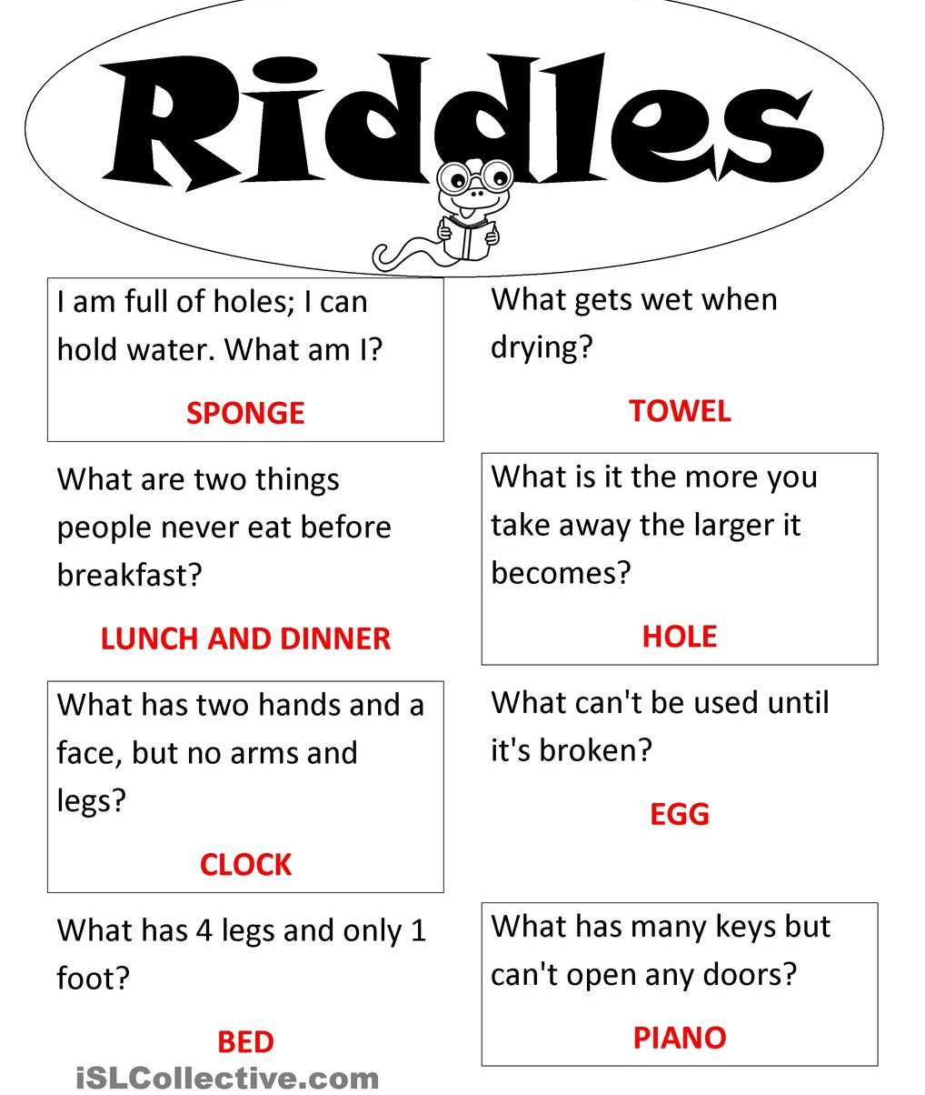
Can you work out these riddles?
Click for answers
Click to go back

Slide 6
Prayer 1: Prayer for Guidance and Focus
Dear God
Grant me clarity in my thoughts and purpose in my actions.
Help me to use my talents wisely and to remain focused on the goals You have placed before me.
Give me courage to face challenges and the perseverance to
keep learning and growing
Amen
Our School Vision:
To be a centre of excellence, inspired by Christian values, where every member of our school community fulfils their potential
Click to go back

Slide 7
Prayer 2: Prayer for Confidence and Strength
Heavenly Father
Please help me believe in myself and the gifts You have
given me
When doubts arise, remind me of my potential and inspire me to try my best in all I do.
May I act with confidence and integrity, always striving to make the most of the abilities You have entrusted to me.
Amen
Our School Vision:
To be a centre of excellence, inspired by Christian values, where every member of our school community fulfils their potential
Click to go back

Slide 8
Prayer 3: Prayer for Wisdom and Encouragement
Lord
Open my heart and mind to the lessons around me.
Teach me to embrace opportunities for learning and
to grow from every experience, whether success or
failure.
Encourage me to be patient with myself, and to trust
that You are guiding me toward fulfilling my potential.
Amen
Our School Vision:
To be a centre of excellence, inspired by Christian values, where every member of our school community fulfils their potential
Click to go back

Slide 9
Prayer 4: Prayer for Service and Purpose
Almighty God
Help me to use my gifts not only for my own benefit but to serve and inspire others.
Let my actions reflect my highest potential and bring positivity to those around me.
May I always seek to grow in knowledge, character, and kindness, fulfilling the purpose You have set for me.
Amen
Our School Vision:
To be a centre of excellence, inspired by Christian values, where every member of our school community fulfils their potential
Click to go back

