Slide 1





The theme for this half term: School Vision Statement: To be a centre of excellence, inspired by Christian values, where every member of our school community fulfils their potential
The Equality and Diversity theme for this half term: Celebrating Diversity
The theme for this week: Persevere
Click for the challenge of the day
Click for the verses of the day
Click for a prayer
Click for an extra prayer
Watch: Be encouraged and inspired by these people who persevered and beat the odds…
https://youtu.be/7hByu8MvIiU

Slide 2



The theme for this half term: School Vision Statement: To be a centre of excellence, inspired by Christian values, where every member of our school community fulfils their potential
The Equality and Diversity theme for this half term: Celebrating Diversity
The theme for this week: Persevere
Click for the challenge of the day
Click for the verses of the day
Word of the Day:
Merriam-Webster
Click for an extra prayer
Click for a prayer
Watch: Click for some further thoughts on persevering…

Slide 3
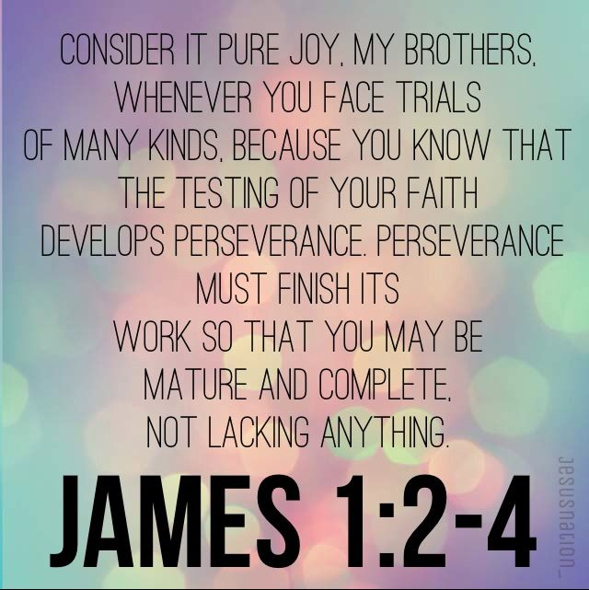
Click to go back
This is very counter-cultural. Most people do not like tests or trials and just want them to end. Here, James is encouraging us to change our attitude towards challenges as we will come across them whether we like it or not. So, when a trial comes your way, take it on with a ‘can do’ attitude!
Question of the day
What has been your biggest challenge so far and how did you get through it?

Slide 4
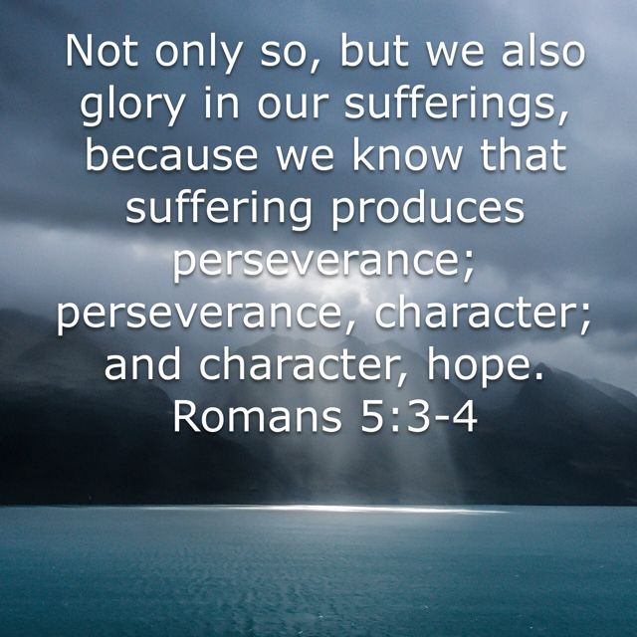
Click to go back
Your character is both exposed and developed during hard times. How we approach difficult times says a lot about who we are – especially to other people. When you develop a strong character, this gives you hope to succeed in the future as you know how far you can push yourself. This doesn’t mean, however, that we try and do everything on our own. We still have to rely on God and other people and often God uses other people as it brings us together in community!
Question of the day:
Which aspect of you character needs work?
Humility? Integrity? Honesty? Loyalty? Courage? Compassion? Resilience?

Slide 5

Can you find the 10 differences?
Click for the answers
Click to go back

Slide 6
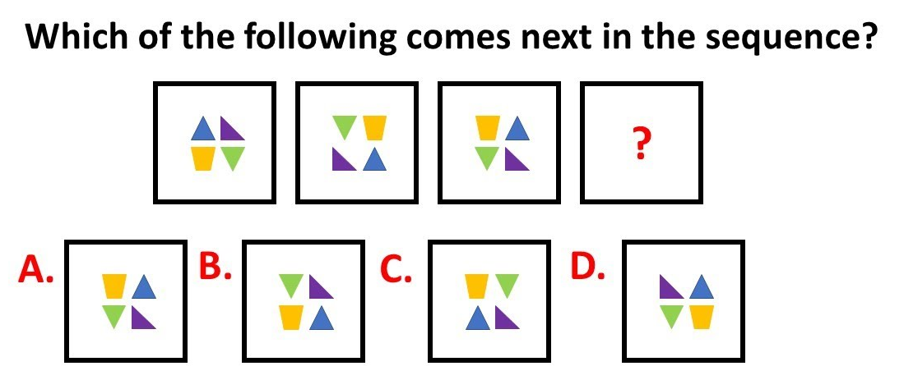
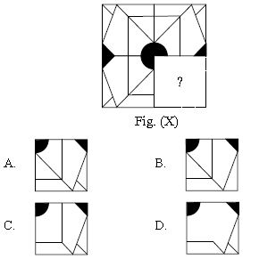
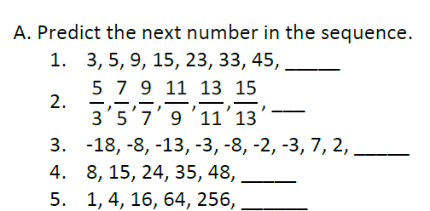
Click for answers
Click to go back
59
17
15
12
63
1024

Slide 7
Prayer for Strength to Keep Going
Dear God
When things feel hard and I want to give up
Give me strength to keep going
Help me to remember that challenges can help me grow
And that I am capable of more than I think
Guide me to take one step at a time
And trust that I will get through
Amen
Our School Vision:
To be a centre of excellence, inspired by Christian values, where every member of our school community fulfils their potential
Click to go back

Slide 8
Prayer for Confidence in Difficult Times
Dear Lord of Grace
Sometimes I doubt myself and feel like I’m not good enough
Remind me that I have gifts and talents for a reason
Help me to believe in myself, even when it’s tough
And to keep trying instead of quitting
Fill me with courage to face every challenge today
Amen
Our School Vision:
To be a centre of excellence, inspired by Christian values, where every member of our school community fulfils their potential
Click to go back

Slide 9
Prayer for Patience and Endurance
God of patience
Teach me to stay calm when things don’t happen quickly
Help me to work hard, even when I don’t see results straight away
Give me endurance to keep learning, improving, and trying again
May I never lose hope in what I can achieve
Amen
Our School Vision:
To be a centre of excellence, inspired by Christian values, where every member of our school community fulfils their potential
Click to go back

Slide 10
Prayer for Encouragement and Hope
Loving God
When I feel tired, stressed, or discouraged
Lift me up and fill me with hope
Remind me that every setback is a chance to grow stronger
Help me to support my friends as we all face challenges together
May I continue with determination and a positive heart
Amen
Our School Vision:
To be a centre of excellence, inspired by Christian values, where every member of our school community fulfils their potential
Click to go back

