Slide 1




The theme for this half term: School Vision Statement: To be a centre of excellence, inspired by Christian values, where every member of our school community fulfils their potential
The Equality and Diversity theme for this half term: Celebrating Diversity
Our School Vision:
To be a centre of excellence, inspired by Christian values, where every member of our school community fulfils their potential
The theme for this week: Our School Vision
Click for the challenge of the day
Click for the verses of the day
Click for an extra prayer
Watch: Will you fulfil your potential?
https://youtu.be/73CHJRv0XIQ
Click for a prayer

Slide 2


The theme for this half term: School Vision Statement: To be a centre of excellence, inspired by Christian values, where every member of our school community fulfils their potential
The Equality and Diversity theme for this half term: Celebrating Diversity
Our School Vision:
To be a centre of excellence, inspired by Christian values, where every member of our school community fulfils their potential
The theme for this week: Our School Vision
Click for the challenge of the day
Click for the verses of the day
Word of the Day:
Merriam-Webster
Click for a prayer
Click for an extra prayer
Listen: Talking about fulfilling your potential, listen to this rap created by one of our students

Slide 3
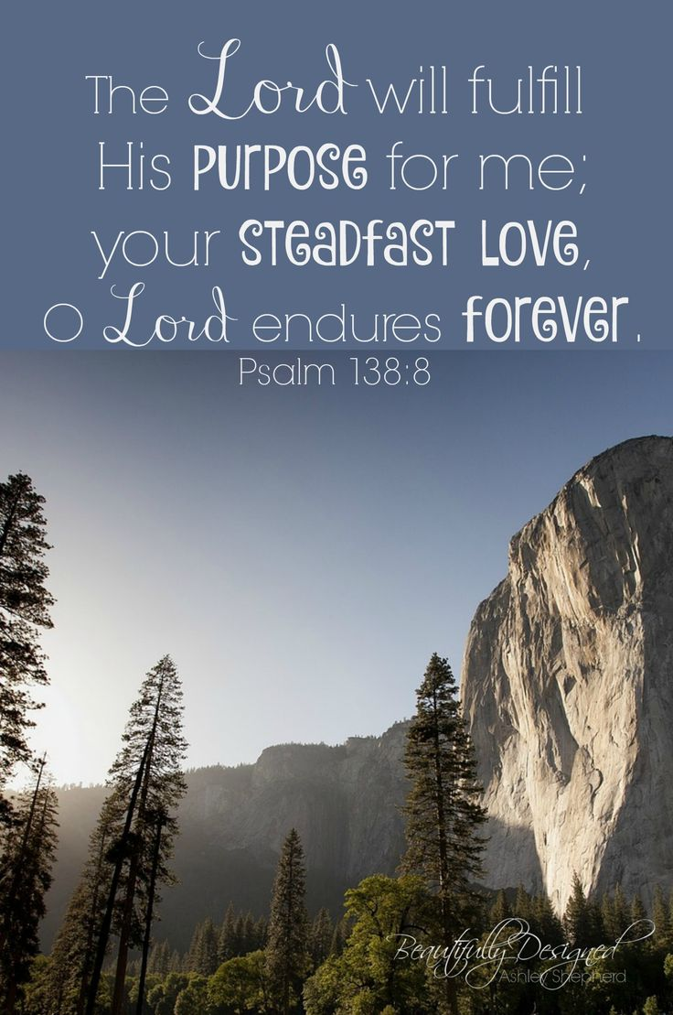
Click to go back
Have a look at the first part of this verse: ‘The Lord will fulfil His purpose for me…’ This was King David talking. He knew that although he made daily choices and mistakes, God had an overall plan, bigger than his own – and that God was outworking it all the time!
Question of the day:
What do you think God’s purpose is for your life?
Our School Vision:
To be a centre of excellence, inspired by Christian values, where every member of our school community fulfils their potential

Slide 4
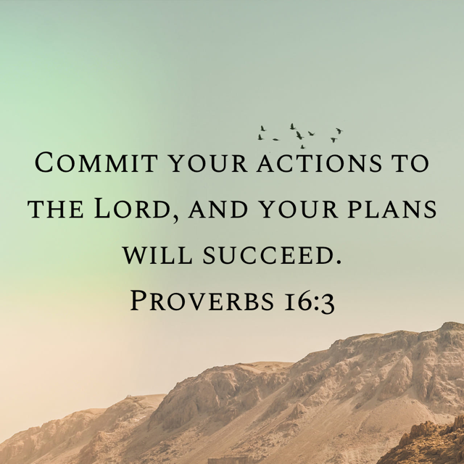
Click to go back
If we think about this verse along with the verse from the other day and put them together: One says that God will fulfil His purpose in you and this one says you have to commit your plans to Him
Question of the day:
If you don’t commit your plans to God, do you think He will ignore you and/or make your plans fail?
Our School Vision:
To be a centre of excellence, inspired by Christian values, where every member of our school community fulfils their potential

Slide 5
Here is a dictionary definition of the word ‘Vision’
Can you fill in the missing words? Click for hints
Our School Vision:
To be a centre of excellence, inspired by Christian values, where every member of our school community fulfils their potential
Vision: the ability to _____ about or ____ the ______ with __________ or _______
t
hink
p
lan
Click to go back
f
uture
i
w
magination
isdom

Slide 6
Can you work out these anagrams? They are synonyms for our four underpinning elements: Dignity, Community, Wisdom, Hope and are displayed in that order
Click to go back
Click for answers
Our School Vision:
To be a centre of excellence, inspired by Christian values, where every member of our school community fulfils their potential
Dignity
flew short
self-worth
Community
cosy tie
society
Wisdom
cured pen
prudence
Hope
inexact poet
expectation

Slide 7
Prayer for Discovering Gifts
Loving God
Thank You for creating me with unique gifts and abilities
Help me to discover the talents You have placed within me
Even the ones I haven’t noticed yet
Give me courage to try new things
And confidence to believe in myself
Guide me to use my gifts not just for my success
But to make a difference in the lives of others
Amen
Our School Vision:
To be a centre of excellence, inspired by Christian values, where every member of our school community fulfils their potential
Click to go back

Slide 8
Prayer for Motivation and Perseverance
Lord
When school feels difficult and I feel like giving up,
Remind me of the potential You have placed inside me.
Give me the strength to keep going,
The discipline to do my best,
And the resilience to learn from my mistakes.
Help me to see challenges as opportunities to grow,
And to never lose hope in what I can become.
Amen.
Our School Vision:
To be a centre of excellence, inspired by Christian values, where every member of our school community fulfils their potential
Click to go back

Slide 9
Prayer for Confidence and Identity
Heavenly Father
Help me to see myself the way You see me—
Capable, valued, and full of promise
When I compare myself to others or doubt my worth
Remind me that my journey is unique
Give me confidence to be true to who I am
And courage to step into the future You have for me
Let me grow into the person You created me to be
Amen
Our School Vision:
To be a centre of excellence, inspired by Christian values, where every member of our school community fulfils their potential
Click to go back

Slide 10
Prayer for Purpose and Future Direction
God of hope
As I think about my future, guide my choices and dreams
Help me to follow paths that bring out the best in me
And allow me to serve others with kindness and wisdom
Give me clarity when I feel unsure
And peace when I feel pressure to have everything figured out
Lead me step by step toward a life of purpose,
Where I can fulfil my potential and honour You
Amen
Our School Vision:
To be a centre of excellence, inspired by Christian values, where every member of our school community fulfils their potential
Click to go back

Slide 11
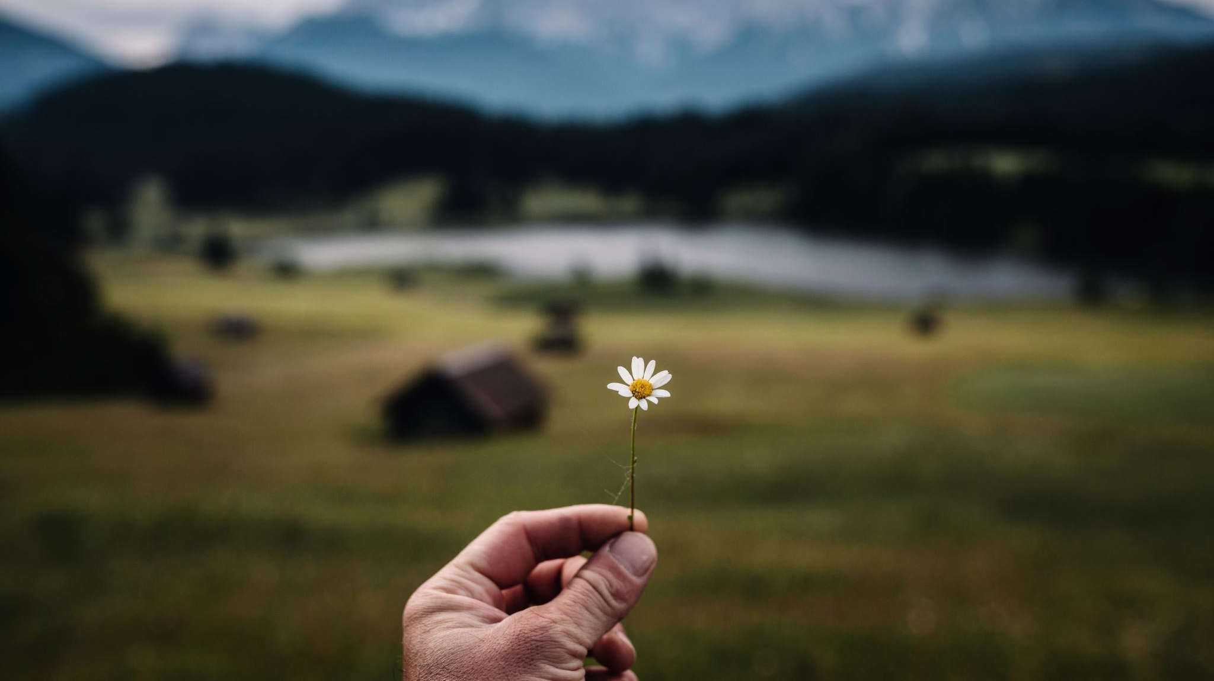
Click to begin
Somewhere I belong

Slide 12

Somewhere I belong

Slide 13
Yeah, I’m 14 nearly 15 feelin’ inbetween
Tryna find my place, tryna know what it means
Got a head full of thoughts but I don’t know what it says
Smiling on the outside but I’m lost most days
People see a face but they don’t see the fight
They don’t hear the noises when I’m alone at night
I took a couple wrong turns, yeah I drifted away
Didn’t know who I was, didn’t know how to stay

Slide 14
Looking in the mirror like who is that?
Tryna piece together what I know I lack
But every little crack let the light shine through
Now I’m holding on to something that I know is true
I’m just tryna find somewhere I belong
In a world that keeps moving way too strong
Through the pain and the doubt I am holding on
Still writing my life in a broken song

Slide 15
Just tryna find
I’m just tryna find
Somewhere I belong
Somewhere I belong

Slide 16
There were days when I was falling couldn’t get back up
Heart felt heavy, yeah, way too much
Then a voice cut through when I lost my way
Told me that I didn’t have to fade away
Stayed when it hurt, helped me to be strong
Now I carry that light when the night gets long
Like a quiet strength when things were wrong
Now all that’s fixed - disappeared and gone

Slide 17
Disappeared and gone

Slide 18
I’m still young but I’ve seen some rain
Felt that silence louder than the pain
But I’m still here, yeah, I’m standing strong
Turning every weak note into a song
I’m just tryna find somewhere I belong
In a world that keeps moving way too strong
Through the pain and the doubt, I’m still holding on
Still writing my life in a broken song

Slide 19
I’m just tryna find somewhere I belong
In a world that keeps moving way too strong
Through the pain and the doubt, I’m still holding on
Still writing my life in a broken song

Slide 20
Somewhere I belong
Click to go back

