Slide 1
Registering for Taster Day

Slide 2
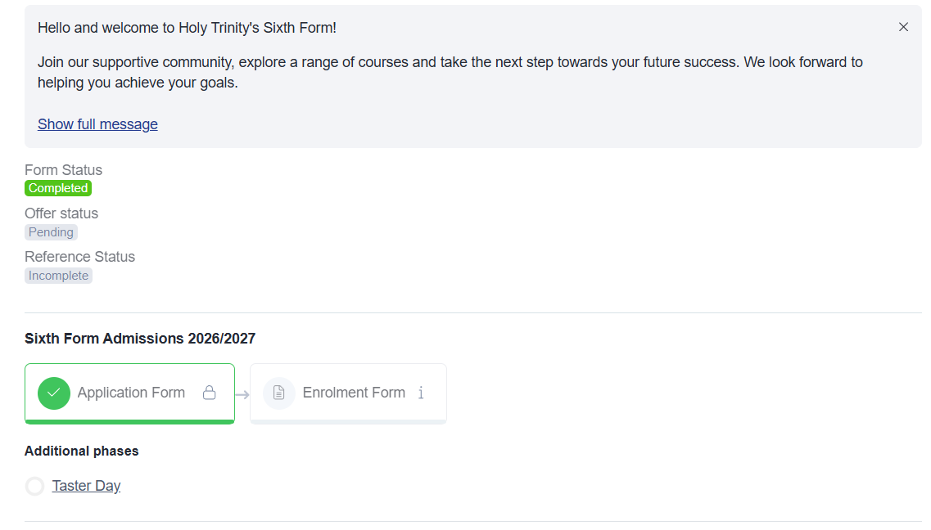
Appicaa Homepage
When you log into Applicaa, your homepage should look like this.
You need to click on the ‘Taster Day’ button at the bottom:

Slide 3


Choose the day
Tick the box with Y12 Taster Day 2026
Choose save and next

Slide 4
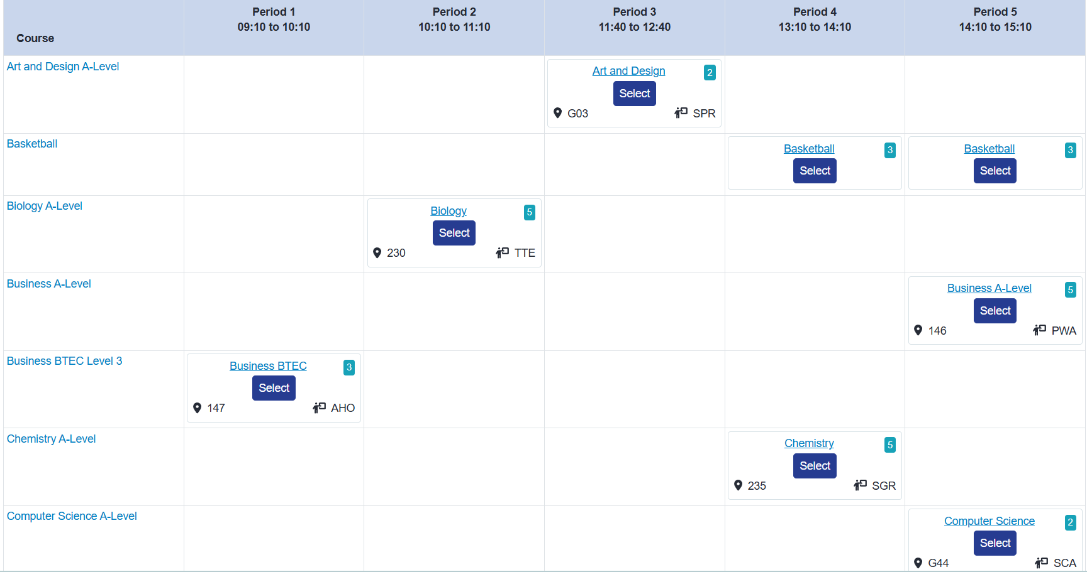
Choosing your subjects
You then click on the subjects you want to attend following the guidance at the top.
Choose 1 for each period, with one in the Sixth Form Center:

