Slide 1
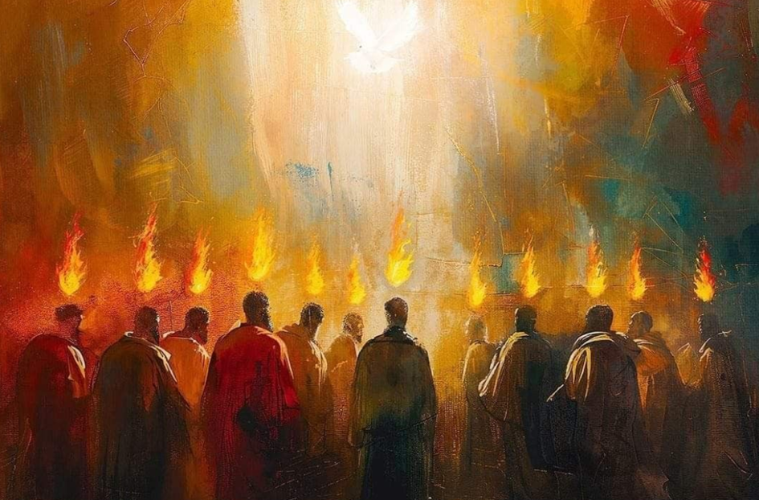


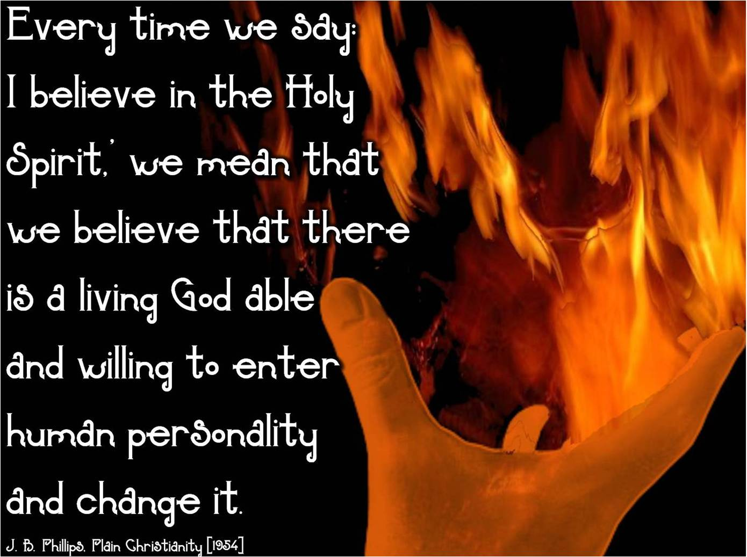

The theme for this half term: School Vision Statement: To be a centre of excellence, inspired by Christian values, where every member of our school community fulfils their potential
The Equality and Diversity theme for this half term: Celebrating Diversity
The theme for this week: Pentecost
Click for the challenge of the day
Click for the verses of the day
Careers – Guess my job!
https://youtu.be/2KpUEjK3hxw
Click for a prayer
Click for an extra prayer
Watch: The day of Pentecost
https://youtu.be/PLa-lj0zCGg

Slide 2


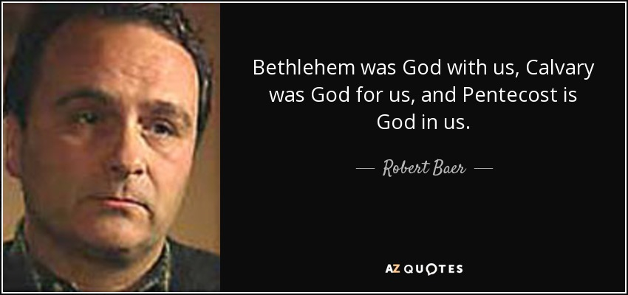
The theme for this half term: School Vision Statement: To be a centre of excellence, inspired by Christian values, where every member of our school community fulfils their potential
The Equality and Diversity theme for this half term: Celebrating Diversity
The theme for this week: Pentecost
Click below for the challenge of the day
The Day of Pentecost Quiz | New Testament | 10 Questions
Click for the verses of the day
Word of the Day:
Merriam-Webster
Click for an extra prayer
Click for a prayer
Watch: Some thoughts on Pentecost from your Chaplain…

Slide 3
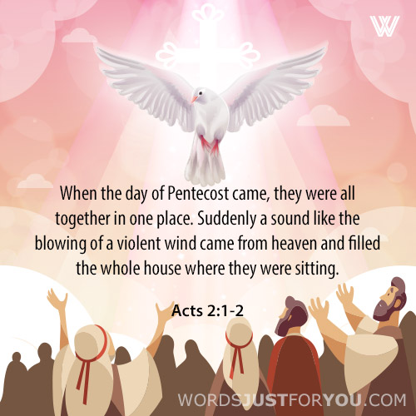
Click to go back
The day of Pentecost took place 50 days after the resurrection of Jesus. There were several people together in one place and these people were from lots of different countries and spoke different languages. God poured out His spirit on all of them and they understood each other. This was the beginning of the ‘church’ – that is, God proclaiming that there would no longer be any barriers between Christians. They were all united in Him. Here is an explanation: https://youtu.be/j19PE0GJZuA
Queston of the day:
What are the biggest barriers challenging the unity of the human race?

Slide 4
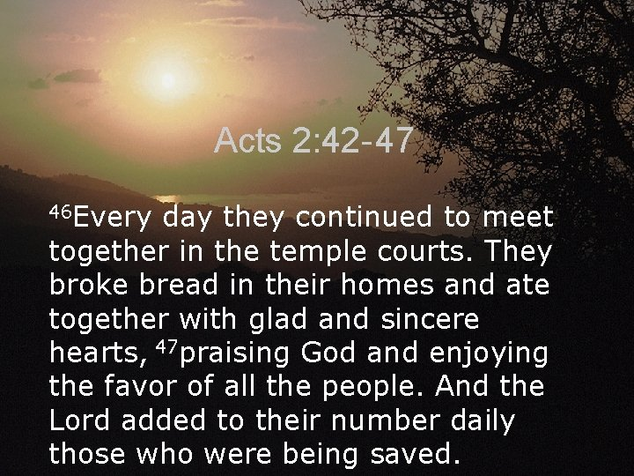
Click to go back
Continuing on from the believers being united in God, they then started the habit of meeting together often. They met in the temple and in their homes, sharing everything they had. This was a wonderful example of true community!
Questions of the day:
What are your three most precious possessions?
If you had to give one away, which would it be?
Who would you give it to?

Slide 5
Fill in the missing words Click for hints
________ 2:42-45
They devoted themselves to the apostles’ ____________ and to fellowship, to the breaking of _________ and to ________. Everyone was filled with awe at the many wonders and _____ performed by the apostles. All the believers were ____________ and had everything in common. They sold ___________ and possessions to give to anyone who had need
Acts
t
eaching
b
read
p
rayer
Click to go back
igns
s
t
ogether
roperty
p

Slide 6
Prayer for Courage and Confidence
Loving God
At Pentecost you filled your followers with courage through your Holy Spirit.
As we face lessons, exams, friendships, and challenges,
give us confidence when we feel unsure
and strength when we feel afraid.
Help us trust that you are always with us.
Amen
Click to go back

Slide 7
Prayer for Unity and Understanding
Holy Spirit
You brought people together even when they spoke different languages.
Help us to understand one another at school,
to listen with patience
and to treat everyone with kindness and respect.
Guide us to be peacemakers in our classrooms and communities.
Amen
Click to go back

Slide 8
Prayer for Wisdom and Learning
Spirit of God
You are the source of wisdom and truth.
Bless our minds as we learn new things each day.
Help us to use our knowledge well,
to make good choices,
and to grow not only in understanding but also in compassion.
Amen
Click to go back

Slide 9
Prayer for Boldness to Do What Is Right
Lord God
At Pentecost you filled your people with fire and purpose.
Light a fire in our hearts too—
to stand up for what is right,
to speak with honesty,
and to act with love, even when it is difficult.
Send us out to make a positive difference in the world.
Amen
Click to go back

