Slide 1





The theme for this half term: Dignity
The Equality and Diversity theme for this half term: Culture
The theme for this week: Celebration of Success
Click below for the challenge of the day
Quiz: Can you tackle a Victorian exam paper? - BBC Bitesize
Click for the verses of the day
Careers – Guess my job!
https://youtu.be/2KpUEjK3hxw
Click for an extra prayer
Click for a prayer
Watch:

Slide 2
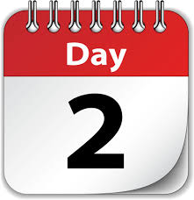


The theme for this half term: Dignity
The Equality and Diversity theme for this half term: Culture
The theme for this week: Celebration of Success
Click below for the challenge of the day
The mind-blowing map of the world quiz - BBC Bitesize
Click for the verses of the day
Word of the Day:
Merriam-Webster
Click for a prayer
Click for an extra prayer
Watch: Be inspired by these talented people…
https://youtu.be/JYa-vS1f_YQ

Slide 3
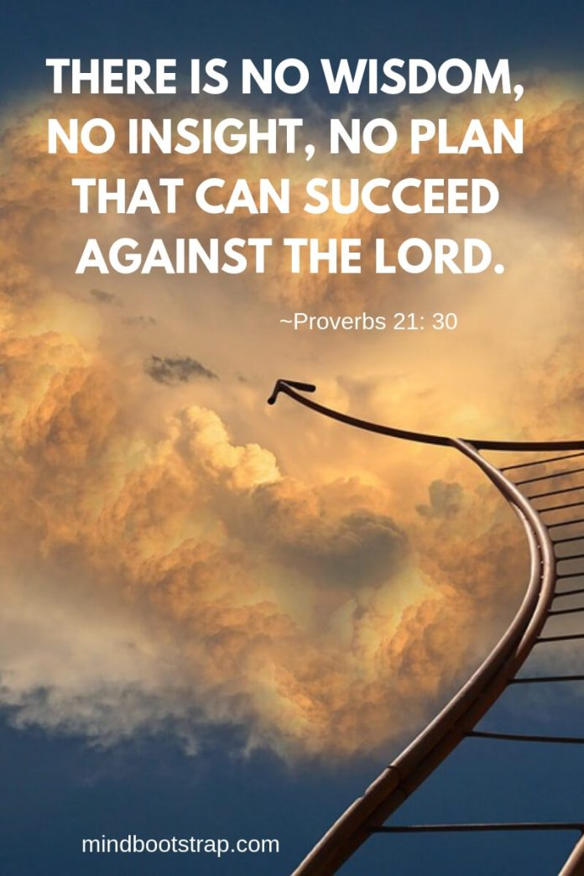
Click to go back
This is a different take on success. This time round, we are thinking about the ultimate authority and sovereignty of God. Christians believe that God is complete in every way and therefore perfect. This means that all His ways and thoughts are always right and true and will always produce the most whole and holy outcome. Subsequently, there is no power that can (or that Christians would want to) come against God. Christians trust in God’s complete control over every situation.
Question of the day:
Who do you trust when things go wrong?

Slide 4
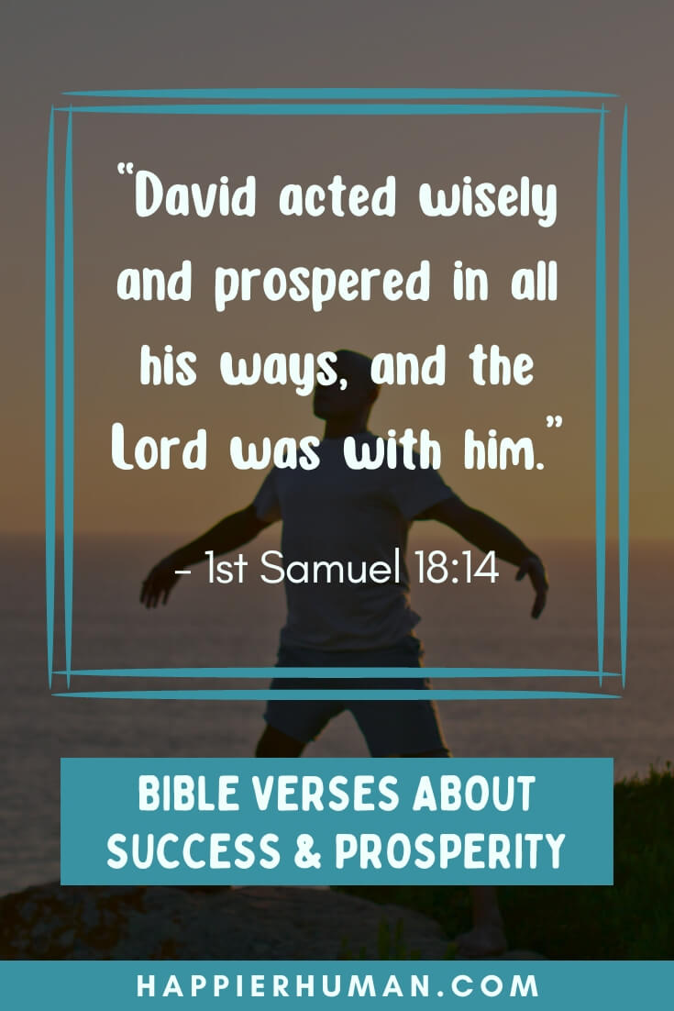
Click to go back
King David was the father of King Solomon. Although David made some big mistakes, his heart was in the right place and God used him mightily. This verse in Samuel tells us that David ‘acted wisely and prospered in all his ways’. Wisdom was a characteristic that David had to work on, however, it clearly had an impact on his son Solomon who, when told by God he could ask for anything, asked for wisdom
Question of the day:
Below are three important words relating to success.
Can you work them out?
P _ _ _ _ _ _ _ _ _ _ _
H _ _ _ _ _ _ _
A _ _ _ _ _ _ _
e
r
s
e
v
e
r
a
n
c
e
Click for answers
u
m
i
i
t
l
y
t
t
i
t
u
d
e

Slide 5
Click for answers
Click to go back
Bad Bunny
RAYE
Bruno Mars
Harry Styles

Slide 6
A Prayer for Effort and Growth
Loving God
Thank you for the gifts and abilities you have given us. Help us to work hard, to stay curious, and to keep learning even when things feel difficult. Give us patience with ourselves and confidence to try our best each day. May our efforts help us grow not only in knowledge, but also in character.
Amen
Click to go back

Slide 7
A Prayer for Success in Studies and Exams
God of wisdom
As we study and prepare for our work, give us focus and clear minds. Help us to remember what we have learned and to stay calm under pressure. Remind us that success is not only about results, but about doing our best honestly and faithfully. Be with us in every challenge we face.
Amen
Click to go back

Slide 8
A Prayer for Resilience and Perseverance
Dear God
When we feel discouraged or afraid of failure, give us strength to keep going. Help us to learn from mistakes and not to give up when things don’t go as planned. Teach us that setbacks can help us become stronger and wiser. May we always find hope and courage to begin again.
Amen
Click to go back

Slide 9
A Prayer of Gratitude and Purpose
Gracious God
Thank you for our teachers, our friends, and those who support us. Help us to use our achievements in ways that help others and make the world a better place. Keep us humble in success and kind in all we do. May our lives reflect gratitude, purpose, and hope.
Amen
Click to go back

