Slide 1

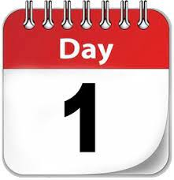

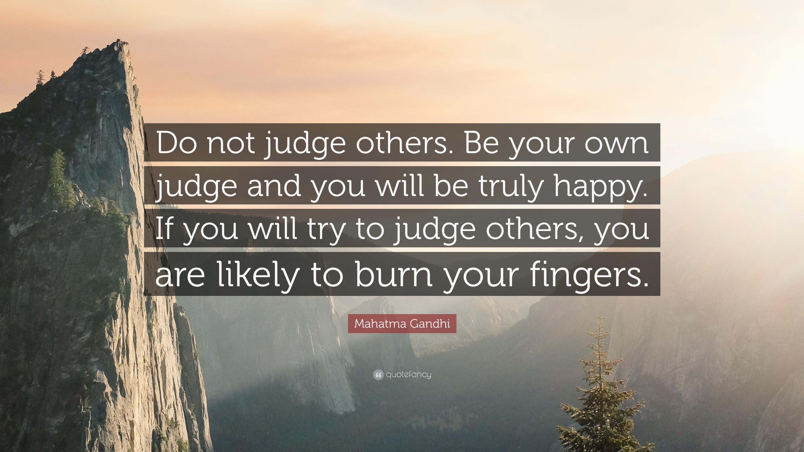

The theme for this half term: Dignity
The Equality and Diversity theme for this half term: Culture
The theme for this week: See, Judge, Act
Click for the challenge of the day
Click for the verses of the day
Careers – Guess my job!
https://youtu.be/nBCCRYVp76M
Watch: What does your chaplain think of ‘See, Judge, Act’? And.. watch for an opportunity to be semi-famous…
Click for an extra prayer
Click for a prayer

Slide 2
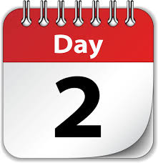

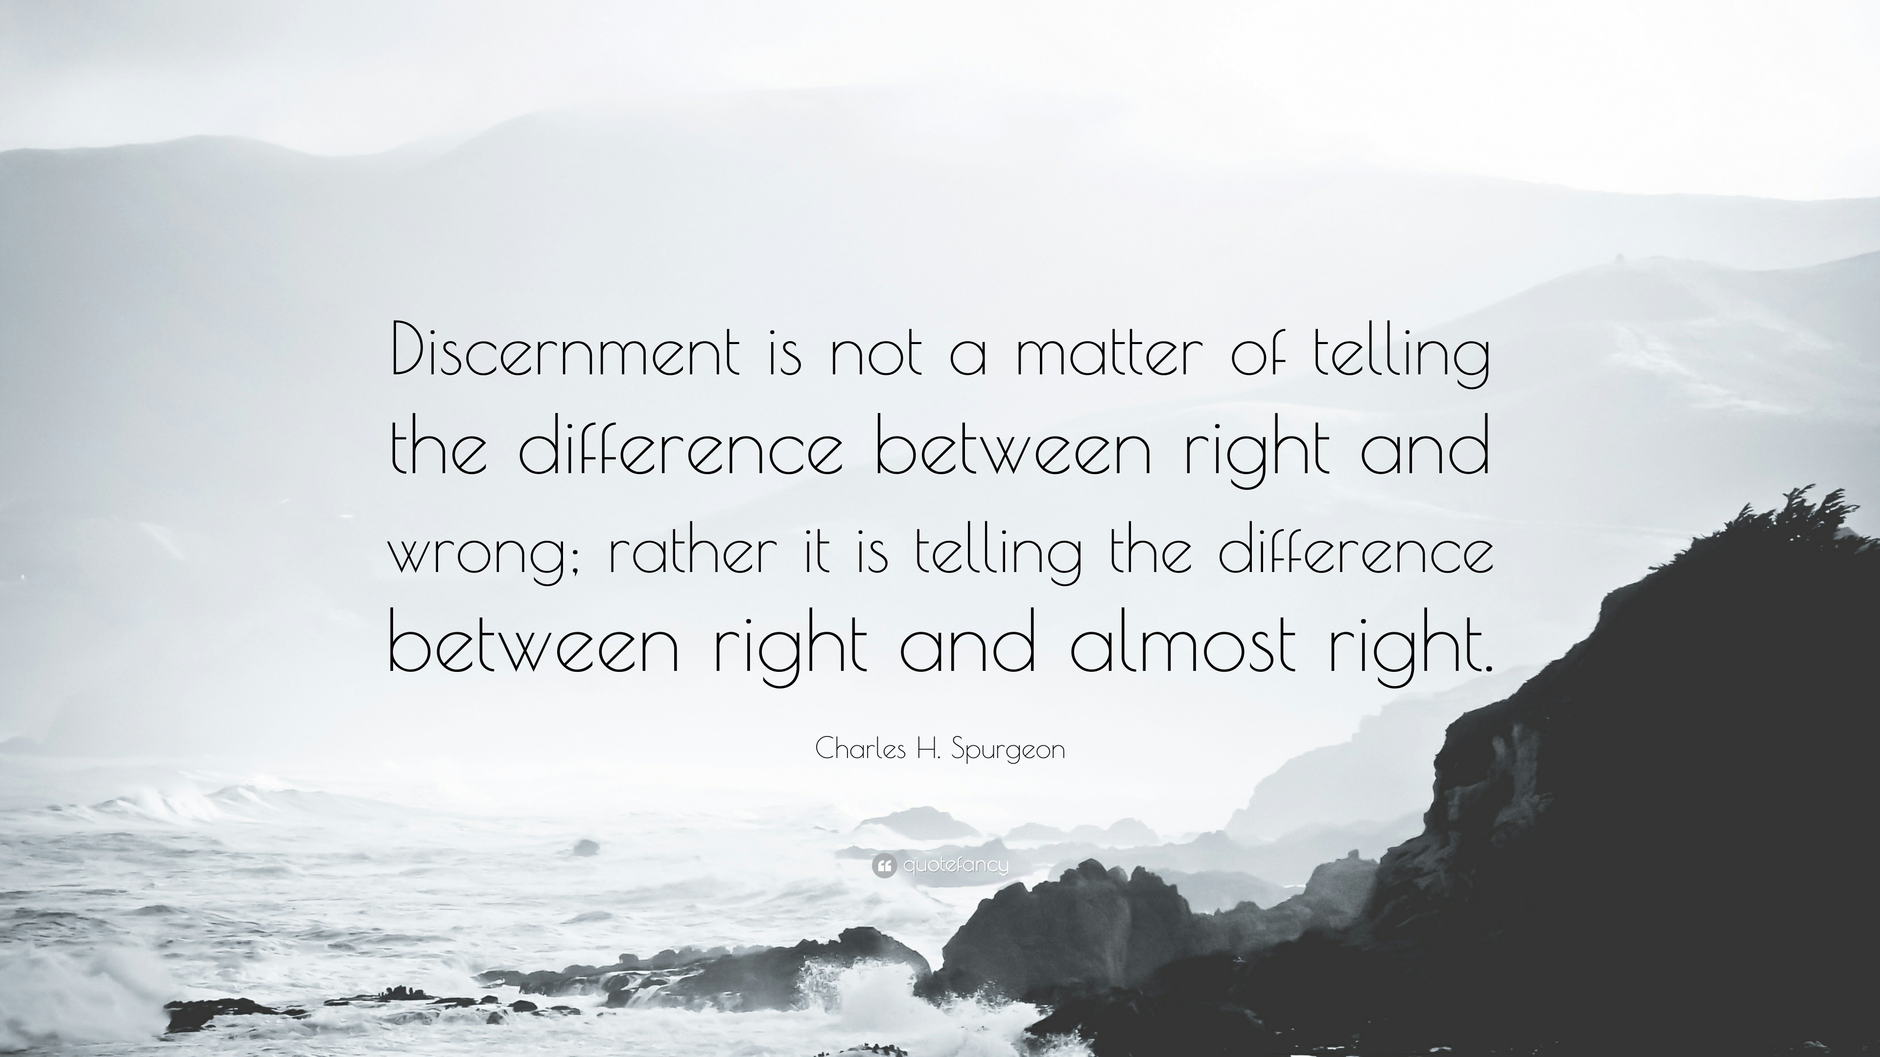
The theme for this half term: Dignity
The Equality and Diversity theme for this half term: Culture
The theme for this week: See, Judge, Act
Click below for the challenge of the day
https://youtu.be/QIEZTaEIQ0A
Click for the verses of the day
Word of the Day:
Merriam-Webster
Click for an extra prayer
Click for a prayer
Watch: Making wise decisions…
https://youtu.be/xQJ66sI-FR4

Slide 3
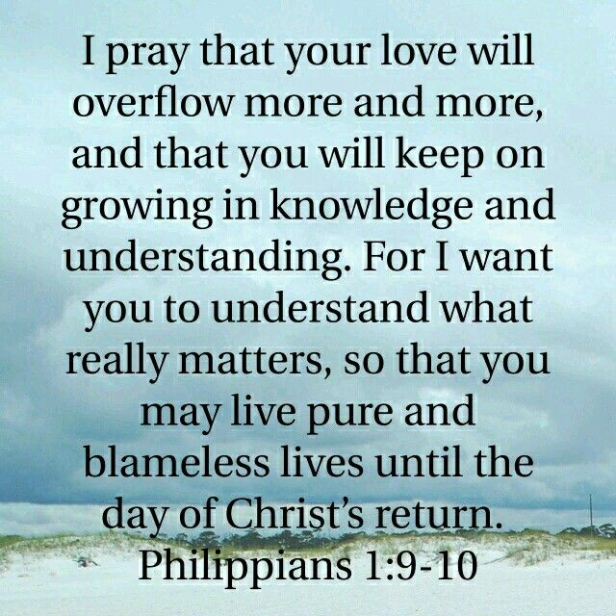
Click to go back
This was Paul addressing the community of believers living in a town called Philippi in North-Eastern Greece. Paul had been encouraged by what he had seen in Philippi. Believers were hospitable and generous and Paul was now encouraging them to keep growing in knowledge and understanding so that they get what ‘really matters’ and live ‘pure and blameless lives’
Questions of the day:
What really matters to you?
List the top five things you cannot live without
List the top five things you don’t want to live without
How do those two lists compare?

Slide 4
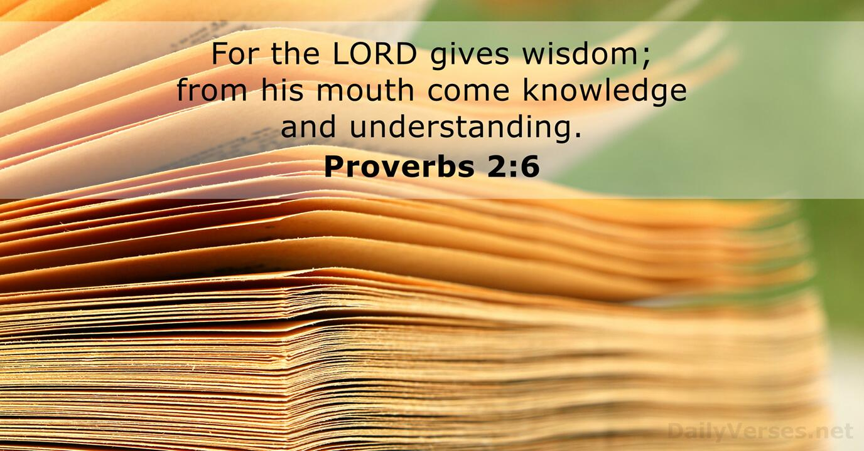
Click to go back
The book of Proverbs was written by King Solomon (Son of King David). He asked God for wisdom which God gave him in abundance – simply because Solomon asked for wisdom above material possessions. Here in Proverbs 2 we are reminded that it is God who gives wisdom. We can become wise by pursuing the correct application of knowledge, however, God gives wisdom without ‘finding fault’ (James 1:5)
Question of the day
What is one thing in your life right now for which you need wisdom?

Slide 5
Can you work out these synonyms for the word ‘discernment’ from their anagrams?
dement jug
judgement
Click for answers
do swim
wisdom
Click to go back
creep point
perception

Slide 6
Prayer for Wise Choices
God of wisdom
Thank you for the gift of today and for all the choices we will face. Help us to think before we act, to choose what is right even when it is hard and to learn from our mistakes when we get things wrong. Guide our minds and hearts so our decisions lead us toward kindness, honesty and growth.
Amen
Click to go back

Slide 7
Prayer for Discernment in Daily Life
Loving God
There is so much noise and pressure around us each day. Help us to slow down and listen carefully. Give us the discernment to tell the difference between what is helpful and what is harmful; between what builds us up and what pulls us down. May we choose paths that bring life, respect, and peace to ourselves and others.
Amen
Click to go back

Slide 8
Prayer for Learning and Understanding
God of truth
As we learn new things today, give us open minds and thoughtful hearts. Help us not just to gain knowledge but to grow in wisdom—to understand how to use what we learn for good. Teach us to ask good questions, to listen to others and to seek understanding rather than arguments.
Amen
Click to go back

Slide 9
Prayer for Courage and Guidance
Faithful God
We don’t always know which way to go. When we feel unsure or pressured by others, give us courage to stand for what is right. Guide us when decisions feel confusing and remind us that we are not alone. May your wisdom shape our choices and your peace remain with us throughout the day.
Amen
Click to go back

