Slide 1



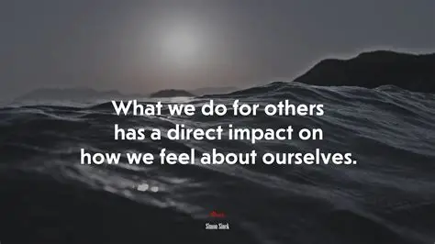

The theme for this half term: Dignity
The Equality and Diversity theme for this half term: Culture
The theme for this week: The Effect You Have On Others
Click below for the challenge of the day
https://youtu.be/sARqfl5W2H8
Click for the verses of the day
Careers – Guess my job!
https://youtu.be/GOsDShZFuBU
Click for an extra prayer
Click for a prayer
Watch: Our impact on others…
https://youtu.be/X3ld9_p2bS0

Slide 2


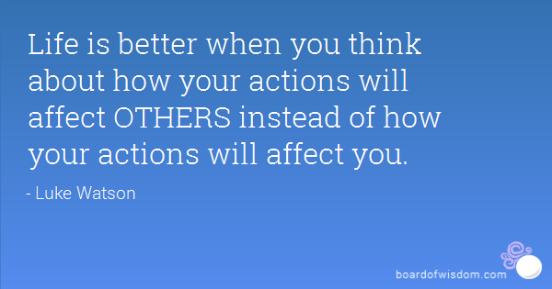
The theme for this half term: Dignity
The Equality and Diversity theme for this half term: Culture
The theme for this week: The Effect You Have On Others
Click for the challenge of the day
Click for a message from your Charity Officers
Click for the verses of the day
Word of the Day:
Merriam-Webster
Click for an extra prayer
Click for a prayer
Watch: Click for some thoughts from your chaplain on our impact on others

Slide 3
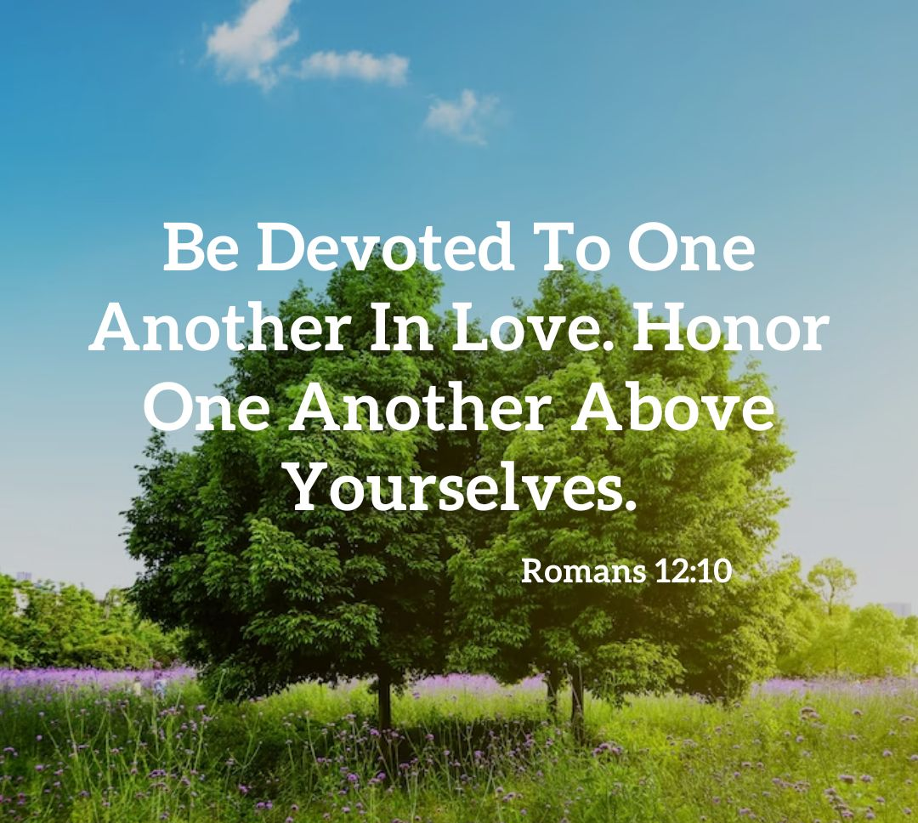
Click to go back
Click to go back
In the book of Romans, Paul was addressing both Jews and Gentiles (non-Jews) living in Rome. Paul spoke a lot to this group of people about faith and the righteousness of God. Here in the 12th chapter, Paul encourages them to be ‘devoted’ (loyal in love) to each other, putting others ahead of themselves. These days, I think this is more challenging than ever!
Question of the day:
Name 5 things you would like to own.
Would you buy those things for someone else?
Honour

Slide 4

Click to go back
Here, Paul is addressing believers living in Corinth (in Greece, west of Athens). Here he says let ALL you do be done with love. ALL. That’s everything. Everything we say, everything we do, everything we think. That is very challenging!
Question of the day:
Think back over your last few days. Can you remember and/or write down 5 good things and 5 bad things you did, said or thought?

Slide 5
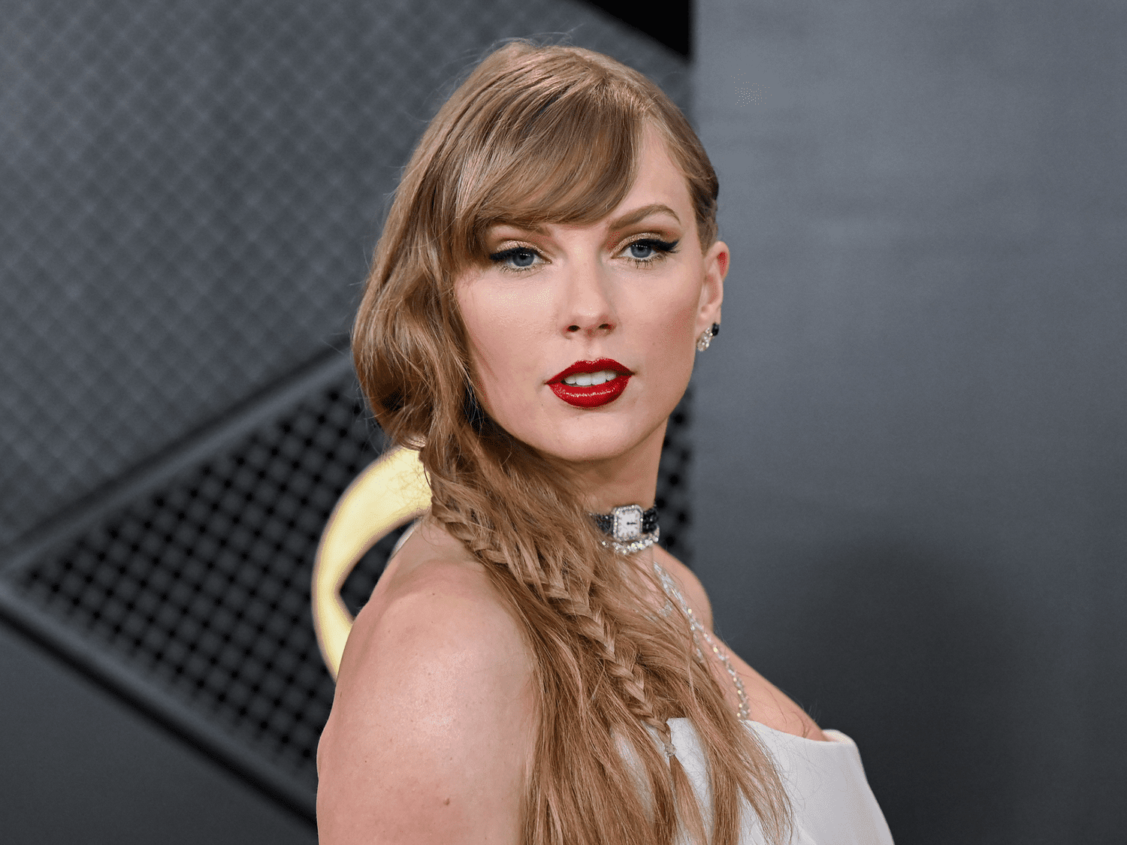
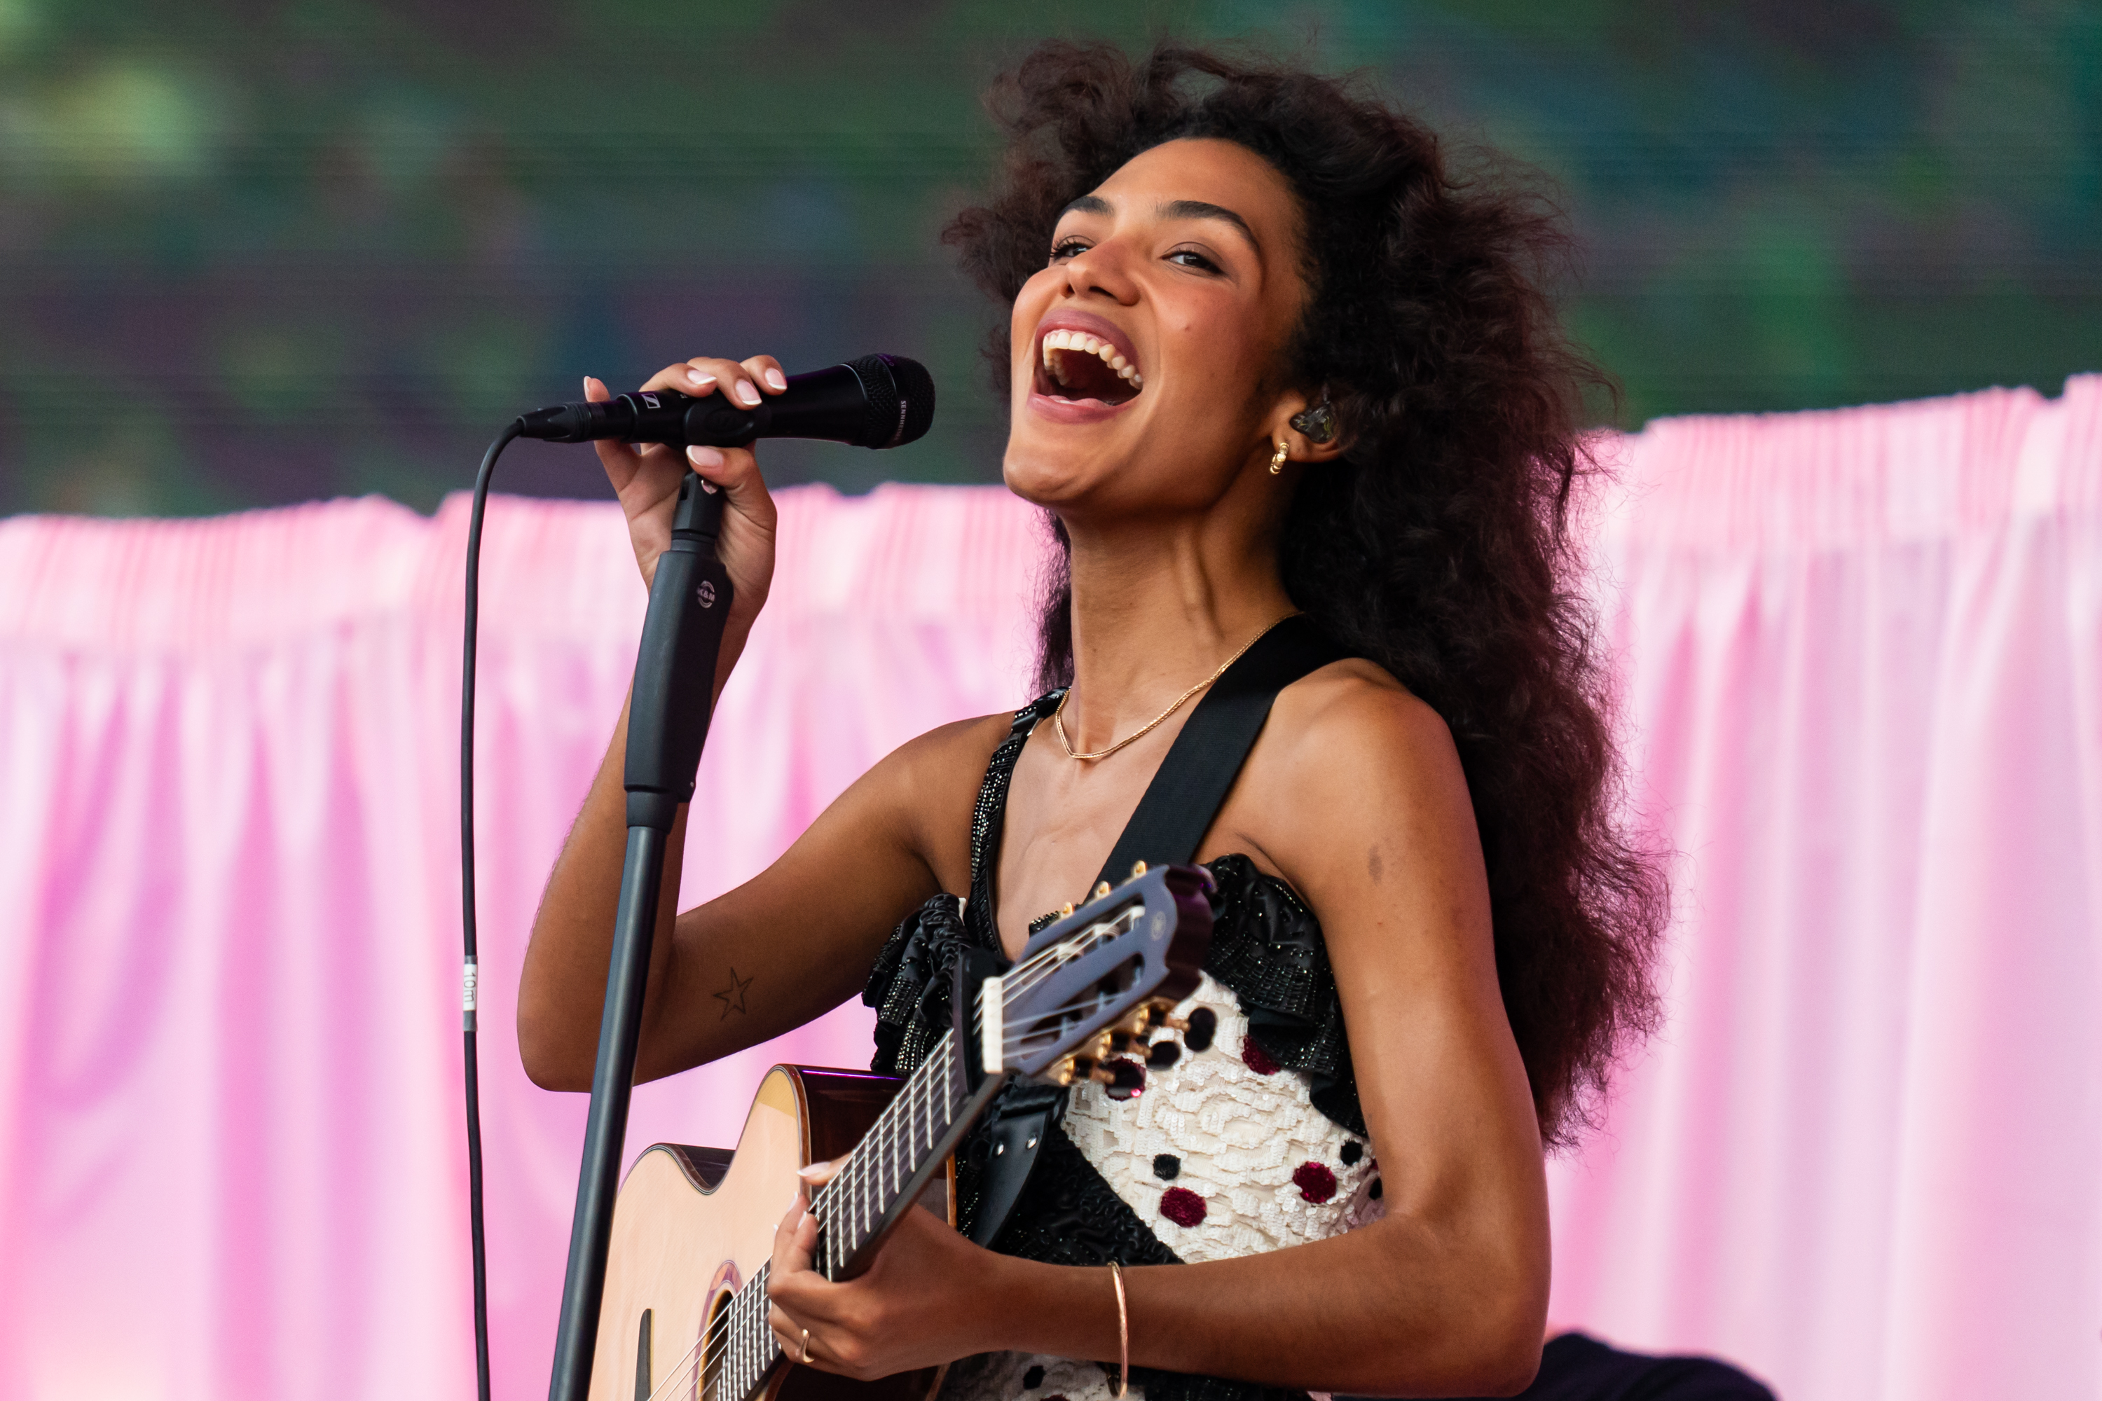
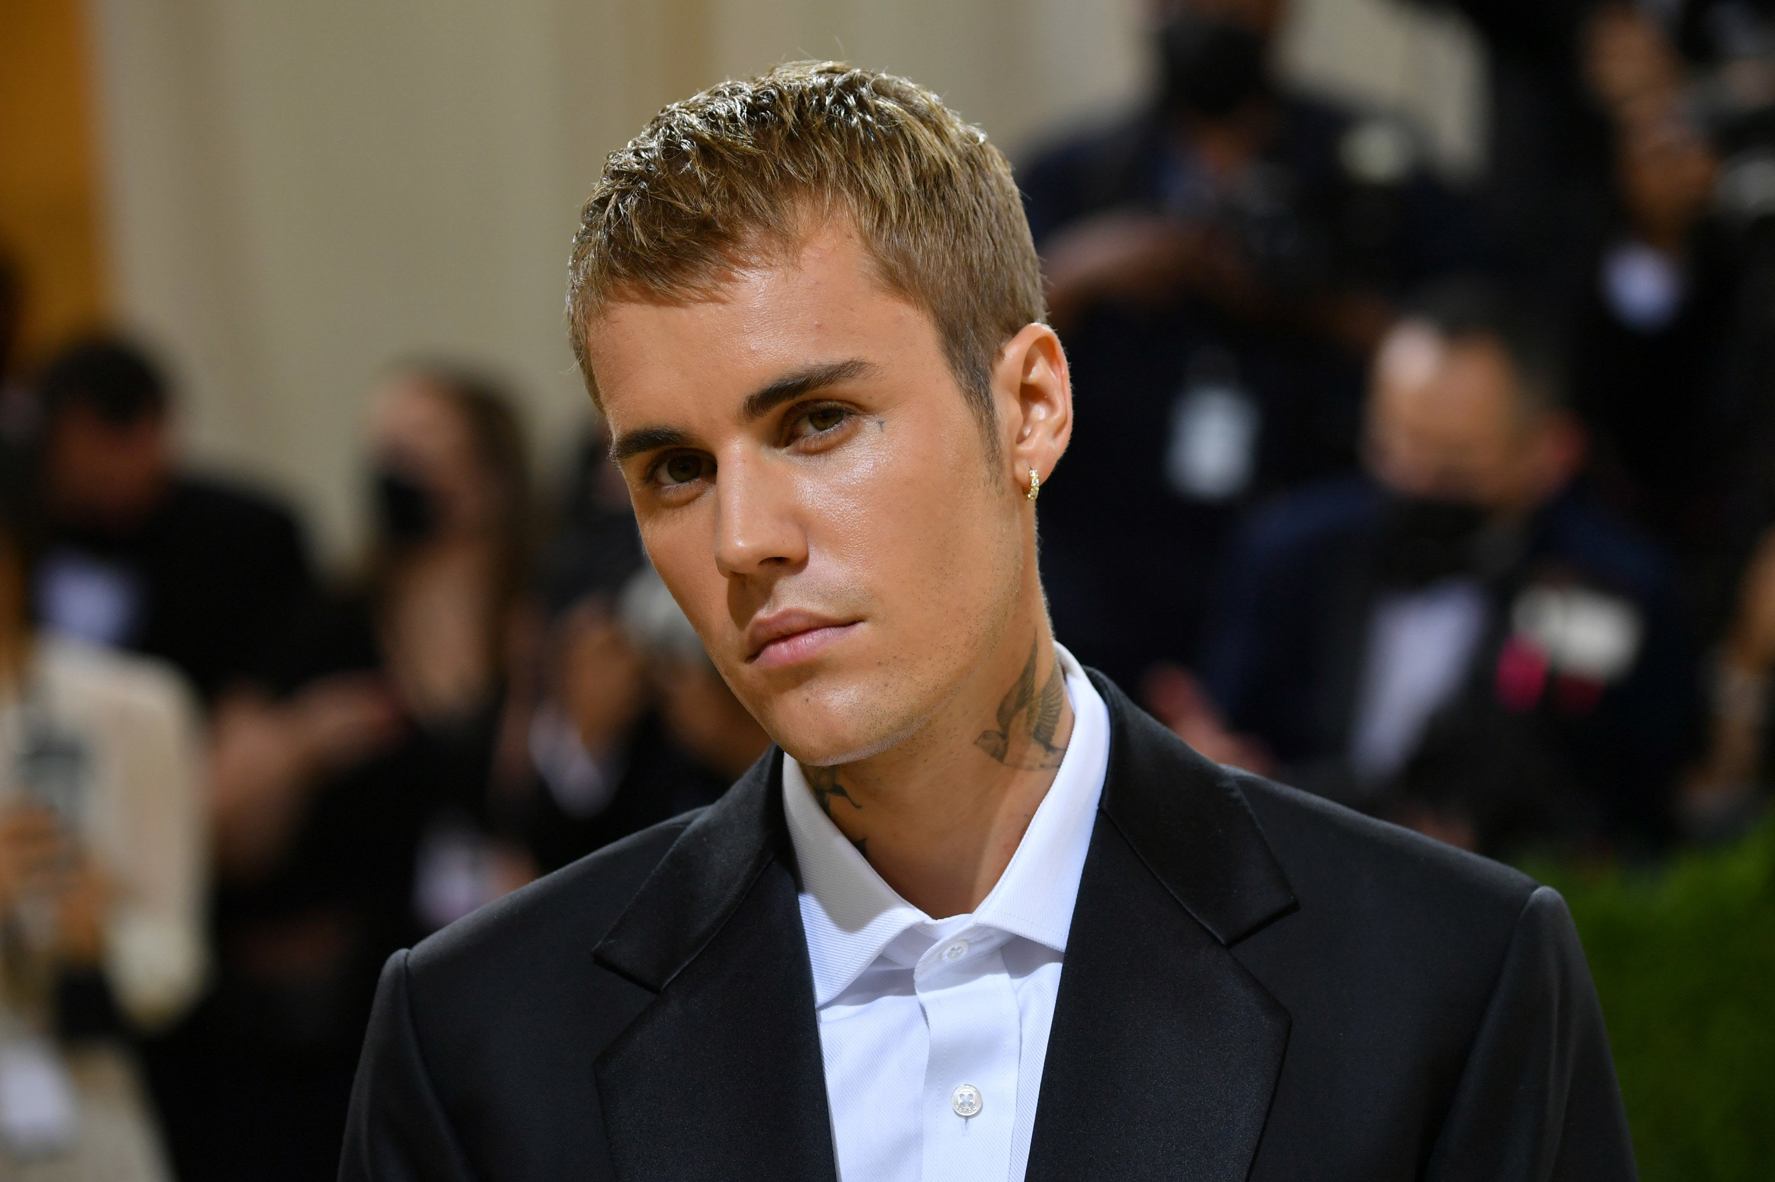
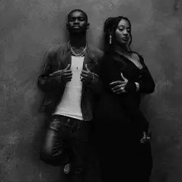
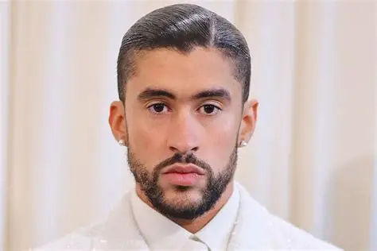
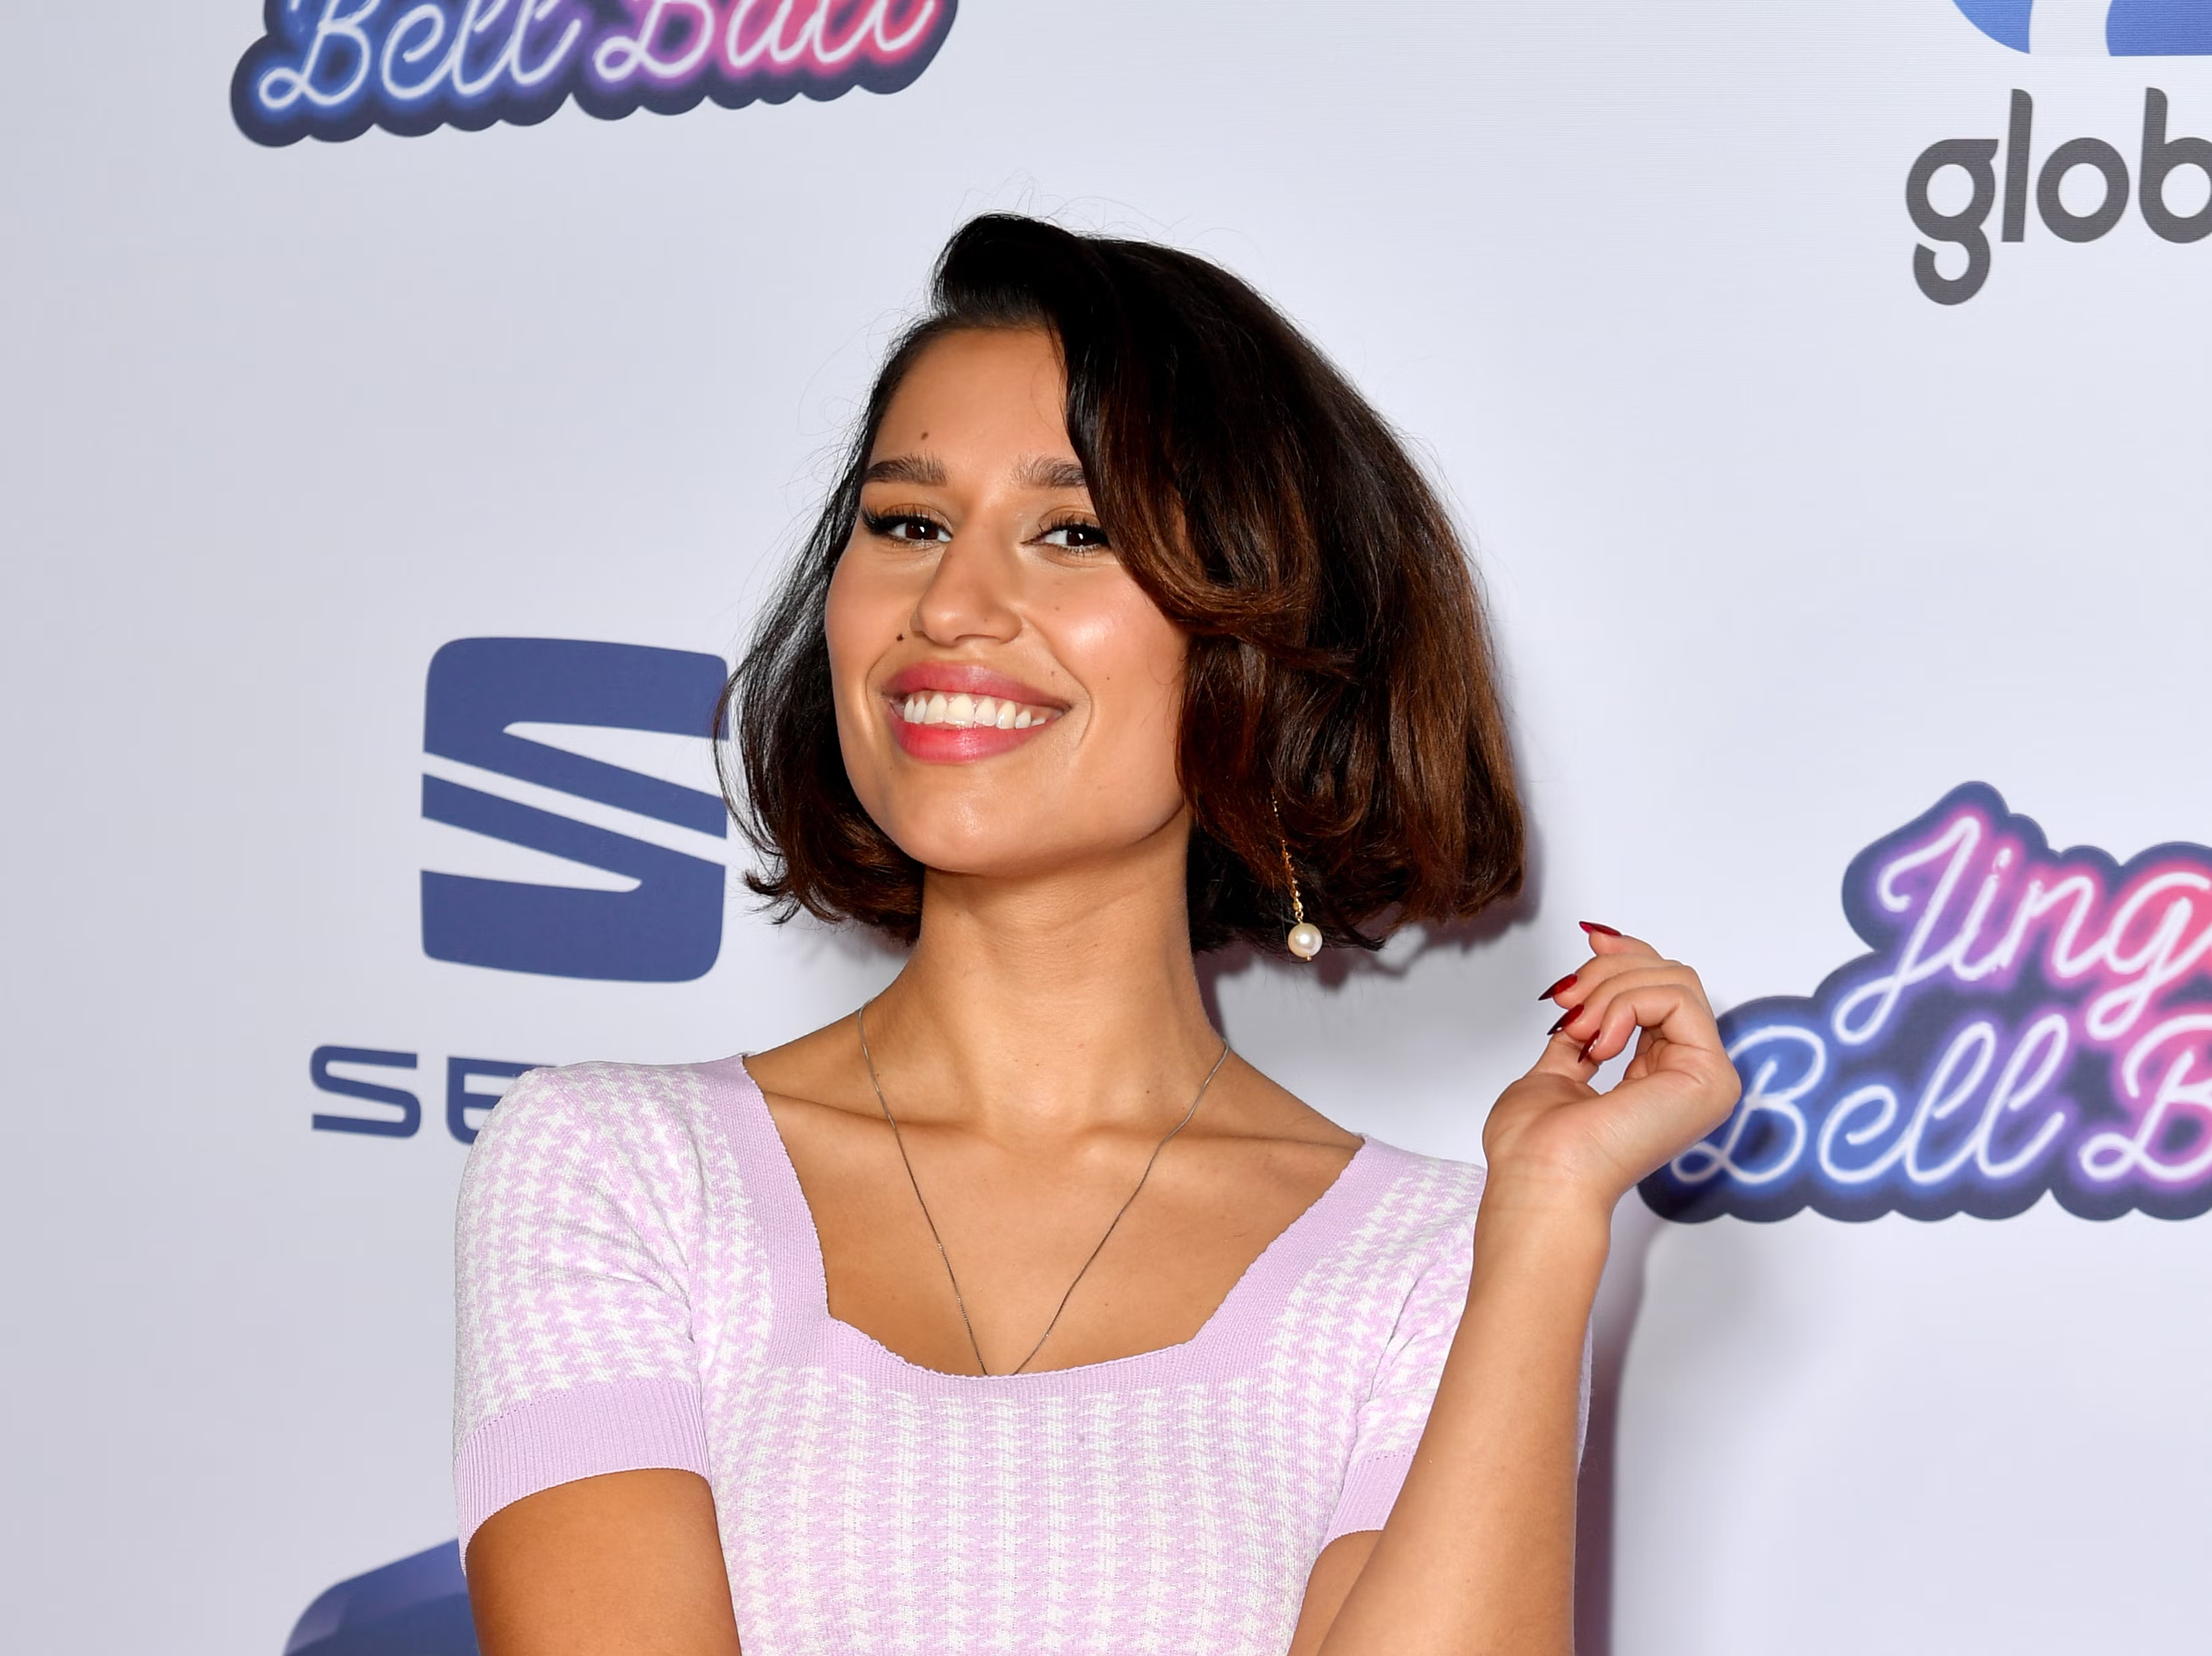
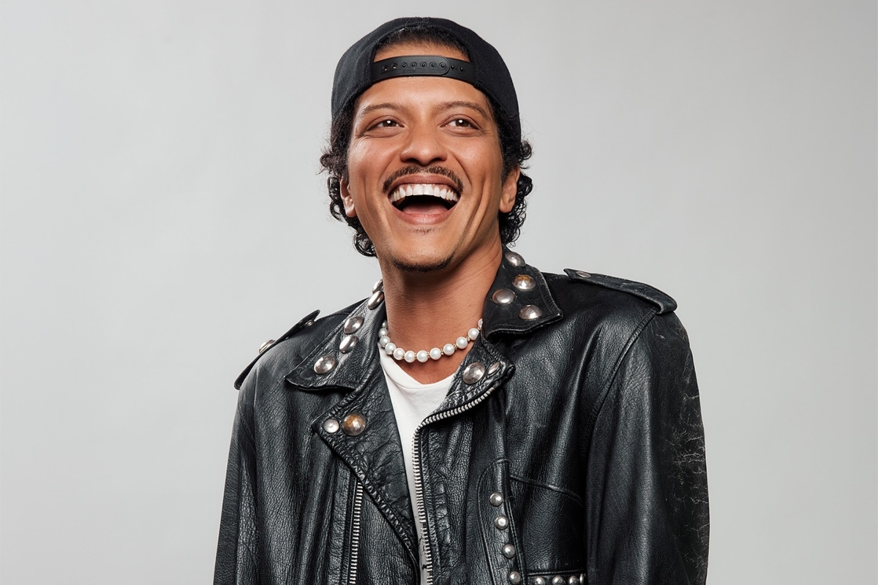

Here are 8 popular artists in 2026. Can you name them?
Click for answers
Click to go back
Taylor Swift
Olivia Dean
Justin Bieber
Dave & Tems
Bad Bunny
RAYE
Bruno Mars
Harry Styles

Slide 6
Making a Difference
Loving God
Thank you for the chances we have each day to make a difference. Help us to notice when others need kindness and give us the courage to act with compassion and care. May our words and actions bring hope and encouragement to those around us.
Amen
Click to go back

Slide 7
Choosing Kindness
God of love
As we learn and grow together, help us to choose kindness in how we speak and act. Teach us to respect each other, even when we disagree and remind us that small acts of goodness can make a big difference.
Amen
Click to go back

Slide 8
Being a Positive Influence
Lord
Thank you for the unique gifts each of us has. Help us to use our talents to support others and to be a positive influence in our school and community. May we lift people up, not put them down and always try to do what is right.
Amen
Click to go back

Slide 9
Caring for One Another
Faithful God
Help us to look beyond ourselves and to care for the people we meet each day. Give us patience, understanding, and empathy, so that everyone feels valued, included, and respected. May our school be a place where kindness shines.
Amen
Click to go back

Slide 10



