Slide 1

Year 10 Information Evening
Welcome
Thank you for being here – research shows parental engagement over a student’s school career is equivalent to adding three years progress to that student’s education

Slide 2

Year 10 PPEs – are they important?
Experience – only time you will practice exams in the ball hall
Habits – allows you to test what revision strategies are effective
Over half-way through GCSE course (had 40 weeks of GCSE teaching, 40 weeks remain)
To identify areas you need to improve to ensure success at GCSE
To allow teachers to know your strengths and weaknesses to tailor Yr 11 lessons to your needs

Slide 3



Revision?
Transforming or recalling the information e.g. retrieving
Active Revision?
Copying, watching, or reading information without changing it e.g. writing out notes from iPad
Passive Revision?
Active revison is much more effective.

Slide 4



3 most effective revision strategies?
Flashcards
Mind Mapping
Self-quizzing (retrieval practice)

Slide 5
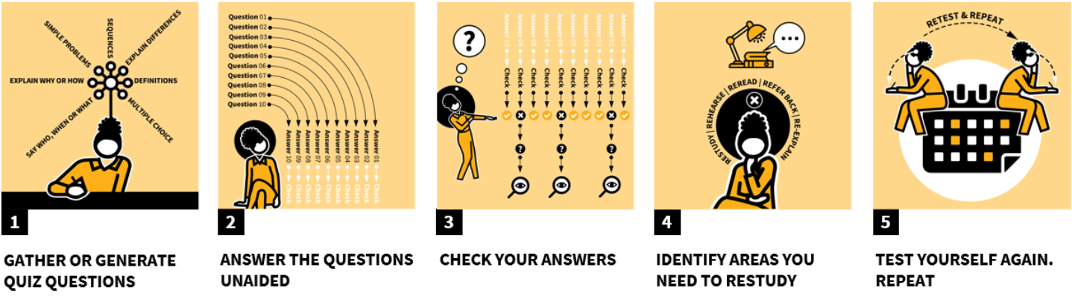
Revision Success – Retrieval Practice
Quiz yourself, check your answers, repeat!
All quizzes on iPad TEAMS for each subject

Slide 6
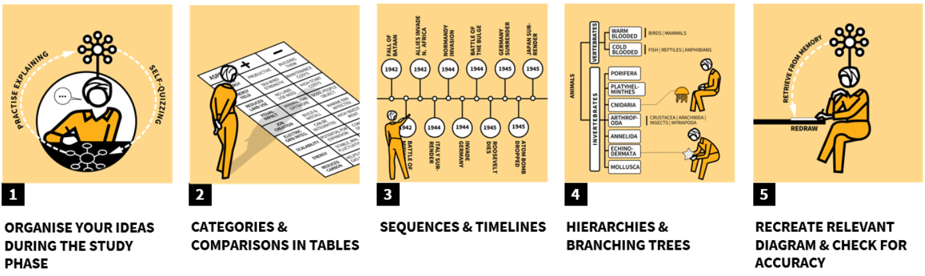
Revision Success – Mapping
Complete from notes, making connections and summarising (not copying)
Recreate without notes and then review, adding in any missed knowledge

Slide 7
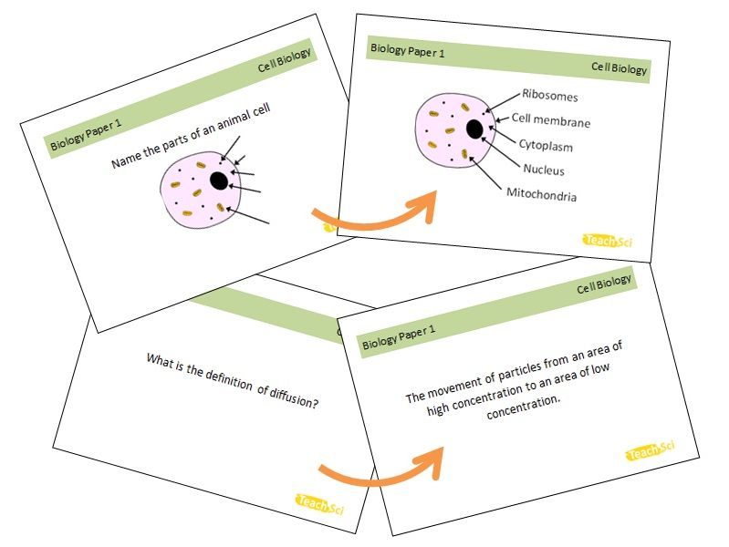
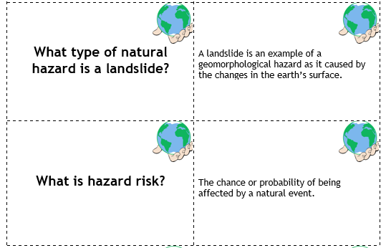
Revision Success - Flashcards
Prompt on one side that requires you to think of a specific answer, answer on the other side

Slide 8
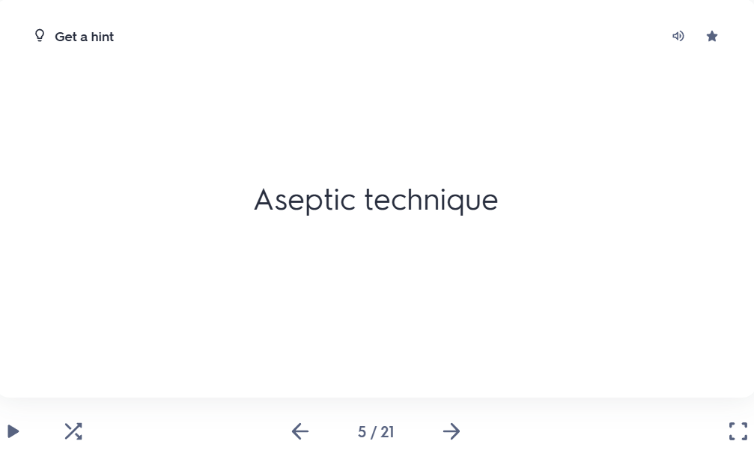
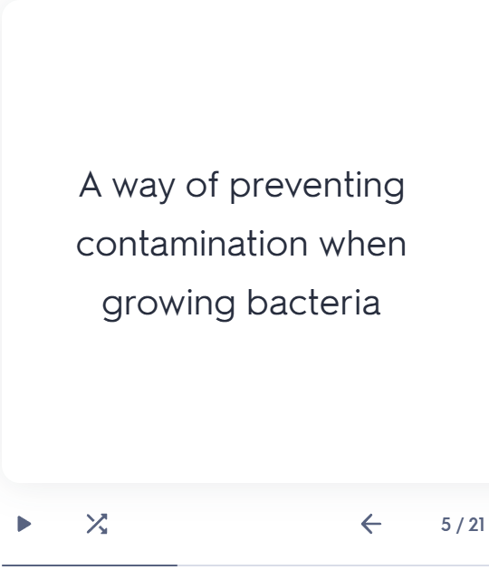
An effective flashcard
Notes:
Effective – tests specific piece of knowledge (definition of technique)

Slide 9
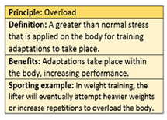
A non-effective flashcard
Overload
Notes:
Not – effective – too much to check knowledge, overloaded. Not a precise question / knowledge check
To improve – split into 3 flashcards, one for definition, one for benefits, one for sporting example

Slide 10


Flashcard Creation
Decide if you prefer physical flashcards or goodnotes app flashcards
Select a single piece of knowledge
Turn the knowledge into a question and write on one side of flashcard
Write a short and clear answer to the question
Notes:
Use the English handout of the knowledge organiser to find information – link with checking off on a PLC

Slide 11
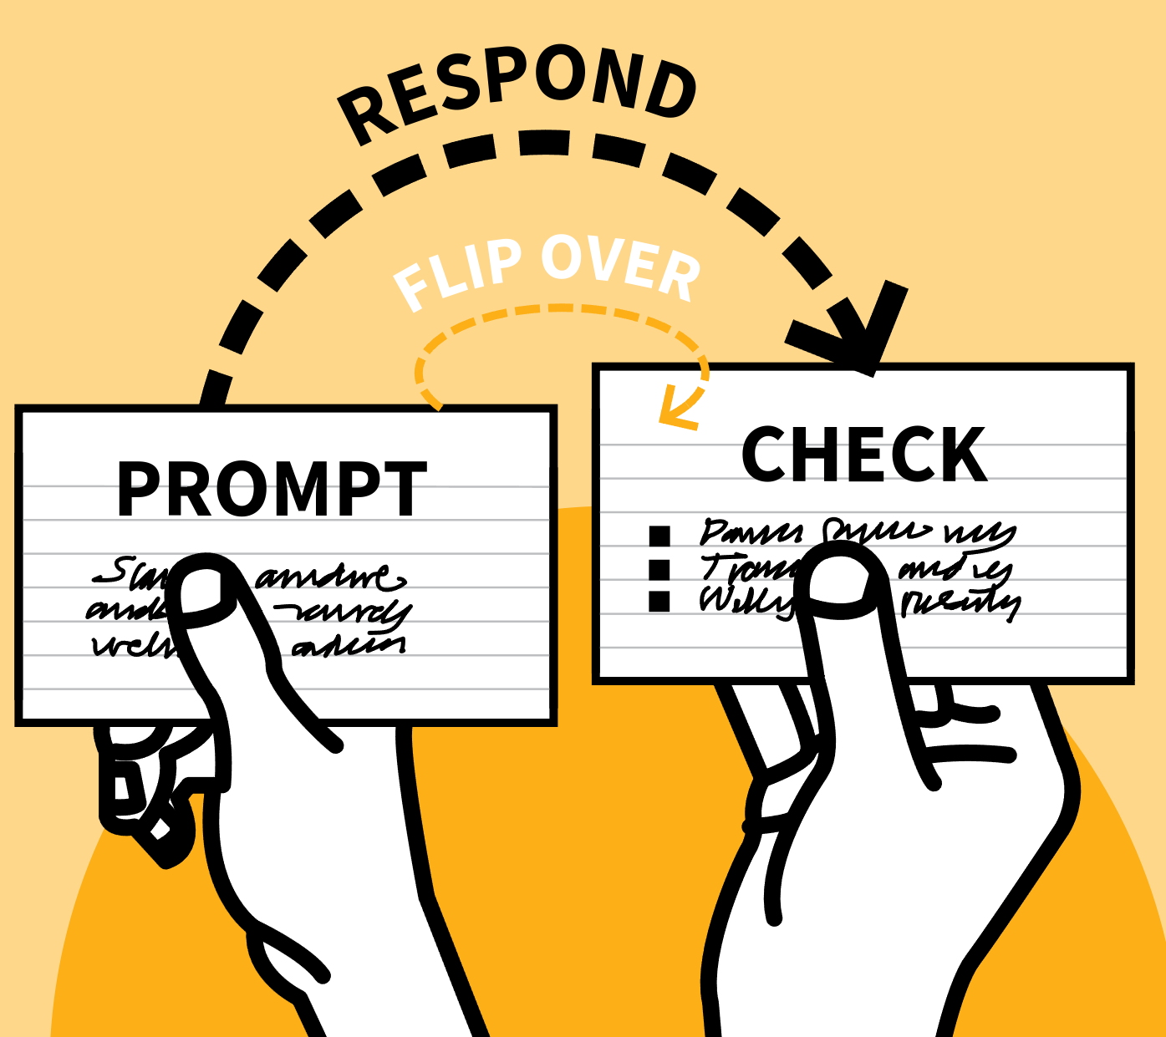
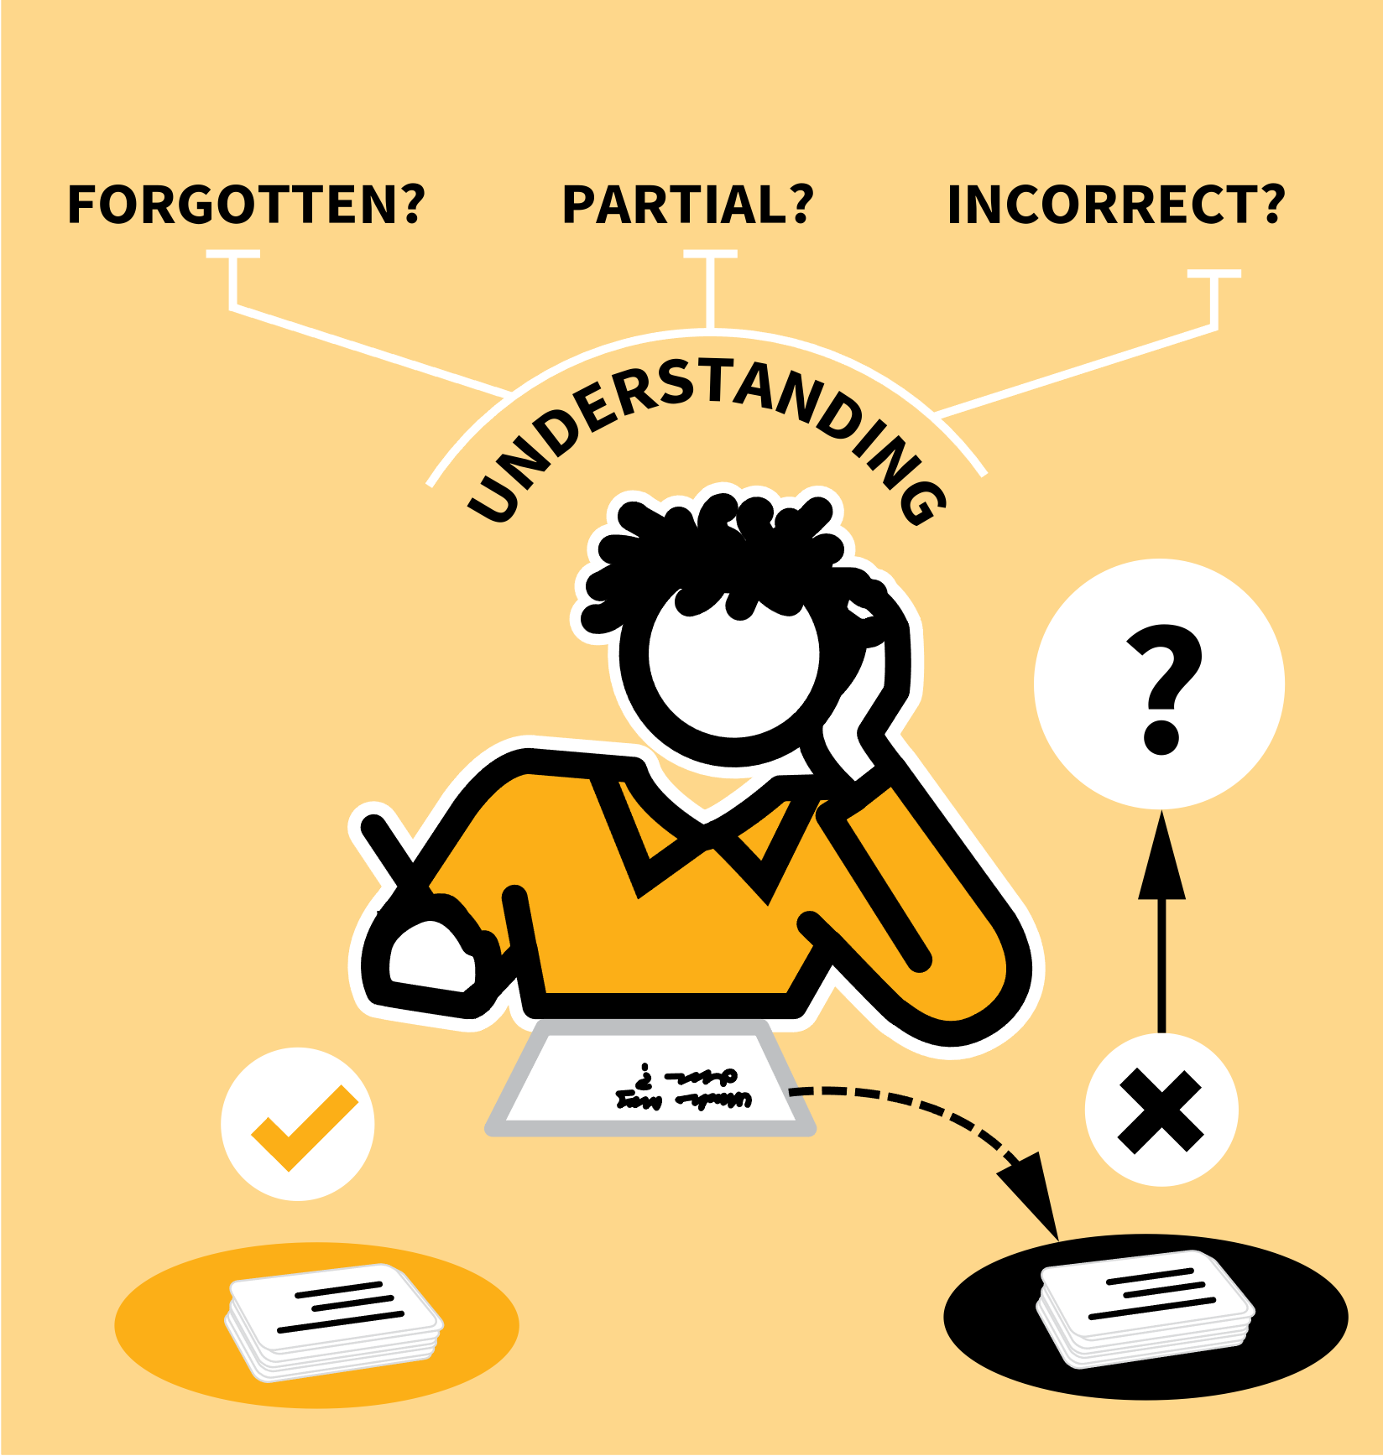

Revision Success - Flashcards
Time to be tested!
Two piles: those you got right and those you got wrong, repeat wrong pile more often (remember to shuffle), still repeat testing with ones you got right

Slide 12
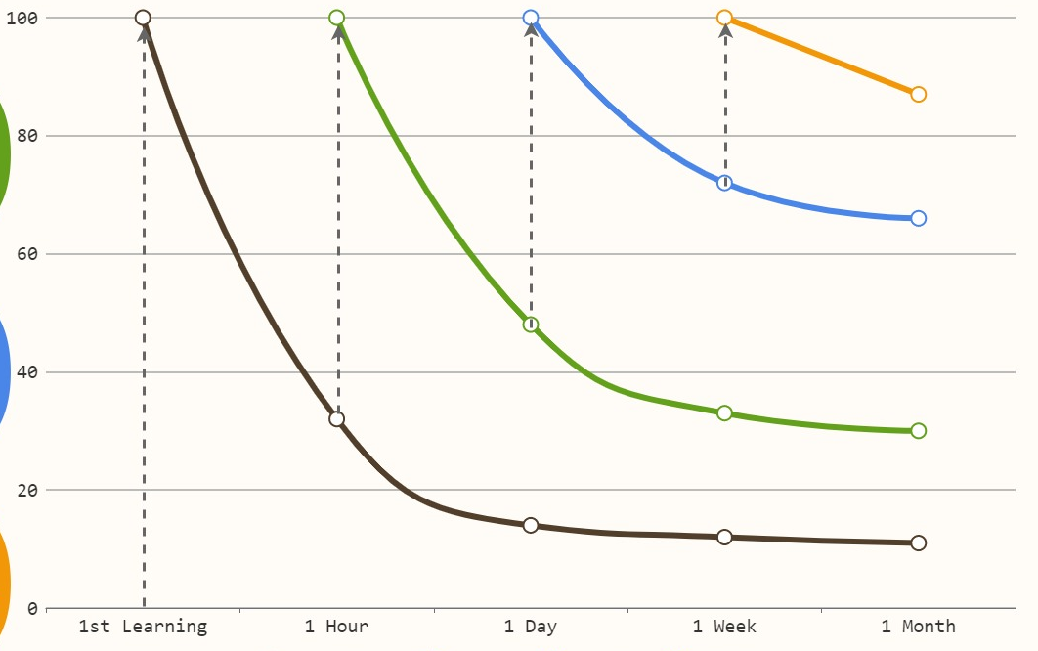
Forgetting Curve?
2nd time revising
Roughly what GCSE grades does each % remembered equal?
1st time learning
1st time revising
3rd time revising
Grade 8/9
Grade 5/6
% of information remembered
Notice how the more you revise the information the quicker the amount you remember increases
Grade 3
Grade 1/2
What does this tell us about revising for the Year 10 PPEs?
Time since being taught information
Notes:
According to Ebbinghaus’ research, when you learn something for the first time — say, in a lesson — you forget up to 85% of it within 24 hours if you don’t revisit it.Not because you’re lazy.Not because you’re bad at revision. But because that’s how the human brain works.
Think of your lessons as the first time information enters your brain.
You learn it. You understand it. It makes sense.
But if you don’t look at that information again, the forgetting curve kicks in immediately.
That’s why, by the time you get to the end of the unit, the topic test, or your Year 10 PPEs, you often say things like:
‘I remember doing this… but I don’t remember HOW to do this.’
That’s exactly the forgetting curve in action
So when we encourage you to take PPEs seriously — in Year 10 and Year 11 — it’s not because we care about the grades on that piece of paper.
It’s because every time you revise, you’re beating the forgetting curve.
Every revision cycle makes the real GCSEs easier.
Your lessons are the first layer.
Year 10 PPE revision is the second layer.
Year 11 Autumn PPE revision is the third layer.
GCSE revision is the final layer.
That’s how you build a memory that lasts long enough to get you the grades you want.

Slide 13
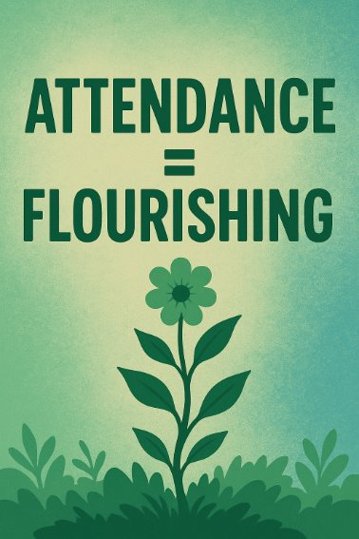
Key Characteristics of Successful Year 10s
For students with above 95% attendance:​
71% more likely to get at least 5 qualifications at grade 5 or higher including English and Maths
88% more likely to get grade 5 or higher in both English and Maths​

Slide 14
Preparing for PPEs (mocks)
14th April – 21st April
Arrive at school as usual at 8:40 as normal every day.
Students will be dismissed from school site at the end of afternoon exams (if they have no afternoon exam they will be dismissed at 12:40 at the end of P3).
Full uniform, including their blazer, will need to be worn for all exams.
Notes:
With the right habits, support, and mindset, every student can succeed.

Slide 15




Preparing for PPEs (mocks)
Exam regulations are strict, and we practise these in PPEs to prevent disqualification from GCSE exams
Notes:
Talk through equipment / expectations / silent line up

Slide 16
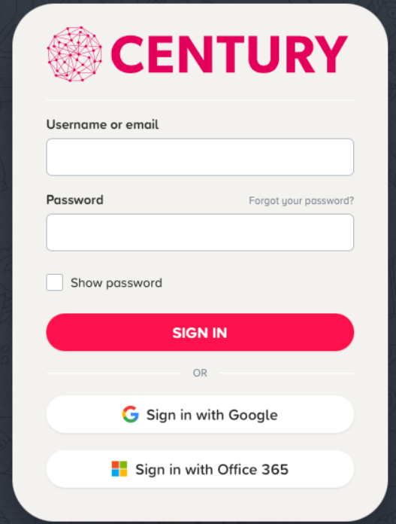
Century Platform
Personalised English, Maths, Science, Geography and PE revision
Identifies gaps in knowledge and areas for improvement – allows more effective teacher support
Research proves regular engagement with Century improves outcomes by 1.5 GCSE grades

Slide 17
Century Platform
In Safari go to ‘Century’
‘Sign in with Office 365’
Username = @office.holytrinitycrawely.org.uk

Slide 18
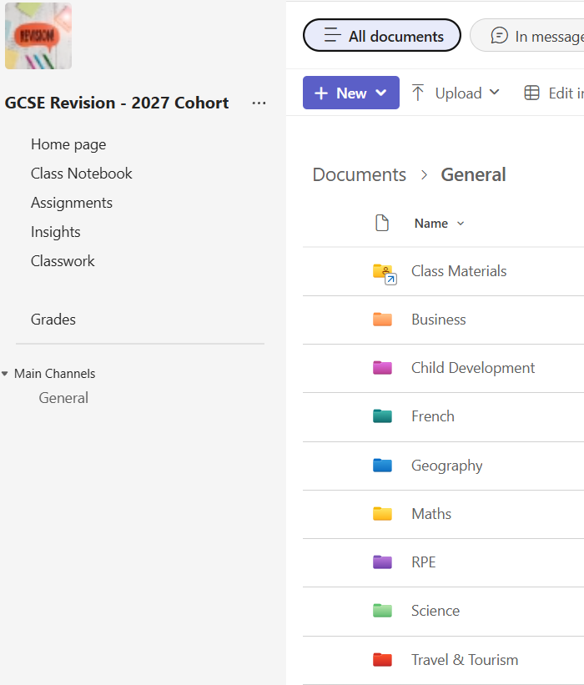
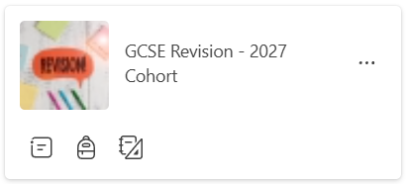
Revision and iPad
GCSE Teams
All resources on iPad – no need for any other technology
General | GCSE Revision - 2027 Cohort | Microsoft Teams
Notes:
State no phones during revision

Slide 19
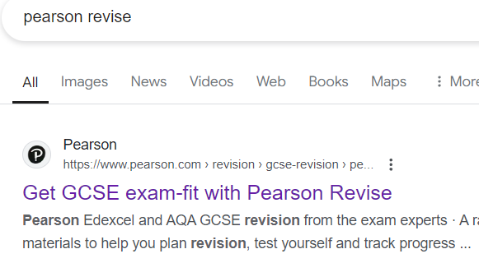
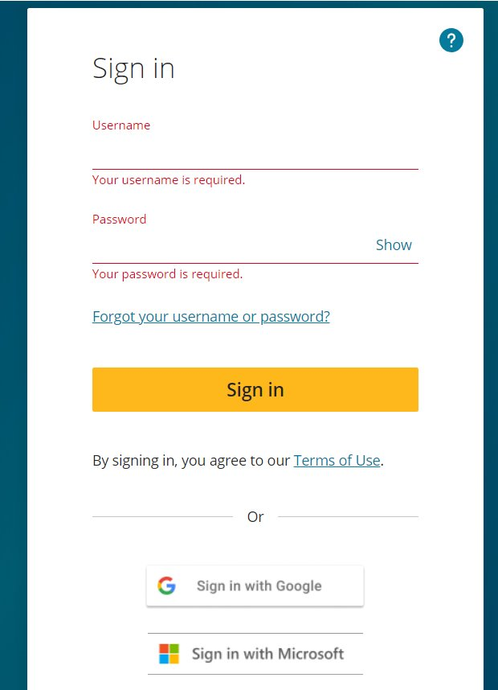

Revision and iPad
Pearson Online Revision Guides and flashcards
Click ‘sign in with Microsoft’
Log in with your office 365 account details
Username = @office.holytrinitycrawely.org.uk

Slide 20

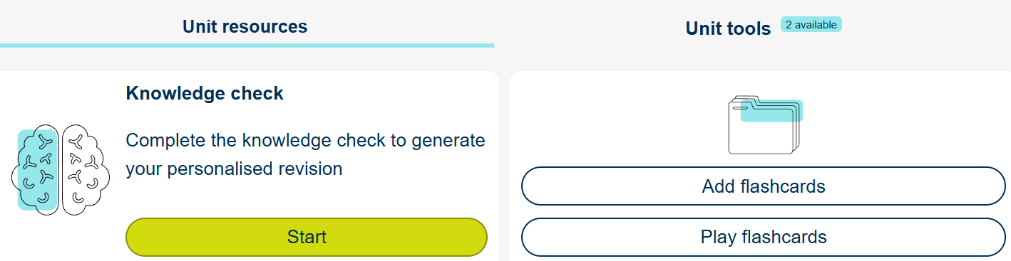
Revision and iPad
Pearson Online Revision Guides and flashcards for majority of subjects (free)

Slide 21
Student Wellbeing
During the exam period, our young people will often feel intense pressure from school, home, peers and themselves.
Focus on emotional support first.
Be mindful of what helps and what to avoid e.g.
Let them know your love isn't tied to results.
Listen more than you advise.
Notes:
CSS – 2 minutes

Slide 22
Student Wellbeing
Help create structure.
Do they need support in creating a revision timetable?
Ask them how you can support their study time.
Let them take ownership.
Homes can be busy places, can you help make the home a calm study space.
Reduce noise during study times.
Keep distractions (TV, loud calls) minimal.
Encourage good sleep.
Notes:
CSS – 2 minutes

Slide 23
Student Wellbeing
Support healthy stress management
When they get stressed at home the following tools might be helpful.
Deep breathing (4-4-4 method)
Short exercise breaks
Talking through worries
Perspective reminders (one exam doesn't define you)
Notes:
CSS – 2 minutes

Slide 24
Student Wellbeing
Be alert to signs of pressure and praise the effort as well as the outcome.
Watch out for sleep issues, mood swings, tearfulness.
Let the Year 10 Pastoral Team know of your concerns.
Research shows that teenagers develop resilience when praised for..
Effort
Persistence
Notes:
CSS – 2 minutes

Slide 25
Key events
Monday 23rd March = Cultural Capital trips
Tuesday 14th April – 21st April = PPE exams
Thursday 3rd July and Friday 4th of July = Cultural Capital trips
Tuesday 9th June to Thursday 11th June = Onsite Work Experience called Project Pitch
Notes:
CSS – 2 minutes
Remind we are here to support your child and how to contact

