Slide 1
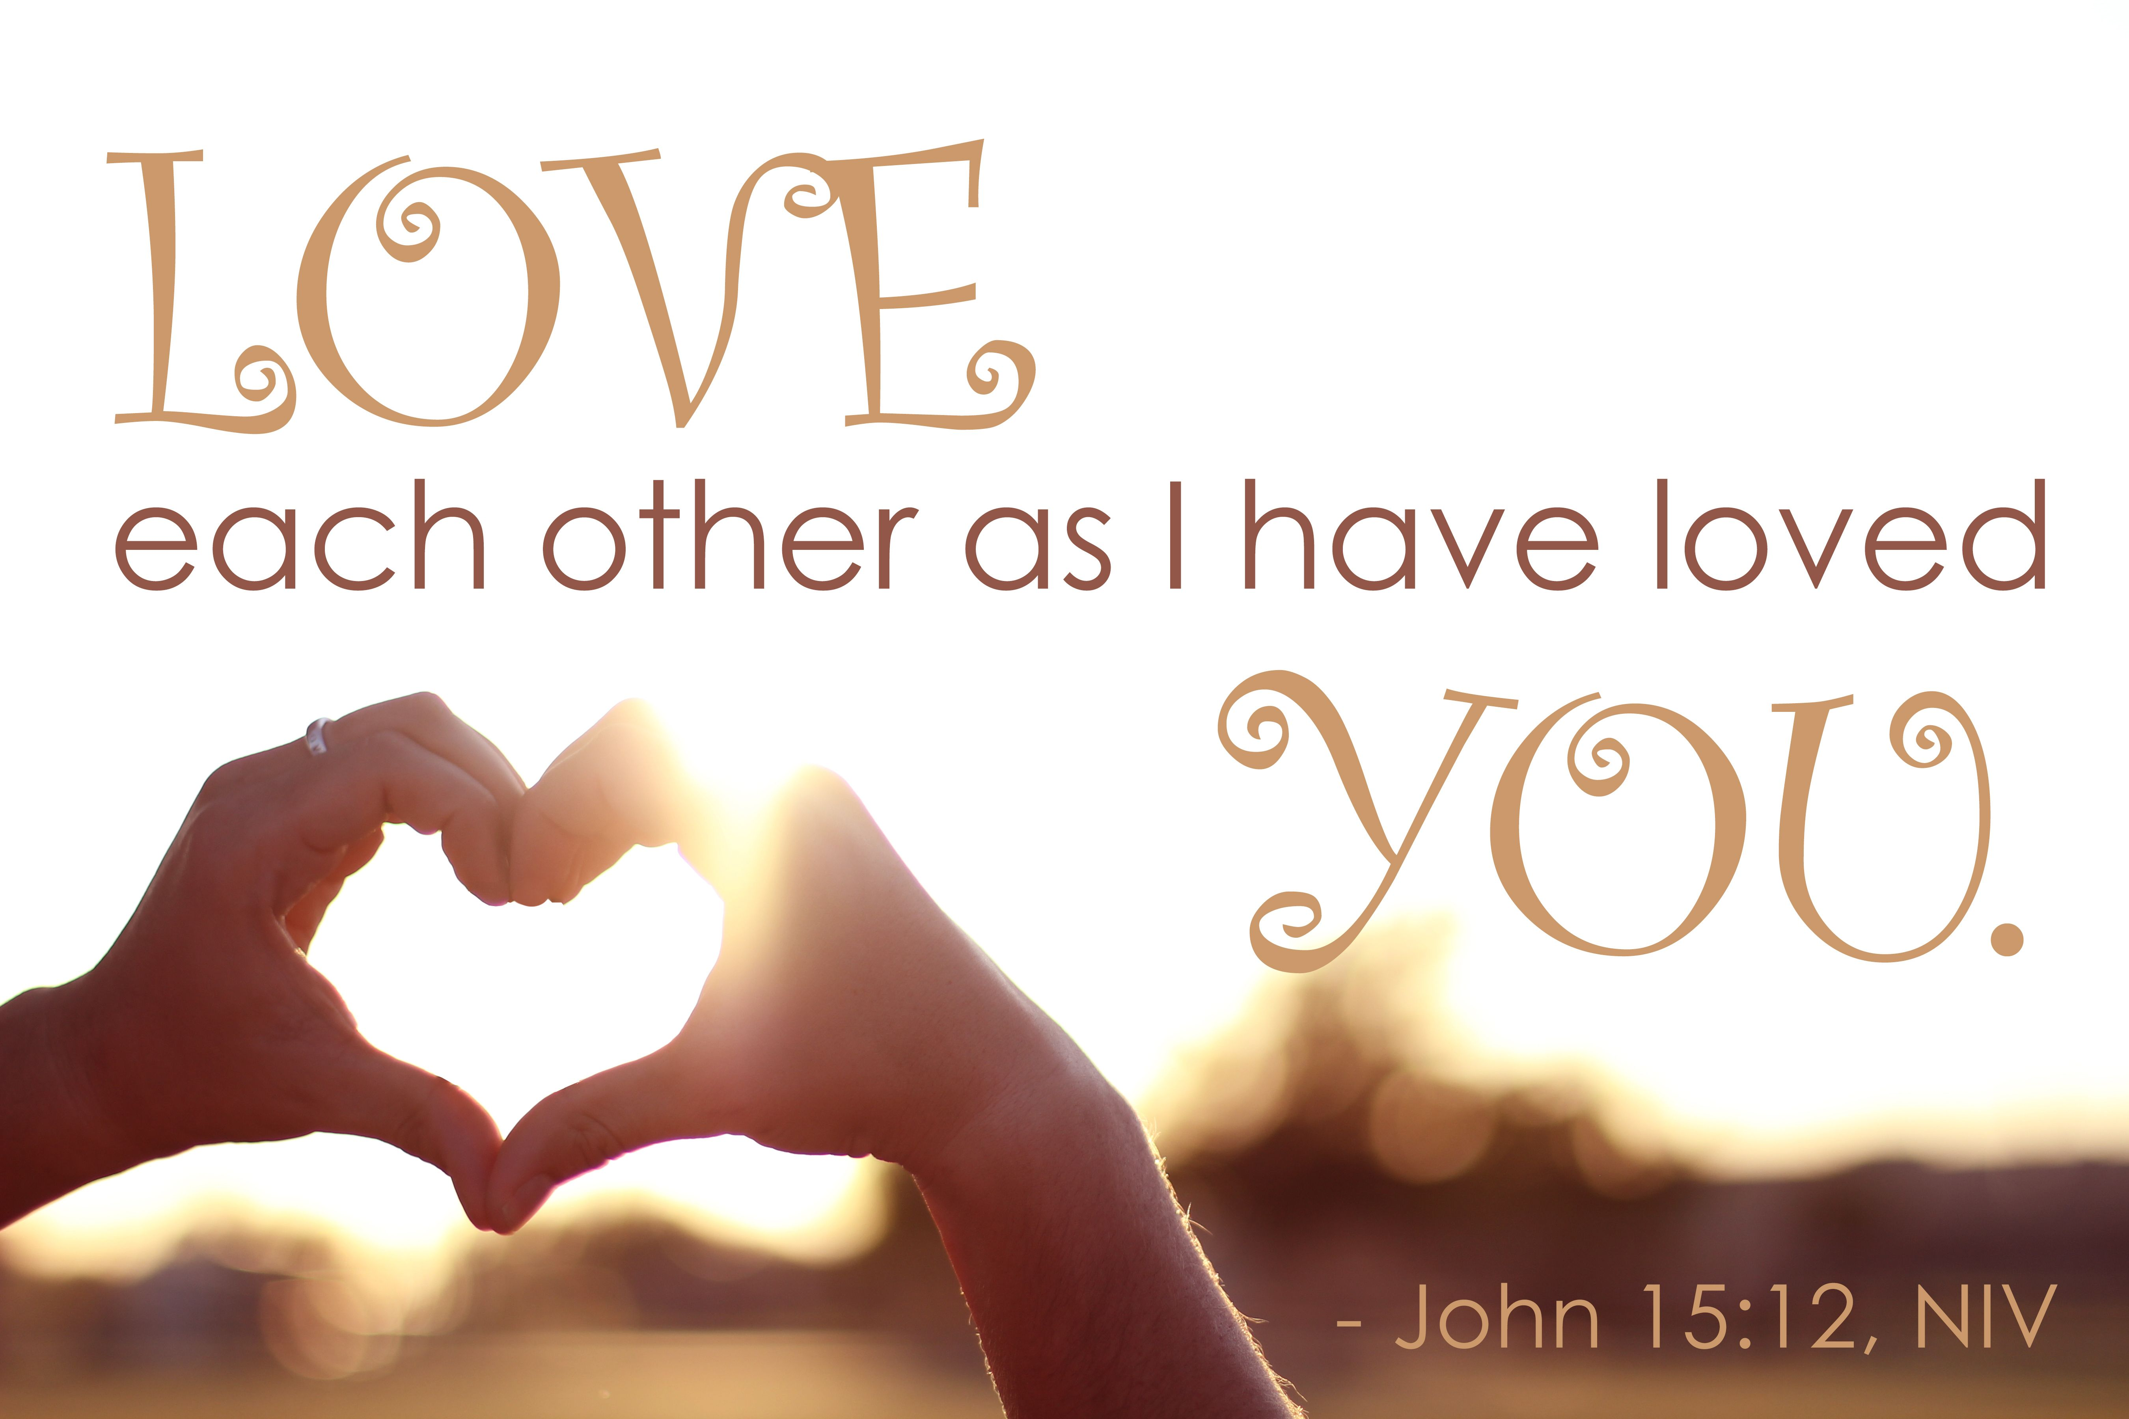


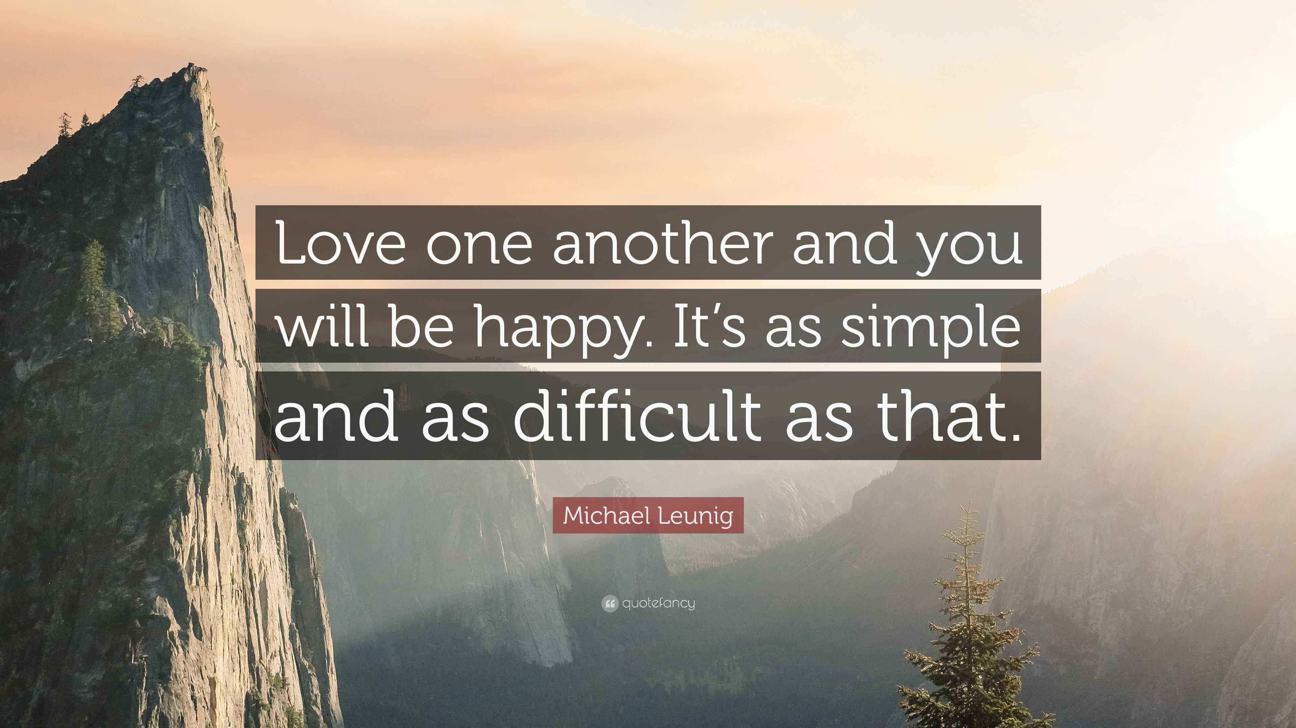

The theme for this half term: Dignity
The Equality and Diversity theme for this half term: Culture
The theme for this week: Love one another
Click for the challenge of the day
Click for the verses of the day
Careers – Guess my job!
https://youtu.be/A0P2oMaR--I
Click for an extra prayer
Click for a prayer
Watch: Click for some thoughts from your chaplain on loving one another…

Slide 2


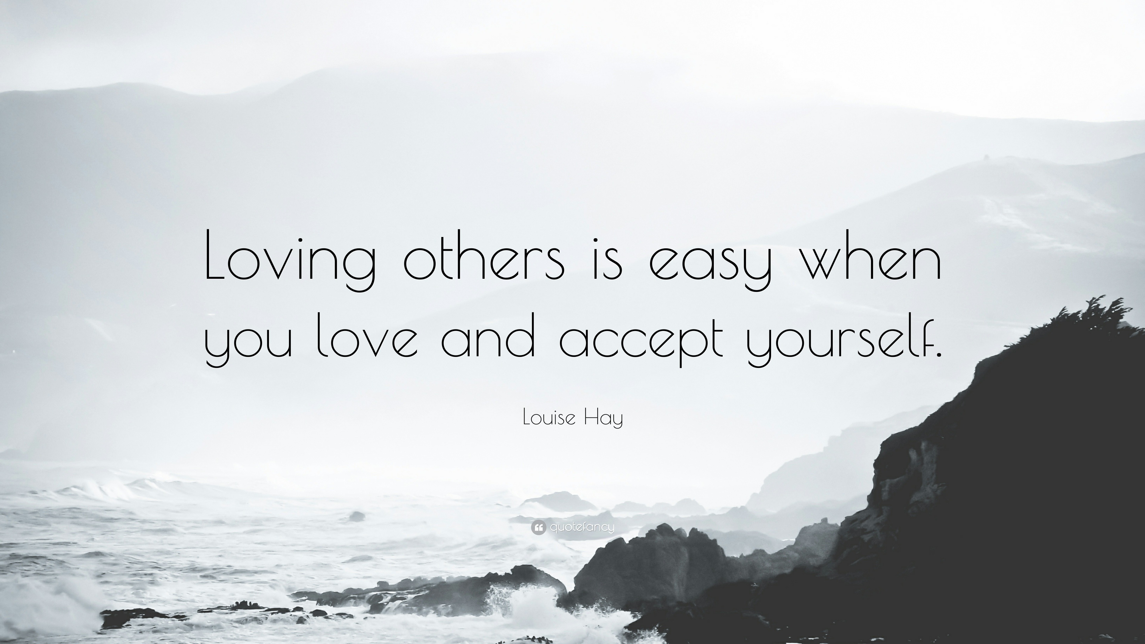
The theme for this half term: Dignity
The Equality and Diversity theme for this half term: Culture
The theme for this week: Love one another
Click for the challenge of the day
Click for the verses of the day
Word of the Day:
Merriam-Webster
Click for an extra prayer
Click for a prayer
Watch: Some simple thoughts on love…
https://youtu.be/NeW9IFxnWmo

Slide 3
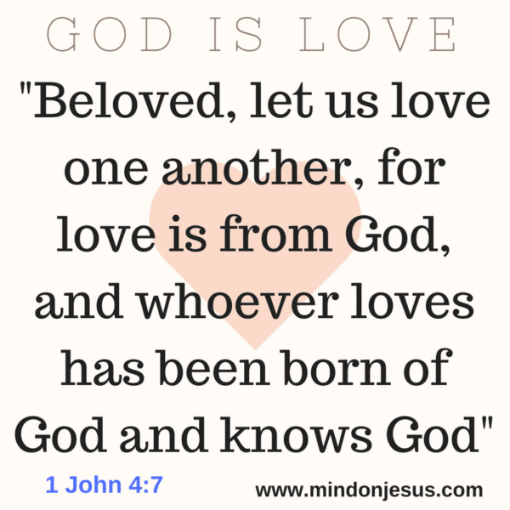
Click to go back
The Bible tells us that God is love. In other words, His very nature is pure love. This verse suggests that whoever understands what it means to love (God and others), has been born of God. This is part of a Christian’s belief – that we are born again when we choose to believe in God. Being born again means starting life again, but differently. We are born into a new life with God. One of love.
Question of the day:
Love is a choice. Do you agree?

Slide 4
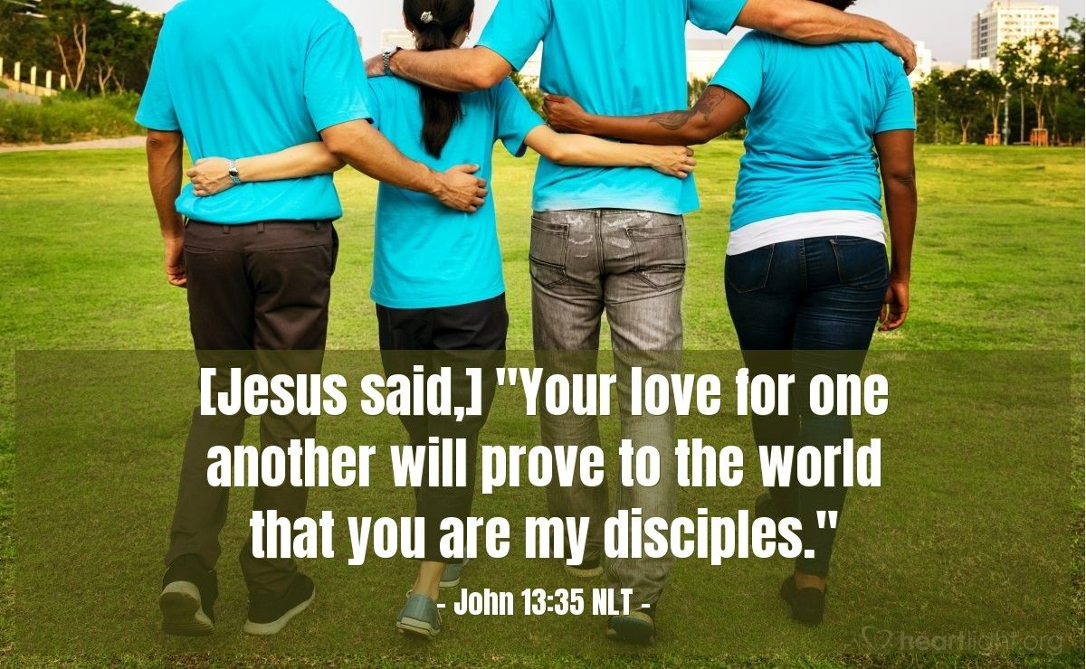
Click to go back
This verse follows on from the last discussion. People who believe in God should begin to understand what it means to love authentically. It requires a change of heart and a change of perspective and choice. When we choose to love and not hate, we are seen as different. That is what Jesus is saying here. This love ‘proves’ that we are followers or ‘disciples’ of God.
Question of the day:
What could you do today that shows love for someone else?

Slide 5
Can you fill in the missing words from this bible verse?
1 John 4:10
This is ____: not that we loved ____, but that he loved us and sent his _____ as an atoning __________ for our _____
Click for answers
love
God
Click to go back
son
sacrifice
sins

Slide 6
Can you work out these synonyms for love from their anagrams?
sender sent
tenderness
Click for answers
city main
intimacy
Click to go back
pie tropicana
appreciation

Slide 7
Click to go back

Slide 8
Prayer for Loving One Another
Dear God
Help us to see the best in each other, even when it’s difficult. Teach us to speak with kindness, to act with patience and to treat everyone with respect. May our school be a place where love grows through our words and actions each day.
Amen
Click to go back

Slide 9
Prayer for a Heart Like Yours
Loving God
Thank you for showing us what real love looks like. Help us to care for others the way You care for us. Give us courage to include those who feel left out and strength to forgive when we’ve been hurt. Shape our hearts to be more like Yours.
Amen
Click to go back

Slide 10
Prayer for Unity and Peace
God of peace
In a world where people are often divided, help us to be peacemakers. Guide us to listen before judging, to understand before arguing and to choose love over anger. Bring unity to our classrooms, our friendships and our whole community.
Amen
Click to go back

Slide 11
Prayer for Loving God
Father God
Thank you for your constant love in our lives. Remind us to trust You when things are tough and to be grateful when things go well. Help us to love You with our whole heart and to show that love by the way we treat others. Stay close to us today and always.
Amen
Click to go back

