Slide 1
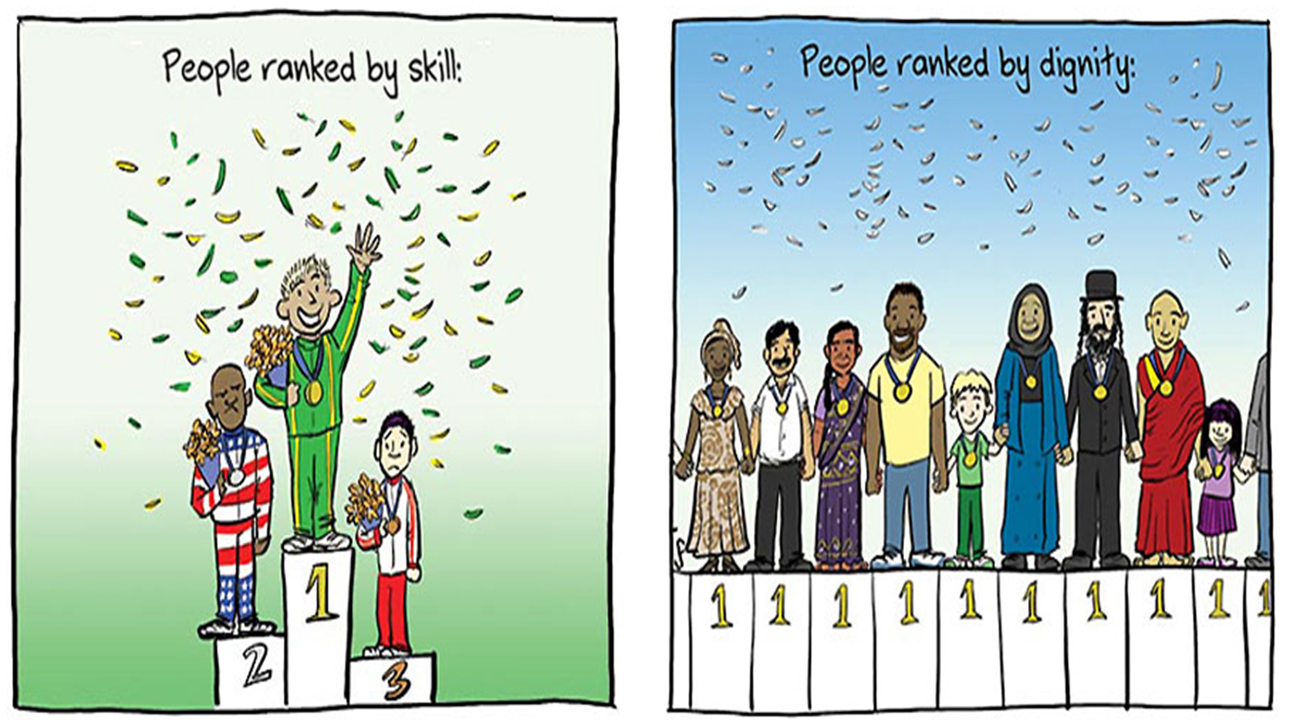
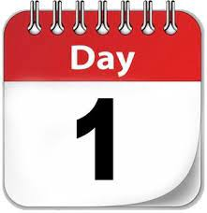



The theme for this half term: Dignity
The Equality and Diversity theme for this half term: Culture
The theme for this week: Dignity
Click for the challenge of the day
Click for the verses of the day
Careers – Guess my job!
https://youtu.be/ay-YmXDMf_8
Click for an extra prayer
Watch:
Click for a prayer

Slide 2

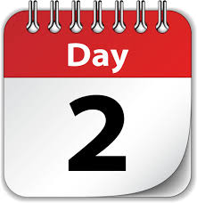
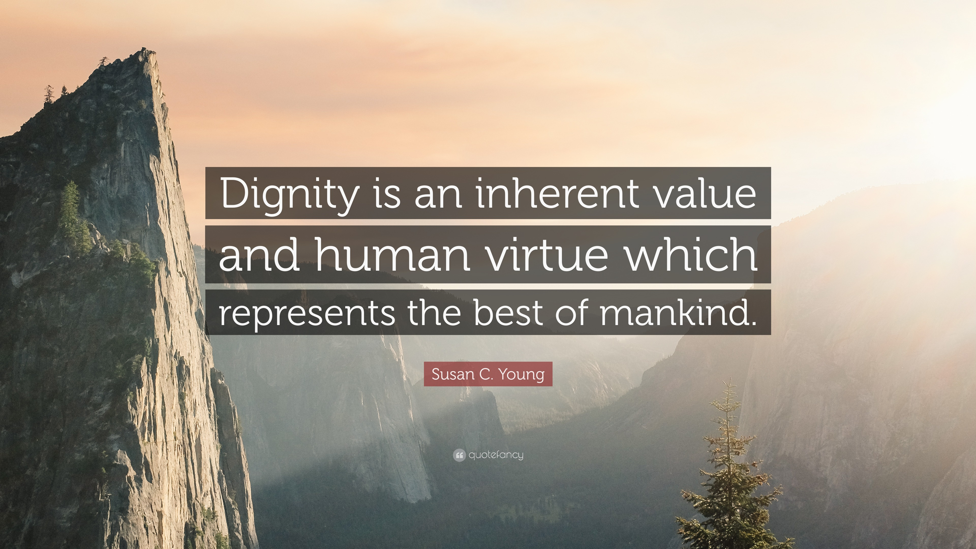
The theme for this half term: Dignity
The Equality and Diversity theme for this half term: Culture
The theme for this week: Dignity
Click for the challenge of the day
Click for the verses of the day
Word of the Day:
Merriam-Webster
Click for an extra prayer
Watch: Some thoughts on Dignity…
https://youtu.be/vhr2_id2hpU
Click for a prayer

Slide 3
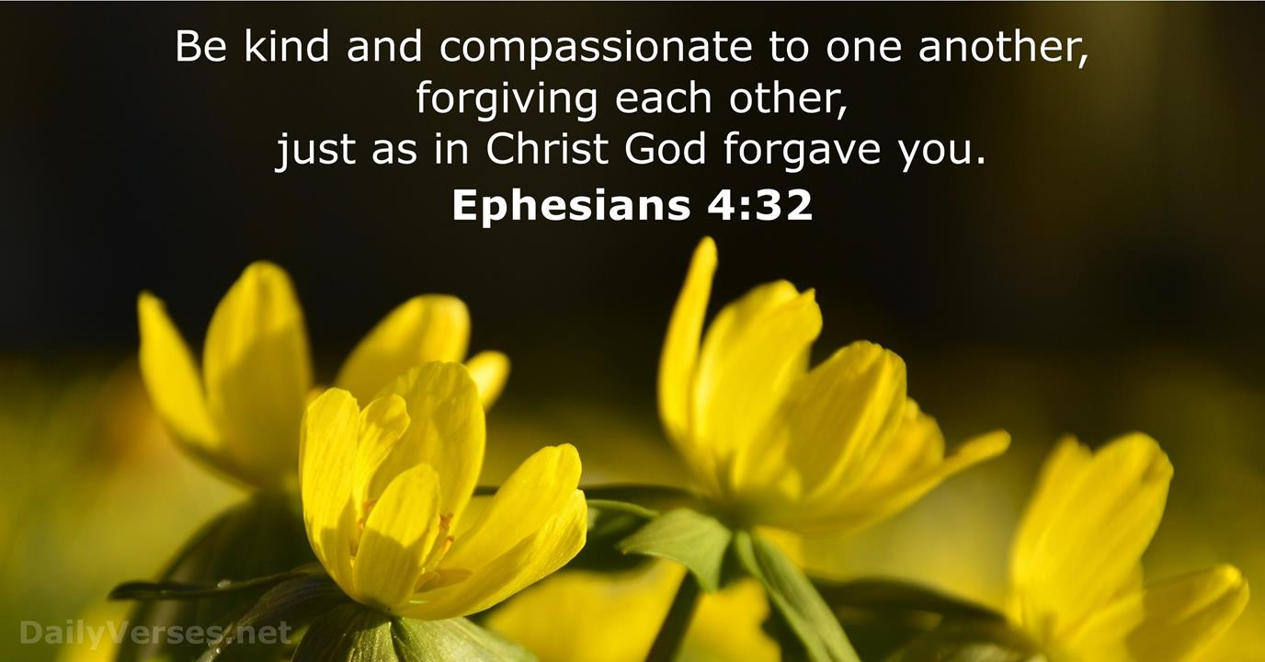
Click to go back
We often talk about being kind to one another, but we don’t often talk about forgiveness. This can be a difficult conversation and action as we don’t always want to do it. I am reminded that God always forgives me when I repent of my wrongdoings and that everyone is made in the image of God. This helps me remember to treat each person with that level of dignity.
Question of the day:
Do you find it easier to be kind or to forgive?

Slide 4
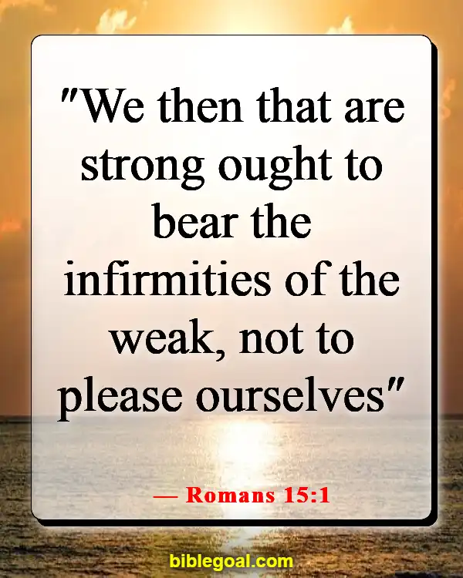
Click to go back
‘We then who are strong...’ This could mean a number of different things. Could be strong in body, strong in mind, strong in faith. Whatever your interpretation, we are encouraged to help those who are less capable than ourselves. It’s humility – looking to the needs of others rather than just focussing on ourselves all the time.
Question of the day:
Can you think of one person you know who could do with your help in a particular area?

Slide 5
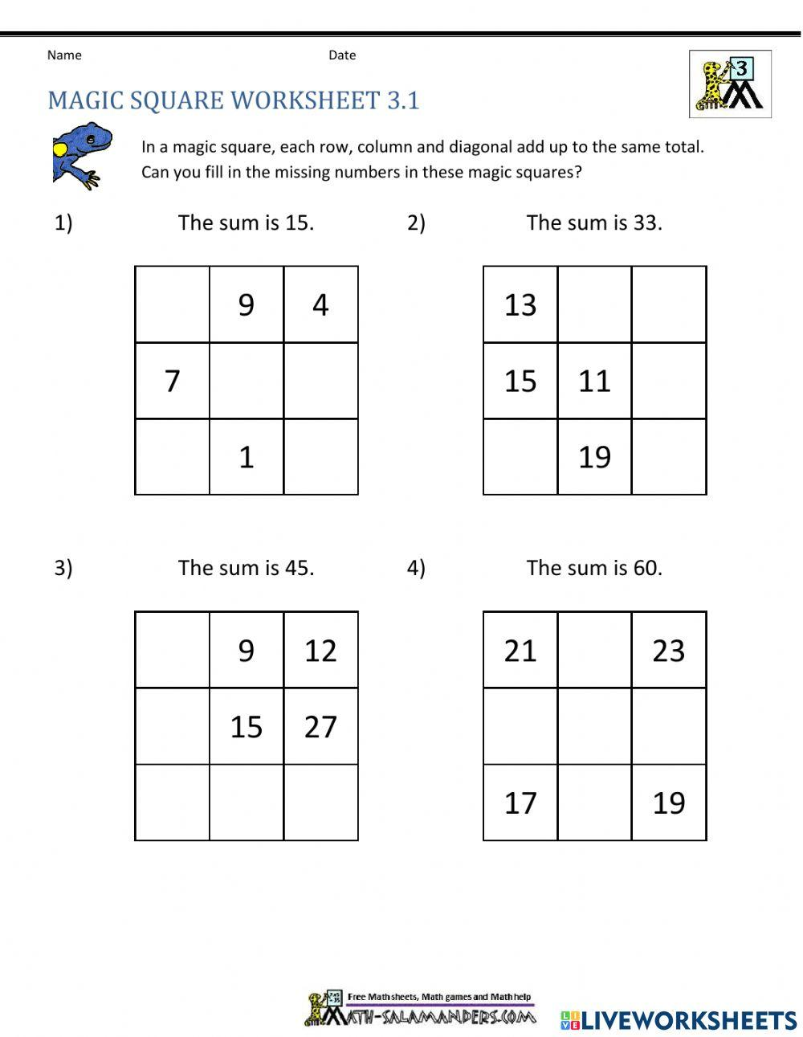
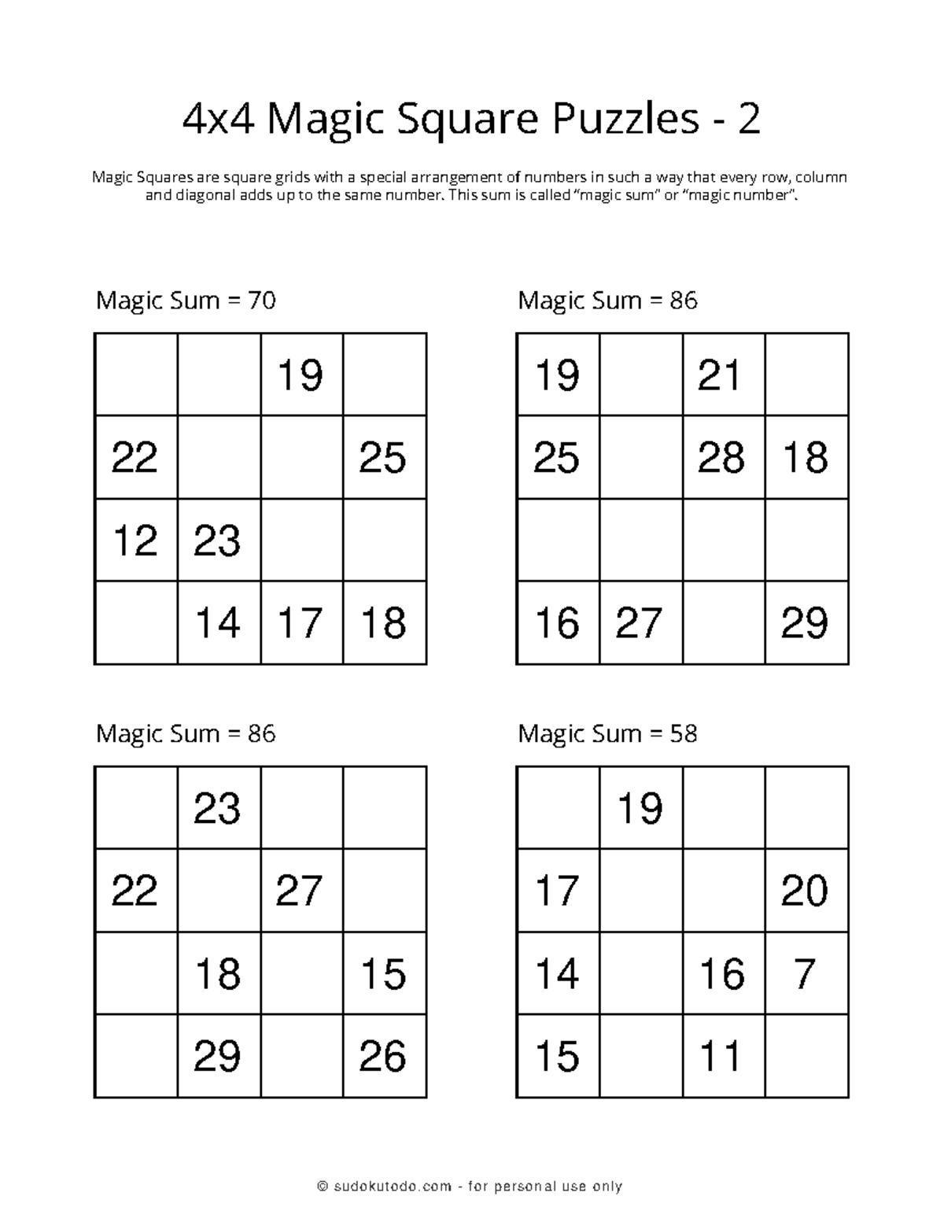
Can you complete these Magic Squares? You can use numbers ONCE each only. Each line, whether horizontal, vertical or diagonal, needs to add up to 15 for the 3x3 square and 58 for the 4x4 square. Hint: the 3x3 square uses numbers 1 to 9 and the 4x4 square uses numbers 8 to 22
12
18
9
Click for answers
2
8
13
5
3
Click to go back
21
6
8
10
22

Slide 6
Can you fill in the missing words from this bible verse?
______139:13-14
“For you _______ my inmost being; you ____ me together in my ________ womb. I praise you because I am ________ and wonderfully made; your works are _________, I know that full well.”
Psalms
created
Click for answers
knit
mother’s
Click to go back
fearfully
wonderful

Slide 7
Dear God
Help me to recognise the dignity You have placed in me. When I doubt myself or feel pressure to fit in, remind me that I am created with purpose, loved, valued, and capable of doing good. Give me confidence to be myself and courage to use my gifts for others.
Amen
Click to go back

Slide 8
A Prayer for Respecting Others
Lord
Open my eyes to see the dignity in every person—in friends, classmates, teachers, and even those I find difficult. Help me to treat others with fairness, kindness and respect. May my words build people up, never tear them down and may I be someone who brings peace wherever I go.
Amen
Click to go back

Slide 9

A Prayer for Standing Up for What’s Right
God of Justice
Give me the strength to stand up for anyone whose dignity is ignored. Help me to speak for those who feel unheard, to challenge unkindness when I see it and to create a school environment where everyone feels safe, valued, and included. Guide my actions so they reflect compassion and courage.
Amen
Click to go back

Slide 10

A Prayer for Our School Community
Loving God
Thank You for our school and everyone in it. Help us to build a community where dignity is protected and celebrated—where differences are appreciated, where we support each other and where everyone has the chance to grow and thrive. May we learn to see one another as You see us.
Amen
Click to go back

