Slide 1
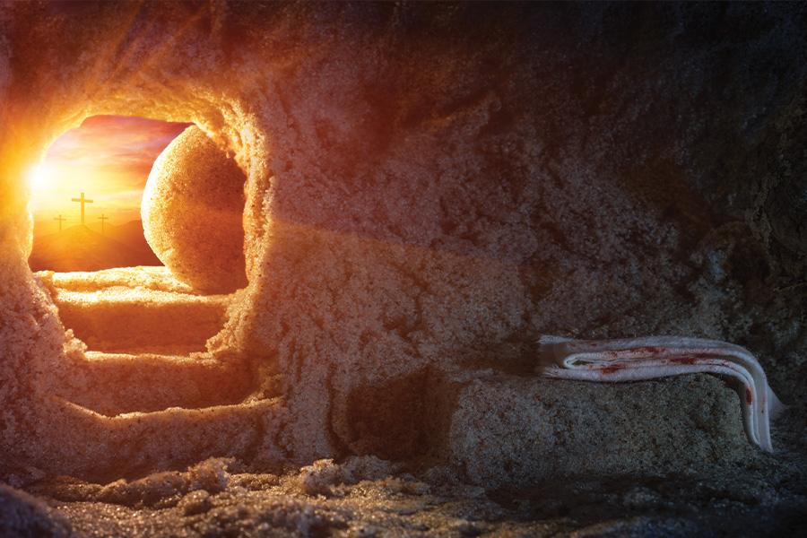
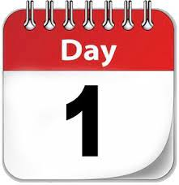

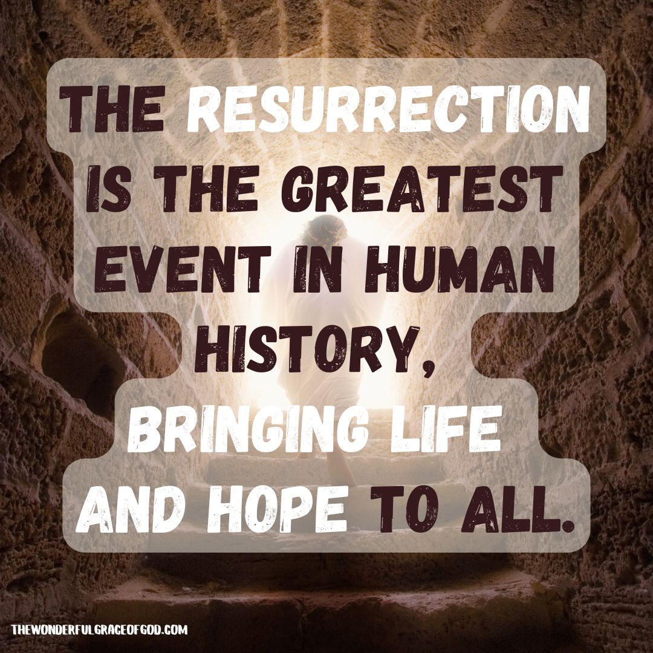

The theme for this half term: Community
The Equality and Diversity theme for this half term: Disability
The theme for this week: Easter (Part 2)
Click for the challenge of the day
Click for the verses of the day
Careers – Guess my job!
https://youtu.be/cNzVQOG21IY
Click for an extra prayer
Watch: Jesus appears to people after His resurrection…
https://youtu.be/EWmiJCbqqPg
Click for a prayer

Slide 2


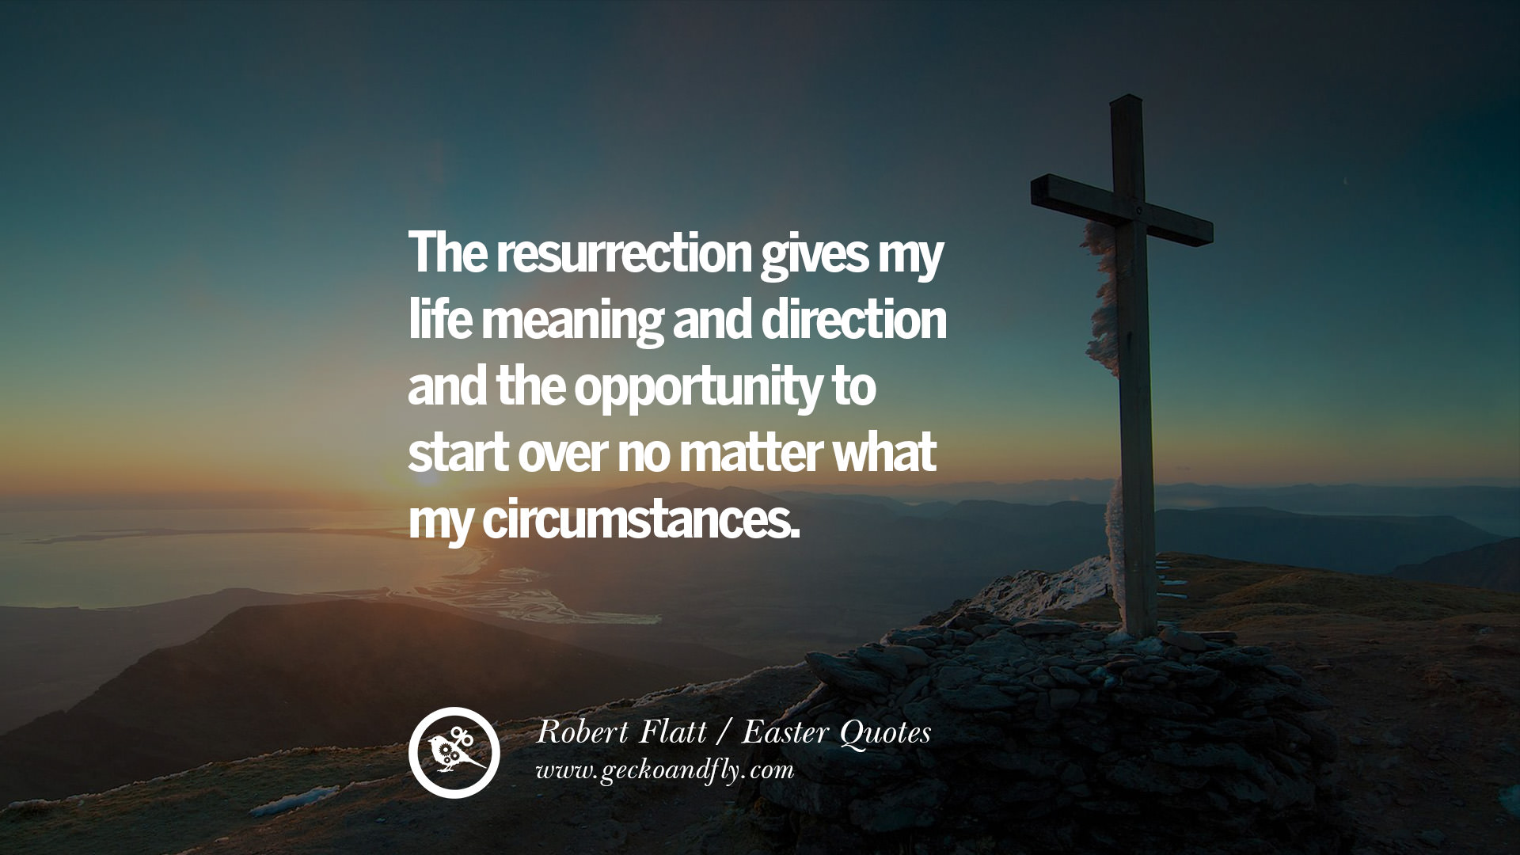
The theme for this half term: Community
The Equality and Diversity theme for this half term: Disability
The theme for this week: Easter (Part 2)
Click below for the challenge of the day
https://youtu.be/rrfp5HGsct0
Click for the verses of the day
Click for info on our school environment
Word of the Day:
Merriam-Webster
Click for an extra prayer
Click for a prayer
Watch: The message of Easter
https://youtu.be/wHVPpNwvNCA

Slide 3
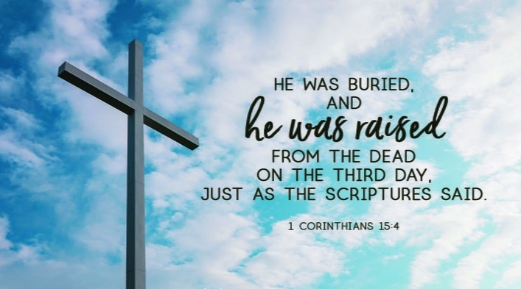
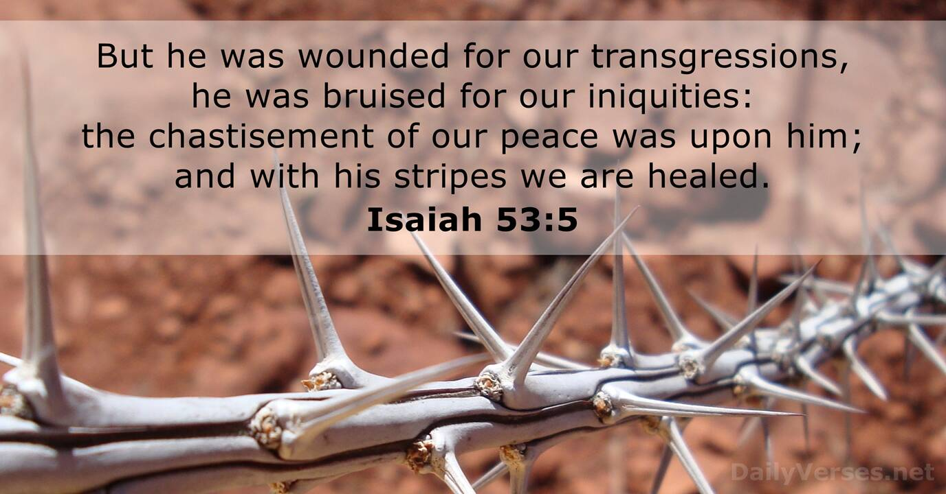
Click to go back
The death and resurrection of Jesus is reported a number of times in the New Testament with one example cited here in Paul’s first letter to the Corinthians. As you can see by the second verse, a prophet called Isaiah also noted the death of Jesus. This was prophesied 700 years before Jesus was alive.
What do you think the answer is to this question:
Why was Jesus crucified for the sins of all of us? Couldn’t God have done it differently?
Click here for some thoughts

Slide 4
Why was Jesus crucified for the sins of all of us?
Couldn’t God have done it differently?
At the heart of everything God has created (the universe, earth and us) is RELATIONSHIP. God did not make us robots – He gave us choice or agency. This means that although He is ultimately in control of everything, He has still given us the ability to choose. That freedom to choose is the most important factor in authentic relationship. When people freely choose something – whether good or bad - this is from the heart and not because they were programmed to do so.
From this place, God knew, before He created anything, that we as created people would sin due to our inability to always choose right. He knew He would have to create us fallible (able to make mistakes) so that our choices would be genuine. Due to bad choices, we sin and separate ourselves from God. So, before God had even created the world and people, He already had made a plan to send his son to die for us so that Jesus’ blood covered our sin meaning we can spend eternity with God – if we choose Him. So God chose to make us as we are, to send Jesus to die and shed His blood to cover our sin and give us an opportunity to repent and believe. So – God chose love and made the ultimate sacrifice for His people – death on the cross. This is the epitome of authentic love!
Click to go back

Slide 5
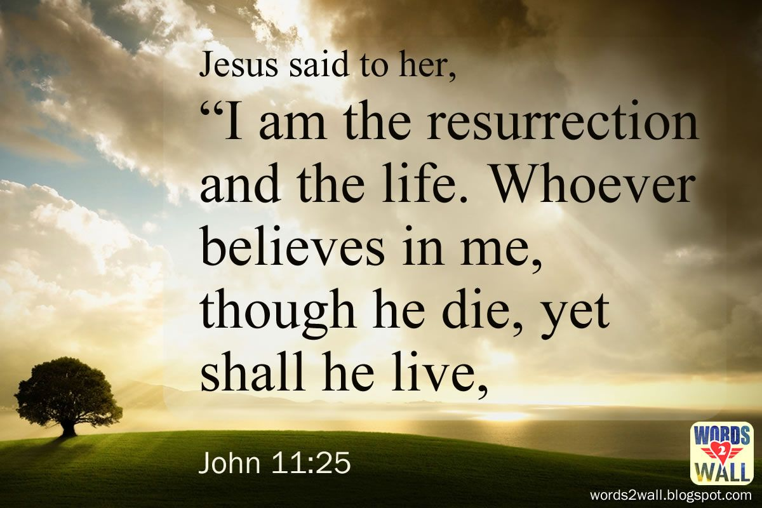
Click to go back
We have discussed this verse in the past. The ‘dying’ in the verse refers to our physical death on earth. We will all face this. But God offers us the chance to live for eternity – by believing in the sacrifice that Jesus made. We cannot make our way back to God through our own good works. We’re just not good enough. But we don’t have to! We just have to believe!
Question of the day:
Do you believe in eternal life?

Slide 6
Can you identify these easter-related words from their anagrams?
mic moo nun
communion
Click for answers
courier rents
resurrection
Click to go back
nonce vat
covenant

Slide 7
Prayer of Hope
Risen Jesus
Thank you for the hope your resurrection brings. When life feels heavy or uncertain, remind us that light is stronger than darkness and that new beginnings are always possible. Help us face challenges with courage and walk each day in your peace.
Amen.
Click to go back

Slide 8
Prayer for Strength and Courage
Lord Jesus
You rose from the tomb and defeated fear. When we feel stressed, worried, or overwhelmed, give us the strength to keep going and the courage to do what is right. Help us support one another and bring kindness into our school.
Amen.
Click to go back

Slide 9
Prayer of Gratitude
Dear Lord
At Easter we remember your love—stronger than death, stronger than anything we face. Thank you for friends, teachers, and the opportunities we have to learn and grow. Help us use our gifts to make the world brighter and to share your love with those around us.
Amen.
Click to go back

Slide 10
Prayer for a New Start
Lord
Your resurrection shows that every ending can become a new beginning.Help us let go of past mistakes and start fresh with confidence and joy.Guide our thoughts, our words, and our actions so that we can reflect your light in everything we do.
Amen.
Click to go back

Slide 11
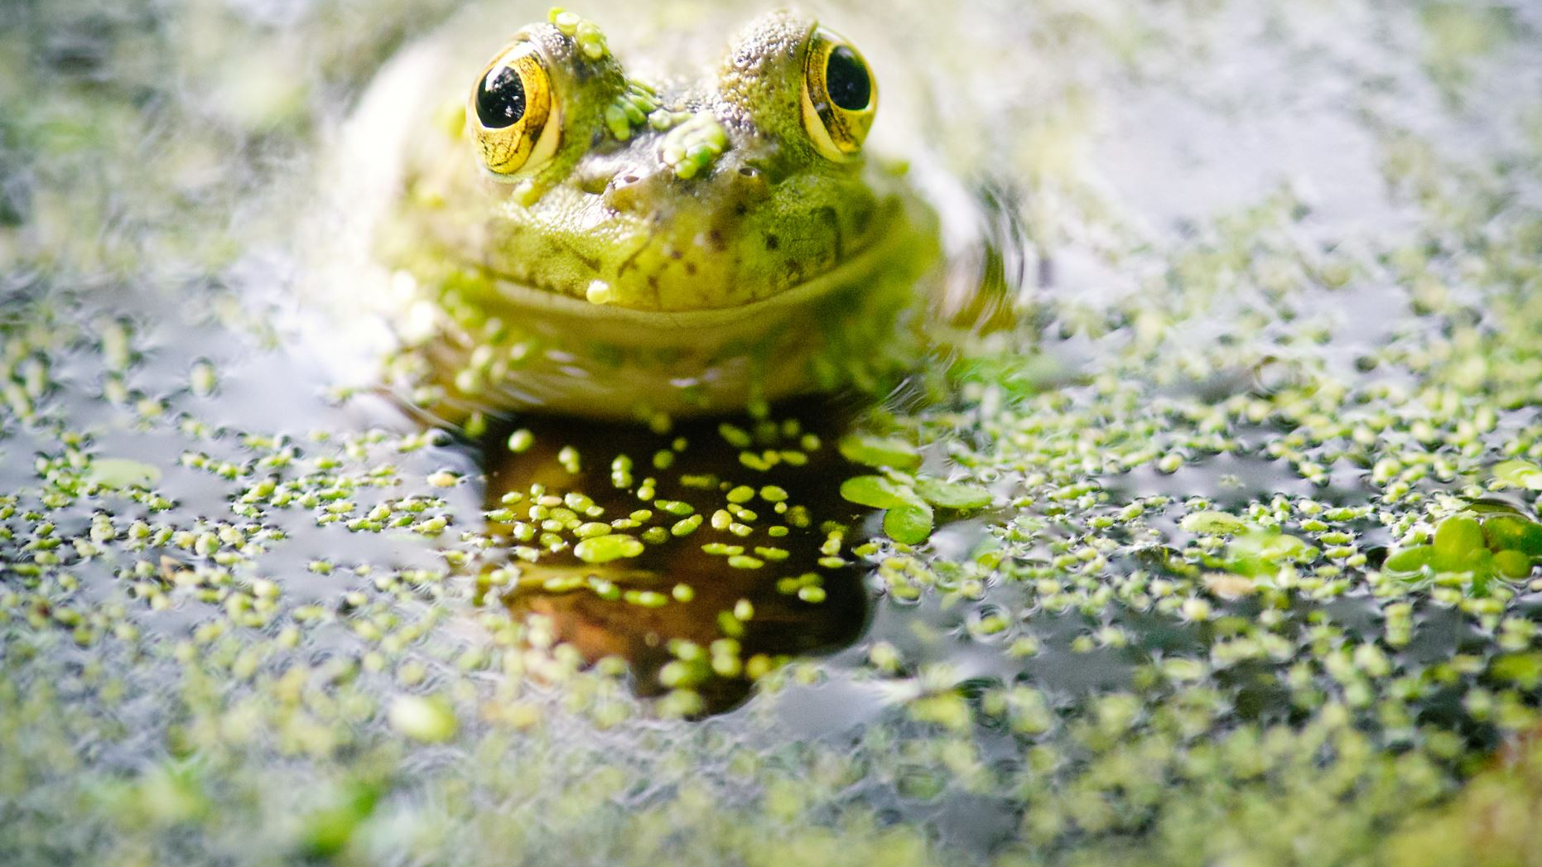
We have frogspawn in the pond!
Green Ambassadors
These are living creatures. We are lucky to have them contributing to the biodiversity of the school grounds.
It is important that we are not cruel to animals, therefore it is important that you do not touch or interfere with the frogspawn/tadpoles/
froglets/frogs in way.
Do the right thing and look after our frogspawn.
Click to go back

