Slide 1





The theme for this half term: Community
The Equality and Diversity theme for this half term: Disability
The theme for this week: Celebration of Success
Click for the challenge of the day
Click for the verses of the day
Careers – Guess my job!
https://youtu.be/NFzSKxYlSHM
Watch:
Click for a prayer

Slide 2



The theme for this half term: Community
The Equality and Diversity theme for this half term: Disability
The theme for this week: Celebration of Success
Click below for the challenge of the day
Top 10 Lists: Tenable S1E2 Quiz - By kevinmattsson200
Click for the verses of the day
Word of the Day:
Merriam-Webster
Click for a prayer
Watch: As always, be inspired…
https://youtu.be/xO0ZQKXiNFk

Slide 3
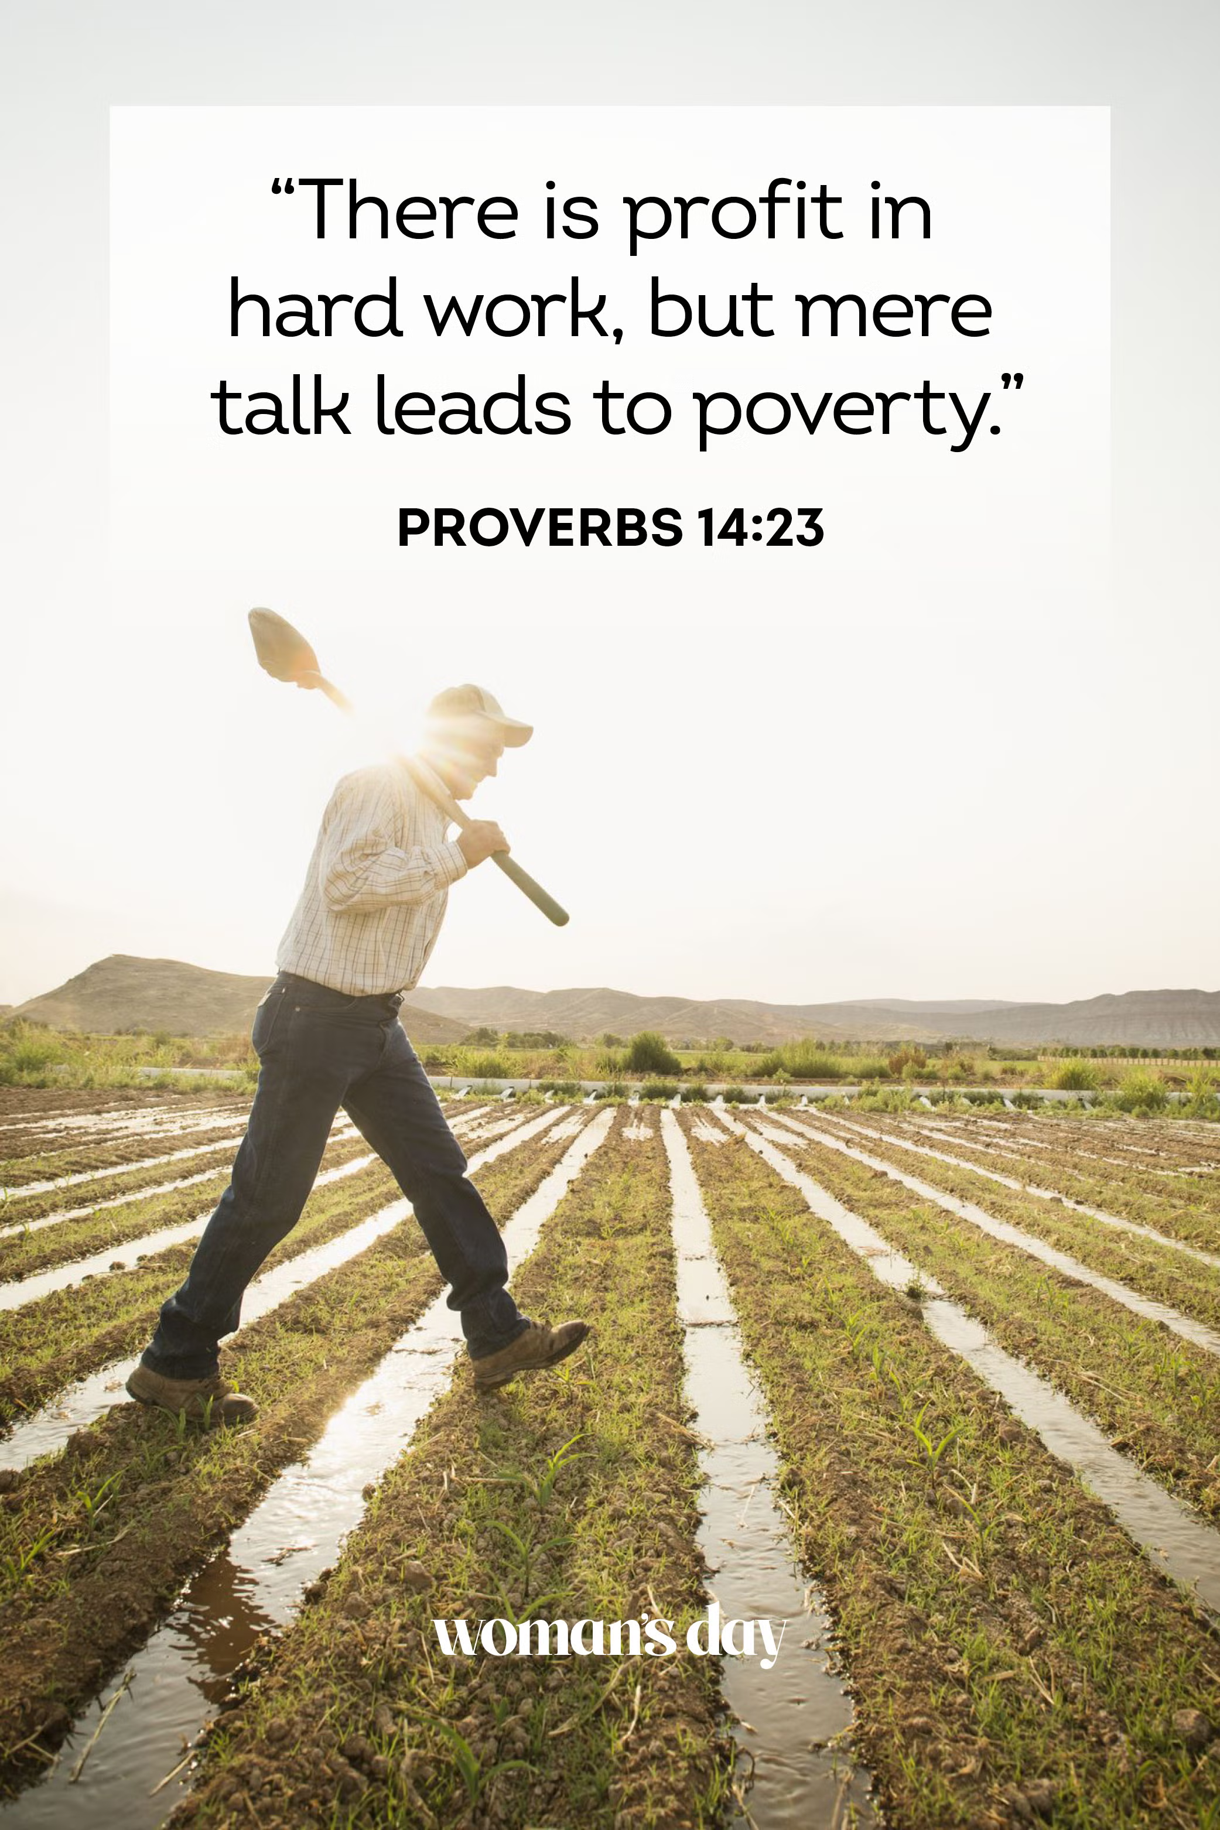
Click to go back
This proverb encapsulates the statement ‘Don’t just talk the talk, walk the walk’. We all know people who do a lot of talking and not much else. After a while, they become quite exhausting. The people I respect the most, are those who don’t talk a lot, but get on and achieve – or at least make an effort to achieve!
Questions of the day:
Would you define your self as a talker or walker?
Would your friends say the same thing?
Is there something you are doing, or could start doing, that you could keep quiet and let your actions speak louder than your words?

Slide 4
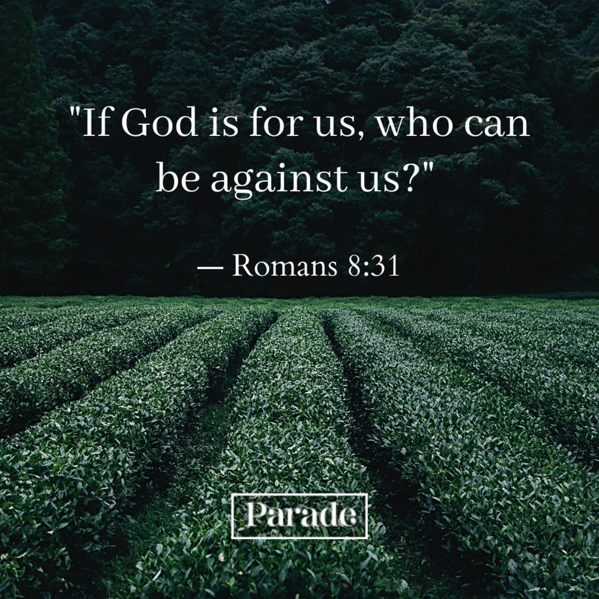
Click to go back
Ultimately (bigger picture) – If you choose to trust in God, He will have your back. That doesn’t mean everything just works out. God is quite clear that while we are on this earth, we will have ‘trouble’ (John 16:33). But He also says that while we take on the challenges of this world, which often include people, He will be with us
Question of the day What are your top three challenges?

Slide 5

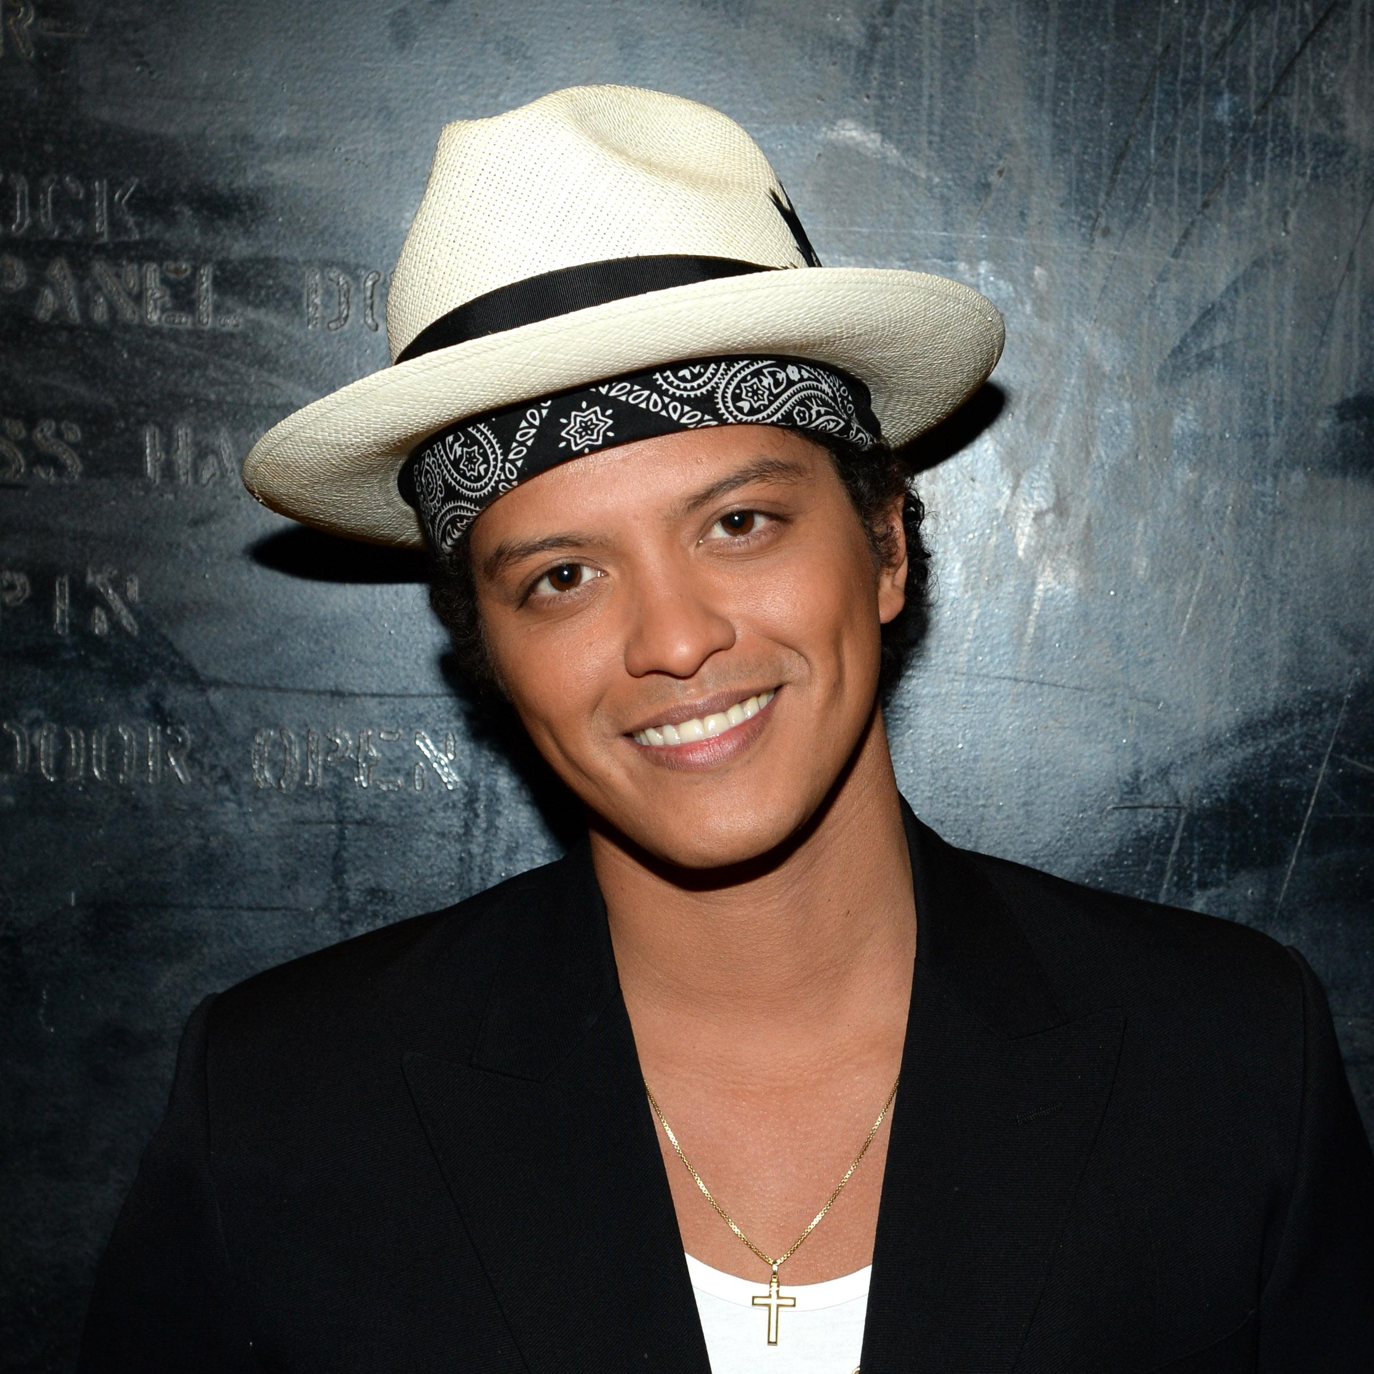
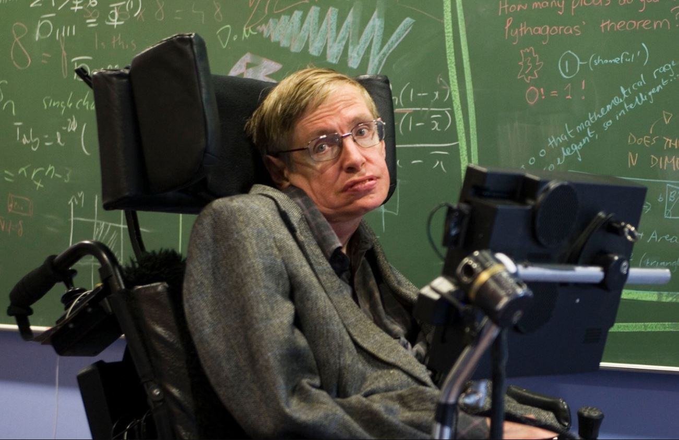
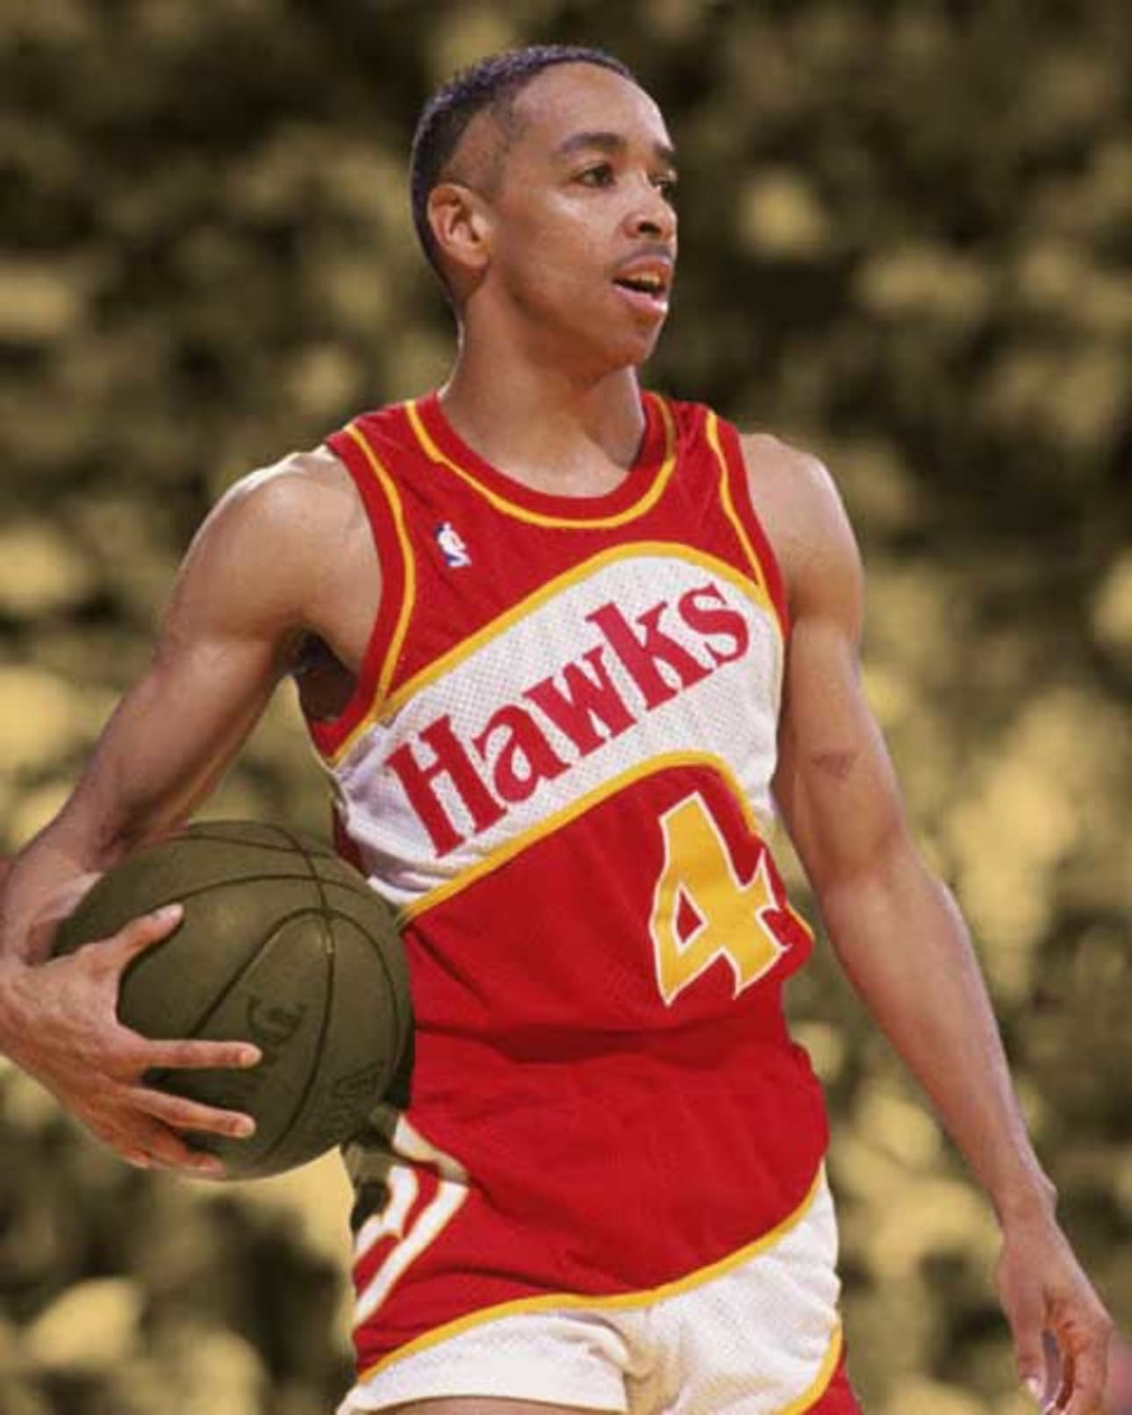
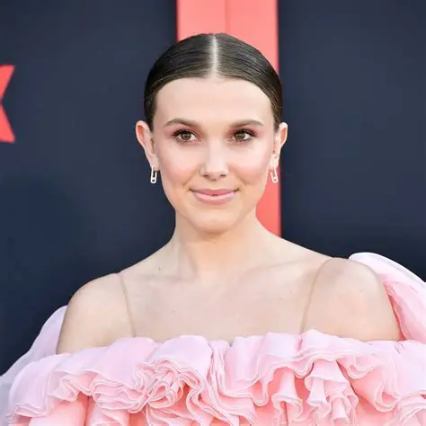
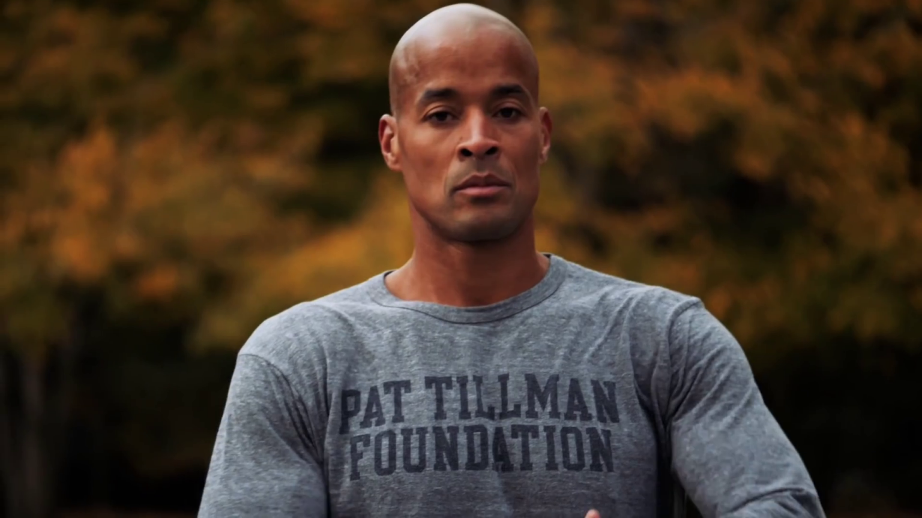
Can you identify the following personalities?
Taylor Lautner
(Twilight)
Bruno Mars
(Music Artist)
Click for answers
Stephen
Hawking
(Scientist)
Spud
Webb
(Basketball)
Click to go back
Millie
Bobby Brown
(Actress)
David Goggins
(Fitness/Speaker)

Slide 6
Heavenly Father
We lift up our school community to You today Bless us with wisdom to make good choices Strength to persevere through challenges And peace that steadies our hearts
May our work be fruitful, our relationships filled with kindness Our steps guided by Your light
Help us to walk in integrity, to serve with love and to shine as examples of Your goodness
Amen
Click to go back

Slide 7
Loving God
You have chosen to make each person differently and each one has a unique set of gifts. We can choose to use and develop those gifts or push them aside. Help us to recognise our strengths and to use them well – for ourselves and others. Also help us to work on those things which are a challenge to us and to help each other improve.
Amen
Click to go back

