Slide 1





The theme for this half term: Community
The Equality and Diversity theme for this half term: Disability
The theme for this week: Community
Click for the challenge of the day
Click for the verses of the day
Careers – Guess my job!
https://youtu.be/xCmDKoc3QiE
Click for a prayer
Watch: School community…
https://youtu.be/zb3JRvOoMGs

Slide 2


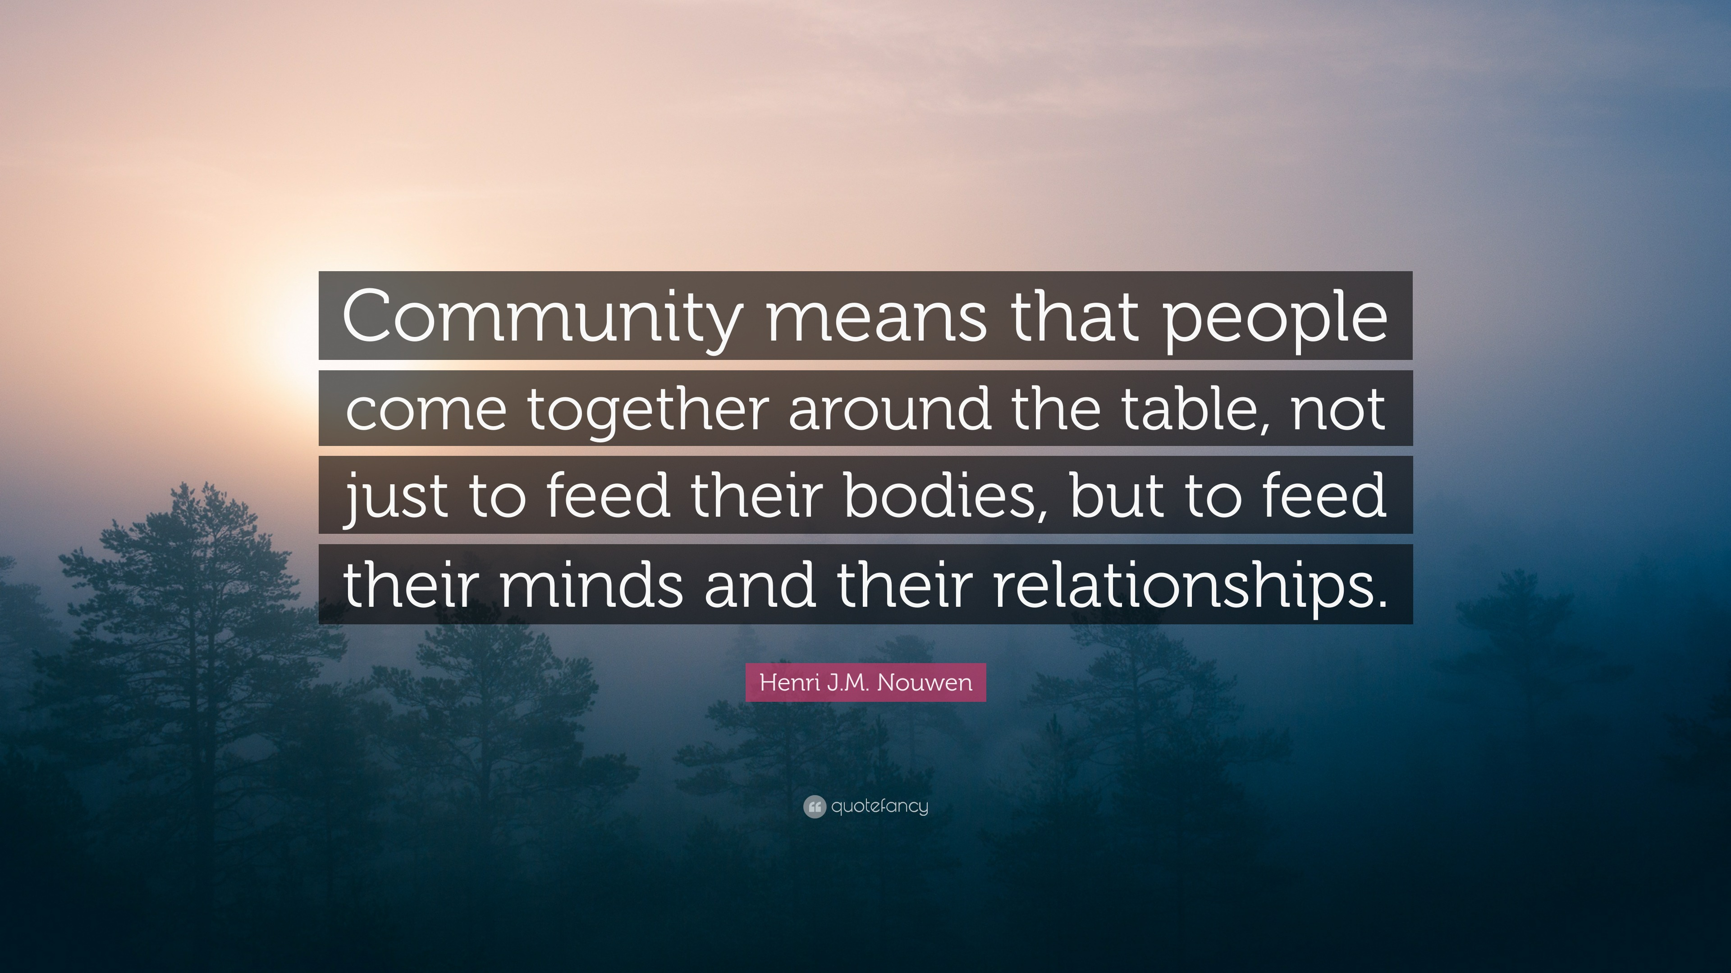
The theme for this half term: Community
The Equality and Diversity theme for this half term: Disability
The theme for this week: Community
Click below for the challenge of the day
https://youtu.be/UgthlHP9h6Y
Click for the verses of the day
Word of the Day:
Merriam-Webster
Click for a prayer
Watch: Click here for some thoughts from your Chaplain…

Slide 3

Click to go back
The focus of these verses was to encourage wholesome community within the believers (Christians). Spending time with each other sharing our goals and dreams is super helpful! Unfortunately, looking after each other and helping each other when we struggle can be counter-cultural.
Questions of the day:
Who do you meet up with during the week and what do you do?
What good ‘works’ can you do that might help or encourage others?
What does counter-cultural mean?

Slide 4
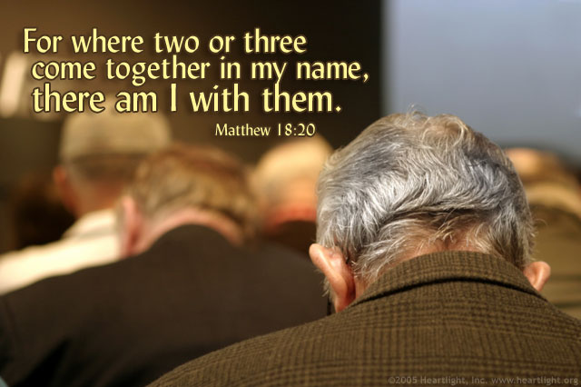
Click to go back
This verse is taken from the book of Matthew – the first gospel in the New Testament. Matthew was a tax collector who made people pay too much tax so he could live a comfortable life. His life was radically changed when he met Jesus and he gave back all the money he had taken – and more! Here, Matthew had realised the amazing reality of Christian community, reporting God’s recognition of it as well in His promise to be with those who meet in His name.
Question of the day:
What areas of life are best when we are in community with others?

Slide 5
Can you answer the following questions about our school and Crawley?
In what year did students first attend Holy Trinity and when was it officially opened?
1967 and 1969
When was the Ball Hall built and opened and what world record was set in there?
2006
Longest game of basketball ever played (72 hours)
Click for answers
How many students are there in a year group and how many are there at the school in total?
240 and 1350
Can you name all the other Secondary Schools in Crawley and how many students, in total, attend?
Thomas Bennett, ICC, Gatwick, Hazelwick, St Wilfrids and Oriel serving around 9 500 students
Click to go back
How many Primary Schools are there in Crawley and how many students, in total, attend?
27 serving just over 10 000 students

Slide 6
Loving God
We are grateful that You have made us in Your image, but also made us so diverse as a human race. The strength of our community is in our diversity. Help us to recognise our strengths and to use them to create a strong bond between all ethnicities.
Amen
Click to go back

Slide 7
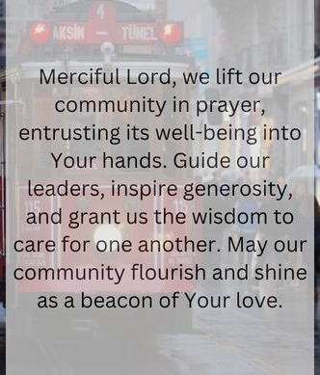
Click to go back

