Slide 1




The theme for this half term: Community
The Equality and Diversity theme for this half term: Disability
The theme for this week: Ramadan
Click for the challenge of the day
Click for info on Iftar
Click for the verses of the day
Careers – Guess my job!
https://youtu.be/9-82ojVnXXw
Click for a prayer
Watch: What is Ramadan?
https://youtu.be/5pvmUoYNbmU

Slide 2



The theme for this half term: Community
The Equality and Diversity theme for this half term: Disability
The theme for this week: Ramadan
Click below for the challenge of the day
https://youtu.be/ttJm5_CINeQ
Click for the verses of the day
Word of the Day:
Merriam-Webster
Click for a prayer
Watch: What happens at the end of Ramadan?
https://youtu.be/-4r0ZTi0olM

Slide 3

Click to go back
Here, Paul is addressing the people in Thessalonica (in Greece). He is first talking to Christians or believers encouraging them to ‘abound’ in love for each other. He also reminds them to love everyone (‘all people’). Love can be described in many ways but one of the best definitions is ‘action’. What are doing to show love?
Question of the day:
What one thing can you do today to show love? (Remember our Muslim students are fasting…)

Slide 4

Click to go back
This verse reminds us that love is bigger than hate. When someone does something wrong against us, we can let this affect us negatively, or we can choose to love and forgive. Love looks past the sin (but doesn’t agree with it)
Question of the day:
Is there someone you need to forgive? Could you be the bigger person and choose love in this way?

Slide 5

Can you work out these religious words from their anagrams?
Hints
ash bat
Shabbat
Judaism
diet frail
Eid-al-fitr
Islam
amp bits
Baptism
Christianity
arm had
Dharma
Hinduism
Click to go back
ivan ran
Nirvana
Buddhism
award rug
Gurdwara
Sikhism

Slide 6

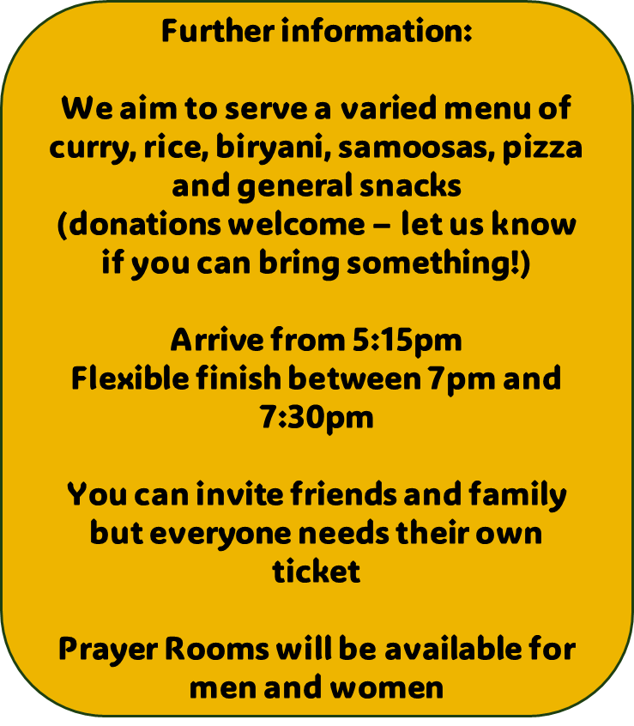
Click to go back

Slide 7

Click to go back

Slide 8
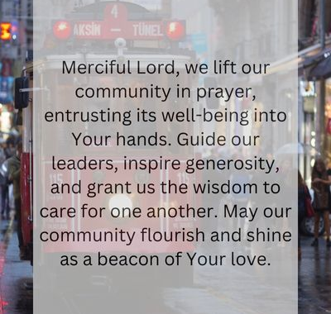
Click to go back

