Slide 1

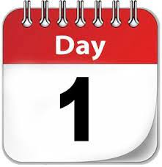

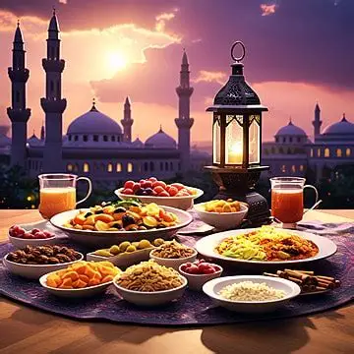
The theme for this half term: Wisdom
The Equality and Diversity theme for this half term: Environment
The theme for this week: Celebration of Success
Click for the challenge of the day
Click for info on Iftar
Click for the verses of the day
Careers – Guess my job!
https://youtu.be/1yiPYHETkbw
Click for a prayer
Watch: Successful people…
https://youtu.be/uAPT7DeVkT8

Slide 2

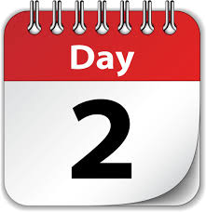


The theme for this half term: Wisdom
The Equality and Diversity theme for this half term: Environment
The theme for this week: Celebration of Success
Click below for the challenge of the day
https://youtu.be/tRBhzJS5JyI
Click for the verses of the day
Word of the Day:
Merriam-Webster
Watch Extra: Extraordinary talent…
https://youtu.be/nY7GnAq6Znw
Click for a prayer
Watch: People are awesome…
https://youtu.be/rcD5xbNUwn8

Slide 3
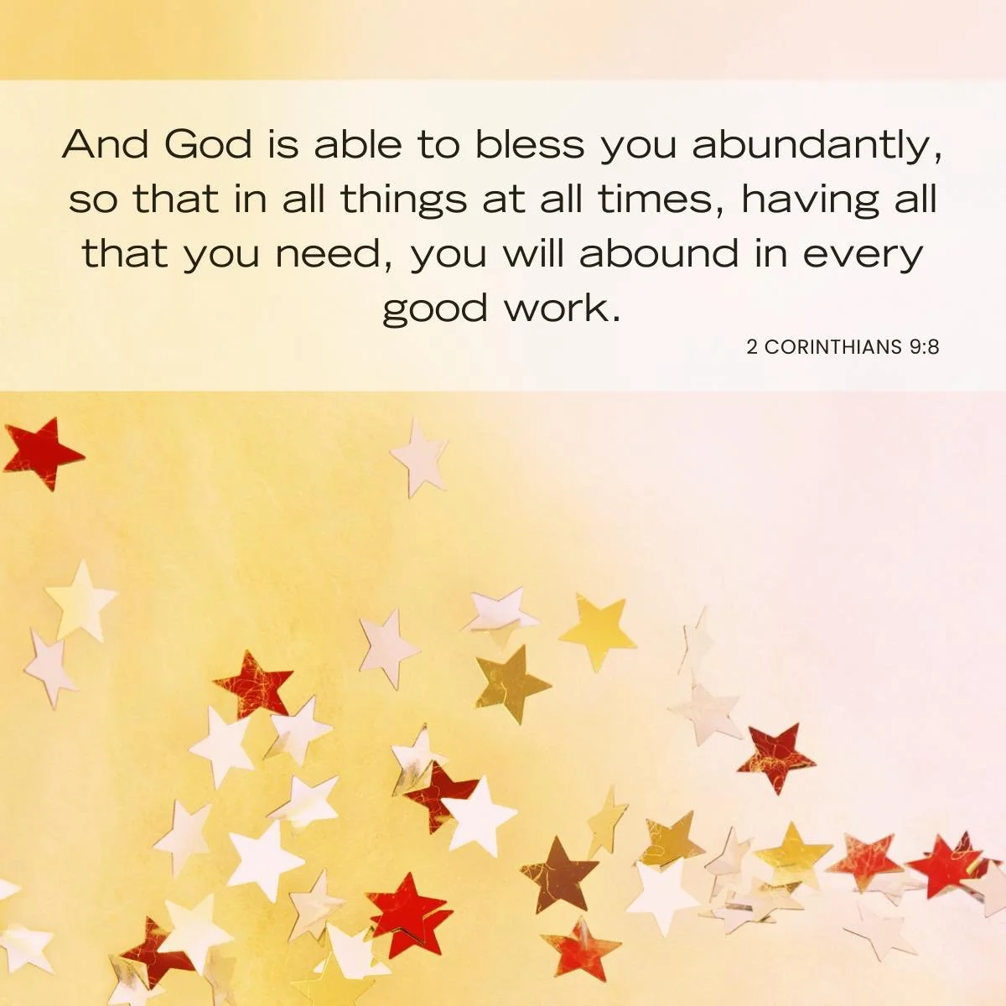
Click to go back
I find this verse very encouraging! The word ‘all’ is used three times indicating that God’s intention is that we always ‘abound’. The word abound means to exist in large amounts ad in this verse God talks about us abounding in every good work. Just think ‘abundance’ ☺
Question of the day:
What ‘good work’ are you doing already or could you do?

Slide 4
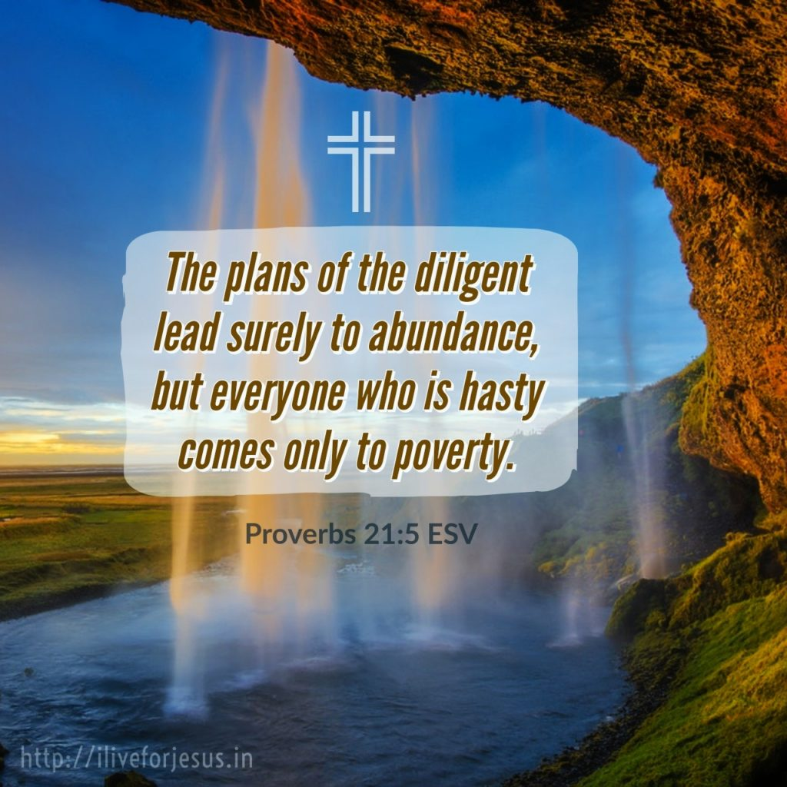
Click to go back
Investing in something and taking our time over it is important! Rushing an activity or a project never usually leads to anything worthwhile. In this world where everything is coming at us quick and fast, we need to slow down!
Question of the day:
In what area of your life do you need to invest more time? A subject? A hobby? A friendship?

Slide 5
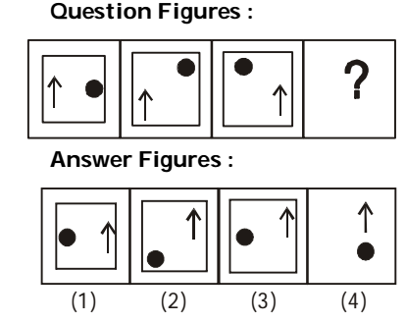
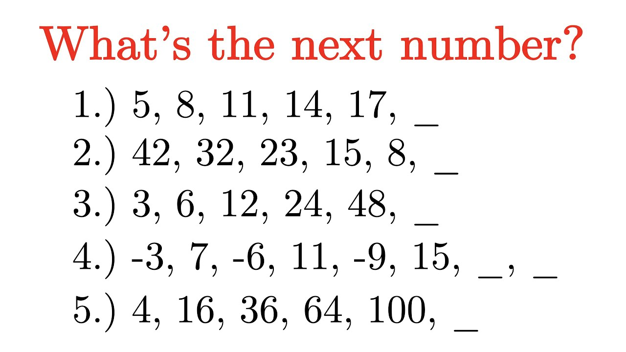
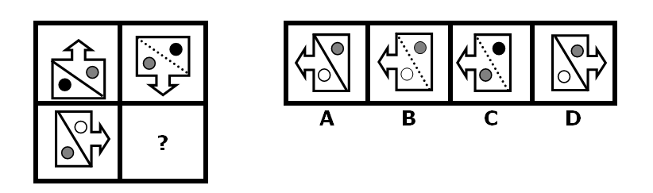
20
2
96
-12
19
144
Click for answers
Click to go back

Slide 6


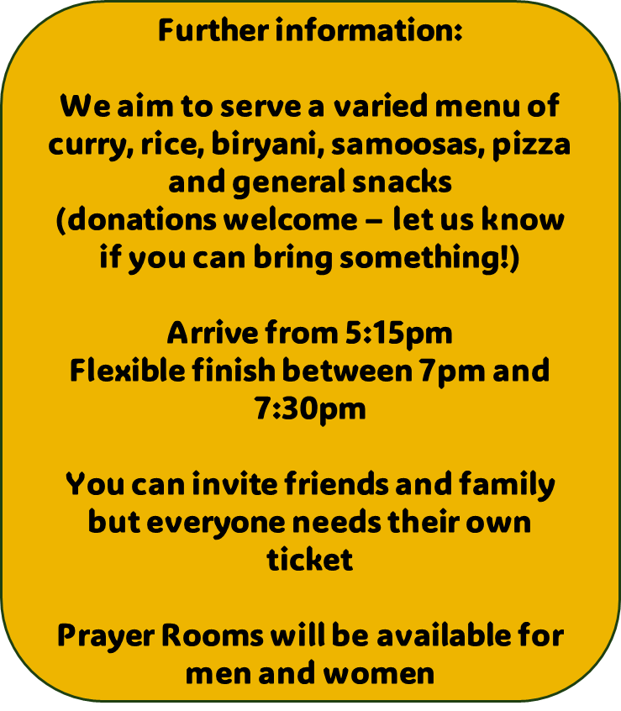
Click to go back

Slide 7
Click to go back

Slide 8
Loving God
This week we celebrate our achievements. We are grateful for our gifts and talents and today we acknowledge that we all have a lot to offer our school community. Help us to continue to work together whether our successes are made public or not. We ask that You would bless us today.
Amen
Click to go back

Slide 9
Almighty God
As we recognise and celebrate achievement this week, we are careful to remember that all of us have been given a wealth of ability and that these abilities compliment each other. Help us to choose this perspective rather than one of comparison.
Bless us all over this half term break.
Amen
Click to go back

