Slide 1
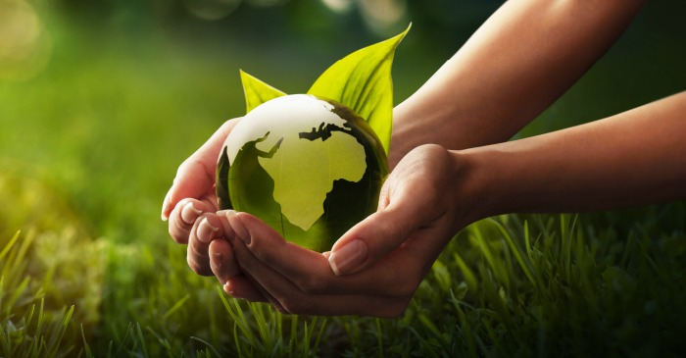
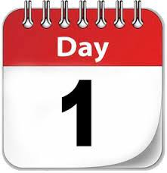

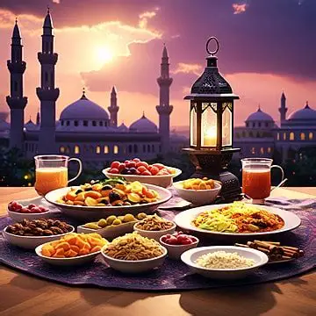
The theme for this half term: Wisdom
The Equality and Diversity theme for this half term: Environment
The theme for this week: Environment
Click for the challenge of the day
Click for info on Iftar
Click for the verses of the day
Careers – Guess my job!
https://youtu.be/JVxGej2sfUw
Click for a prayer
Watch: The Greenhouse Effect…
https://youtu.be/HK8LLWSIIm4

Slide 2

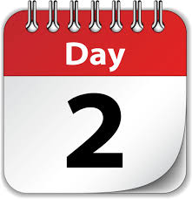
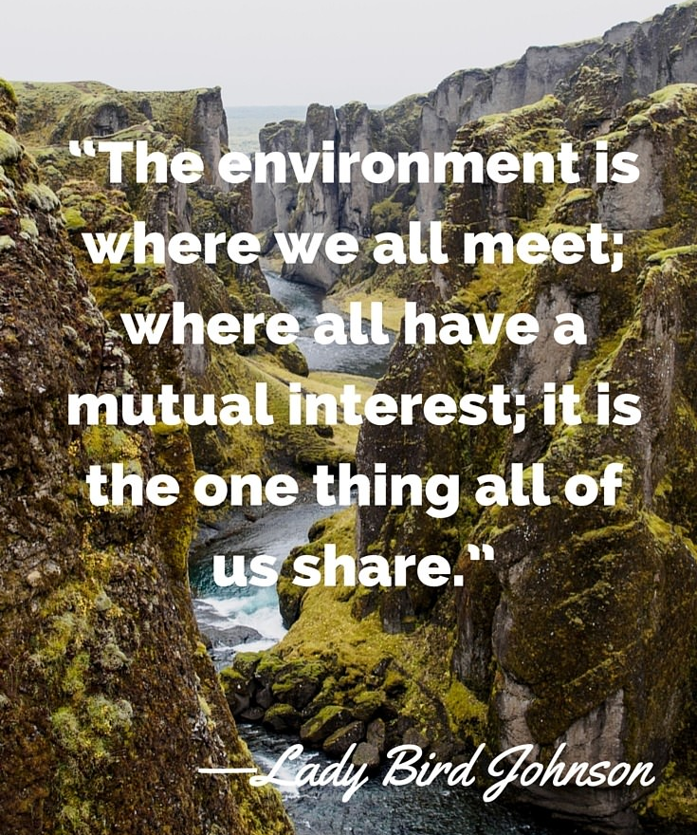


The theme for this half term: Wisdom
The Equality and Diversity theme for this half term: Environment
The theme for this week: Environment
Click below for the challenge of the day
https://youtu.be/epjLamXJkmU
Click for the verses of the day
Word of the Day:
Merriam-Webster
Click for a prayer
Watch: The environment…
https://youtu.be/2njn71TqkjA

Slide 3
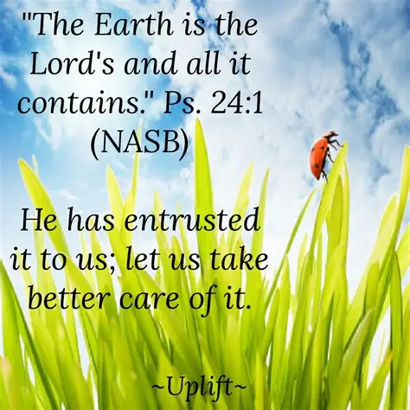
Click to go back
In this Psalm, King David reminds us that God created the earth (and the heavens). All that it contains, that is, the natural world, has been made by Him. The natural world, if not tampered with, will regenerate itself and remain in balance. When the natural cycle is disrupted by unnatural processes, it falls out of kilter. Human beings have damaged both the atmosphere and surface of the earth that we were given, causing imbalance. That is why we have natural disasters like floods.
Question of the day:
What is one thing you could start doing regularly that would help our environment?

Slide 4
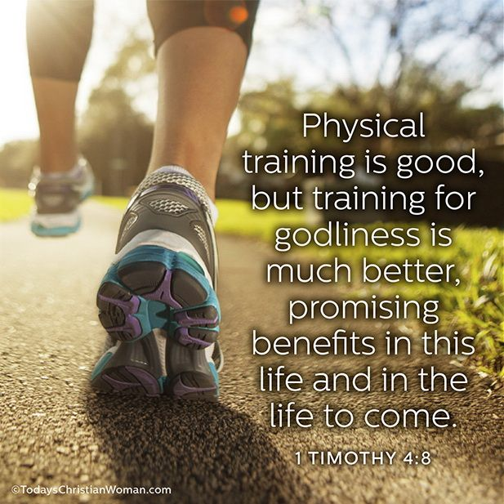
Click to go back
Here, Paul is writing to his companion Timothy and this is the first of two letters to him. Paul encourages him (and us) to look after both our soul and body. While on earth, it is wise for us to eat well and exercise, however, Paul emphasises the importance of our spiritual lives stating its significance in this life and the ‘life to come’
Questions of the day:
What could you start today that would improve both your physical and spiritual states?
What is the ‘life to come’?

Slide 5
Can you work out these environmental words from their anagrams?
inn overcoats
conservation
leaner web
renewable
pool until
pollution
Click for answers
Click to go back

Slide 6
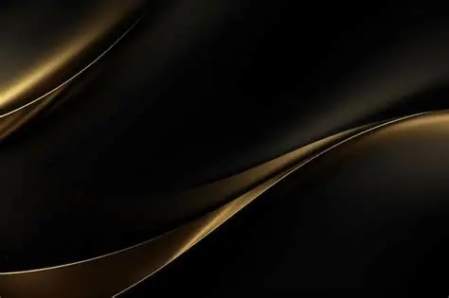

Click to go back

Slide 7
A Prayer for Healing the Earth
God of mercy and renewal
Our world groans under the weight of pollution
deforestation, and climate change
Forgive our neglect and selfishness
Guide our hands to restore what has been broken
and our hearts to protect what remains.
Amen
Click to go back

Slide 8
A Prayer for Courage and Action
Lord of justice and peace
Give us courage to speak for the voiceless —
the forests, the oceans, the creatures in peril
Inspire leaders to act with wisdom
and communities to work together in hope
May we be faithful stewards of Your creation
Amen
Click to go back

Slide 9

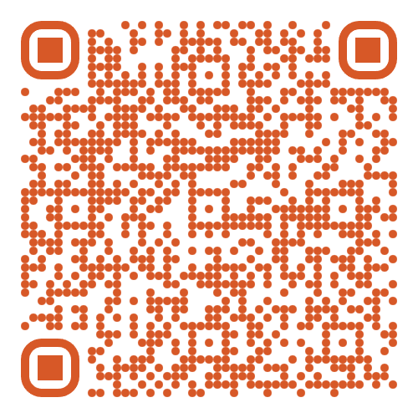
The School Production of 'Annie' is from Weds 4th Feb to Fri 6th Feb
Tickets are on sale NOW!
Scan this QR code to take you to Eventbrite to buy tickets
Click to go back

