Slide 1
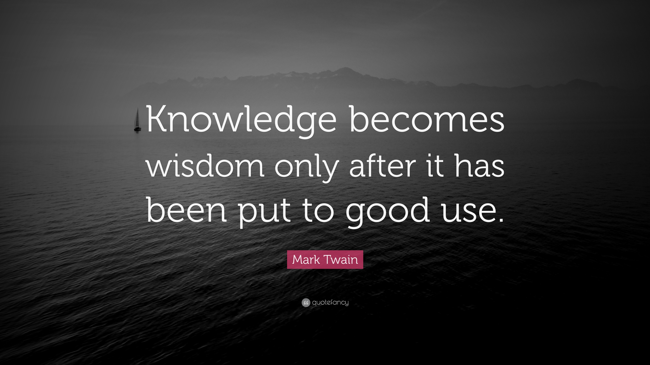



The theme for this half term: Wisdom
The Equality and Diversity theme for this half term: Environment
The theme for this week: School Production Previews
Click for the challenge of the day
Careers – Guess my job!
https://youtu.be/M7H4XYinY4s
Click for the verses of the day
Watch extra:
Wisdom in Patience
https://youtu.be/e24fuRR93to
Watch:
A lesson on Wisdom from Proverbs…
https://youtu.be/v0drf0vKuVE
Click for a prayer

Slide 2




The theme for this half term: Wisdom
The Equality and Diversity theme for this half term: Environment
The theme for this week: School Production Previews
Click below for the challenge of the day
Try some of these riddles:
https://youtu.be/RhXxbAYtkHo
Click for info on Iftar
Click for the verses of the day
Watch extra:
English Proverbs
https://youtu.be/4A6bLMQpPGU
Click for a prayer
Word of the Day:
Merriam-Webster
Watch: The wisdom of King Solomon
https://youtu.be/8tFhWPyMNJM

Slide 3
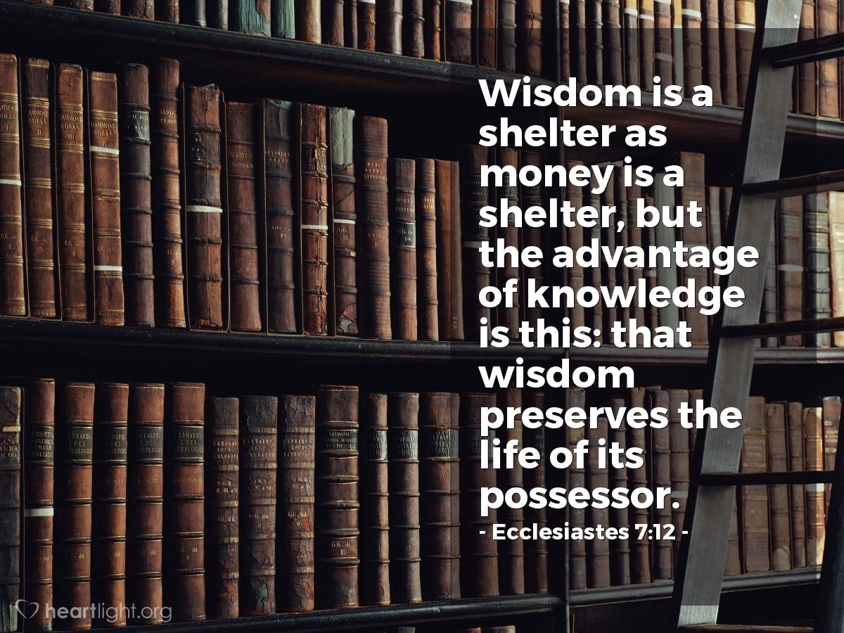
Click to go back
In this verse, we are reminded that although both wisdom and money can bring a safety and security, it is wisdom that lasts, ‘preserving’ those who choose it. God makes it quite clear that money is not a bad thing, but that it’s the love of money that is the ‘root of all evil’
(1 Timothy 6:10). God says we should choose wisdom for it is worth more than gold
(Proverbs 16:16)
Challenge of the day:
Think of one area of your life where you need more wisdom. Tell someone about it, act on it and get them to check up on you later this week
Ecclesiastes was possibly written by King Solomon (who wrote the book of Proverbs), however, this is not confirmed

Slide 4
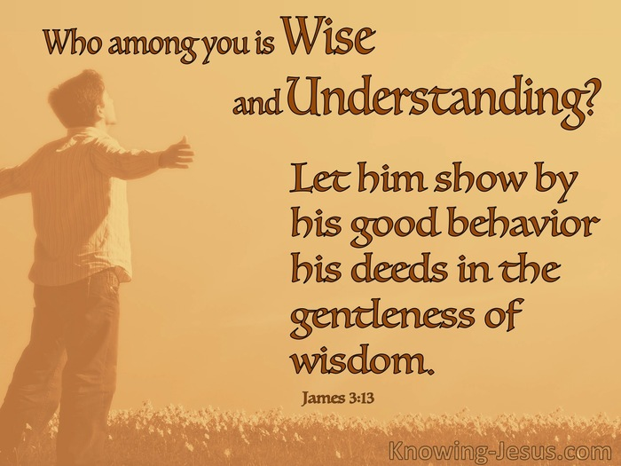
Click to go back
When we actively choose wisdom and choose to make positive changes in our daily lives (through kind words and actions), we form good habits. For example, if you choose to be on time to lessons and choose to speak to other students and teachers in a respectful manner, you build a culture of wise choices into your life which you will do without thinking. Chicken Dinner! ☺
Question of the day:
If someone (maybe a friend or member of your tutor group) was to rate your daily behaviour out of 10, what would they give you?

Slide 5
Can you name these well-known historical figures from their anagrams?
Click for hints
Lois treat
Aristotle
Philosophy
Goaty sharp
Pythagoras
Mathematics
Bevon thee
Beethoven
Music
Click for answers
Click to go back

Slide 6
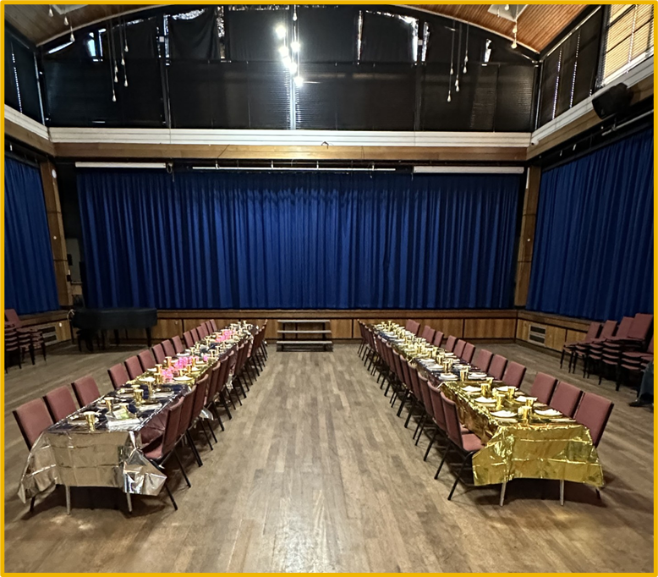
Iftar
Monday 2nd March 2026 6pm to 8pm
Click to go back
Save the Date
and keep an eye out for more information

Slide 7
Loving God
Each day as we navigate our way through life, we ask that You would give us wisdom to make good decisions. Help us to speak less and listen more. Show us the meaning of patience and understanding. Guide us to love and encourage rather than hate and bring down.
Amen
Click to go back

Slide 8
Almighty God
Help us to pause each day and take time to consider our words and actions. Give us the wisdom to know what to say and do in each situation so that we build good habits of encouragement rather than destruction.
Amen
Click to go back

Slide 9

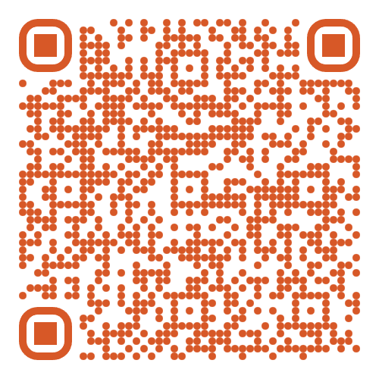
The School Production of 'Annie' is from Weds 4th Feb to Fri 6th Feb
Tickets are on sale NOW!
Scan this QR code to take you to Eventbrite to buy tickets
Click to go back

