Slide 1
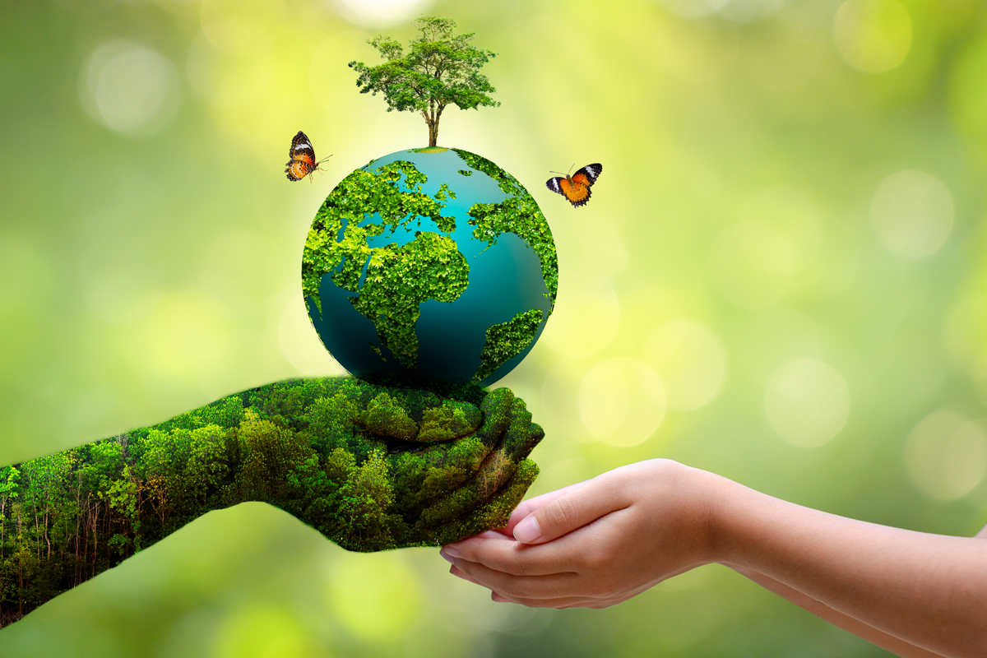


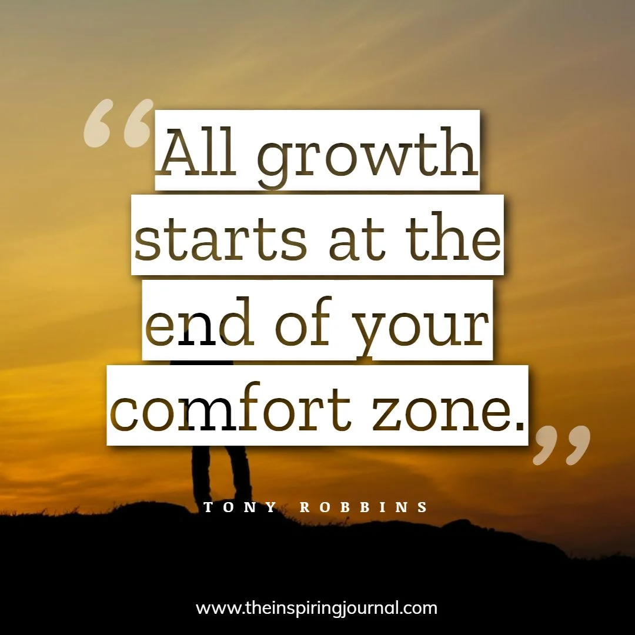
The theme for this half term:
School Mission Statement: Wisdom
The Equality and Diversity theme for this half term: Environment
The theme for this week: Expanding Your Environment
Click for the challenge of the day
Click for the verses of the day
Careers – Guess my job!
https://youtu.be/adfDrNgbqhg
Watch: Bear Grylls – expanding his environment through faith
https://youtu.be/qfiQoHyJC10
Click for a prayer

Slide 2
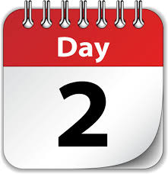

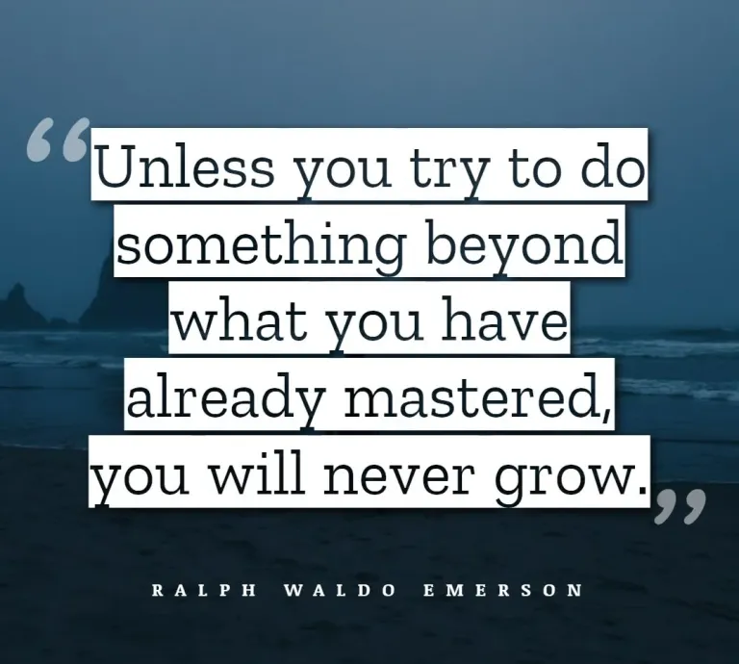


The theme for this half term:
School Mission Statement: Wisdom
The Equality and Diversity theme for this half term: Environment
The theme for this week: Expanding Your Environment
Click below for the challenge of the day
https://youtu.be/epjLamXJkmU
Click for the verses of the day
Word of the Day:
Merriam-Webster
Click for a prayer
Watch: Some more of Bear Grylls:
Extreme environments…
https://youtu.be/EucvD2TJ6xQ

Slide 3
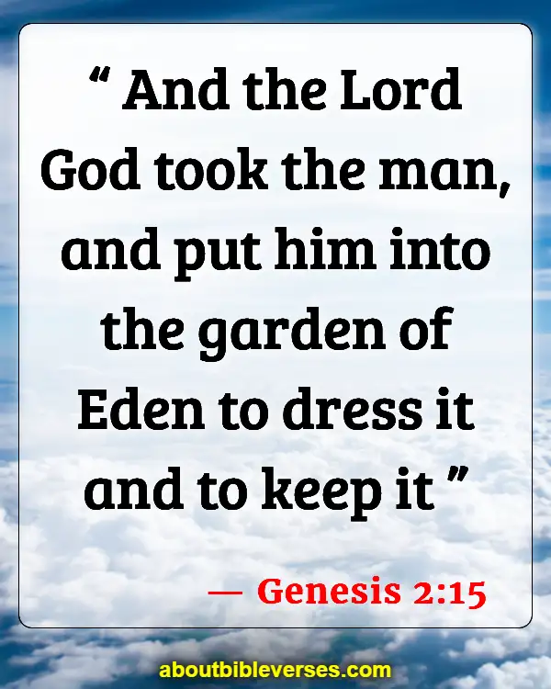
Click to go back
From the beginning, God gave man (Adam) responsibility. He was to look after the garden. (God also asked Adam to name the animals). Responsibility gives us the opportunity to use our talents and gifts and also collaborate with others. Once God had created a partner and helper for Adam (Eve), they worked together.
Question of the day:
What is the biggest responsibility you have been given in your life so far?

Slide 4

Click to go back
This is the full verse:
1 Chronicles 4:10 And Jabez called out to the God of Israel, "If only You would bless me and enlarge my territory! May Your hand be with me and keep me from harm, so that I will be free from pain." And God granted the request of Jabez.
Questions of the day:
Are you a big or small capacity person?
How much responsibility would you like one day? CEO? Headteacher? Manager of a football club? Doctor of something?

Slide 5
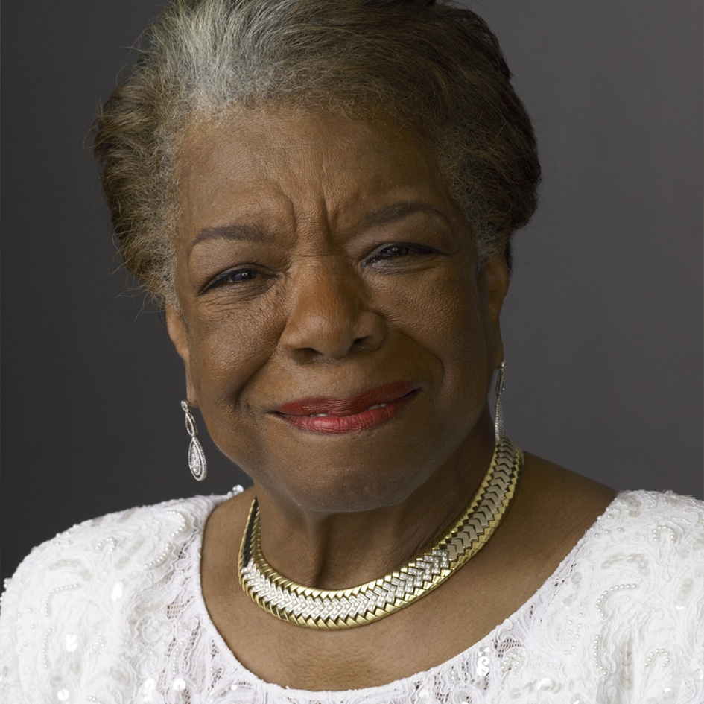
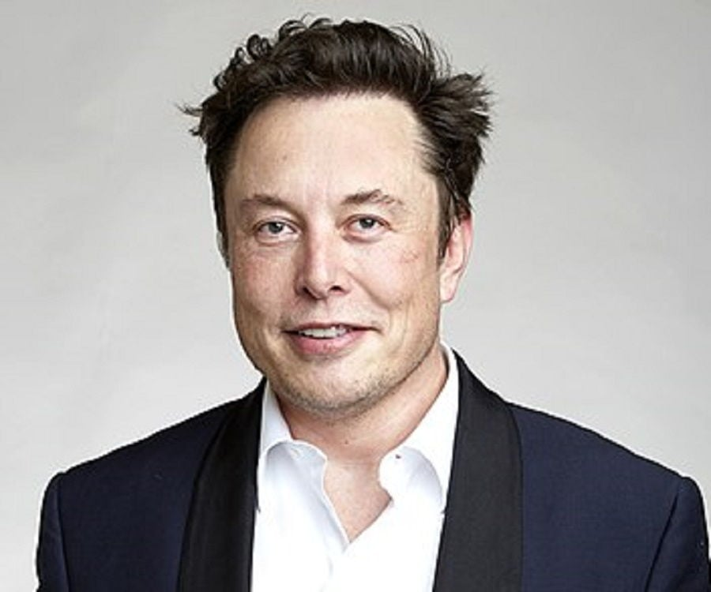
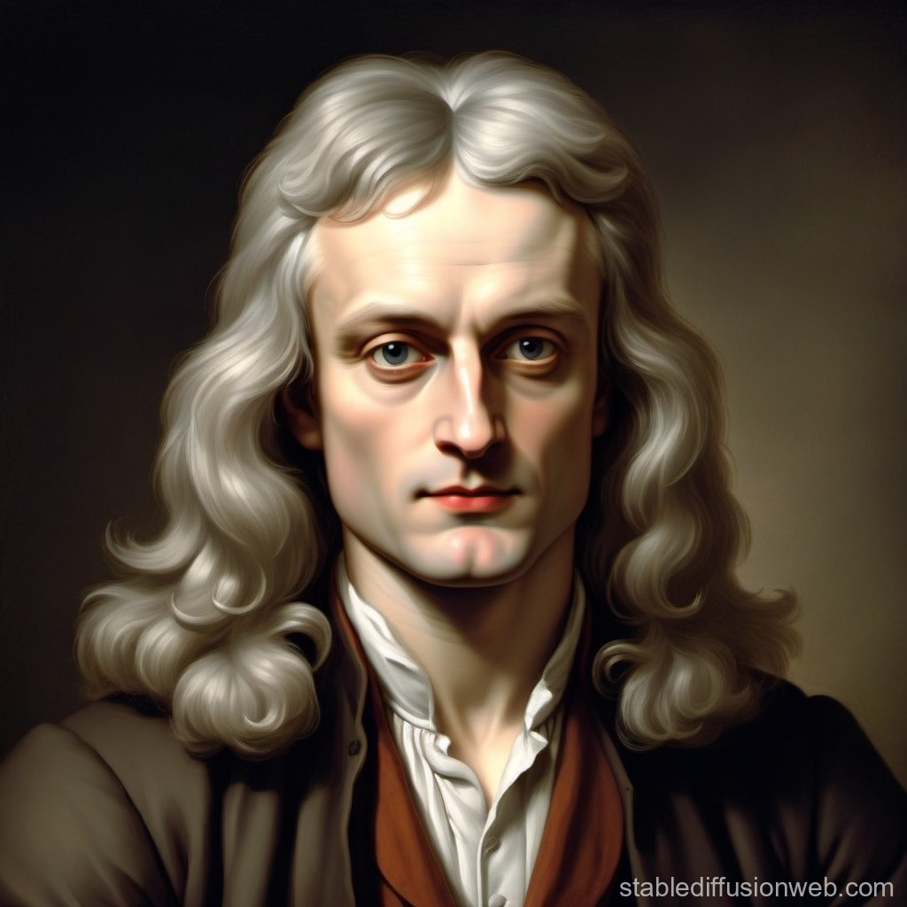
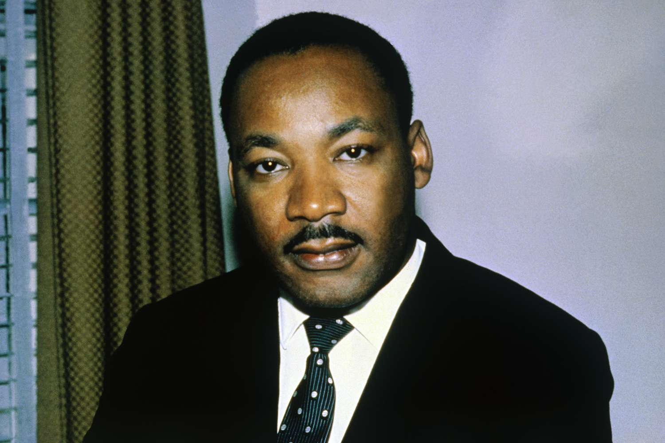
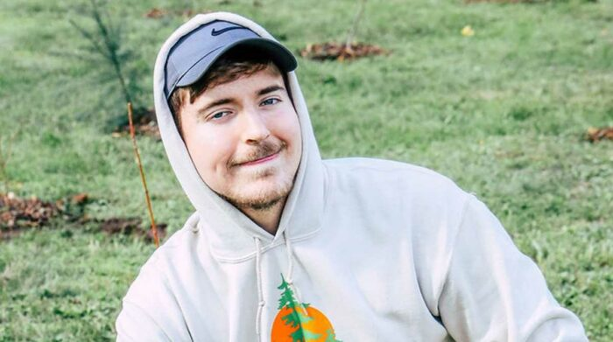
Can you name these world influencers?
Click for answers
Maya Angelou
Civil Rights Activist
Elon Musk
Businessman (Tesla, Space X, Twitter)
Isaac Newton
Mathematician, physicist, astronomer, alchemist, theologian, author and inventor
Click to go back
Martin Luther King
Minister, Civil Rights Activist
Mr Beast
Youtuber and Businessman

Slide 6
Let’s use the prayer of Jabez for today:
Almighty God
If only You would bless me and enlarge my territory! May Your hand be with me and keep me from harm!
Amen
Click to go back

Slide 7
Loving God
You have given us all wonderful gifts and talents that we may use them to benefit those around us. Help us to use what we have responsibly and with humility that we might not only expand our own territory, but encourage others to do the same.
Amen
Click to go back

Slide 8

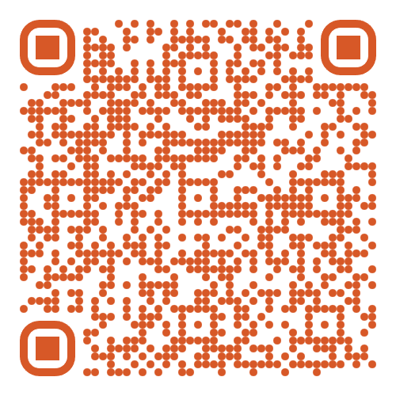
The School Production of 'Annie' is from Weds 4th Feb to Fri 6th Feb
Tickets are on sale NOW!
Scan this QR code to take you to Eventbrite to buy tickets
Click to go back

