Slide 1

Year 9 KS4
Options Evening
Think about:
What subjects did you enjoy at school?
How have the subjects you studied in your past benefitted your life?

Slide 2




GCSE Options
Subject decisions
Think carefully!
Determines your future
Notes:
Exciting but scary – big choices, need careful consideration
Year 9 options are the decisions you make as to which subjects you wish to continue studying and which subjects you will drop!
▪ It is vital that you think carefully about the choices you make and the subjects you chose.
▪ The decisions you make can impact on your future choices

Slide 3
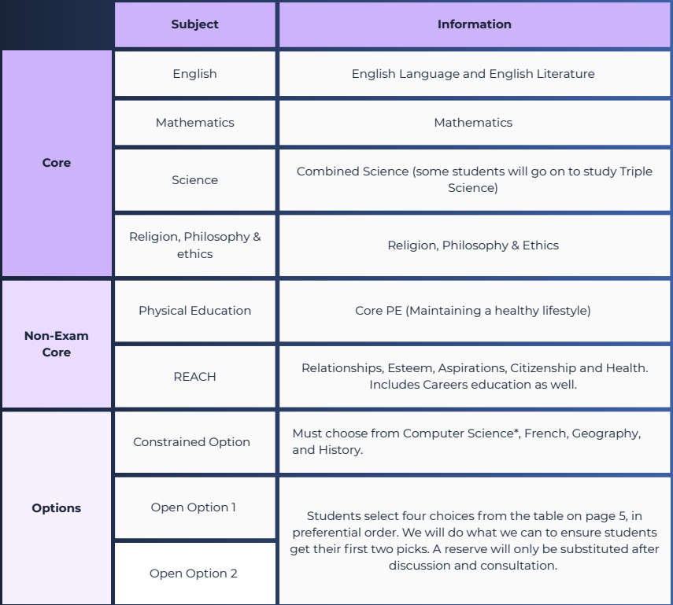
KS4 Study

Slide 4
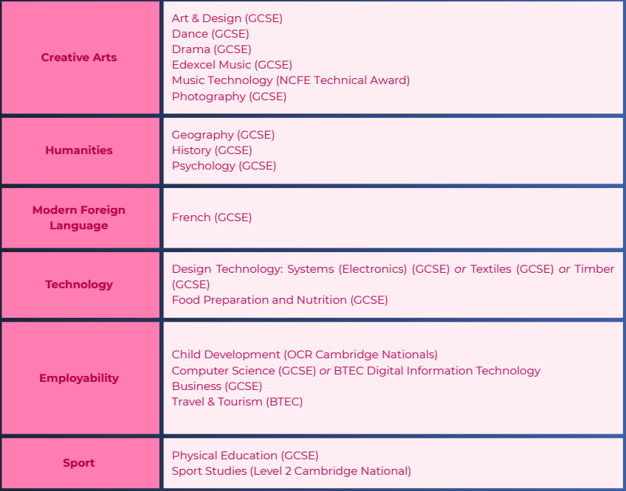
KS4 Study

Slide 5



How do you choose the right subject?
What do you enjoy?
What are your strengths?
What will help your future?
Notes:
First, think about what you enjoy and what you’re good at. If you like a subject and usually do well in it, that’s a strong sign it could be a good choice. You’ll spend a lot of time on these subjects, so pick ones that motivate you.
Second, keep your options open. Even if you’re not sure about your future career, choosing a broad mix of subjects gives you flexibility later. For example, languages, sciences, and humanities all develop skills that employers and universities value.
Third, understand how each subject is assessed. Do you prefer exams or coursework? Do you enjoy writing, practical work, or creative projects? Check the details in the options booklet and ask questions at the Options Evening.
Finally, make your decision for YOU—not for your friends or because you like a teacher. Teachers can change, and friends may choose different paths. Focus on what suits your interests and strengths.

Slide 6

3 Option Choices, 2 Reserves
Reserve choices are important!
We do our best to ensure students get their first choice, however we are constrained by logistics and demand.

Slide 7
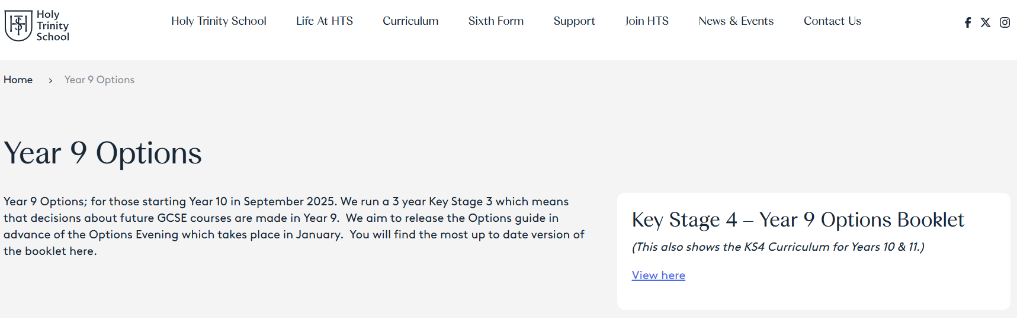
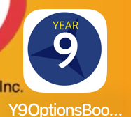
Options Booklet – App and Website

Slide 8
GCSEs vs Vocational Level 2 Qualifications
GCSE:
Mostly external written exams taken at end of Year 11
Grade 9 (highest) to Grade 1 (lowest)
Vocational Level 2 :
60% coursework-based assessment completed in lessons through Year 10 and 11, 40% exam at end of Year 11
Grade Pass – Distinction*

Slide 9

English Baccalaureate (EBacc)
Grade 5 or higher in the below subjects:
English
Maths
Science (combined or triple)
French
Geography or History
Recognised by universities as developing key skills, it is not an extra qualification.

Slide 10

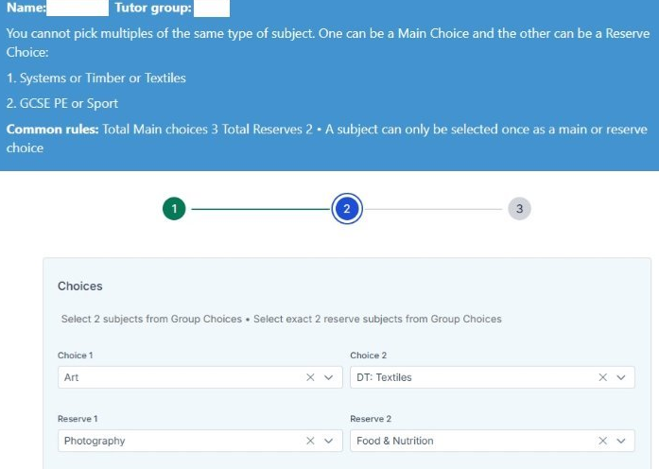
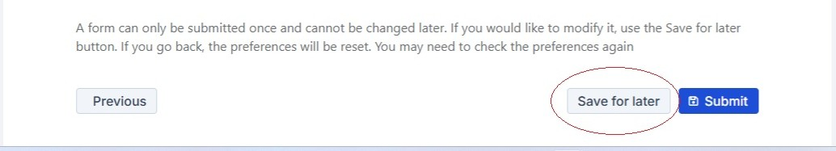
Options Form
Available on student portal tomorrow
Students select options in tutor time
Submit by Friday 6th February

Slide 11


Support?
Visit subject teachers (even for subjects you aren’t sure you will pick)
Exam Access and SEND – 126
PPE Results – 123
Triple Science - 129

Slide 12
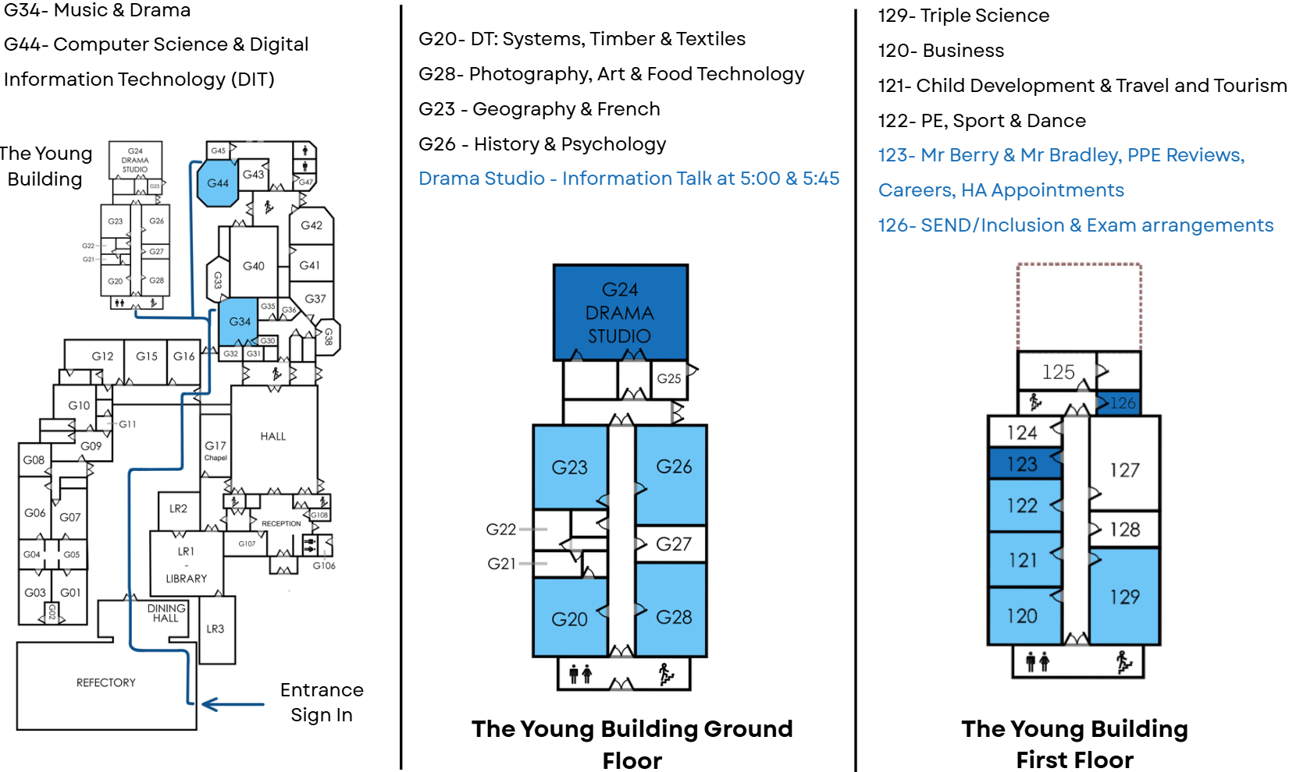
Where?
Visit subject teachers (even for subjects you aren’t sure you will pick)
Exam Access and SEND – 126
PPE Results and HA – 123
Triple Science - 129

