Slide 1
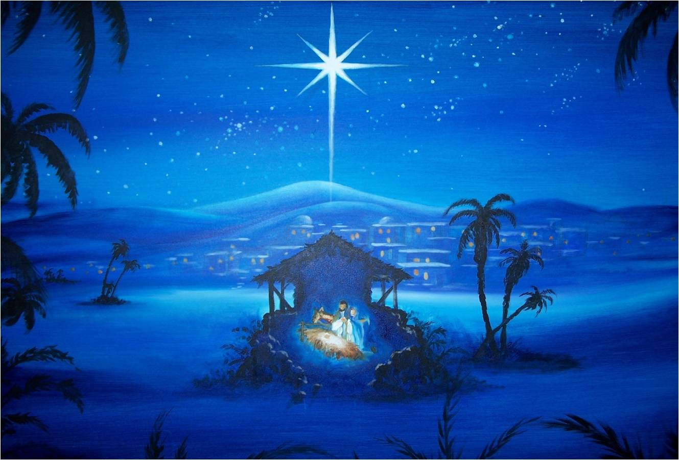
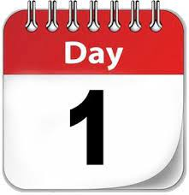

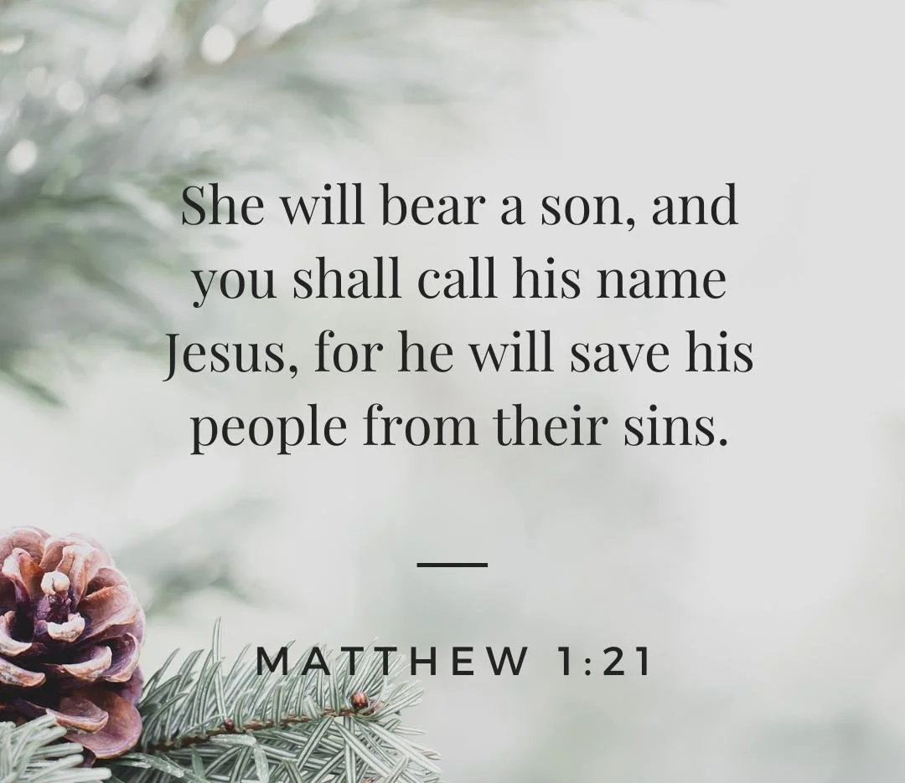
The theme for this half term:
School Mission Statement: Deeply Christian; Open to All
The Equality and Diversity theme for this half term: Religion/Belief
The theme for this week: Christmas
Click for the challenge of the day
Click for the verses of the day
Careers – Guess my job!
https://youtu.be/ik71Yd1yZ7Q
Click for a prayer
Watch: A story of Christmas
https://youtu.be/vmi5xQcB9zA

Slide 2

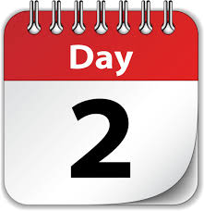
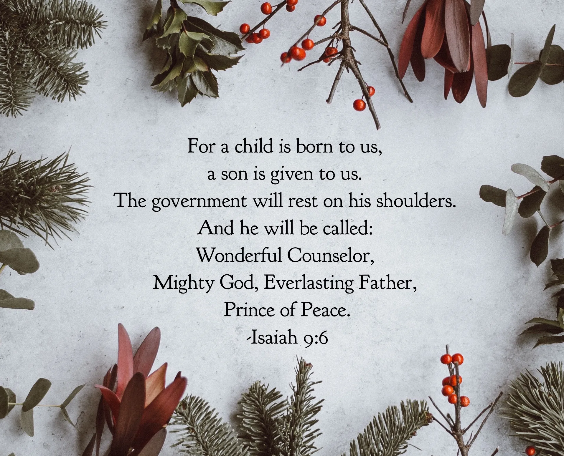

The theme for this half term:
School Mission Statement: Deeply Christian; Open to All
The Equality and Diversity theme for this half term: Religion/Belief
The theme for this week: Christmas
Click for the challenge of the day
Click for the verses of the day
Word of the Day:
Merriam-Webster
Watch: Two accounts of the birth of Jesus
https://youtu.be/B9Iozh6NBPA
https://youtu.be/TWMOV1Xg6nQ
Click for a prayer

Slide 3
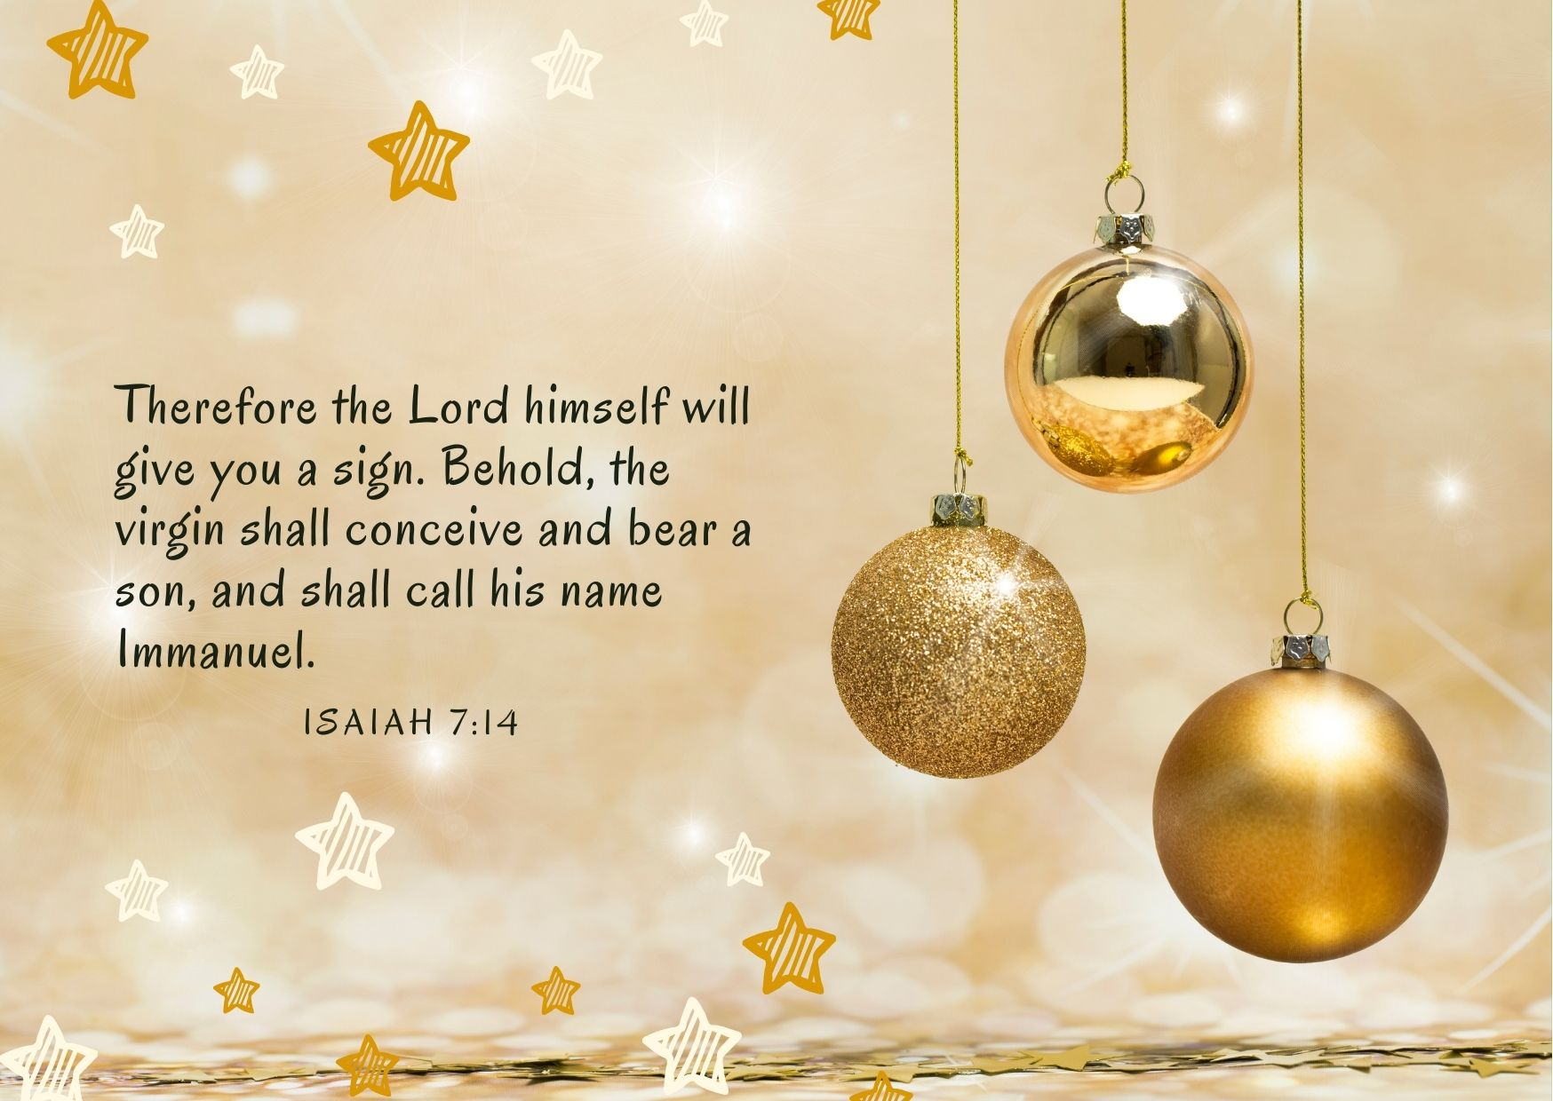
Click to go back
The name ‘Immanuel’ means God is with us. God’s message to the world through the birth of Jesus is that although the sin we commit as human beings separates us from God, Jesus’ birth, death and resurrection covers over that sin and makes a way back to God. God could have reconciled us to Him in another way, but He chose to renew the broken covenant between Him and us through the sacrifice of his son, Jesus
Questions of the day:
Do you think we live for eternity?
Can you give a reason for your answer?

Slide 4
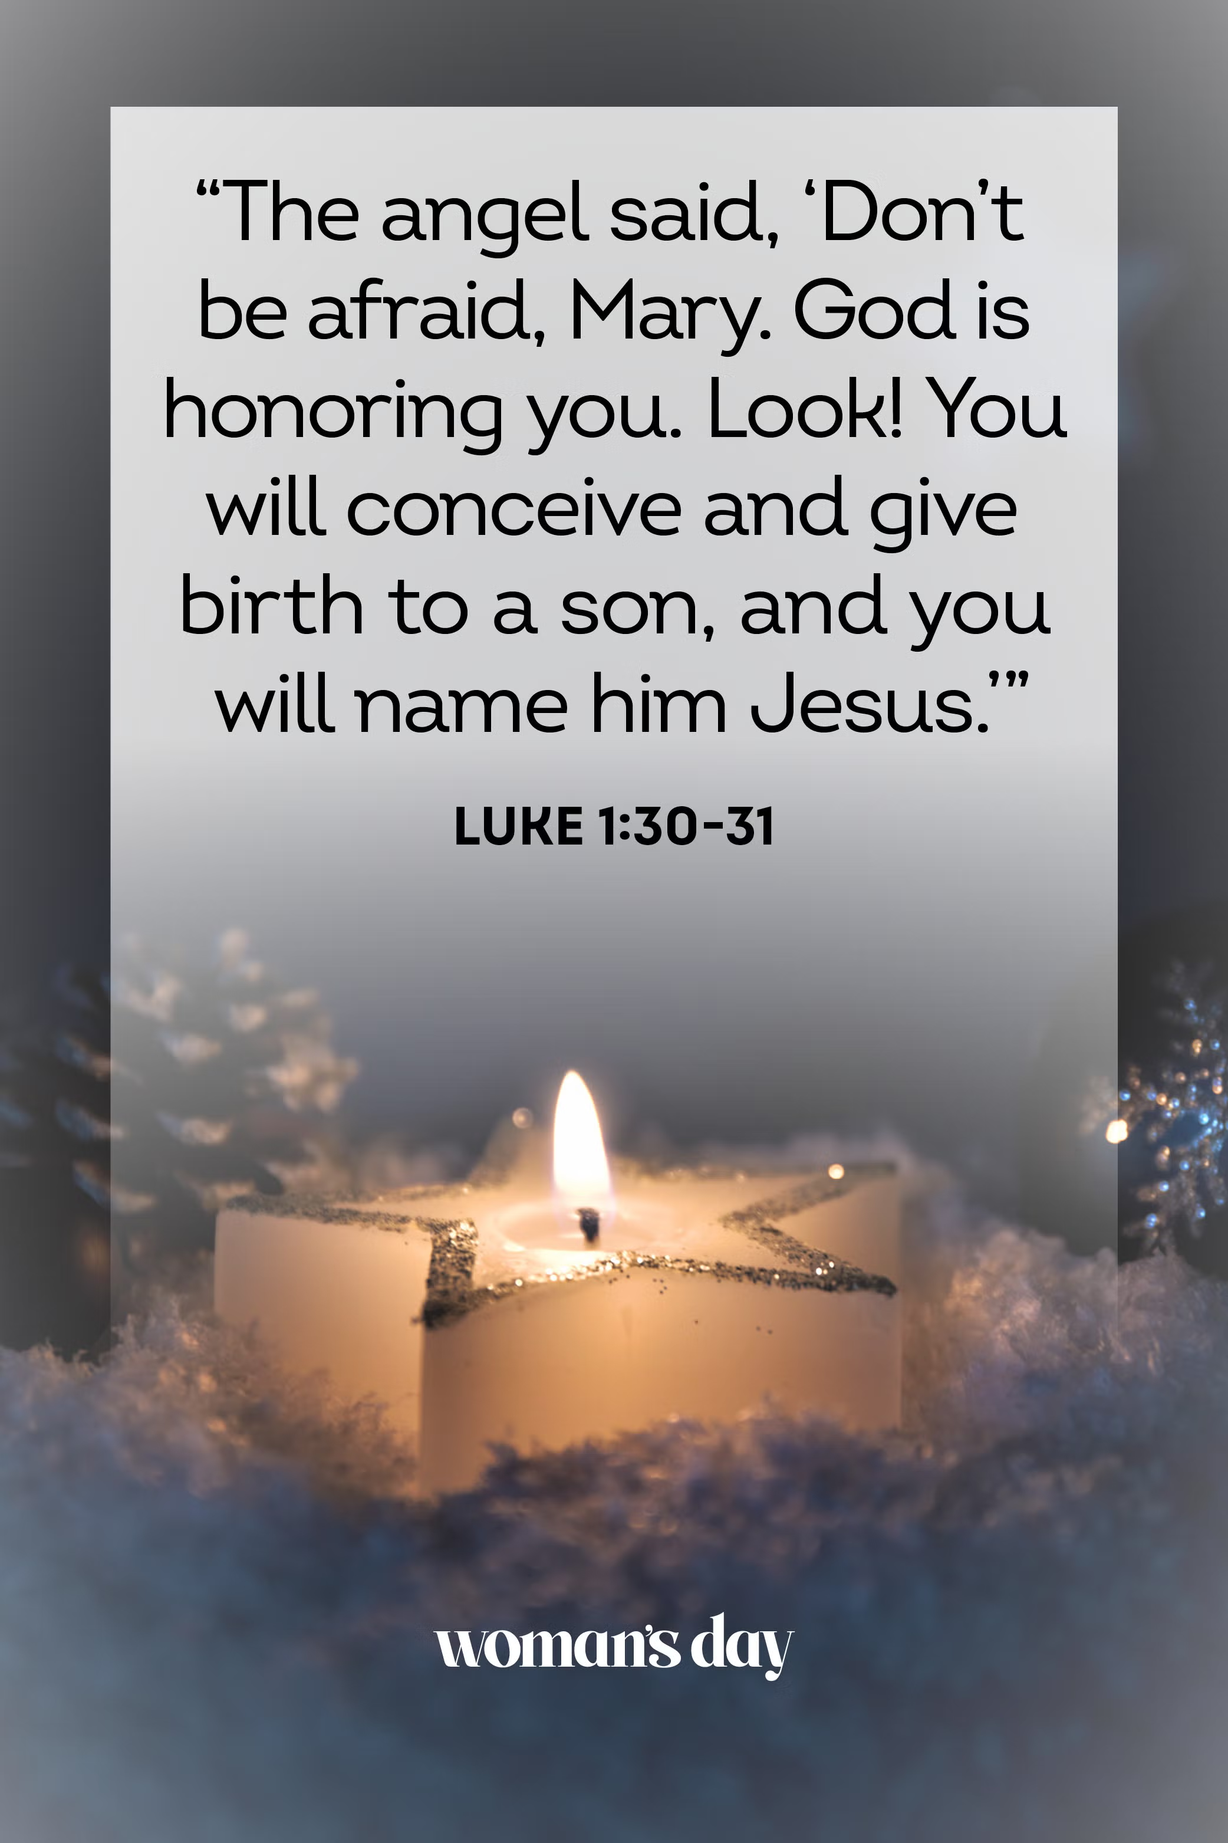
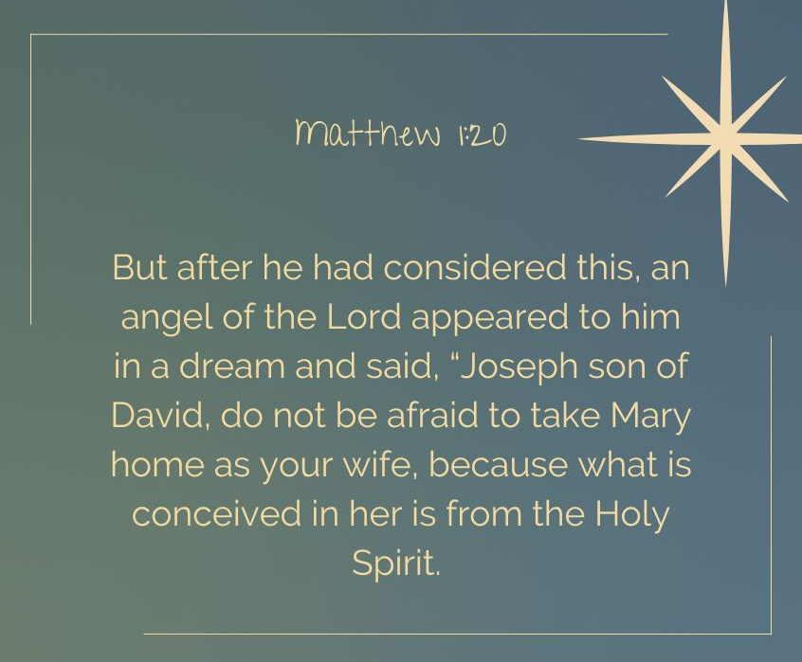
Click to go back
Here, God communicated with both Mary and Joseph through angels as He could see they were both afraid and confused about what was happening to them. It must have been quite a big shock for the two of them to find they were to have a child when they were not married (also meaning they would not have yet been intimate). Not only that, but that they were to parent the son of God
Question of the day:
What is the biggest surprise you’ve ever had?

Slide 5

Click for answers
Click to go back

Slide 6

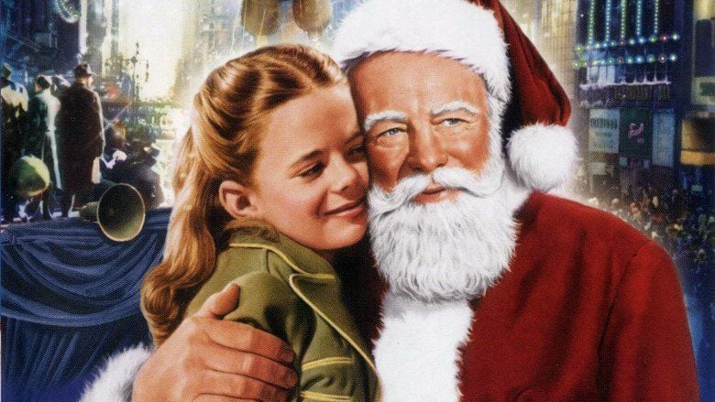
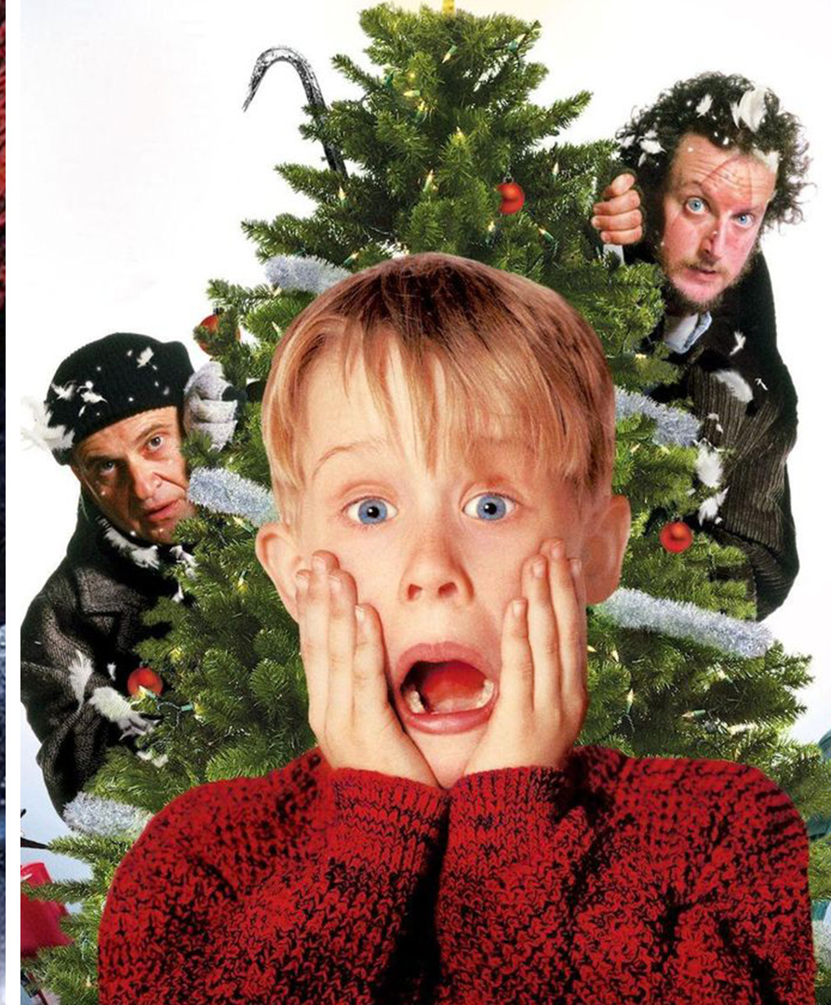
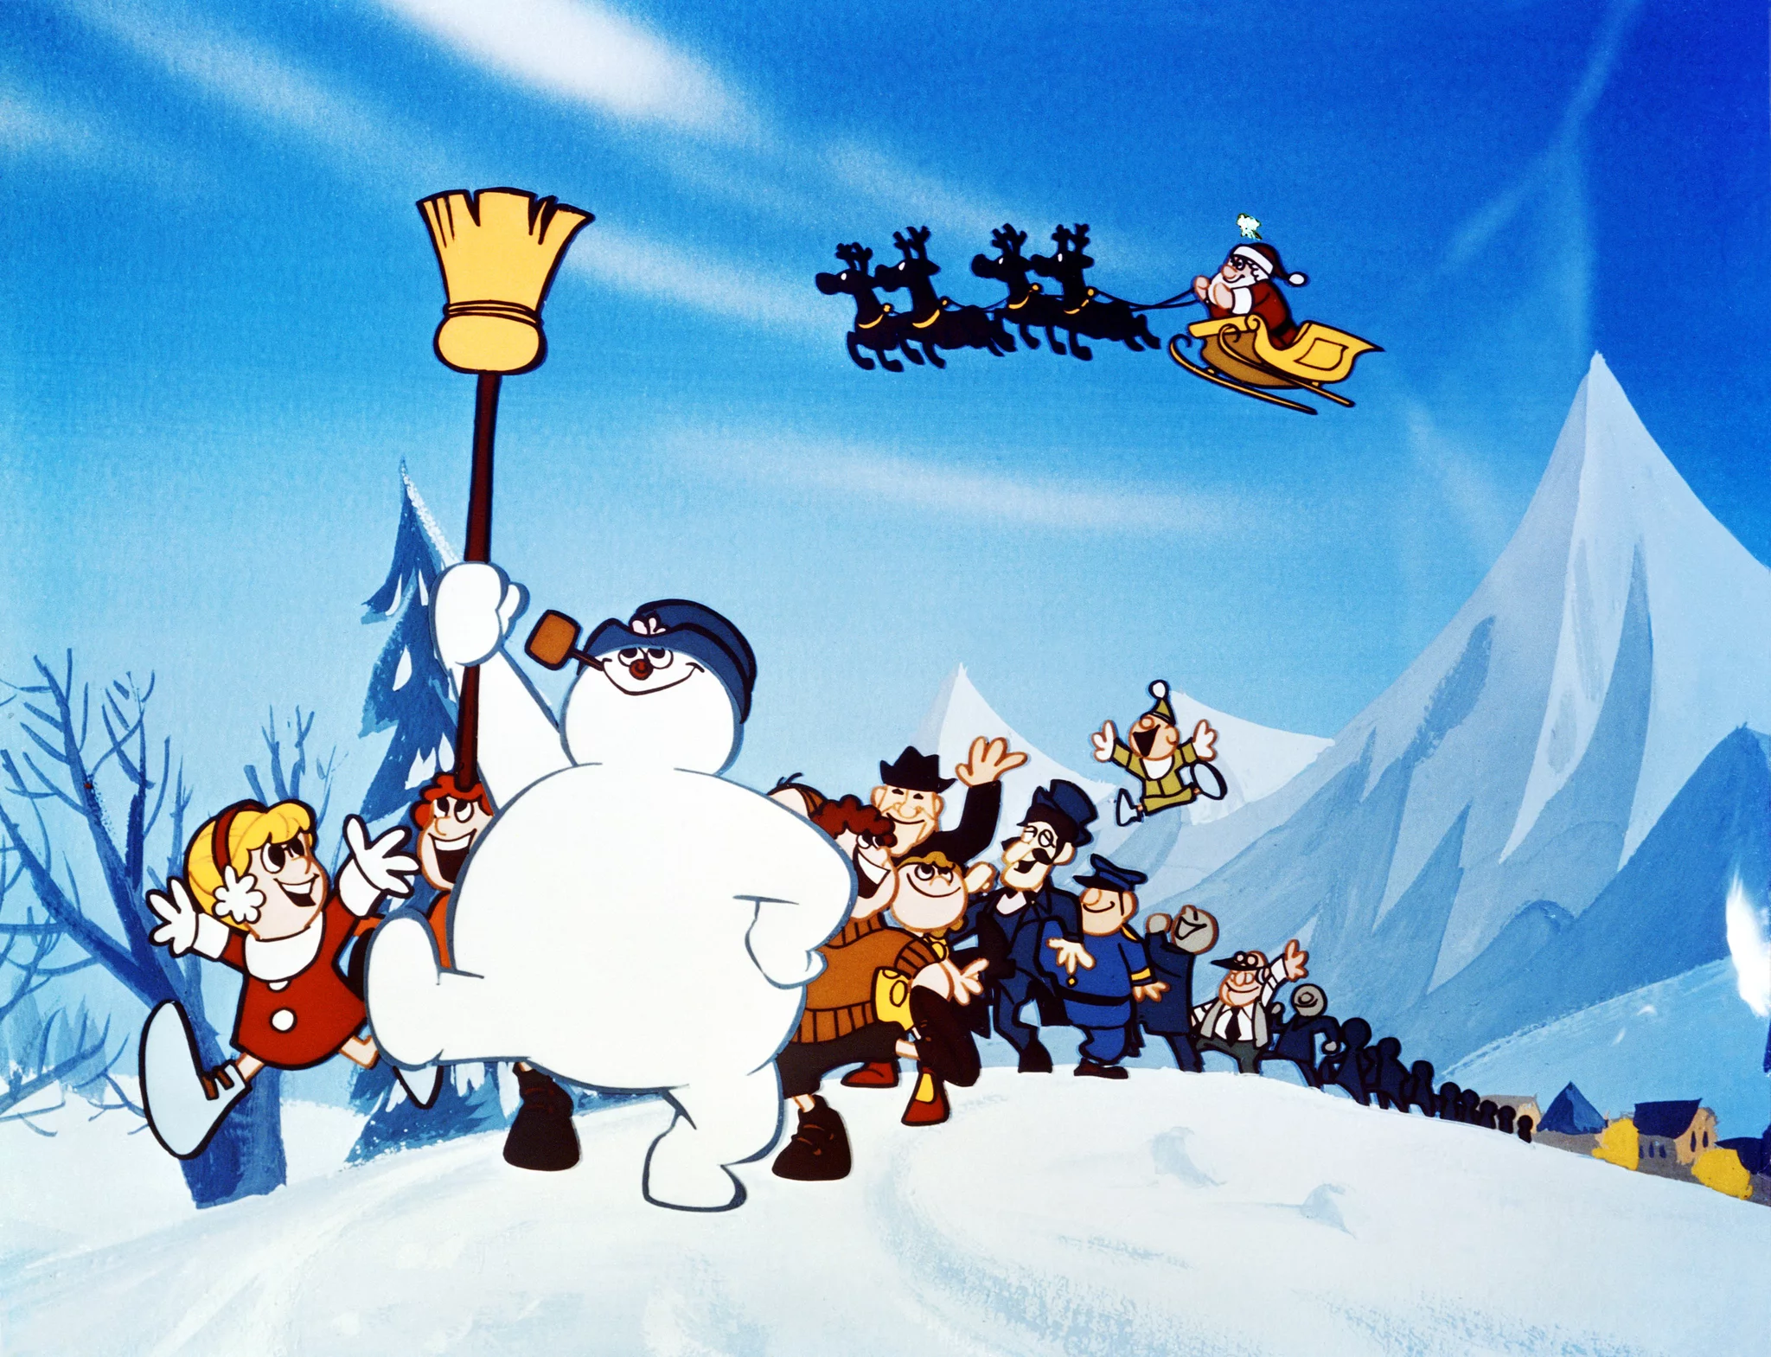
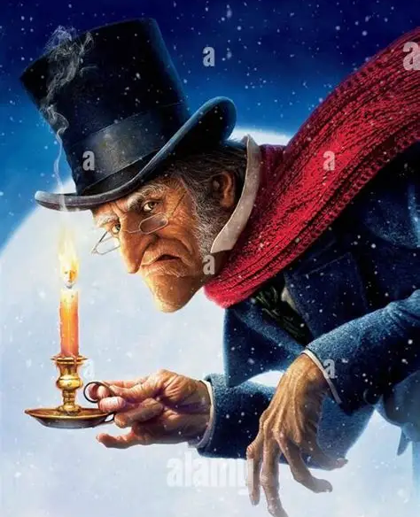
Can you recognise these Christmas films?
Click for answers
Elf
Miracle on 34th Street
Home Alone
Click to go back
Frosty the Snowman
A Christmas Carol

Slide 7

Click to go back

Slide 8
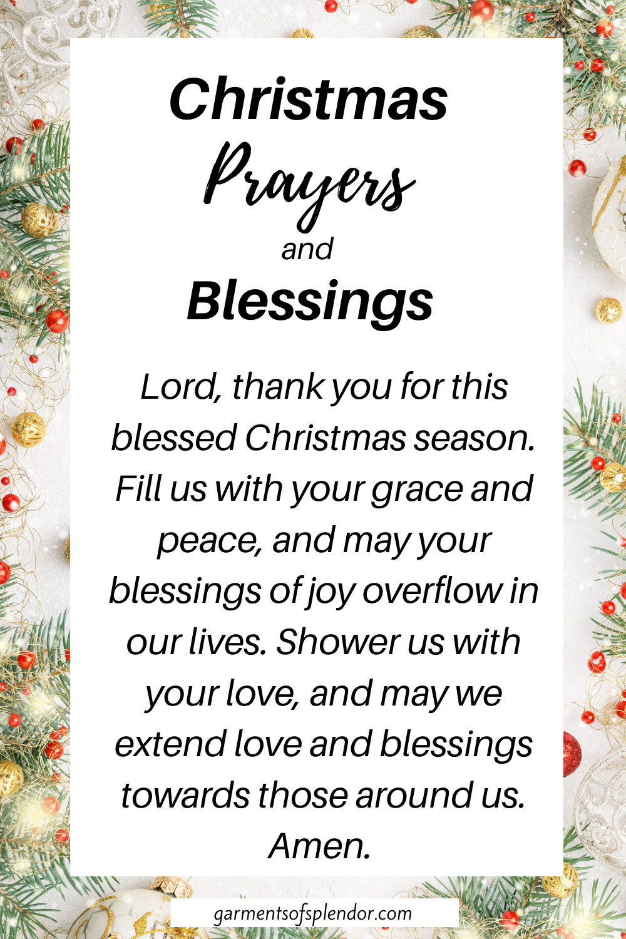
Click to go back

