Slide 1




The theme for this half term:
School Mission Statement: Deeply Christian; Open to All
The Equality and Diversity theme for this half term: Religion/Belief
The theme for this week: Celebrating Success
Click for the challenge of the day
Click for the verses of the day
Careers – Guess my job!
https://youtu.be/fBgykERWqEI
Click for a prayer
Watch: Some motivation for success
https://youtu.be/J3KP7nR9iJ0

Slide 2




The theme for this half term:
School Mission Statement: Deeply Christian; Open to All
The Equality and Diversity theme for this half term: Religion/Belief
The theme for this week: Celebrating Success
Click for the challenge of the day
Click for the verses of the day
Word of the Day:
Merriam-Webster
Click for a prayer
Watch: Be motivated
https://youtu.be/DLAEYCO9HqQ

Slide 3
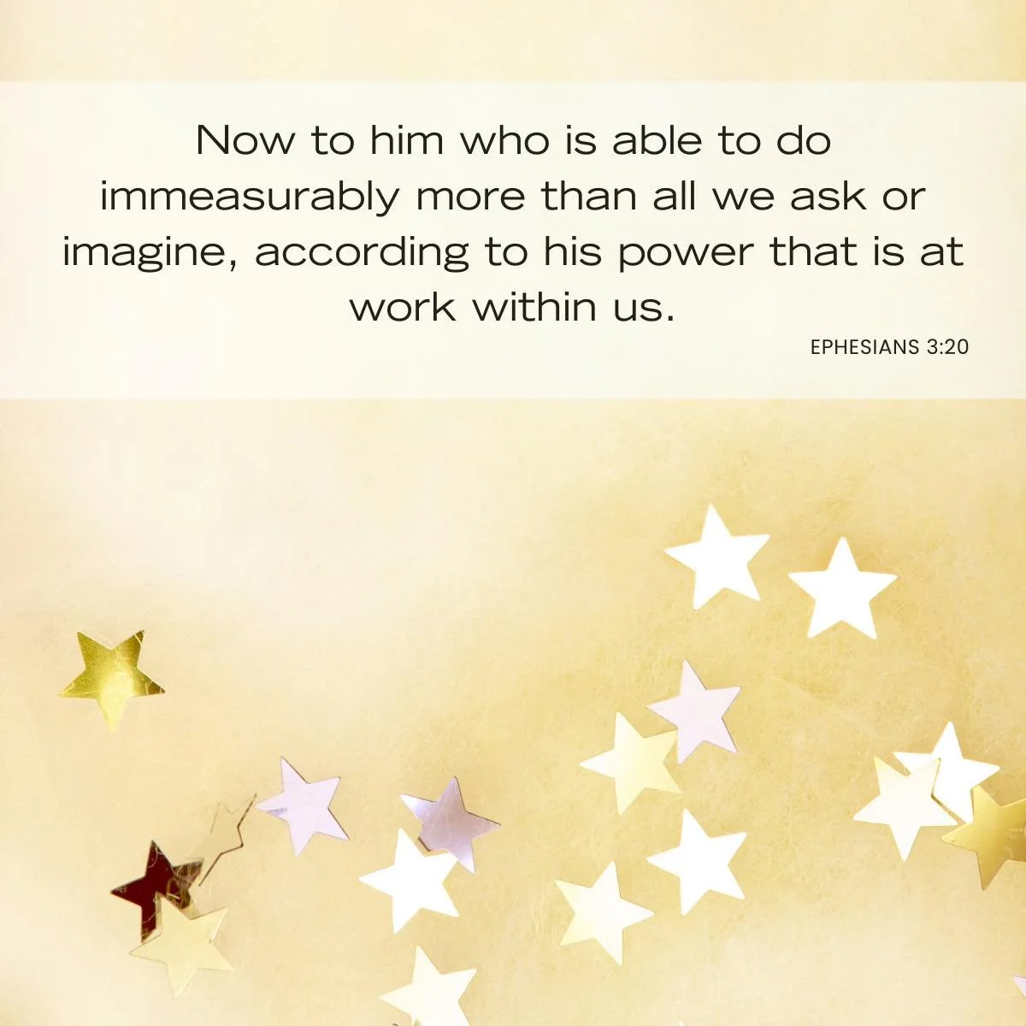
Click to go back
Paul’s message to the church in Ephesus was that, if they allowed Him, God would help them achieve a lot more than they could on their own. We can take encouragement from this and allow Him to work through us with the same expectation. Sometimes it’s our unbelief (and also our pride) that stops this from happening
Question of the day:
If you could pick one thing that you want to achieve in life (and believe you have the ability to achieve it but would need God’s help), what would that be?

Slide 4
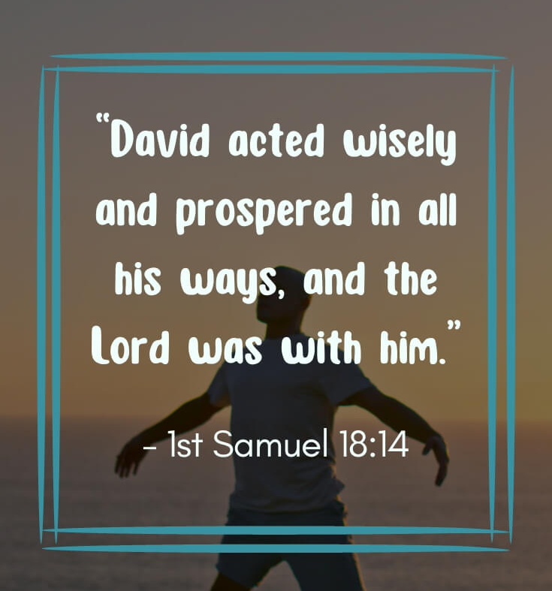
Click to go back
This verse from Samuel can be read from two different angles:
God was with David; David acted wisely and because of those things, he prospered
David acted wisely and because of that, he prospered and then the Lord was with him as a result of this
Question of the day
Do you think it’s No.1 or No.2 and why?

Slide 5
Here are three synonyms for the word achievement.
Can you work them out from their anagrams?
bat mention
obtainment
Click for answers
meant titan
attainment
Click to go back
mirth up
triumph

Slide 6

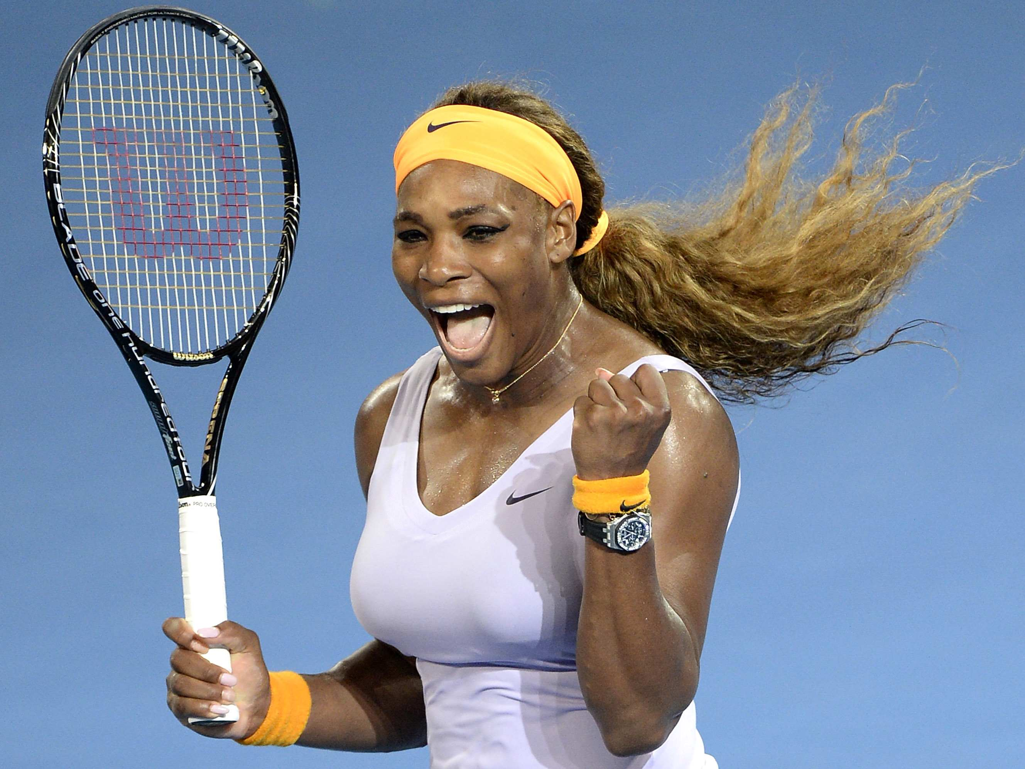
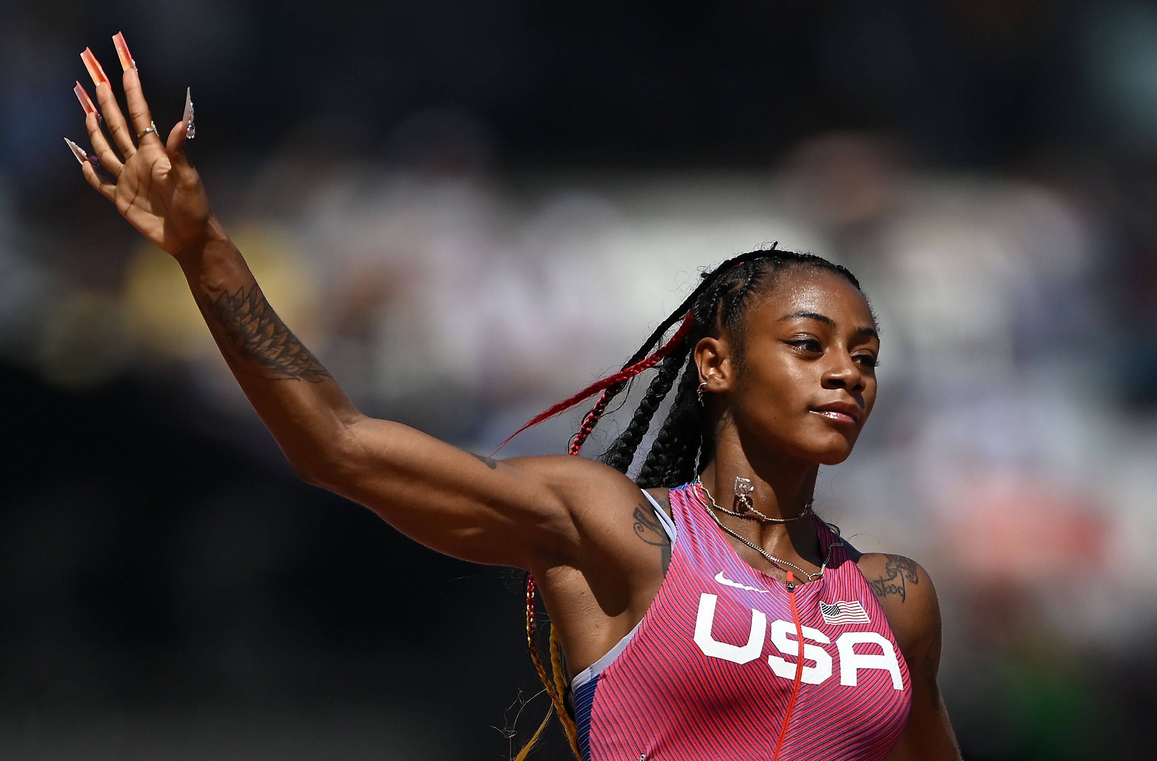

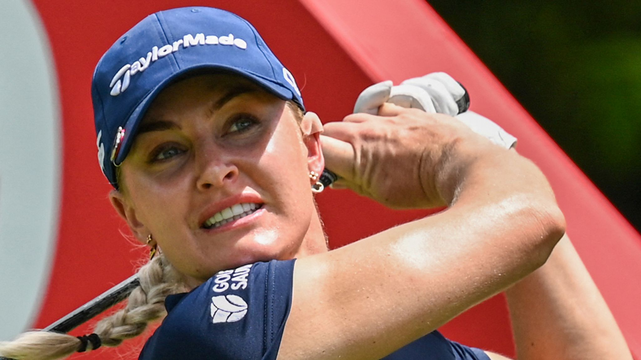
Here are 5 women sports personalities
Can you guess who they are?
Click for answers
Lauren Hemp
Football
Serena Williams
Tennis
Sha’Carri Richardson
Athletics
Click to go back
Simone Biles
Gymnastics
Charlie Hull
Golf

Slide 7
Almighty God
You have given each of us different talents and gifts on purpose that we may compliment one another. Where one is lacking, another is competent. Help us to recognise our own strengths, the strengths of others and how these strengths, and any weaknesses, can be used together to bring about not just success, but humility and understanding.
Bless us in all we do today.
Amen
Click to go back

Slide 8
Gracious God
In Your infinite wisdom, You create a world where we need each other. Help us to accept this rather than oppose it. Help us to actively look how our achievements can be used to help others and keep us humble enough to recognise the success of others.
Continue to work through us for our good.
Amen
Click to go back

