Slide 1



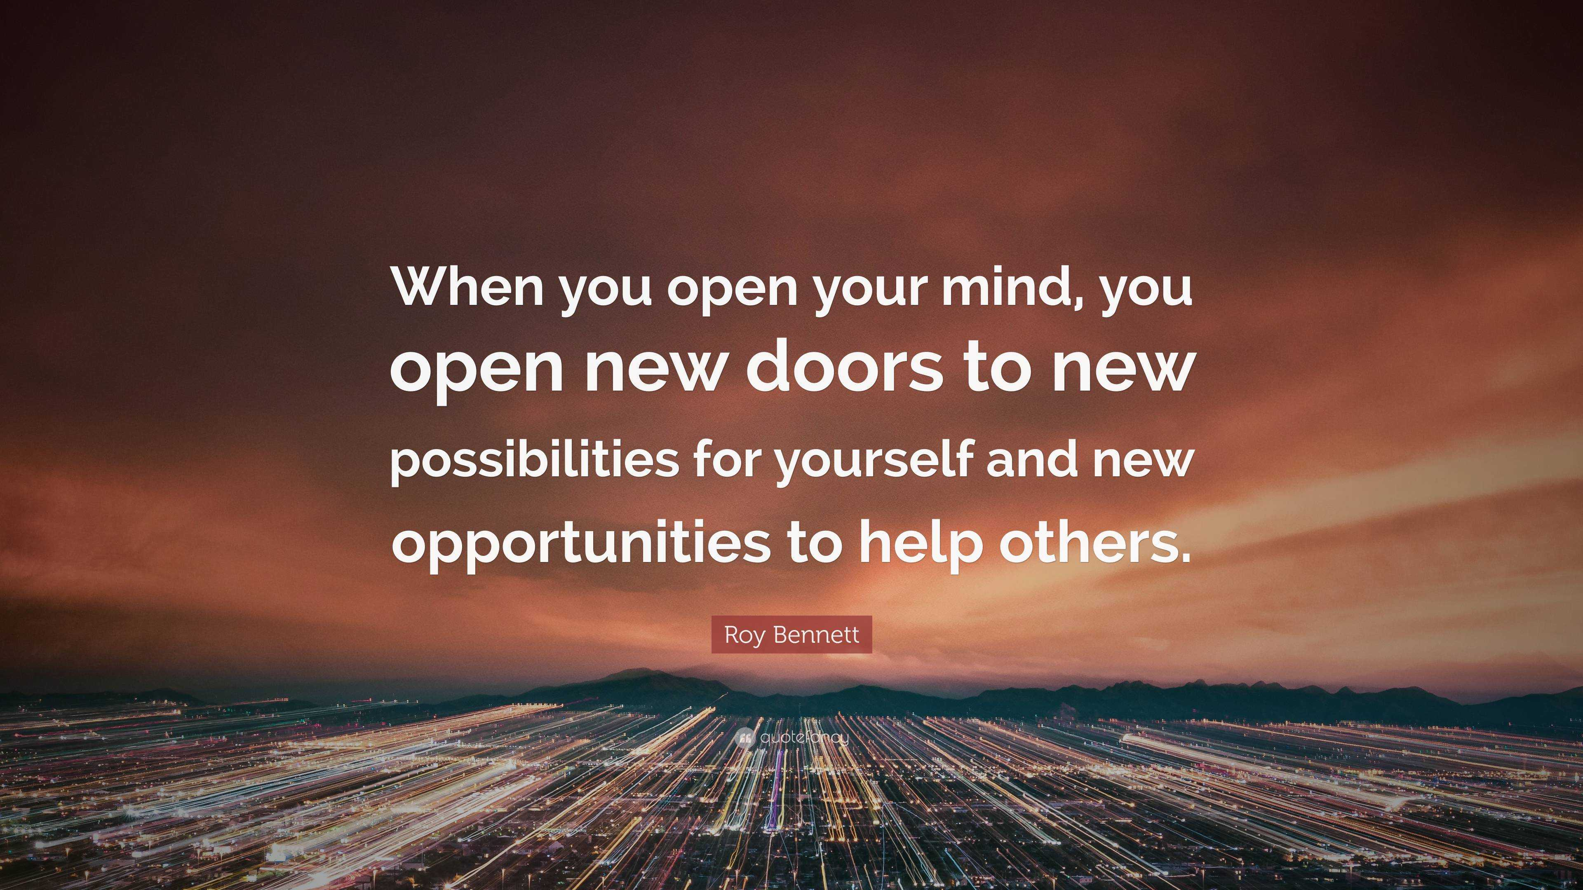

The theme for this half term:
School Mission Statement: Deeply Christian; Open to All
The Equality and Diversity theme for this half term: Religion/Belief
The theme for this week: Open to All
Click for the challenge of the day
Click for the verses of the day
Careers – Guess my job!
https://youtu.be/nnHcN-VWdxk
Click for a prayer
Watch: What does it mean to be a Christian or follower of Jesus?
https://youtu.be/lCodxfn6EG0

Slide 2

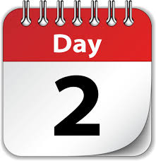
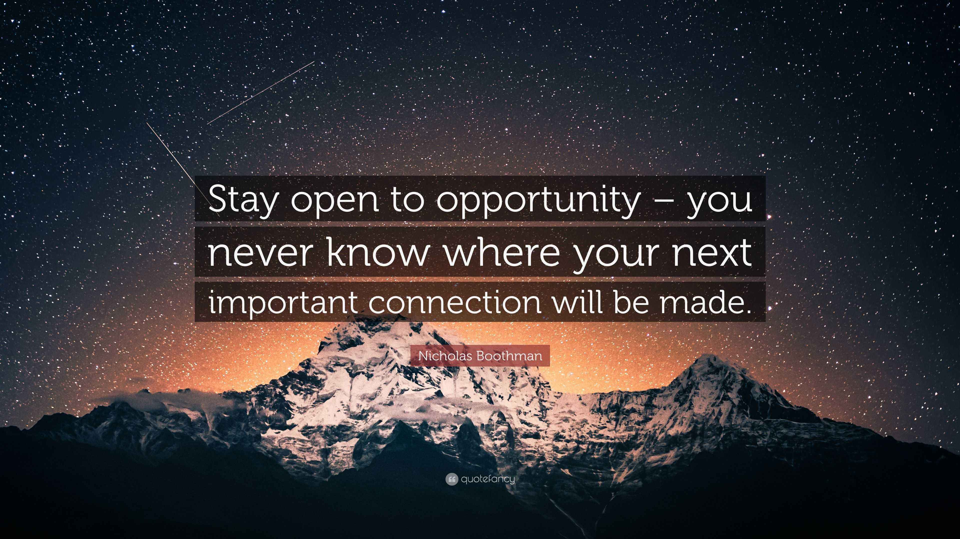
The theme for this half term:
School Mission Statement: Deeply Christian; Open to All
The Equality and Diversity theme for this half term: Religion/Belief
The theme for this week: Open to All
Click for the challenge of the day
What is your Bible knowledge like?
https://youtu.be/QQPxgPh1Kos
Click for the verses of the day
Word of the Day:
Merriam-Webster
Click for a prayer
Watch: Jesus was open to helping everyone
https://youtu.be/JMj1ggINLe4

Slide 3
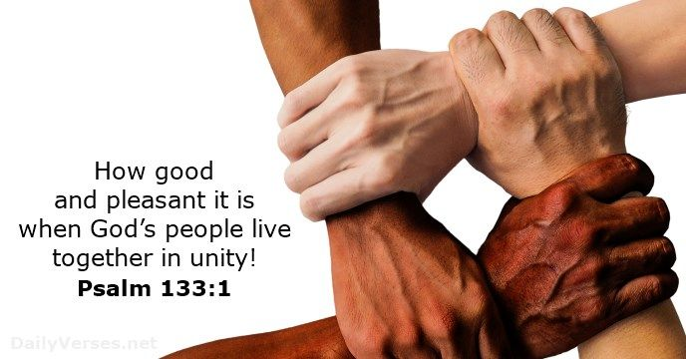
Click to go back
In this Psalm, David talks about unity, however, he specifically addresses ‘God’s people’.
Question of the day:
What would unity look like in our world today and what would it take to achieve?

Slide 4
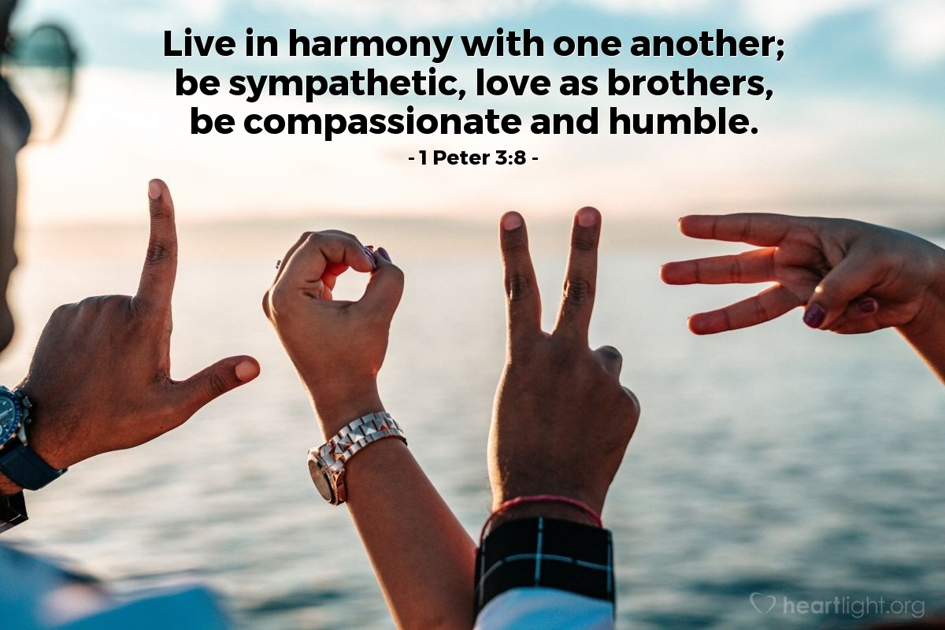
Click to go back
Here, Peter is talking to those who are followers of Jesus. This challenge, however, can be for all of us.
Challenge of the day:
Next time you want to say something unhelpful to anyone, why don’t you pause, stop yourself and say nothing. Try this for one whole day…

Slide 5
Here are four religions
Can you work them out from their anagrams?
maj nisi
Jainism
Click for answers
fun mic casino
Confucianism
Click to go back
him skis
Sikhism
amos it
Taoism

Slide 6
Loving God
As a diverse community, we are aware of the huge differences we both acknowledge and share. As a school, we seek to be both deeply Christian and open to everyone.
Help those of us who have a faith to share it in love, and, at the same time, be accepting of everyone, just as Christ was.
Amen
Click to go back

Slide 7
Loving God
As we open our doors to everyone and accept all people into our school, help us to talk openly with each other and listen authentically.
You have made us in Your image and Your desire is that we all would come to know you as God. We ask that You would bless our school community, continuing to bring us together in unity and faith.
Amen
Click to go back

