Slide 1
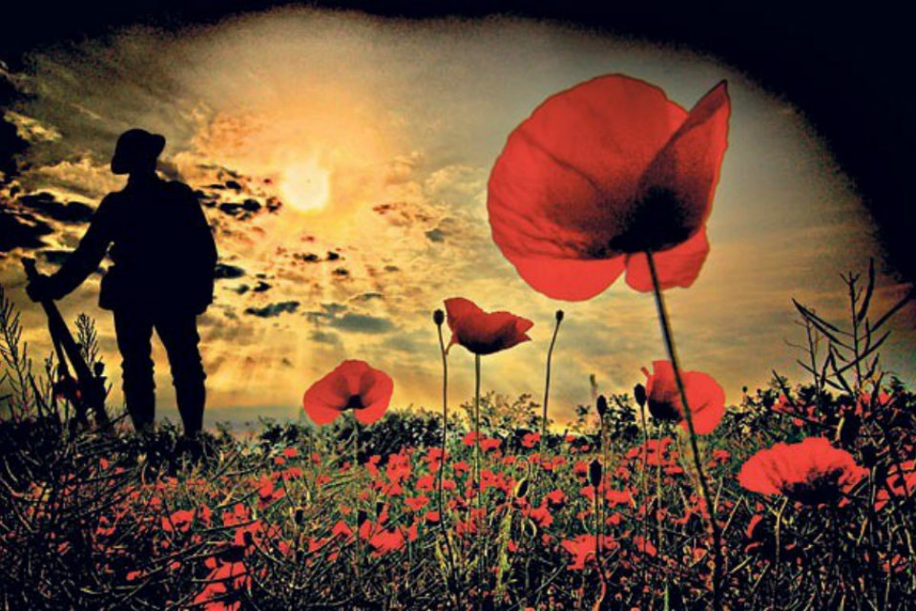
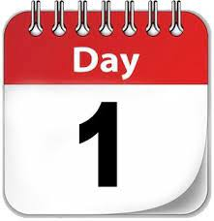

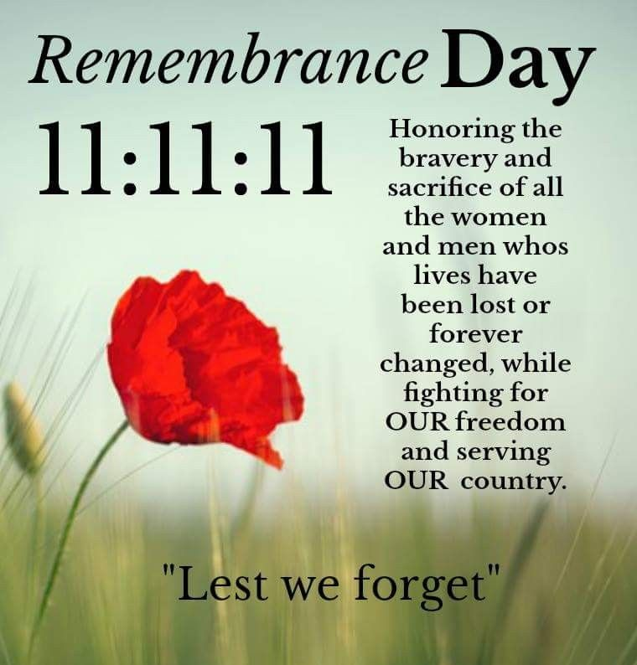
The theme for this half term:
School Mission Statement: Deeply Christian; Open to All
The Equality and Diversity theme for this half term: Religion/Belief
The theme for this week: Remembrance
Click for the challenge of the day
25 Remembrance Day Quiz Questions and Answers - Kwizzbit
Click for the verses of the day
Careers – Guess my job!
https://youtu.be/H0OY9LIyeYU
Click for a prayer
Watch: What is Remembrance Day?
https://youtu.be/MKT1JPdMoCA

Slide 2

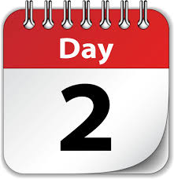
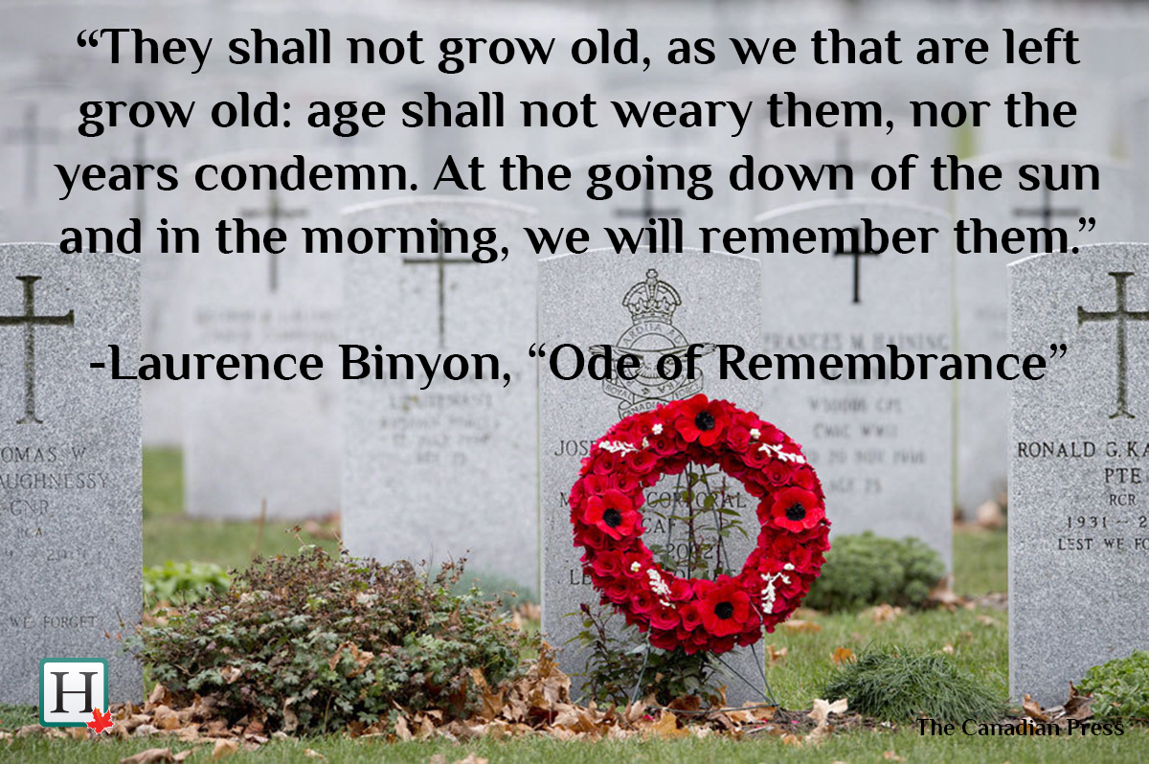

The theme for this half term:
School Mission Statement: Deeply Christian; Open to All
The Equality and Diversity theme for this half term: Religion/Belief
The theme for this week: Remembrance
Click for the challenge of the day
Click for the verses of the day
Word of the Day:
Merriam-Webster
Click for a prayer
Watch: World War 1 from a veteran…
https://youtu.be/SIwOSXcVQm8

Slide 3
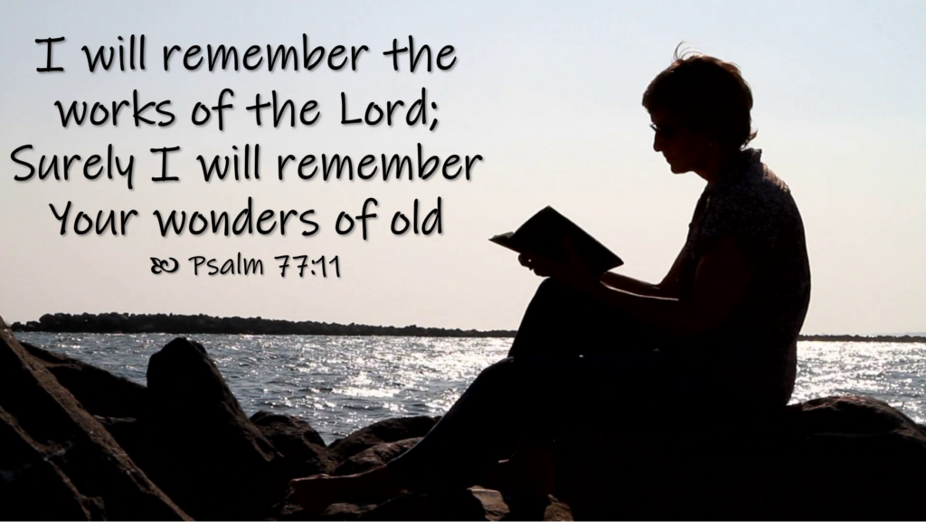
Click to go back
Taking time to remember people who have changed the course of history can be a useful exercise. Those who have fought for freedom all over the world deserve the respect and honour that is given them and remembering what they have done is important.
In the same way, King David says here in Psalm 77 that he will remember what God has done in the past. God had provided for David as a boy when David had been a shepherd and had to fight off lions and bears and also when he stood up to fight Goliath when none of the army would. He protected David when King Saul tried to kill him and also promised David that he would be king and that his people would have a land in which to live and dwell for centuries to come
Question of the day:
What would you like to do with your life that people might remember in years to come?

Slide 4
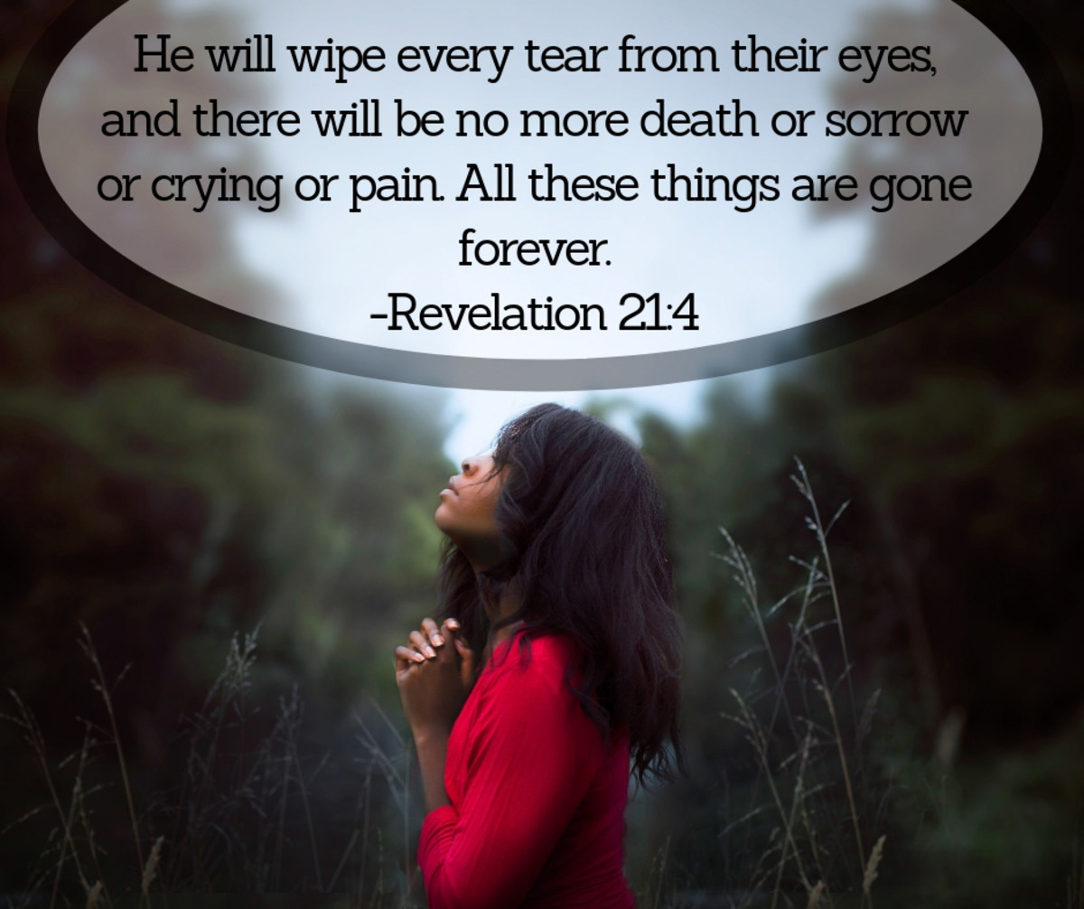
Click to go back
The book of Revelation is believed to have been written by the disciple John. It is also believed that John received all the visions relayed in this book while he was on the island of Patmos.
Questions of the day:
Whose tears will God wipe away?
Why will death, sorrow, crying and pain be ‘gone forever’?
Click here for some thoughts

Slide 5
God will wipe away the tears of those who have believed in Him and who will spend eternity with Him. God says that while we are on earth, we will have ‘trouble’. God understands that people are capable of making good and bad choices and He never promises to take these away from us – even those who believe will struggle. That is because you cannot live on an earth where there is so much wrong (and also a lot that is right) and expect to escape trial. But God promises that in heaven, everything that is evil, bad, corrupt and broken will not be present
Click to go back

Slide 6
Here are 4 anagrams to do with Remembrance
Can you work them out?
crisis face
sacrifices
Click for answers
oils red
soldier
Click to go back
drawl for wrist
First World War
irate mics
armistice

Slide 7
Loving God
As we take time to remember those who were affected by loss, may You grant them the following:
Where pain still overwhelms, bring healing.
Where hearts still break, bring comfort.
Where communities are still victimized, bring justice.
May we strive for all that makes for peace and work for a just future for all humanity.
Amen
Click to go back

Slide 8
Loving God
We remember with thanksgiving and sorrow those whose lives, in world wars and conflicts past and present, have been given and taken away. They shall grow not old, as we that are left grow old; age shall not weary them, nor the years condemn. At the going down of the sun and in the morning, we will remember them.
Amen
Click to go back

