Slide 1




The theme for this half term: Hope
The Equality and Diversity theme for this half term: Inclusion
The theme for this week: Celebrating Success
Click for the challenge of the day
Careers – Guess my job!
https://youtu.be/wUrklw8AENI
Click for the verses of the day
This week, our Hindu families are celebrating Diwali.
But what is Diwali?
https://youtu.be/tdndYtihdW4
Click for a prayer
Watch: People becoming champions..
https://youtu.be/FM6HxBVeRUc

Slide 2




The theme for this half term: Hope
The Equality and Diversity theme for this half term: Inclusion
The theme for this week: Celebrating Success
Click below for the challenge of the day
https://youtu.be/1UCRbsUqjX4
Click for info on Harvest
Click for the verses of the day
Click for info from Student Council
Word of the Day:
Merriam-Webster
Click for a prayer
Watch: People becoming champions 2…
https://youtu.be/ra2kaESEZAo

Slide 3
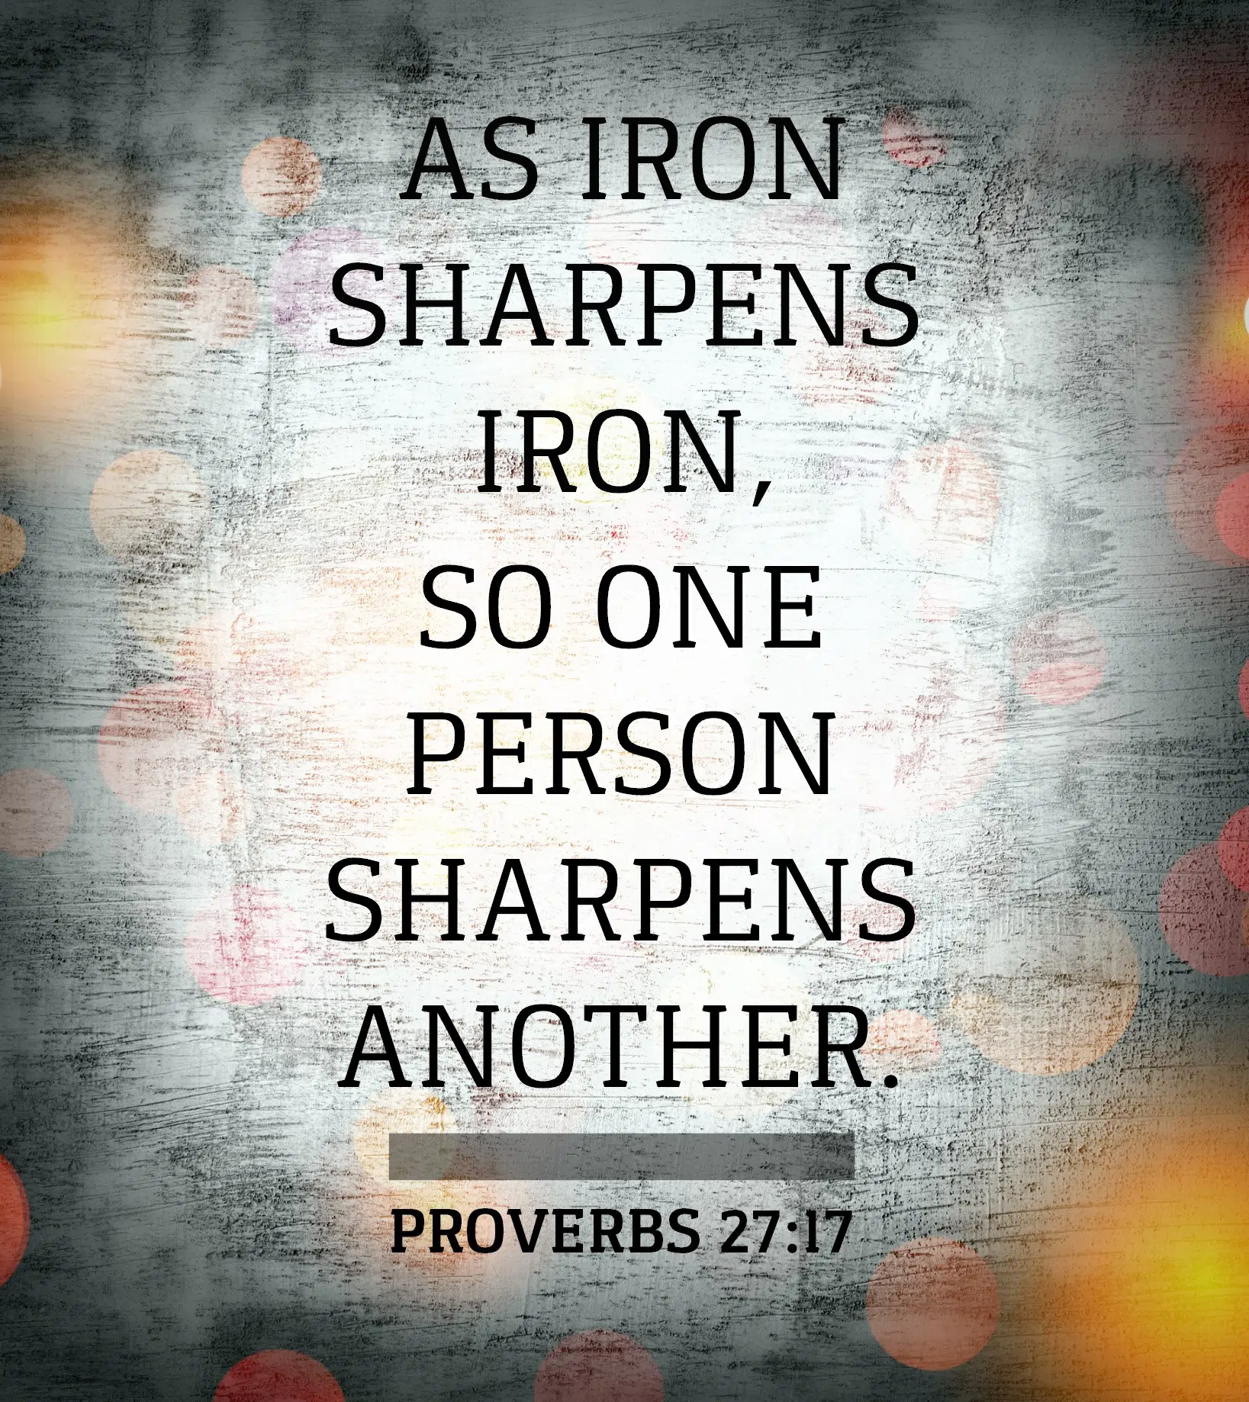
Click to go back
A reminder that the book of Proverbs was written by King Solomon. Solomon was the son of King David who wrote most of the Psalms. God asked Solomon what he desired the most and while Solomon could have asked for anything – wealth, power, etc, he asked for wisdom (which ended up bringing him wealth and power). God was pleased with Solomon’s choice and gave him wisdom beyond measure. Solomon’s words are worth consideration. As in this proverb, we can challenge one another to be better at what we do. We keep each other accountable and push each other to be the best versions of ourselves. That is when success is achieved!
Question of the day:
More money, more problems? Do you agree?

Slide 4

Click to go back
This is an amazing promise from God. This was Paul’s second letter to those people living in Corinth. Just before he said this, he had been encouraging them to be generous in their giving. God loves a generous heart and when people give, it pleases Him.
Question of the day:
If God says He wants to bless us but wants us to be generous with what we have been given. What could you give today? Time? Advice? Help with work? Friendship?

Slide 5
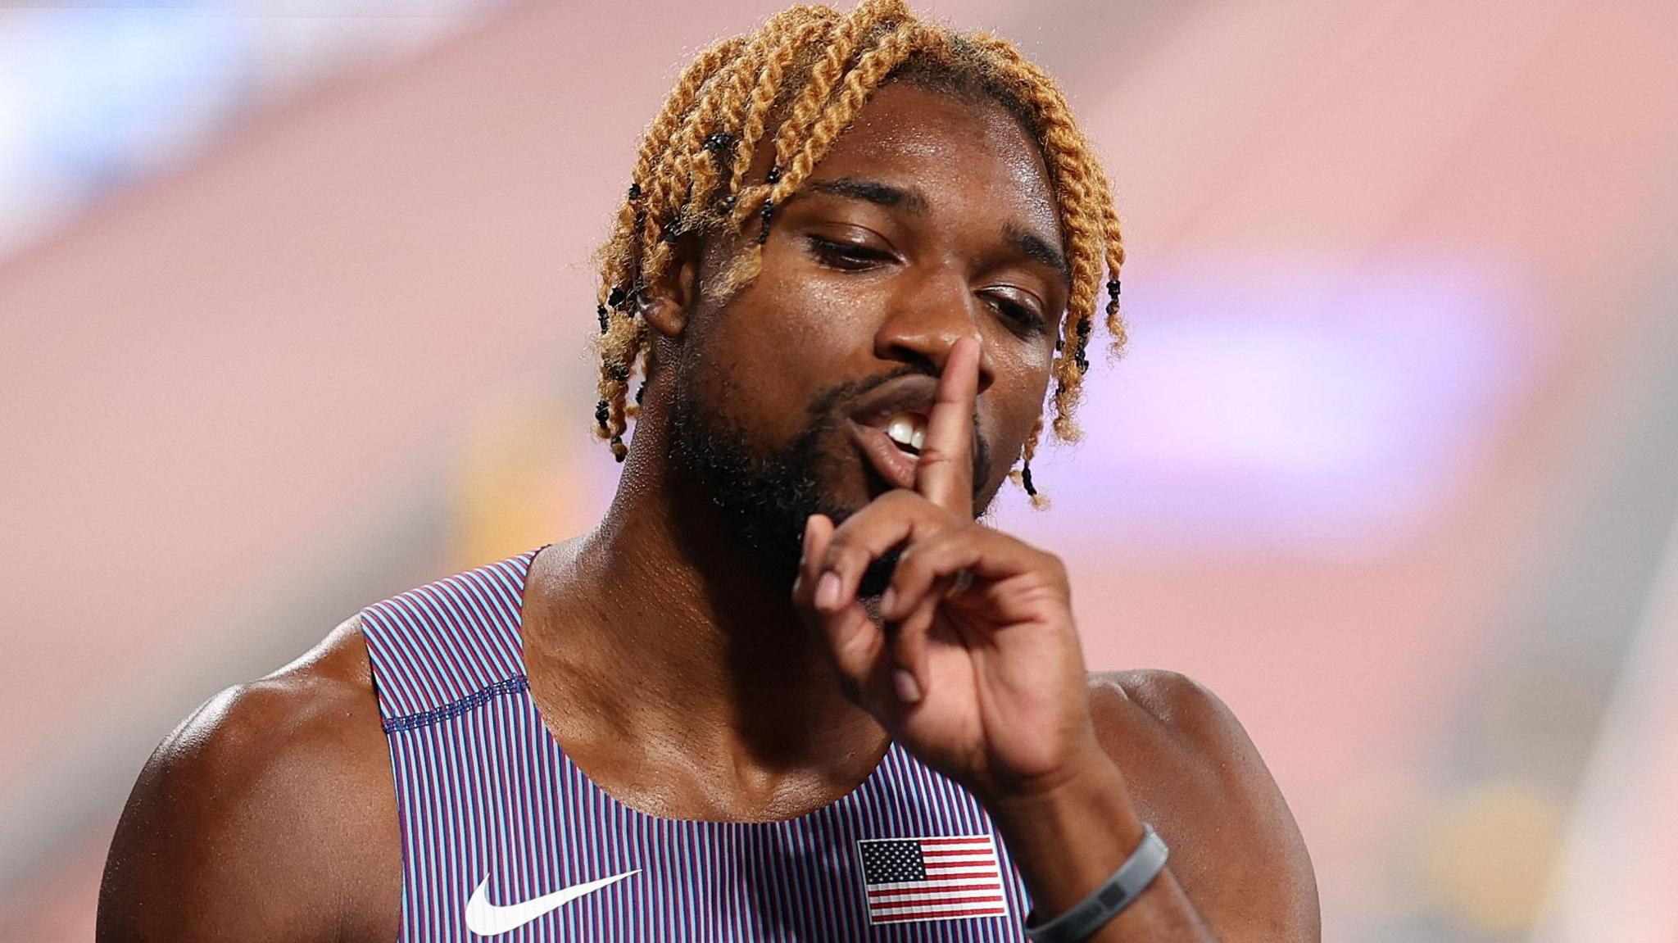

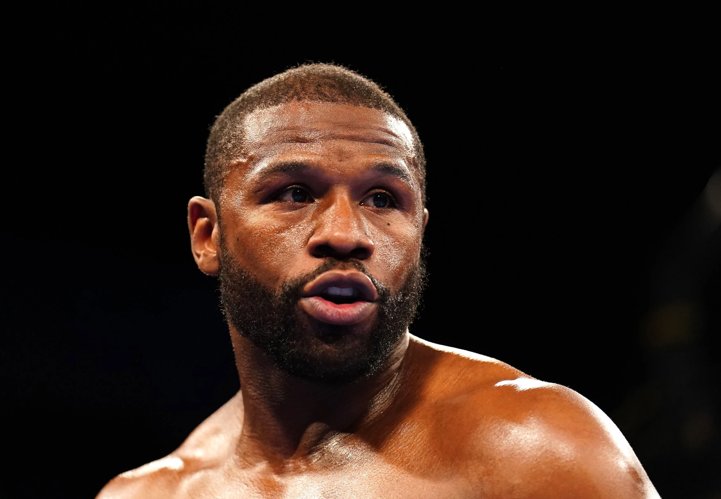
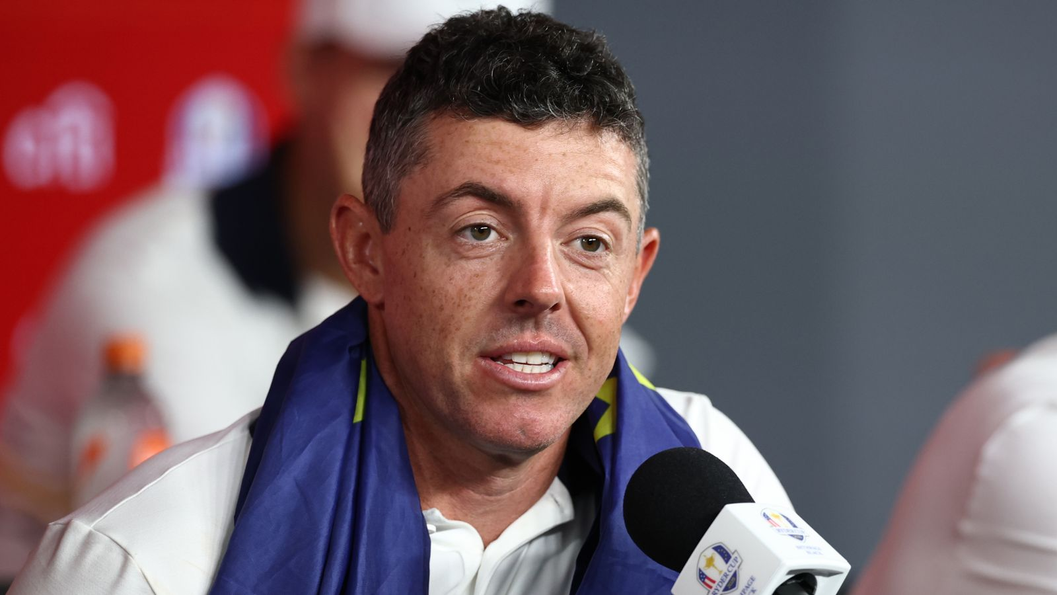
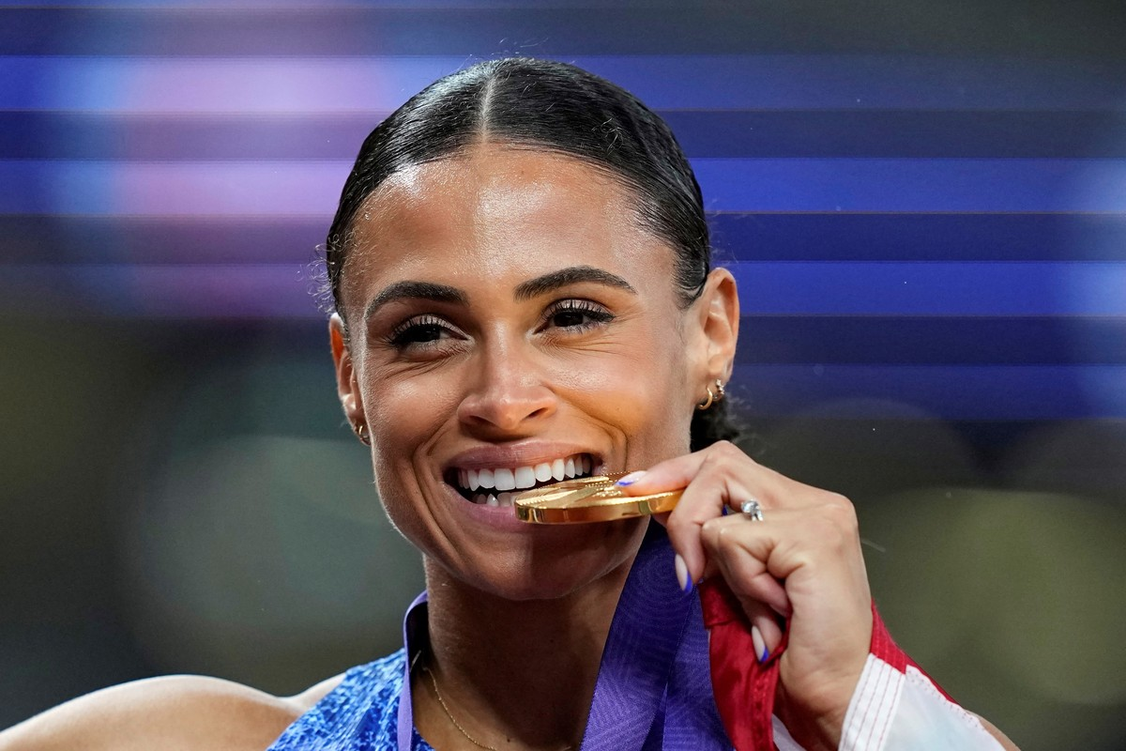
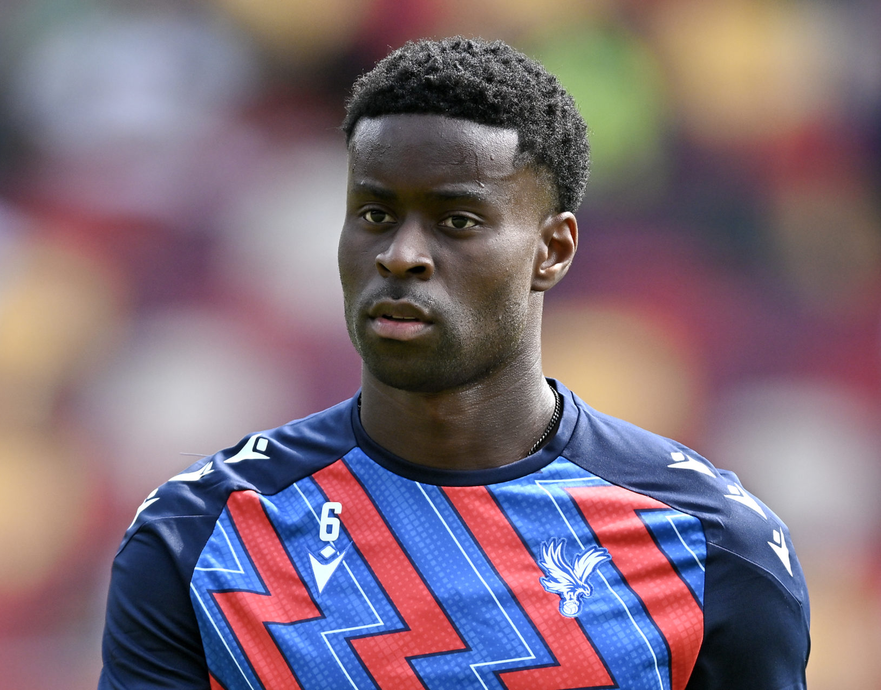

Can you name these sports personalities?
Click for answers
Click to go back
Noah Lyles
Athletics
Femke Bol
Athletics
Floyd Mayweather
Boxing
Rory McIlroy
Golf
Sydney McLaughlin-Levrone
Athletics
Marc Guehi
Football
Max Verstappen
Formula One

Slide 6


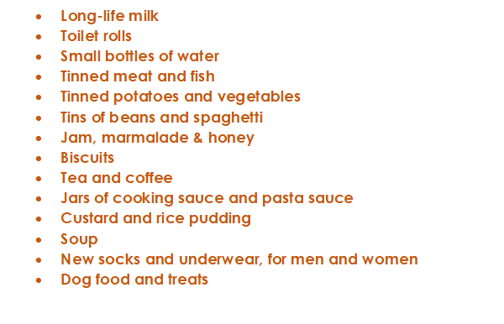



This is a message from Crawley Open House. They are looking for donations for the month of Harvest (October) and we as Holy Trinity always do what we can to assist. On the left is a list of items they require. We are asking that you consider buying something on the list – or even looking in your cupboards for spare items. You can bring them directly to the chapel and then I will deliver them with the help of a small group of students the week after half term
Start thinking about this now but we will only start collecting in October
Click to go back

Slide 7
Almighty God
This week, as we celebrate our achievements, we pause and reflect on the different gifts and talents that You have given us. You have made it such that each one of us has particular strengths and weaknesses – strengths to help those who are weaker, and weaknesses to remind us to rely on the strengths of others and on You.
Bless our words and actions today. May they be helpful and uplifting.
Amen
Click to go back

Slide 8
Loving God
As we celebrate with each other this week and recognise the achievements of so many of our school community, show us again how we can work together, using our different talents, to become the most effective body of people possible.
Remind us again today to build up and not tear down; to look for opportunities to help rather than hinder.
Amen
Click to go back

Slide 9
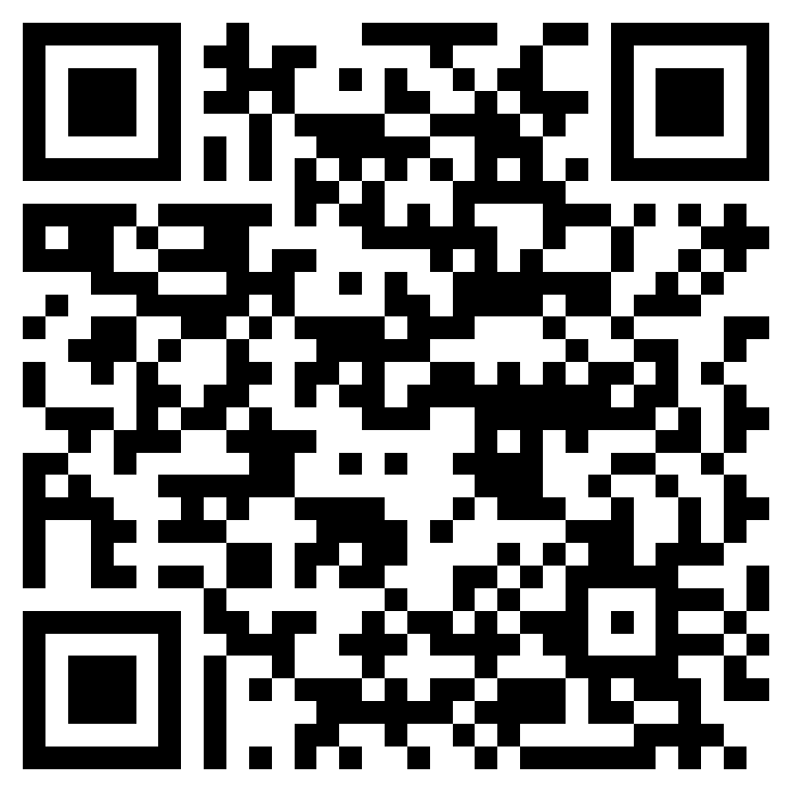
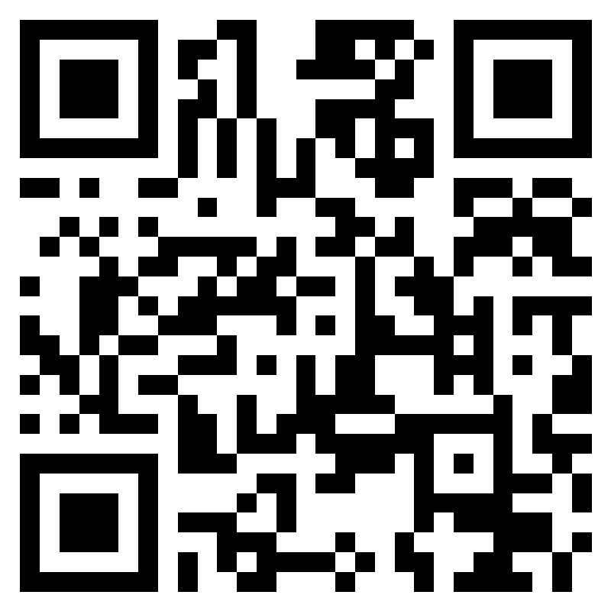
Week 7 – W.B 13/10/25
Click to go back
On Monday 13th of October, Student council met with SLT. We discussed:
The House system
Refectory Menu
This is what was talked about
400+ students completed the trinity triple, but less than 100 completed the student council survey so we need to execute the surveys differently
House trophies coming this week
Talk to teachers who used to be here at the time of more inclusive house system
Changed to a year system after change of house
Vertical house assembly will be happening next half term led by Mr Cook
House leadership - both students (head team) and teachers
Add refectory slides to school newsletter
In a few weeks time, student council can use the tv in refectory to advertise and promote what is happening in the school.
House system survey – Give your feedback here as we will discuss this next week!
Any other topics you want discussed? Leave them in this survey

