Slide 1




The theme for this half term: Hope
The Equality and Diversity theme for this half term: Inclusion
The theme for this week: Inclusive beyond borders
Black History Month
Click for the challenge of the day
Click for the verses of the day
Careers – Guess my job!
https://youtu.be/YBA5cJXZiNA
Watch: Black History Month
Standing Firm in Power and Pride
https://youtu.be/i6NDafMWSqA
Click for a prayer

Slide 2



The theme for this half term: Hope
The Equality and Diversity theme for this half term: Inclusion
The theme for this week: Inclusive beyond borders
Black History Month
Click below for the challenge of the day
Black History Month Questions & Answers 2025
Click for info on Harvest
Click for the verses of the day
Word of the Day:
Merriam-Webster
Click for a prayer
Watch: Edukid trip to Uganda
Inclusive beyond borders
https://youtu.be/PxUUL61Ym80

Slide 3
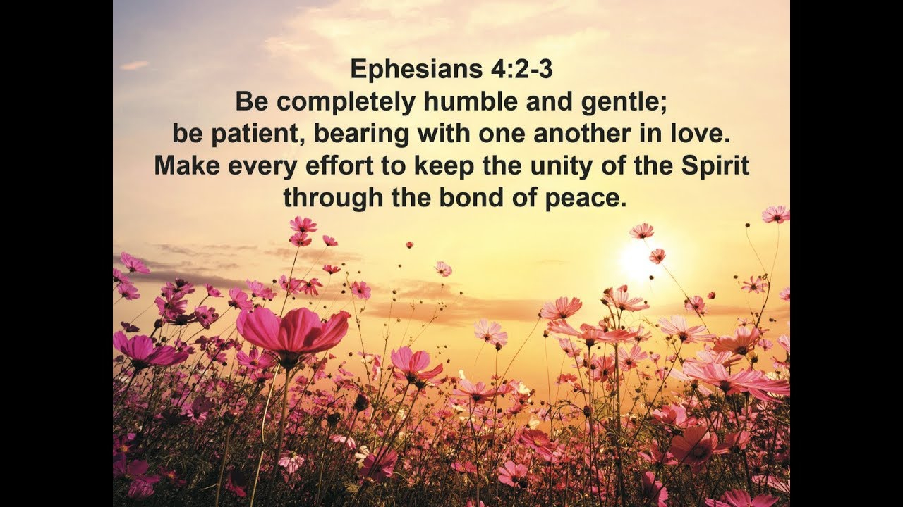
Click to go back
Here, the apostle Paul is writing to the church in the city of Ephesus. Every time Paul visited a village, town or city, he would write to encourage the believers (the church). In this case, he had possibly seen a lack of unity amongst the Christians and so was imploring them to make an effort in this area. The key words are humble, gentle, patient, love and peace.
Question of the day:
Can you think of antonyms (opposite words) for each of these key words?

Slide 4
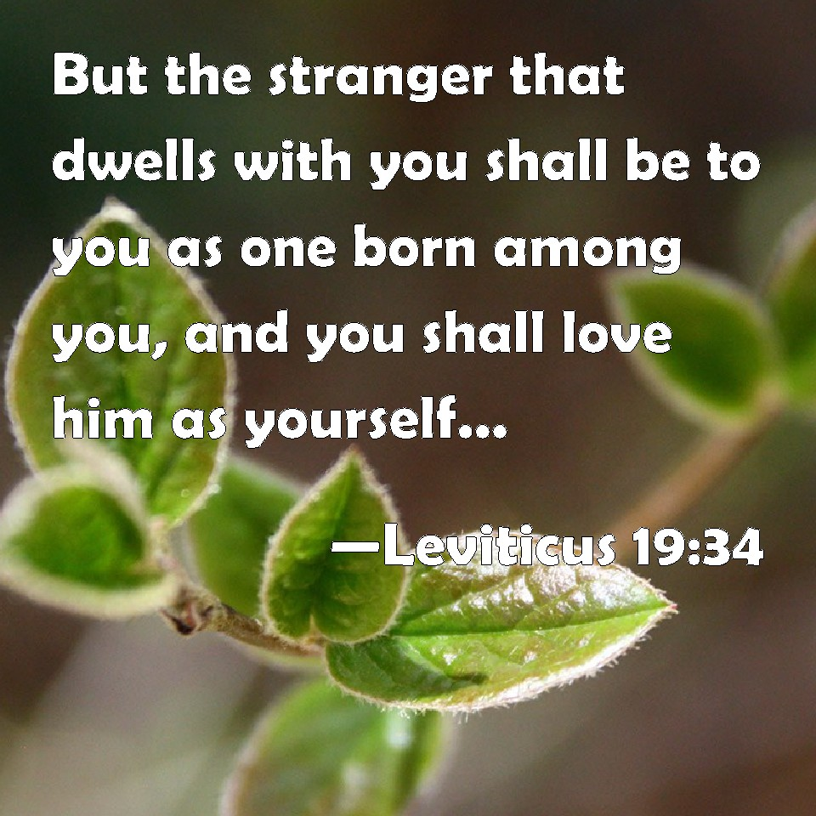
Click to go back
The book of Leviticus is the third book in the Bible (Old Testament) and the third book of the Torah (Jewish) or Pentateuch. It was a writing of Moses and was aimed at any followers of God explaining how they could be closer to Him. One of the exhortations was to accommodate ‘strangers’; i.e., people of foreign lands suggesting that the local people should ‘love him as yourself’. God was adamant that people love each other as He loves us (love your neighbour as you love yourself (Matthew 22:37)
Question of the day:
Is there someone in your tutor group who you do not know? Could you spend some time with them asking them some questions about their background, religion or heritage?

Slide 5
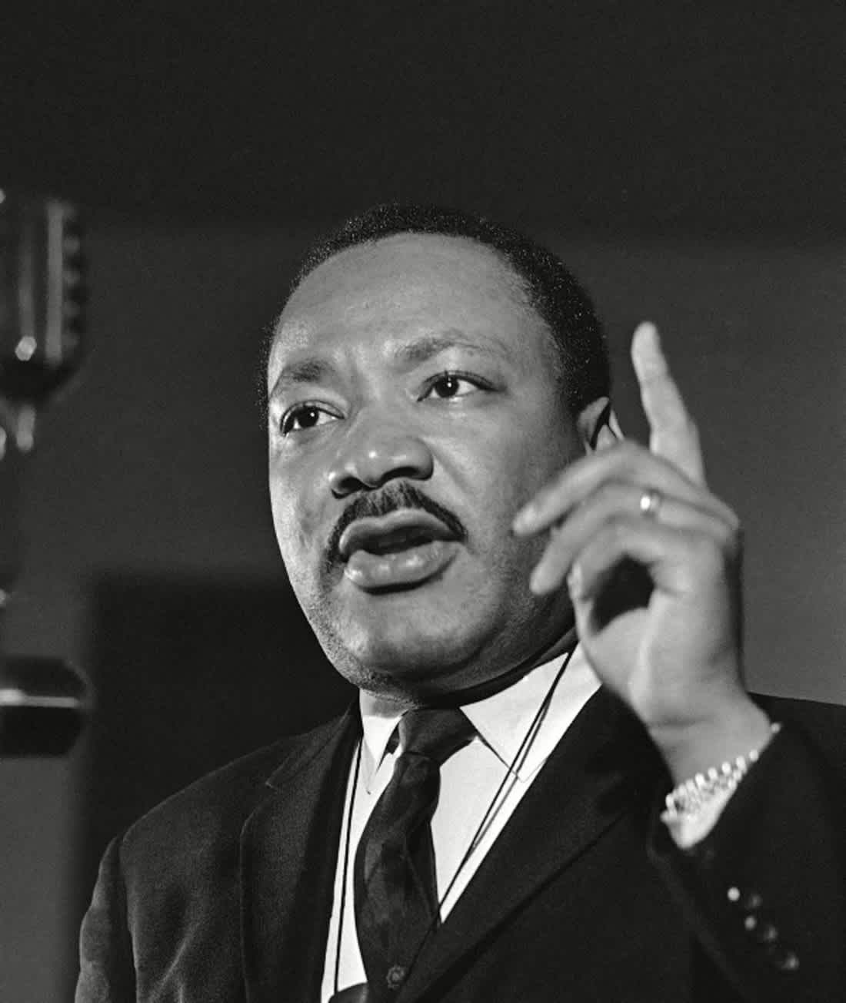
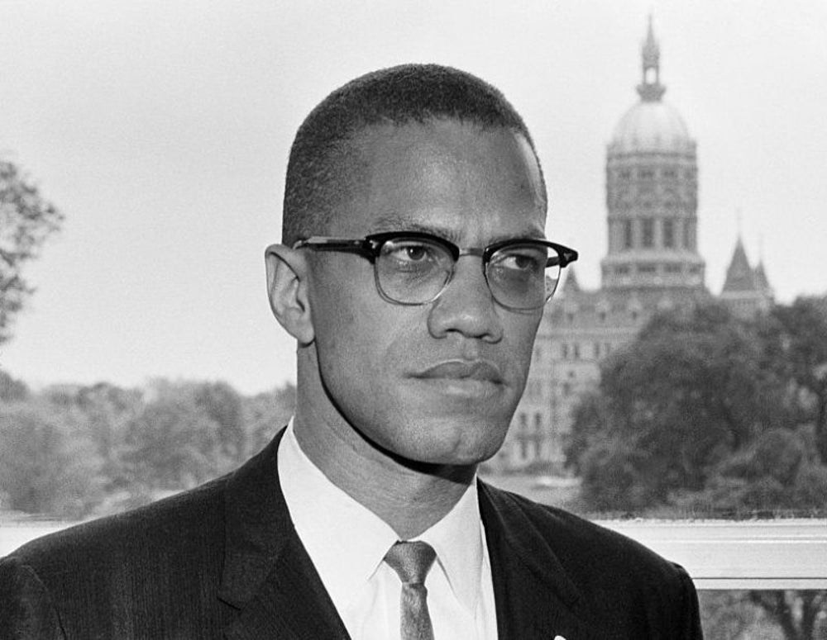
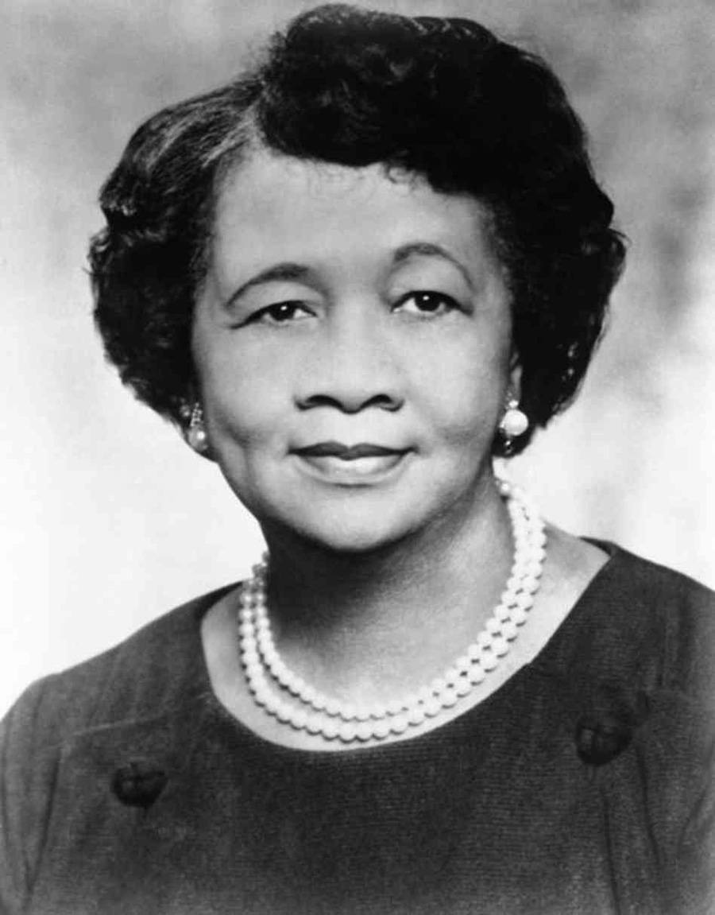
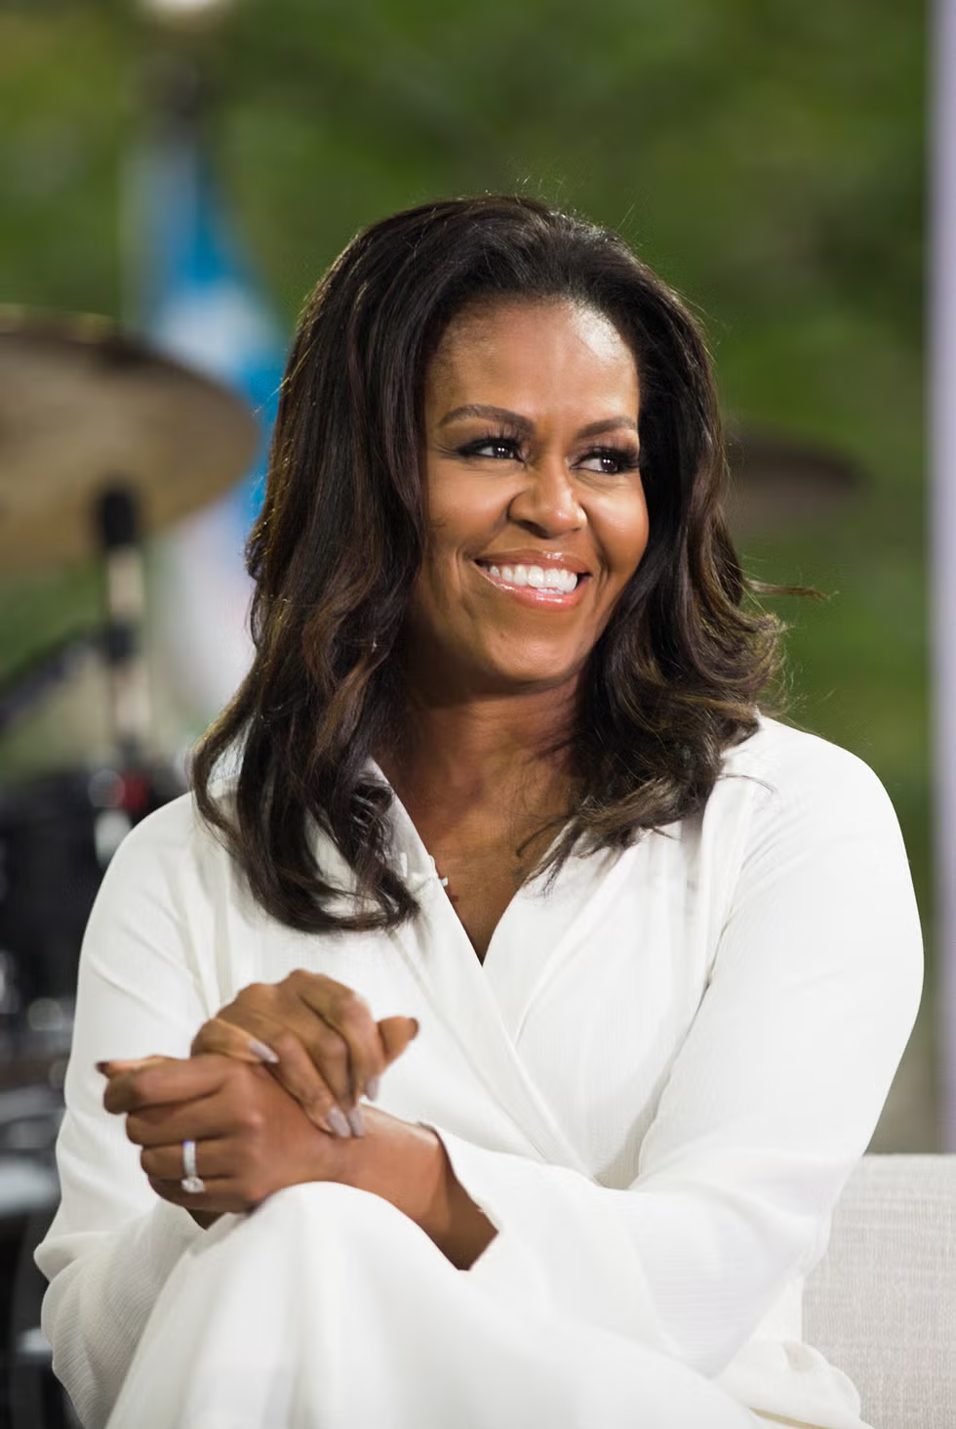
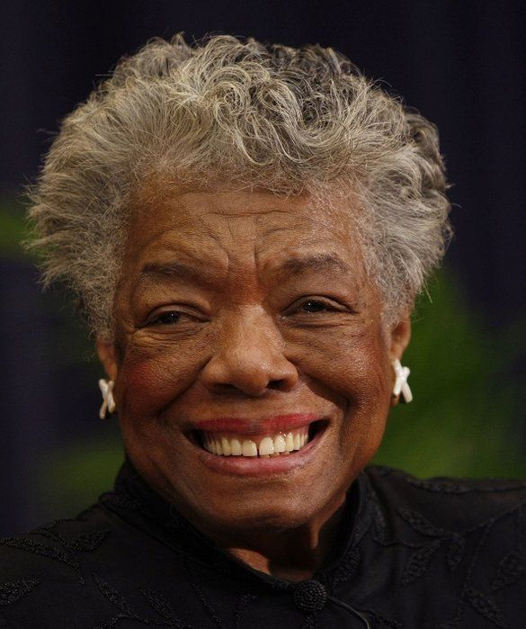
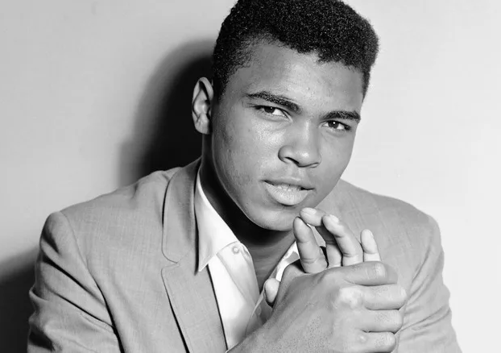
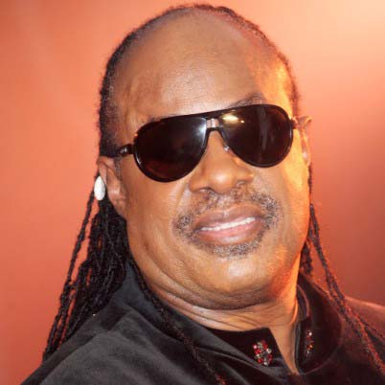
Can you name these famous black personalities?
Click to go back
Martin Luther King Jr
Baptist Minister and Civil Rights Activist
Malcom X
Human Rights Activist
Dorothy Heights
Civil Rights and Woman’s Rights Activist
Michelle Obama
Former First Lady of the USA
Maya Angelou
Memoirist, poet and civil rights activist
Muhammad Ali
World Champion Boxer and Social Activist
Stevie Wonder
Musician/Singer

Slide 6


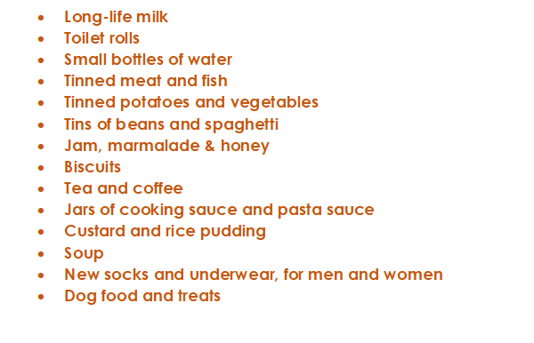



This is a message from Crawley Open House. They are looking for donations for the month of Harvest (October) and we as Holy Trinity always do what we can to assist. On the left is a list of items they require. We are asking that you consider buying something on the list – or even looking in your cupboards for spare items. You can bring them directly to the chapel and then I will deliver them with the help of a small group of students the week after half term
Start thinking about this now but we will only start collecting in October
Click to go back

Slide 7
Loving God
Continue to extend Your love to each of us
Burden us with the needs of others
Unsettle us when we encounter discrimination
Rally us when we see injustice
Help us to see the world as You see it and to ‘Get out the stands and get in the game of life’
Amen
Click to go back

Slide 8
Dear God
Help us to embrace and celebrate the diversity among us. May we learn from our differences and foster deeper connections. Guide us to appreciate the unique gifts each person brings and empower us to stand against intolerance. Let us remember that in Your creation, we are all beautifully different yet united as one body in spirit.
Amen
Click to go back

