Slide 1



The theme for this half term:
School Mission Statement: Deeply Christian; Open to All
The Equality and Diversity theme for this half term: Inclusion
The themes for this week: Healthy body, healthy mind
Black History Month
Click for the challenge of the day
Read:
https://www.mentalhealth.org.uk/explore-mental-health/stories
Click for the verses of the day
Careers – Guess my job!
https://youtu.be/TB1H5ULKG5U
Click for a prayer
Watch:
Looking after your mental health
https://youtu.be/-OAjfrhuwRk
Word of the Day:
Merriam-Webster

Slide 2




The theme for this half term:
School Mission Statement: Deeply Christian; Open to All
The Equality and Diversity theme for this half term: Inclusion
The theme for this week: Healthy body, healthy mind
Black History Month
Click below for the challenge of the day
https://youtu.be/rieP8q72jWE
Click for info on Harvest
Click for the verses of the day
Click for some info on Student Council
Click for a prayer
Watch: An inspirational message from Dr Gaines
https://youtu.be/UDFYP_JmLsU

Slide 3
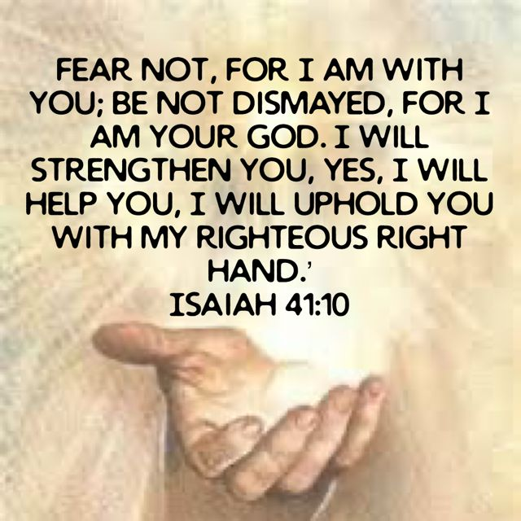
Click to go back
God loves us. And because He loves us, He is always FOR us and never against us. In this verse, Isaiah tells us that God is talking to the nation of Israel who are exiled in Babylon (click here for more info)
God is telling His people that although they have been displaced from their land, He continues to be with them

Slide 4
It was the great and terrible (King) Nebuchadnezzar II who rebuilt Babylon. Ruling from 605 to 562 B.C., Nebuchadnezzar extended the Babylonian empire across Egypt, Syria and the Kingdom of Judah, where he seized Jerusalem in 597 B.C.E., capturing tens of thousands of Israelites and dragging them off to Babylon as forced labourers where the Bible tells us they were in exile (barred from their own country) by its rivers (Hence the song: The Rivers of Babylon, written in 1970 by ‘The Melodians’ and re-popularised by the group ‘Boney M’)
Rivers of Babylon
https://youtu.be/l3QxT-w3WMo
Click to go back

Slide 5
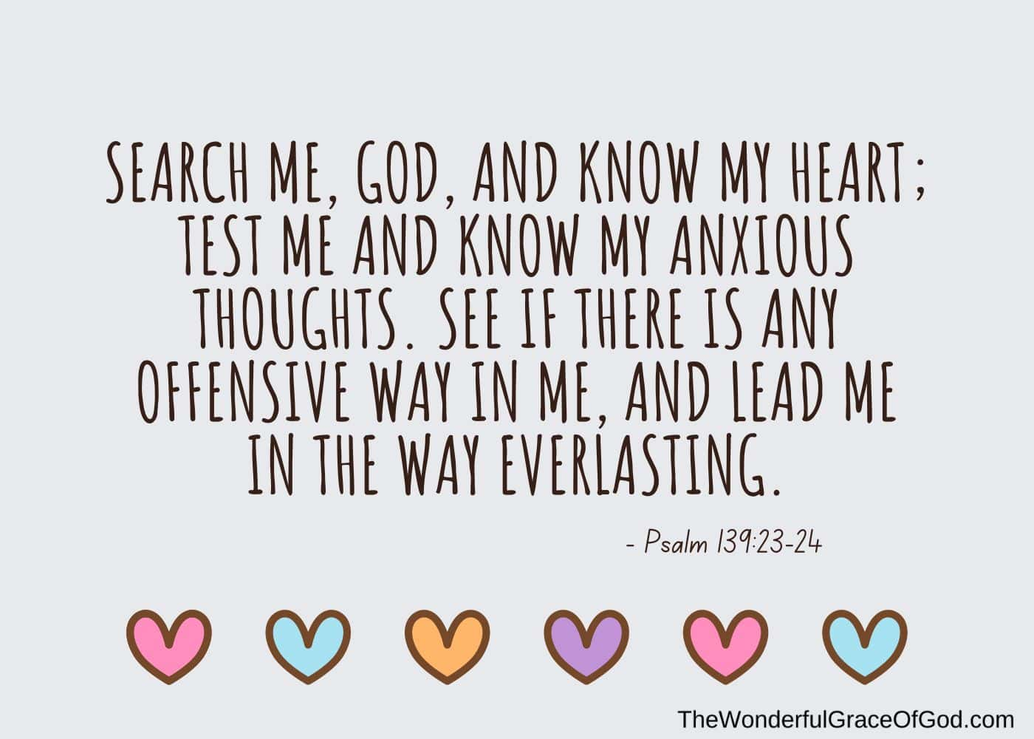
Click to go back
In this Psalm, King David asks God to search his heart. God already knows him, but David wants God to show him if there is any anxiety or offensive way that shouldn’t be in his mind. He wants God to help him deal with his worries and show him a better way of doing life.
Question of the day:
Is there an ‘offensive way’ in your life that you need to check? Are you quick with negative words or only see the bad in someone? Perhaps ask God and people who know you to point these out so you can make a change…

Slide 6
Can you name the following parts of the body from their anagrams?
Click for answers
Click for a hint
angel mist
ligaments
To do with muscles and bones
clever tin
ventricle
To do with the heart
Click to go back
altars meat
metatarsal
To do with your feet
heap slang
phalanges
To do with your toes

Slide 7


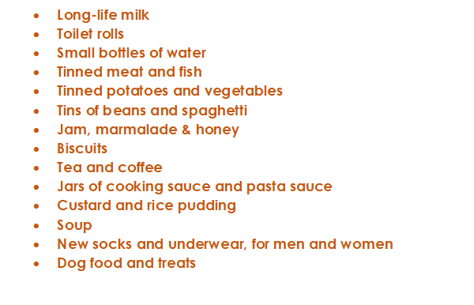



This is a message from Crawley Open House. They are looking for donations for the month of Harvest (October) and we as Holy Trinity always do what we can to assist. On the left is a list of items they require. We are asking that you consider buying something on the list – or even looking in your cupboards for spare items. You can bring them directly to the chapel and then I will deliver them with the help of a small group of students the week after half term
Start thinking about this now but we will only start collecting in October
Click to go back

Slide 8
God of peace and presence
In the quiet moments and in the storms of the mind, be near;
Hold us when thoughts are heavy, lift us when the weight feels too much to bear.
For every anxious breath, bring calm.
For every racing thought, bring clarity.
For every deep sadness, bring comfort.
For every moment of despair, bring light.
Amen
Click to go back

Slide 9
Click to go back

Slide 10
God of peace
Help us to know that we are not alone—that struggling does not make us weak.
Give us the courage to ask for help and the grace to accept it.
Restore what has been broken.
Strengthen what is still whole.
Renew hope each day and wrap us in your love.
Amen
Click to go back

Slide 11
Click to go back

Slide 12
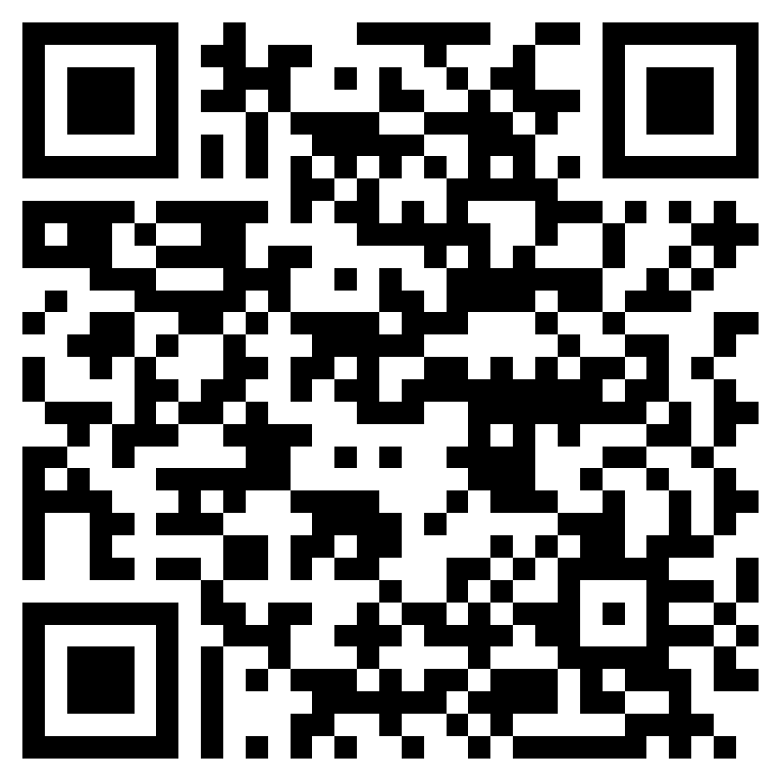
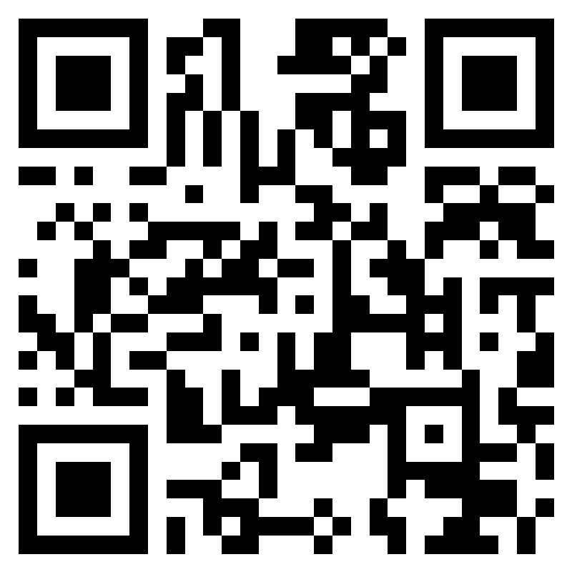

Week 5 – W.B 29/09/25
Click to go back
Last Friday in student council we looked at different ideas for the refectory. We fed back some ideas to refectory staff using survey data and student council voices on Tuesday 30th September.
This is what we asked for:
Adding various chicken dishes to the menu (Wraps and other dishes)
More sauces and condiment options
Warm cookies available more often, not just on Friday's
Curly fries and more variety of cultural dishes
Adding wider varieties of options to burgers e.g. cheese, sauces
Possibility of making small, medium and large options for food at different prices
Changes to the pizza offered (New pizza provider will be used starting next week)
House system survey – Give your feedback here as we will discuss this next week!
Student Council said…
Any other topics you want discussed? Leave them in this survey
We are meeting with SLT to share your voice on Monday 13th October

