Slide 1
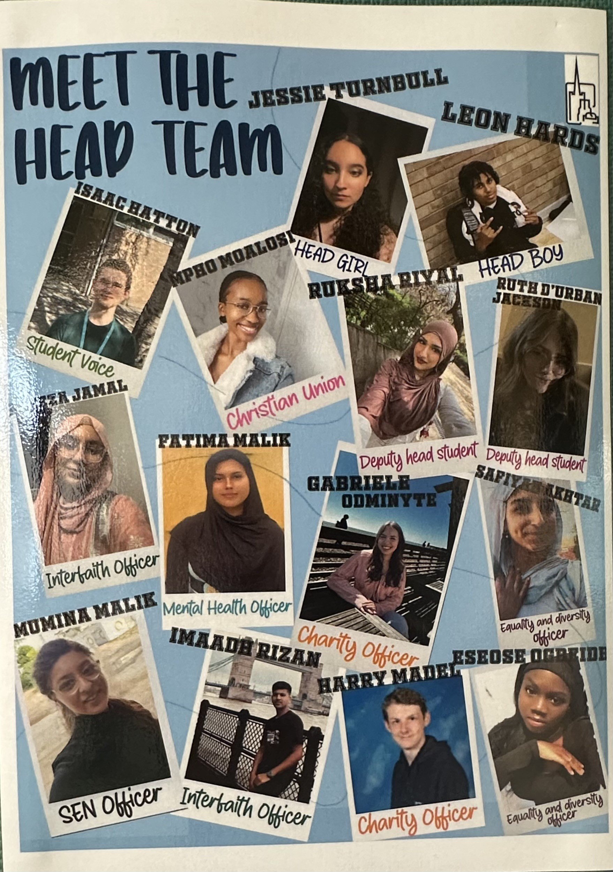



The theme for this half term:
School Mission Statement: Deeply Christian; Open to All
The Equality and Diversity theme for this half term: Inclusion
The theme for this week: Head Team Introductions
Click for the challenge of the day
Click for the verses of the day
Careers – Guess my job!
https://www.youtube.com/watch?v=HjdFamshtmE
Word of the Day:
Merriam-Webster
Click for a prayer
Watch: Jesus explains servant leadership…
https://youtu.be/EGSrApzkqCo

Slide 2

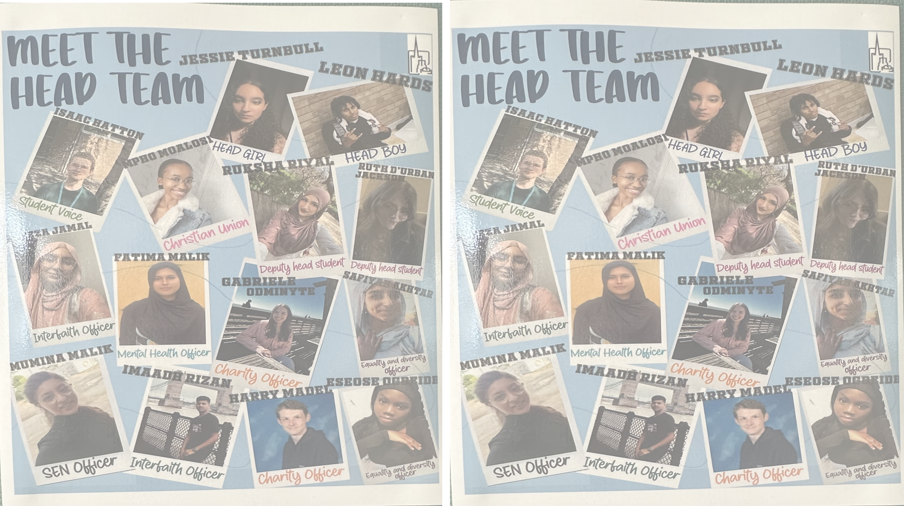


The theme for this half term:
School Mission Statement: Deeply Christian; Open to All
The Equality and Diversity theme for this half term: Inclusion
The theme for this week: Head Team Introductions
Click for the challenge of the day
Click for the verses of the day
Click for info on Harvest
Click for info from Student Council
Click for a prayer
Watch: Servant Leadership…
https://youtu.be/XajxQOh3iqQ

Slide 3

Click to go back
This may seem like a controversial statement from the gospel of Matthew. Jesus speaks quite a lot about leadership but stresses that it is not about intimidation, dominance or abusing authority but about being servant-hearted in your approach to people. As a leader, your authority is already established and you are in a position of power, but a humble approach to the people you oversee will produce much better results.
Question of the day:
Can you name a leader who has (is) abused (abusing) their power and one who was humble?

Slide 4

Click to go back
The word ‘slave’ in this passage does not have the same meaning we derive from people who have been subject to slavery. This is talking about placing yourself in a position of service to others, even if you are a leader. Jesus came to serve mankind and eventually give up His life in our place so we could live eternally – the epitome of humility.
Question of the day:
Can you give examples of current leaders who are either servant-hearted or who abuse their authority?

Slide 5
How may words can you make from the letters of the word ‘leader’
rale
read
real
dale
dare
deal
lard
reel
earl
read
lead
lear
lee
led
are
lea
rad
ale
eel
era
red
lad
ear
Click for answers
eared
elder
dealer
Click to go back

Slide 6


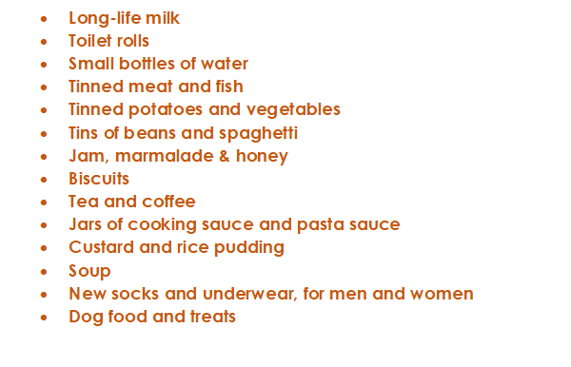



This is a message from Crawley Open House. They are looking for donations for the month of Harvest (October) and we as Holy Trinity always do what we can to assist. On the left is a list of items they require. We are asking that you consider buying something on the list – or even looking in your cupboards for spare items. You can bring them directly to the chapel and then I will deliver them with the help of a small group of students the week after half term
Start thinking about this now but we will only start collecting in October
Click to go back

Slide 7

Almighty and Loving God
We thank You for our school community and every person that is part of the Holy Trinity family. We pray for those who are in positions of leadership – especially those on the Head Team. We ask that You would give them wisdom and clarity as they fulfil their roles – and – above all, a love for what they do and joy in doing it.
In Jesus name
Amen
Click to go back

Slide 8
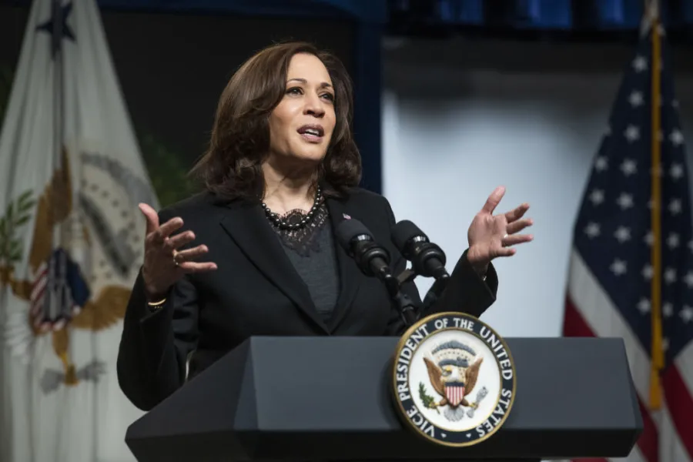
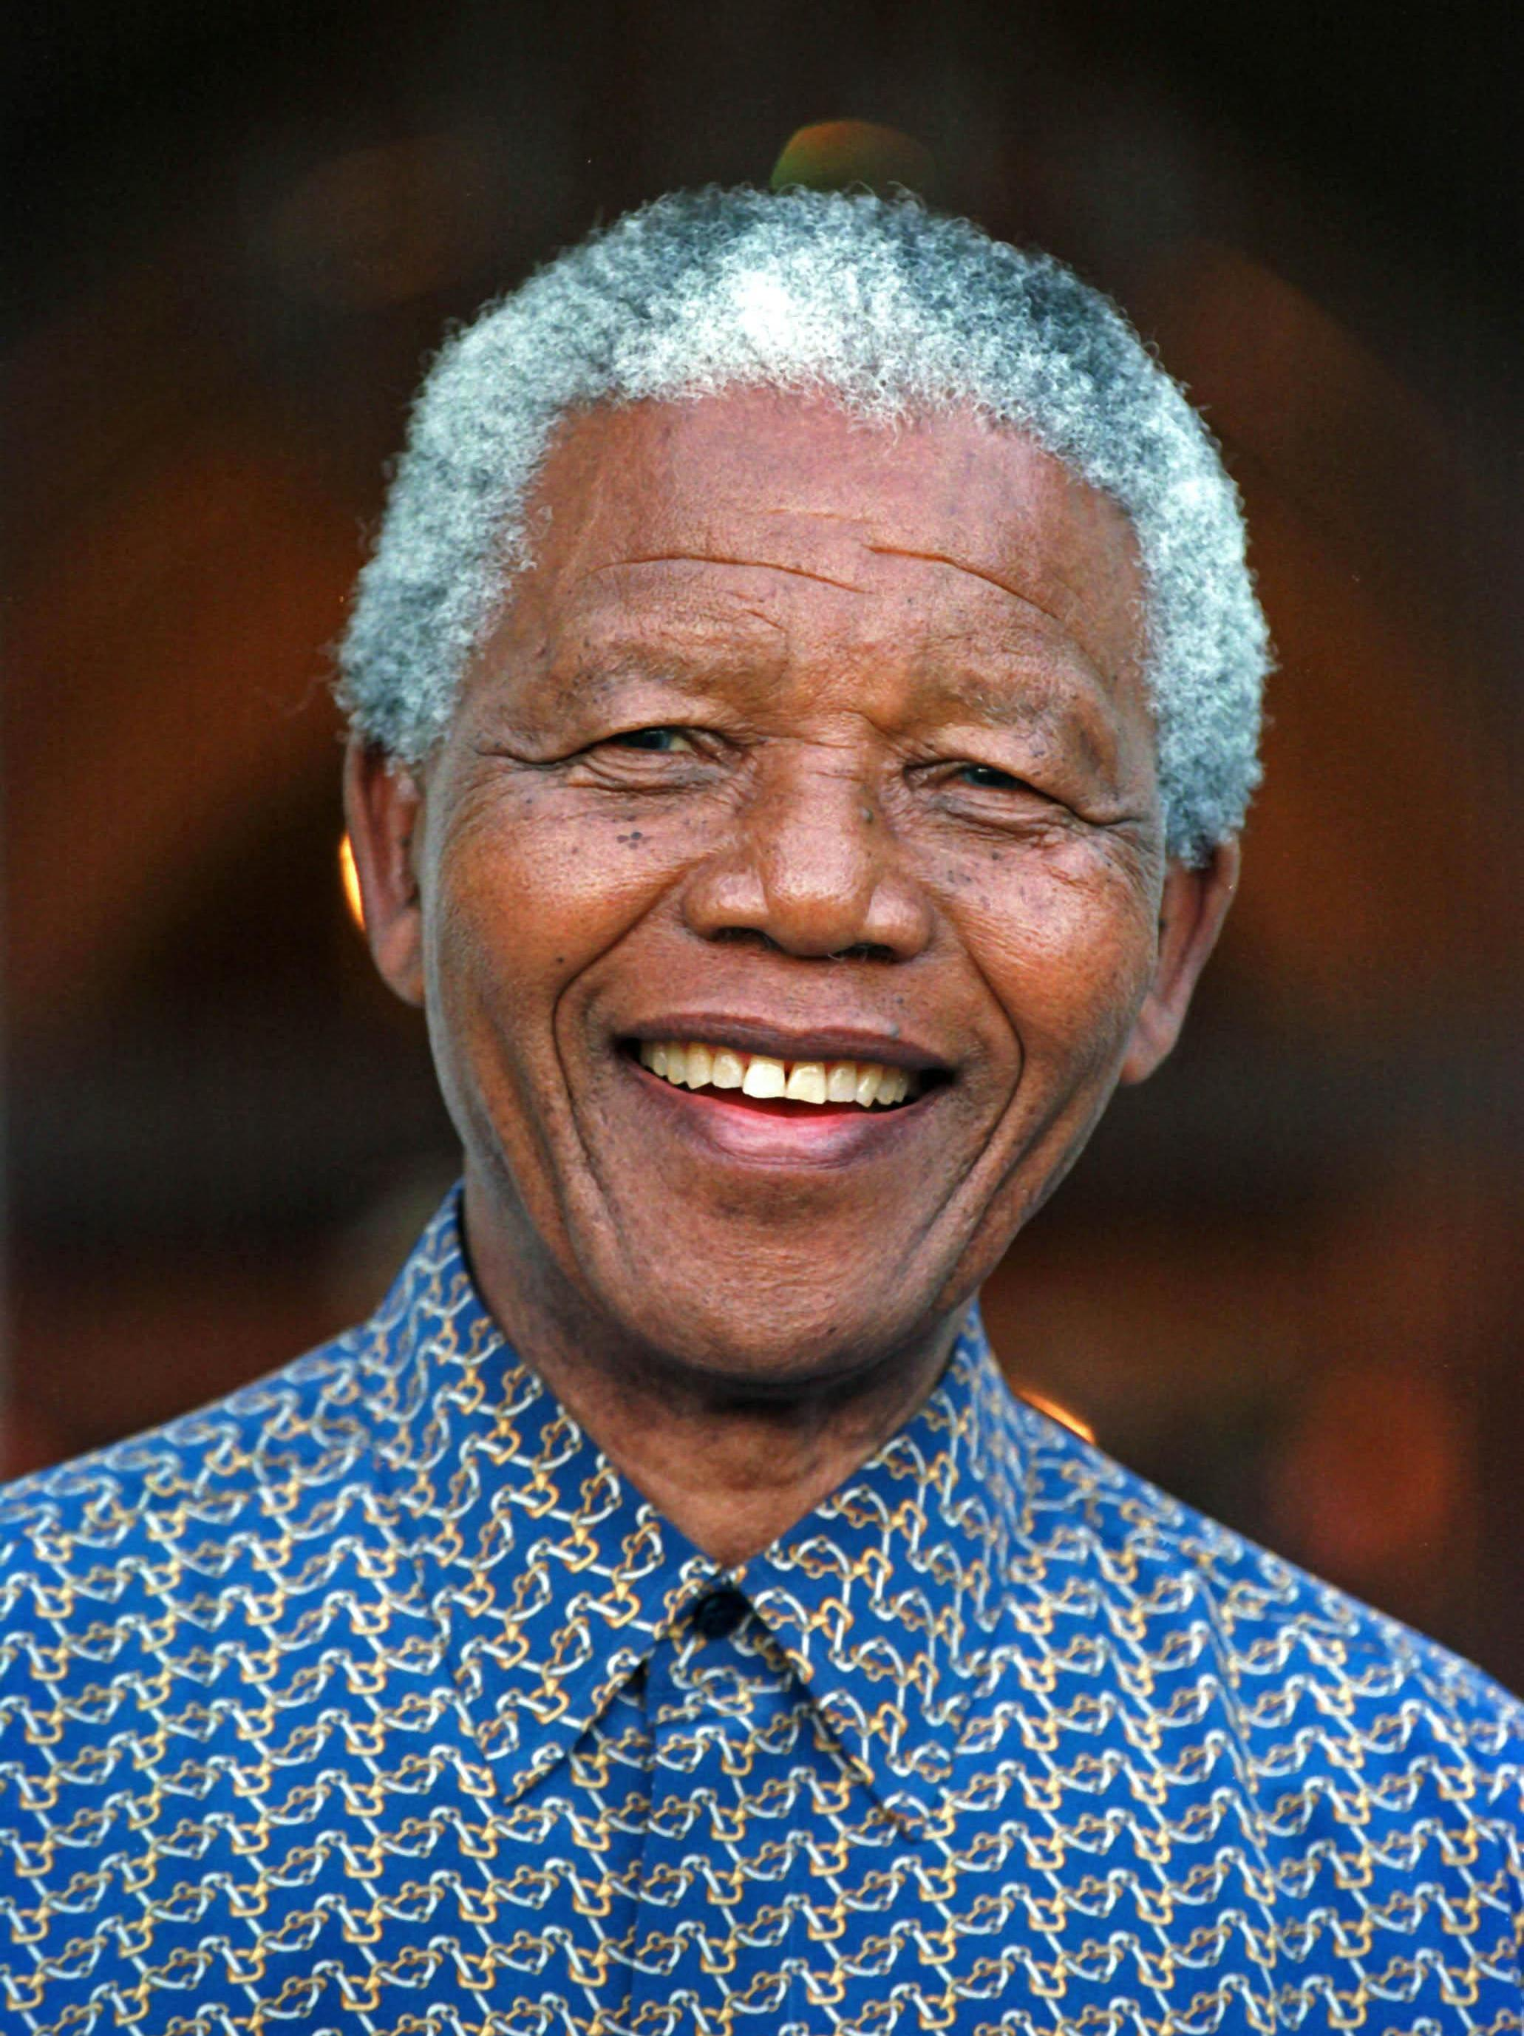
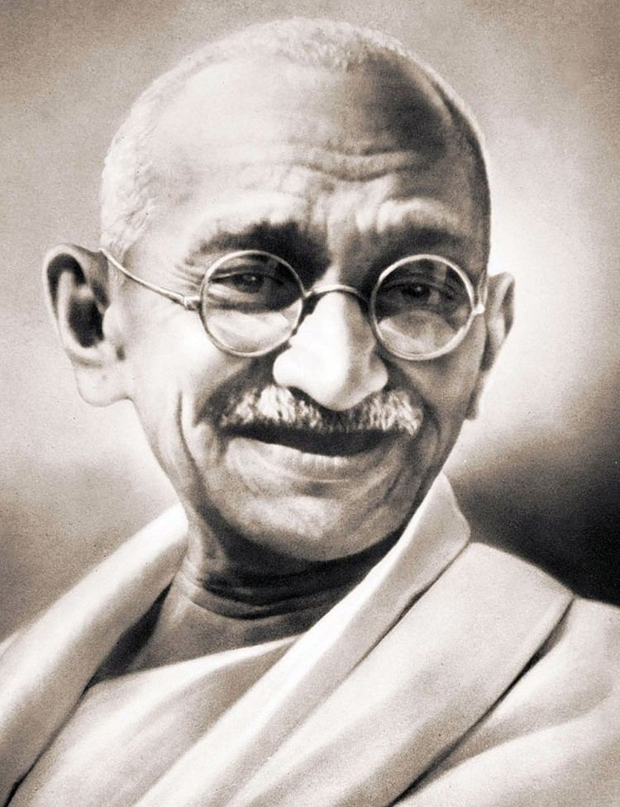
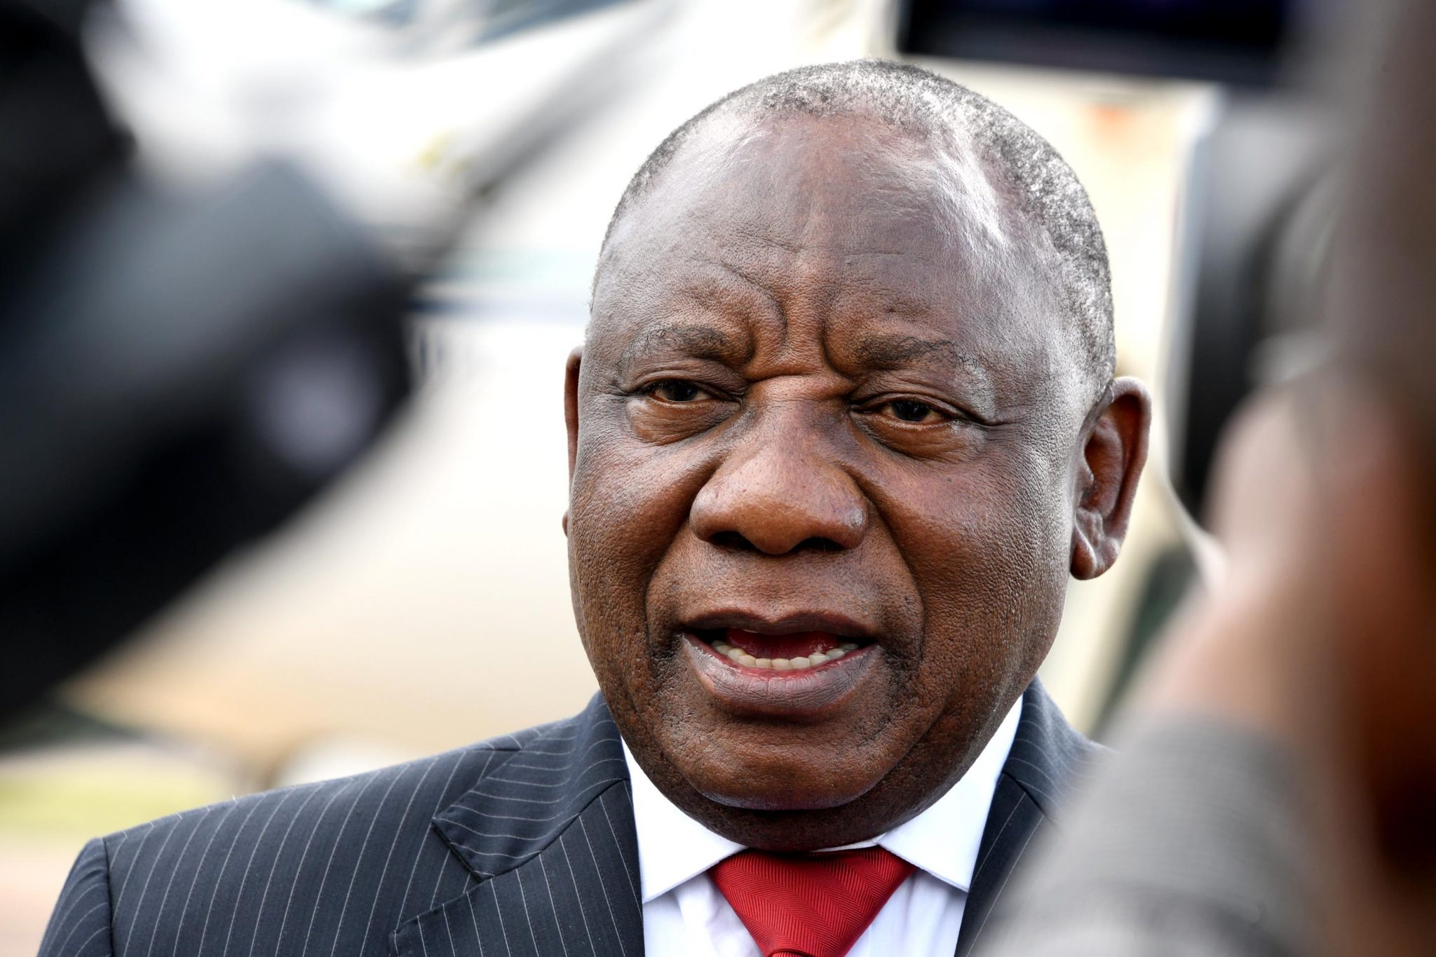

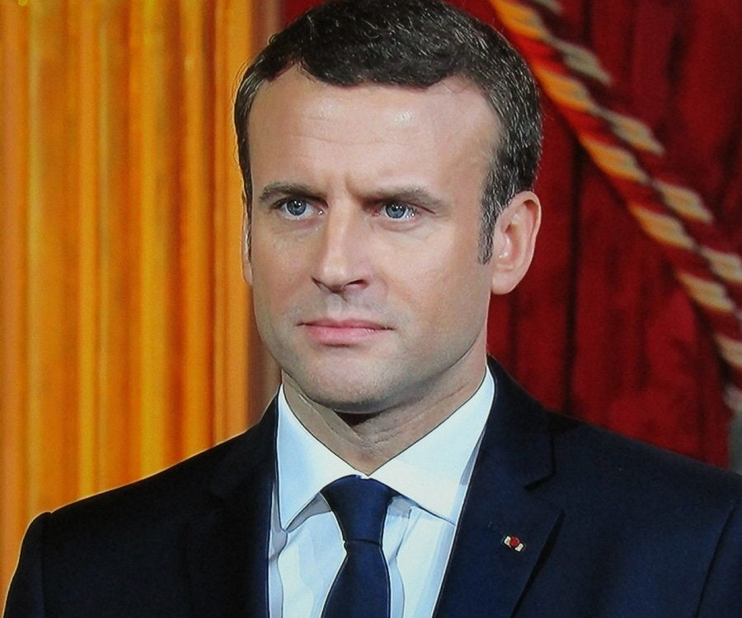


Can you name these leaders?
Click to go back
Kamala Harris
Politician and former vice president of the USA
Nelson Mandela
Late president of South Africa
Mahatma Ghandi
Late lawyer and politican facilitating India’s independence from British rule
Cyril Ramaphosa
President of South Africa
Sebastian Coe
Former olympic athlete and President of World Athletics
Indira Ghandi
Late Prime Minister of India
Emmanuel Macron
President of France
Donald Trump
President of the USA

Slide 9

Click to go back

Slide 10
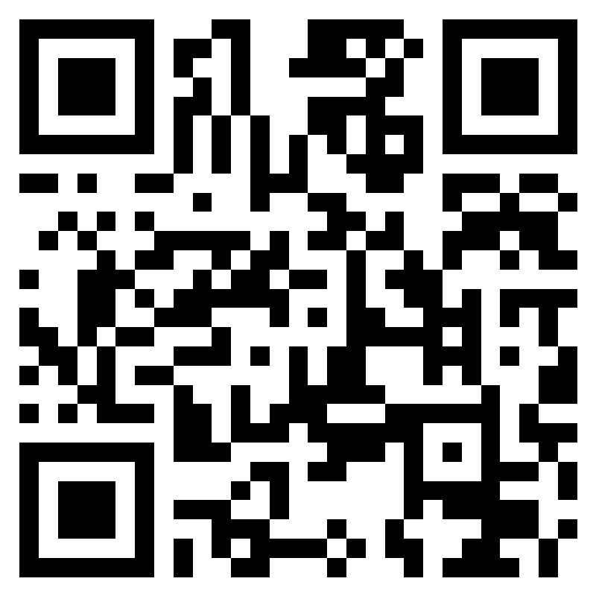
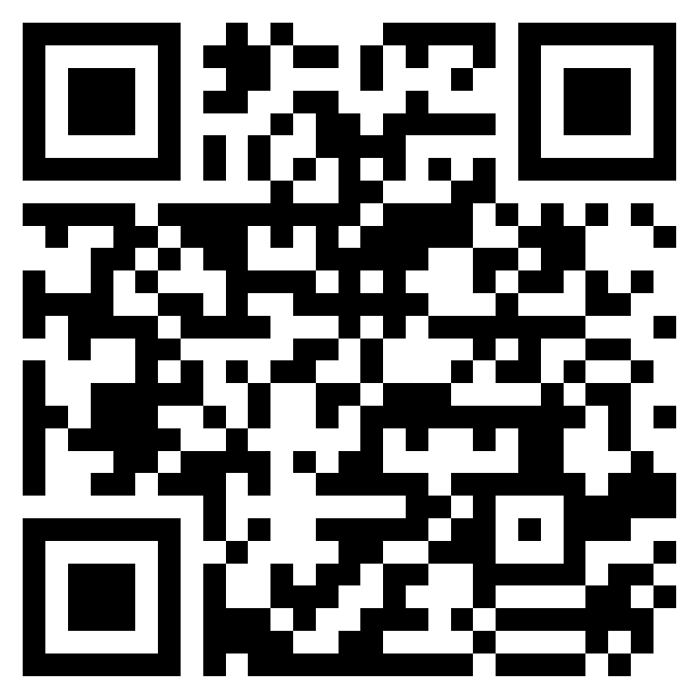

Week 4 – W.B 22/09/25
Click to go back
Last Friday in student council we looked at different ideas for the house system and community.
Some ideas we had were:
Rewards for house with highest achievement points or with highest attendance
Rewards for highest completion of trinity triple
Seasonal inter house sports
Competition in each core subject
Sponsored walk- each house gets a different charity
Do you have any ideas? Share them with your Student council rep
Share ideas of what you want discussed in Student Council Meetings
Student Council said…
We are meeting with refectory staff on Tuesday 30th of September
Refectory Survey – share feedback here

