Slide 1



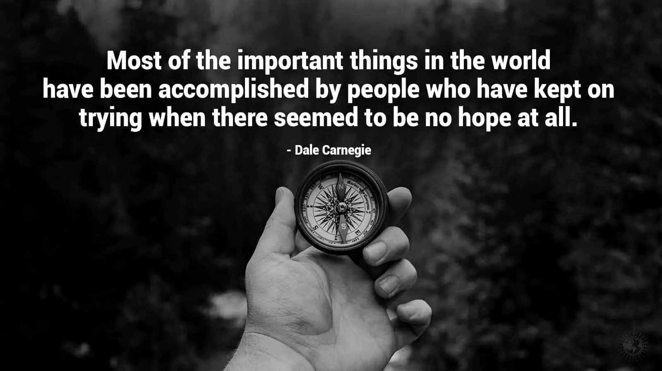
The theme for this half term:
School Mission Statement: Deeply Christian; Open to All
The Equality and Diversity theme for this half term: Inclusion
The theme for this week: Hope for the world
Click for the challenge of the day
Click for the verses of the day
Click for some info on Student Council
Watch: A short video on our trip to Uganda
(read info below first)
https://theholytrinity.sharepoint.com/:v:/s/AllStaff/EQPKoEIS8r5NloFiV3v63bwB3zXo0mKdHQrMMe37QgmK8w?e=KB0PJr
Click here for info on the trip
Click for a prayer

Slide 2


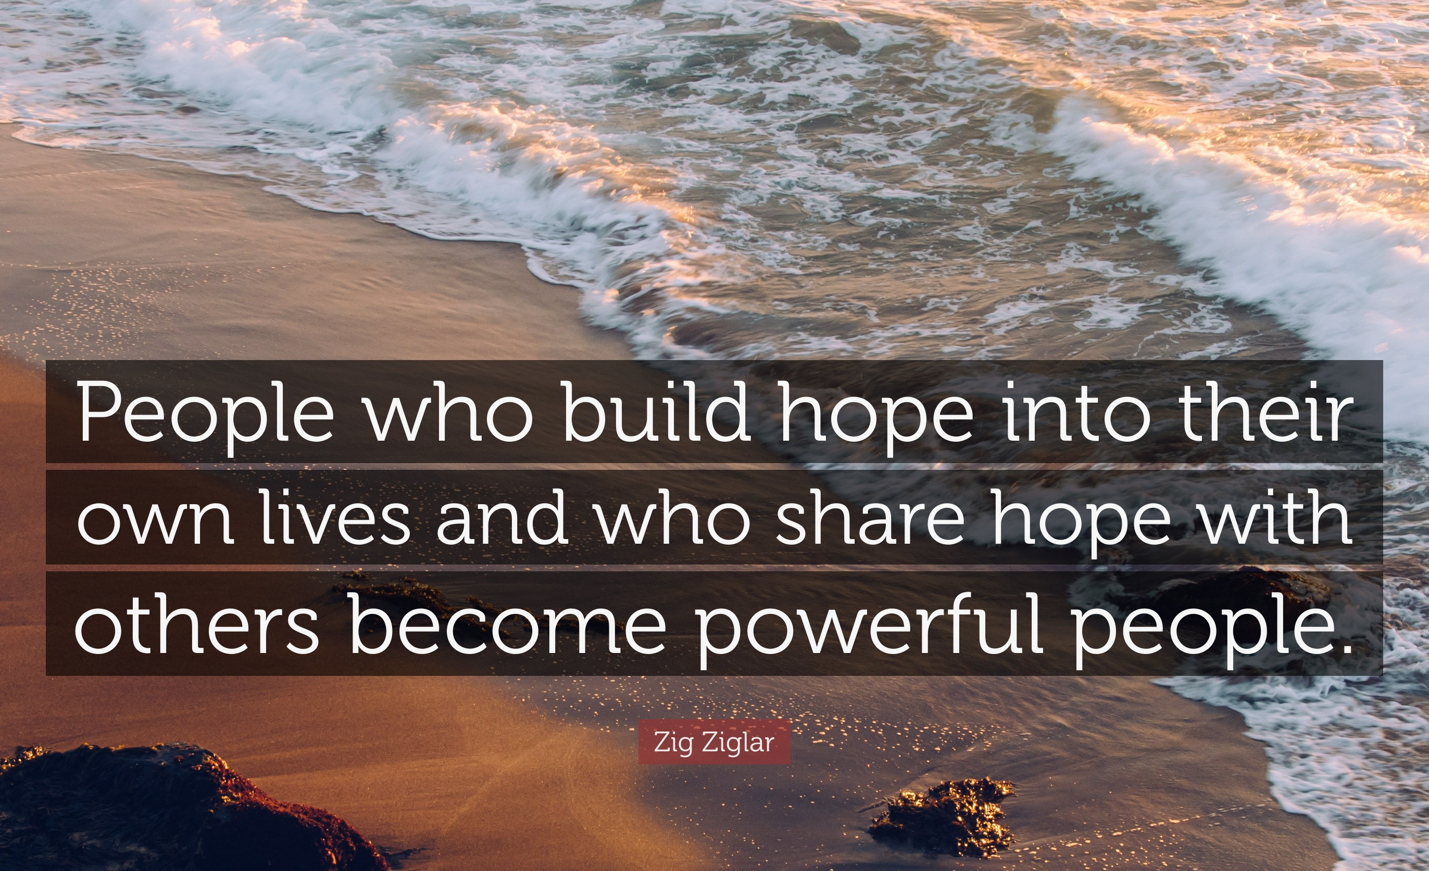

The theme for this half term:
School Mission Statement: Deeply Christian; Open to All
The Equality and Diversity theme for this half term: Inclusion
The theme for this week: Hope for the world
Click for the challenge of the day
Click for the verses of the day
Click for info on Harvest
Word of the Day:
Merriam-Webster
Click for a prayer
Watch: Hope for the hopeless..
https://youtu.be/JlObMe2yclA

Slide 3
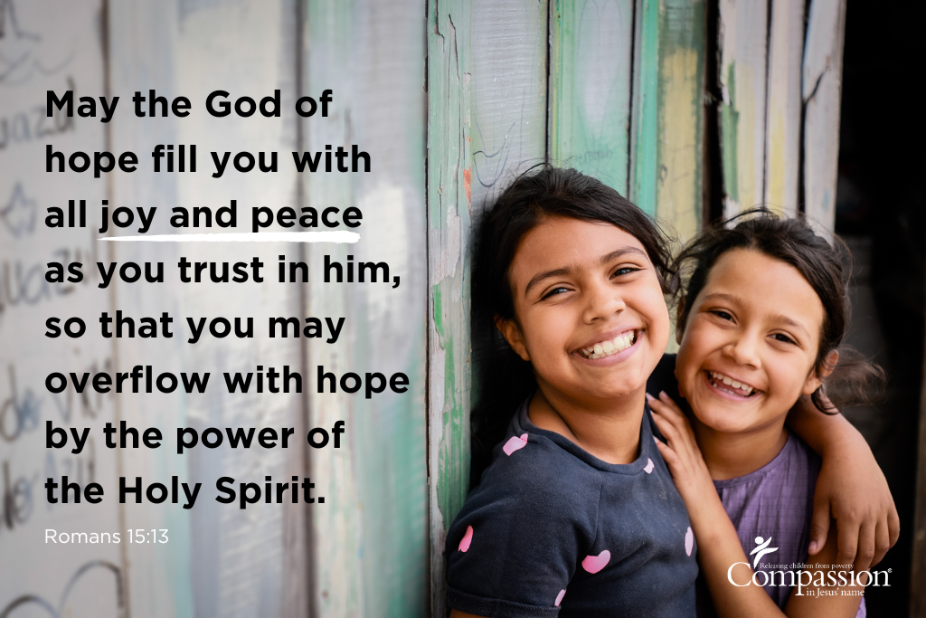
Click to go back
God wants us to trust Him and allow Him to be part of what we do. What better person to lean on? Someone who knows your past and already knows your future? We can ‘overflow with hope’ if we learn to place our trust in the one person who already has everything taken care of?
Your questions of the day:
Have you trusted people in the past and been let down?
Is there someone in your life now who you feel you could trust implicitly?

Slide 4
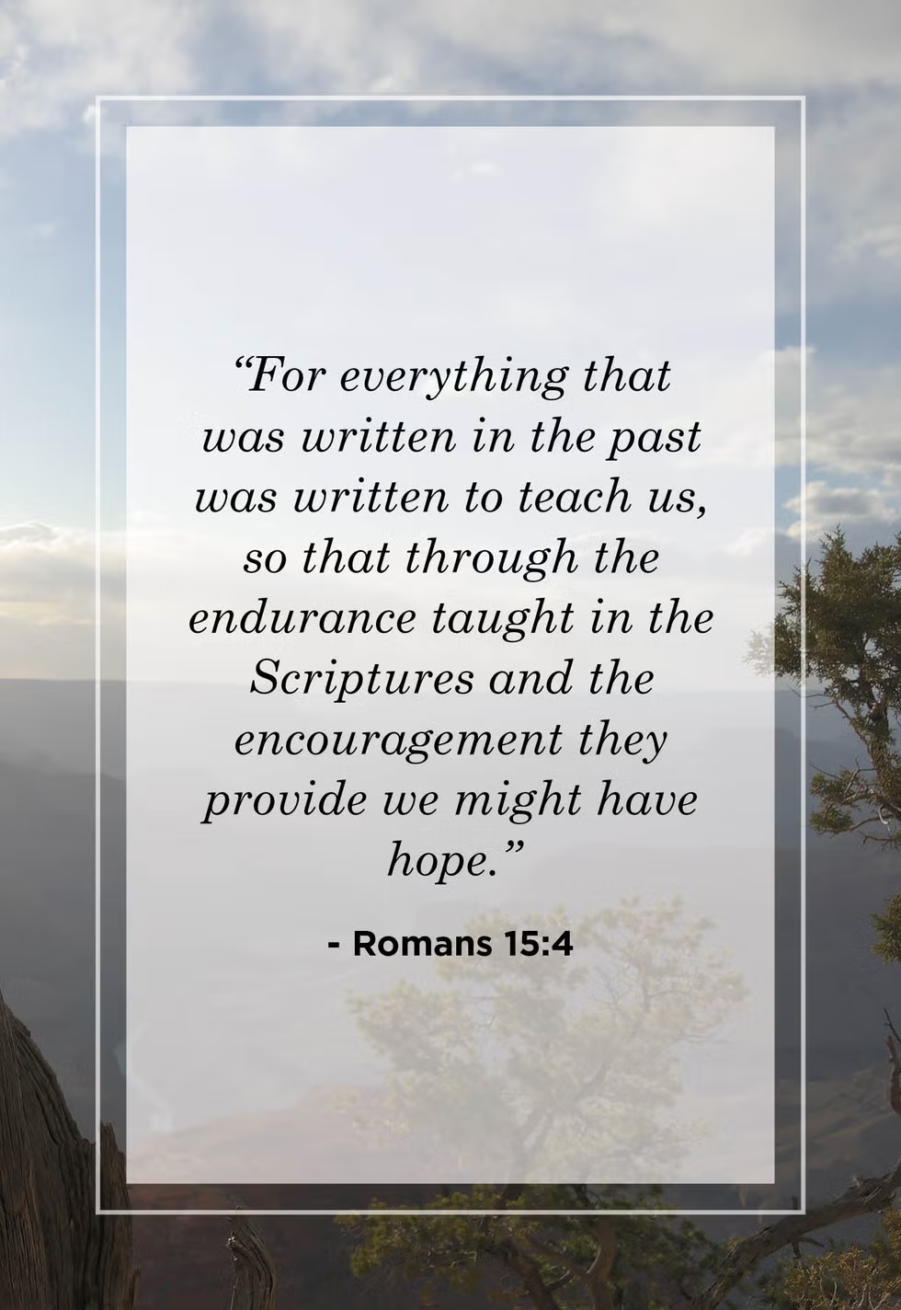
Click to go back
The apostle Paul is writing to the people in Rome and reminding them that everything that is taught as scripture is valuable and written to teach us and encourage us. The question is: are we willing to learn? One thing we are told quite often is to try and learn from everything that happens in our lives – whether good or bad. I think this is a very healthy attitude to have as it builds good habits and resilience.
Question of the day:
What is the most difficult experience you’ve had in your life and what have/can you learn from it?

Slide 5
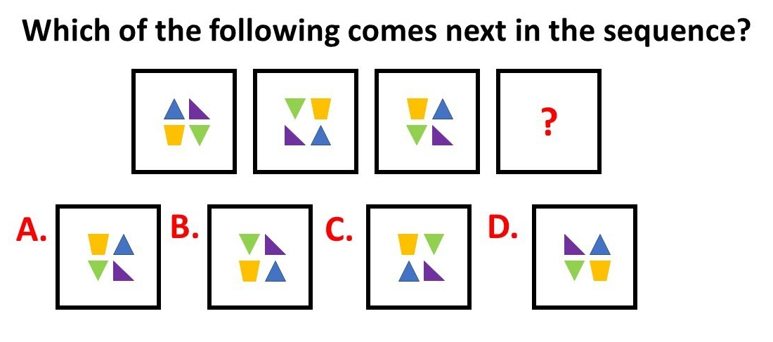
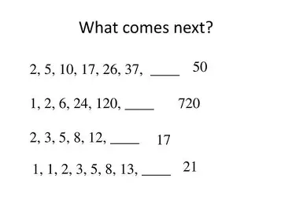

The shapes in image 1 move anti-clockwise two places to image 2
The shapes in image 2 move 1 place anti-clockwise to image 3
The shapes in image 3 then need to stay in the same position going into image 4 (Answer = A)
1
2
3
4
Click to go back
+3
+5
+7
+9
+11
+13
x2
x3
x4
x5
x6
+1
+2
+3
+4
+5
Click for answers
Fibonacci – add the first two to get the third, the second and third to get the fourth etc

Slide 6


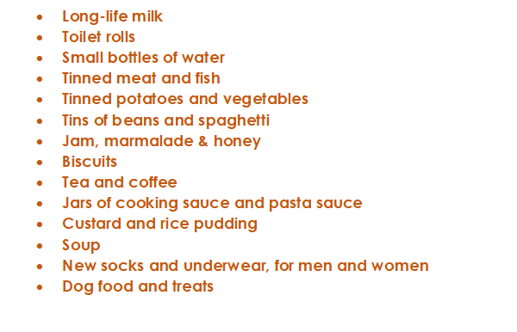



This is a message from Crawley Open House. They are looking for donations for the month of Harvest (October) and we as Holy Trinity always do what we can to assist. On the left is a list of items they require. We are asking that you consider buying something on the list – or even looking in your cupboards for spare items. You can bring them directly to the chapel and then I will deliver them with the help of a small group of students the week after half term
Start thinking about this now but we will only start collecting in October
Click to go back

Slide 7
Lord God
As we start a new academic year and set goals for ourselves, help us to remember that we can ask other people and You for guidance and wisdom.
Each of us are made in Your image and Your desire is that we would have a future that is full of hope. Trials will come our way, however, help us to use them to take the next step and allow the challenges of family, school and life shape us into the best versions of ourselves.
Amen
Click to go back

Slide 8
Here are 4 anagrams for the word ‘faith’.
Can you work them out?
civic not on
conviction
Click for answers
line race
reliance
Click to go back
strut
trust
inexact poet
expectation

Slide 9
Trip to Uganda July 2025
On 26th July, 7 of our Year 11 students and Mr Deysel, joined two other schools and a small group of independent travellers (33 in total) on a trip to Uganda organised by Edukid. Edukid is a charity run by a former student of Holy Trinity helping poor communities in Uganda, Peru and Cambodia by supplying urgent needs and sponsoring children’s education.
We spent 9 days in Uganda; four of those at a school called Wilacic where we organised and ran activities including a sports day, a variety of individual sports and games like tug of war and rugby; face painting, frisbee etc. We visited families who were in need and were able to supply them with basic needs like mattresses, mosquito nets and clothes.
We are hoping to join this trip every year and will advertise later this term
Click to go back

Slide 10
Almighty God
As we venture out into our school day, help us to remember the following:
You value us and give us dignity;
We are part of a wonderful community;
You will help us make wise decisions;
Because You are for us, we can have hope!
Bless all we do today. Help us to be kind with our words and actions.
Amen
Click to go back

Slide 11
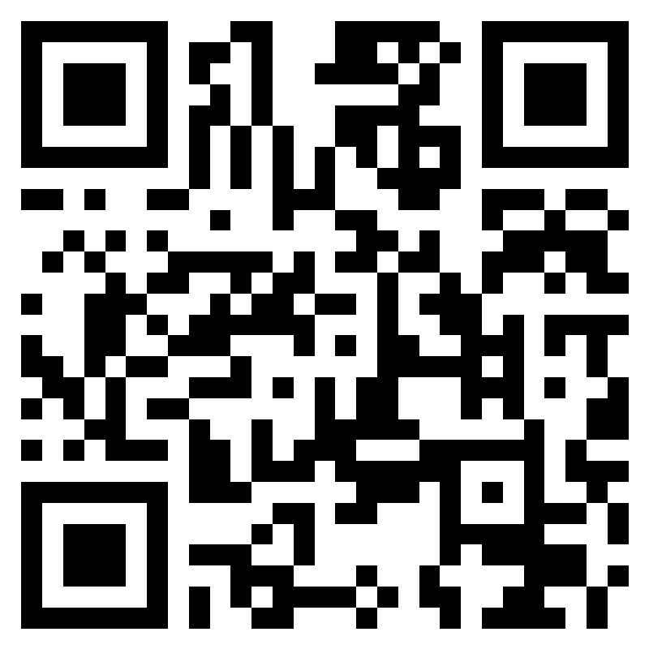
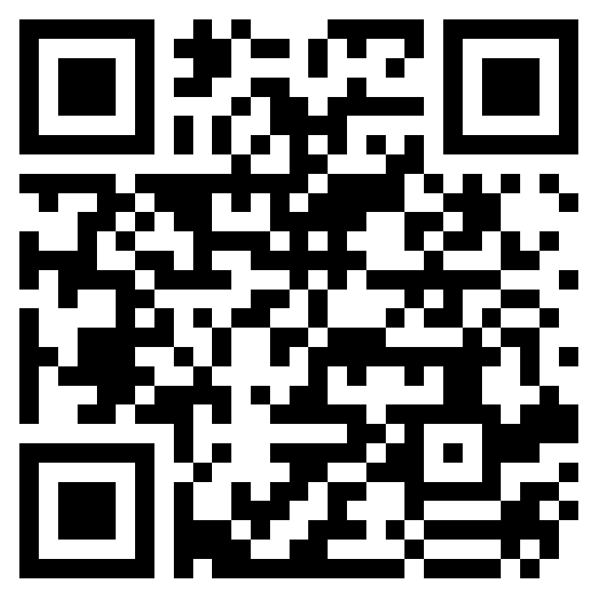

Week 3 – W.B 15/09/25
Click to go back
Student Council are meeting every week in 134 on Friday. You should receive a Student Council update once every 2 weeks.
Find out who your student council rep is in your tutor group
Don't have one? Let Mr. Wolfson know
Is there anything you want student council to discuss this year?
Fill out the form and let us know!
Is there any information you want to feedback to the refectory?
Fill out the refectory feedback form
Share ideas of what you want discussed in Student Council Meetings
Refectory Survey
Student Council said…
We are meeting with refectory staff on Tuesday 30th of September

