Slide 1
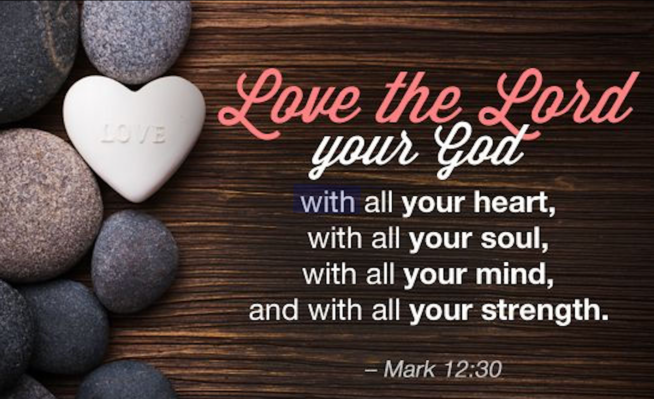


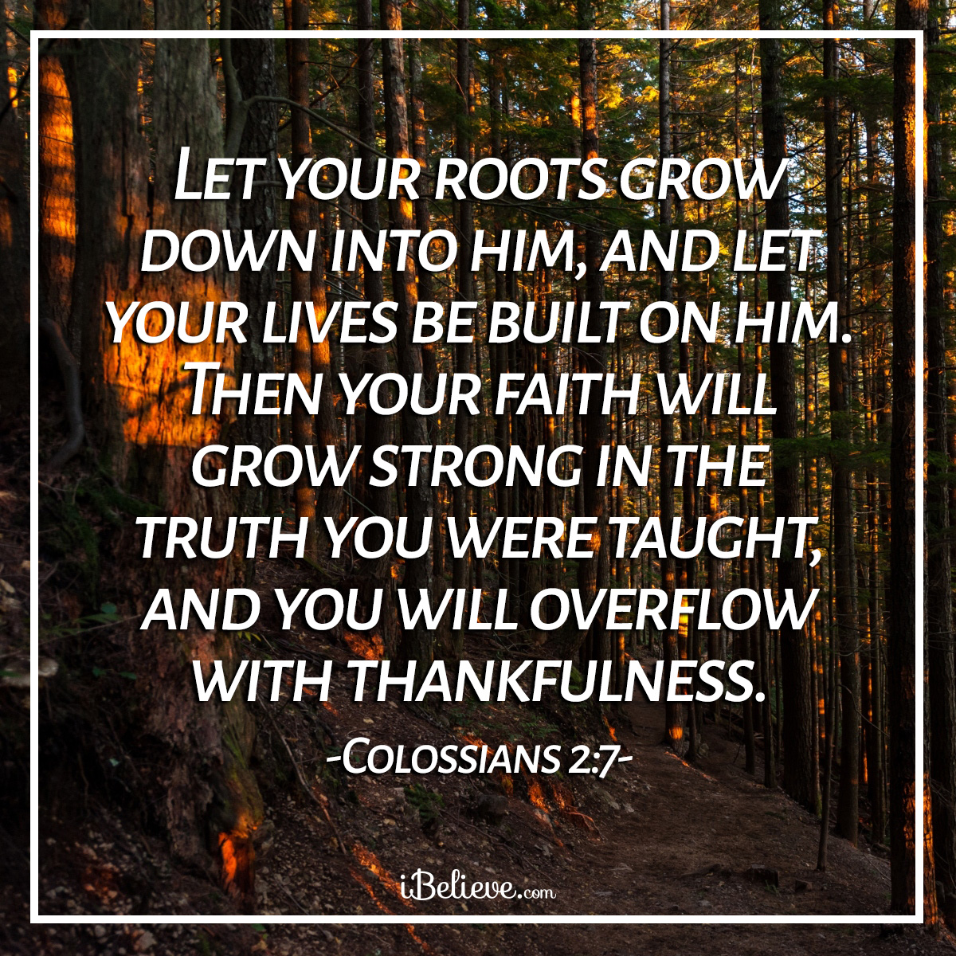
The theme for this half term:
School Mission Statement: Deeply Christian; Open to All
The Equality and Diversity theme for this half term: Religion/Belief
The theme for this week: Deeply Christian
Click for the challenges of the day
https://youtu.be/c-GnoRWWFiU
Click for the verses of the day
Careers – Guess my job!
https://youtu.be/l8TYMZF0c_8
Click for a prayer
Watch: A strong message of God’s love
https://youtu.be/tIIn6tyk-hQ

Slide 2
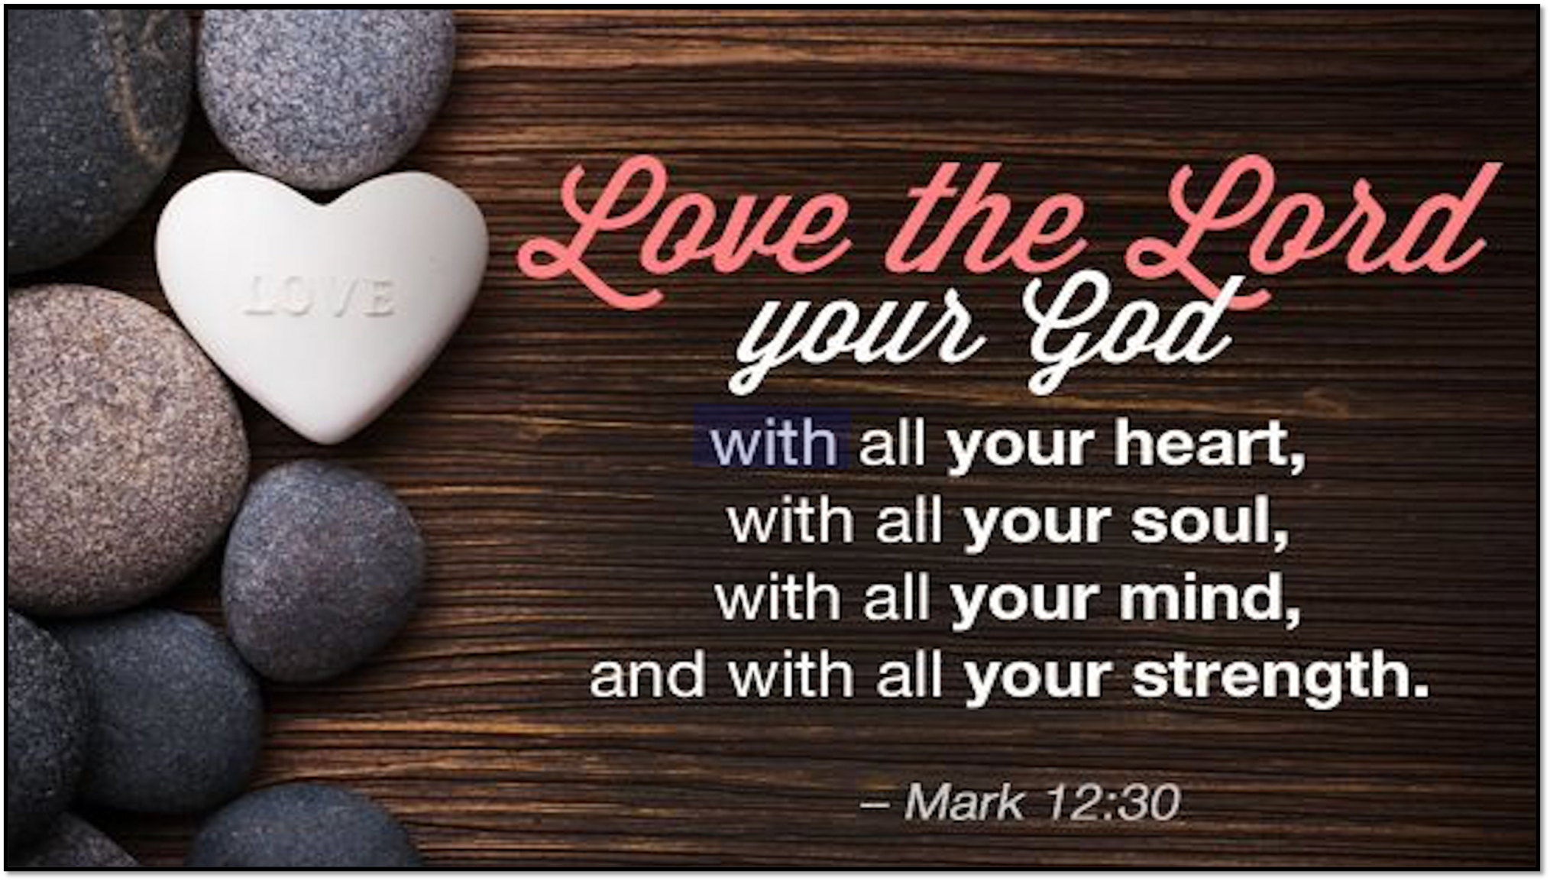



The theme for this half term:
School Mission Statement: Deeply Christian; Open to All
The Equality and Diversity theme for this half term: Religion/Belief
The theme for this week: Deeply Christian
Click for the challenges of the day
https://youtu.be/c-GnoRWWFiU
Anagram challenge
Christmas Care Boxes
Click for the verses of the day
Word of the Day:
Merriam-Webster
Click for a prayer
Watch: Deeply Christian = Deeply Love
https://youtu.be/3cx1sU7JJpY

Slide 3
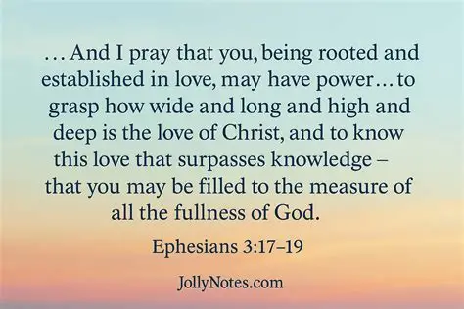
Click to go back
The idea that God’s love is wide, long and high, in this context, can mean it is unlimited. There is no boundary on this as God, himself, has no boundaries. God says that before anything existed (the universe), He WAS. In other words, He has always been there. The Bible also says God is love (1 John 4:7&8)
Question of the day
What do you think the verse means when it says ‘love surpasses knowledge’?

Slide 4
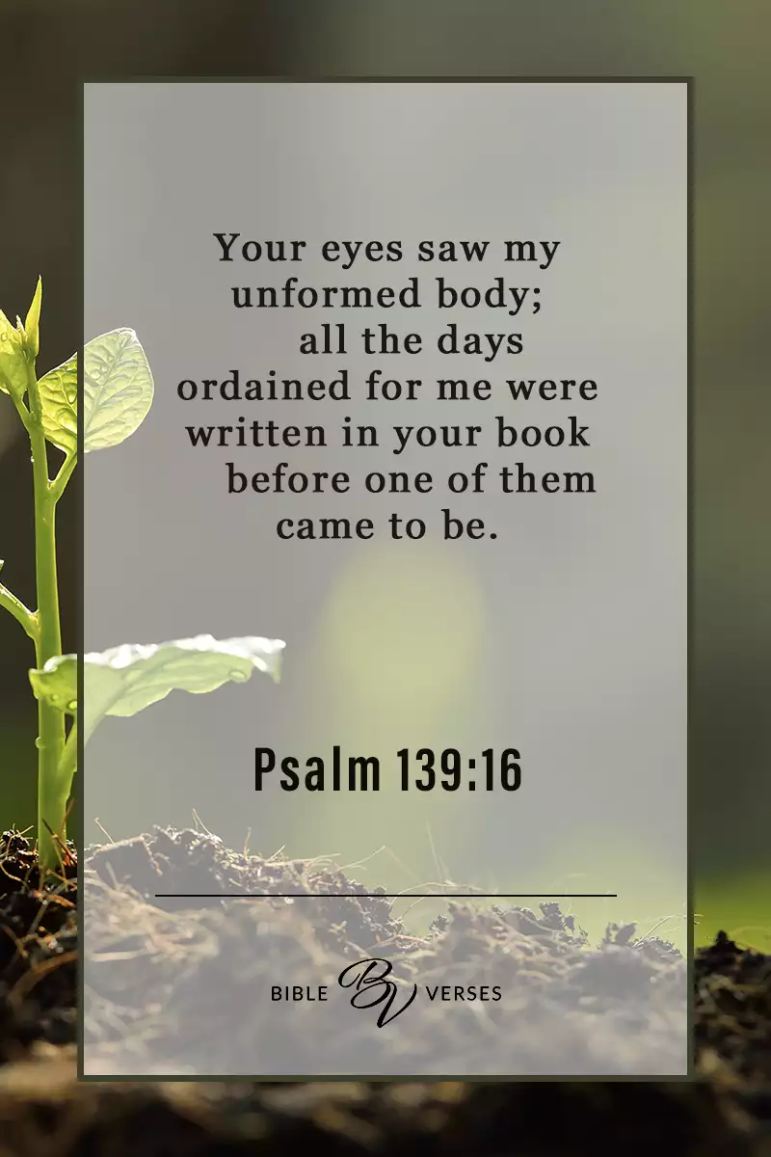
Click to go back
This Psalm was written by King David. David had a very close relationship with God. He made lots of big mistakes but was always repentant and aware of God’s love for Him. He says here that God is so closely involved in His life that God knew him before he was born and knew the life he would live. So God knew all the things David would do – both good and bad - and He still chose to love him and use him mightily. This implies a deliberate and unmatched intimacy.
Question of the day:
Do you have anyone in your life now that knows you very well? Your secrets, your mistakes, your likes and dislikes?

Slide 5
Can you work out these synonyms of the word ‘intimate’ from their anagrams?
attain coffee
affectionate
Click for answers
art seed
dearest
Click to go back
doc infant
confidant

Slide 6
Loving God
You tell us that You have made us in Your image
You tell us that You love us deeply and know us intimately
Your intention is that we seek You and find You
Your promise is that You will hold us in the palm of Your hand
Help us to have the faith to believe this
Amen
Click to go back

Slide 7
Gracious God
Thank You that You have promised us a wonderful hope and an exciting future if we seek You. Help us to have faith that You are always there even when things don’t go well here on earth. You are present when we pray and are always waiting for us to call on You. Thank You for your deep love for all of us.
Amen
Click to go back

Slide 8

Christmas Care Home Boxes
What is it?
Every Tutor group (excluding Year 11) will receive a box that they will have the task of filling for the care home residents. In addition we ask for each tutor to make and all sign a Christmas card. The Headteam will then personally deliver each box to the residents on December 17th!
Notice: Please bring all gifts unwrapped!
Deadline: Wednesday 10th december
Ideas: Socks, hand creams, lip balm, scalfs, treats, crosswords, hair accessory’s, mini puzzles, biscuits, hot chocolate packets etc
Click to go back

