Slide 1



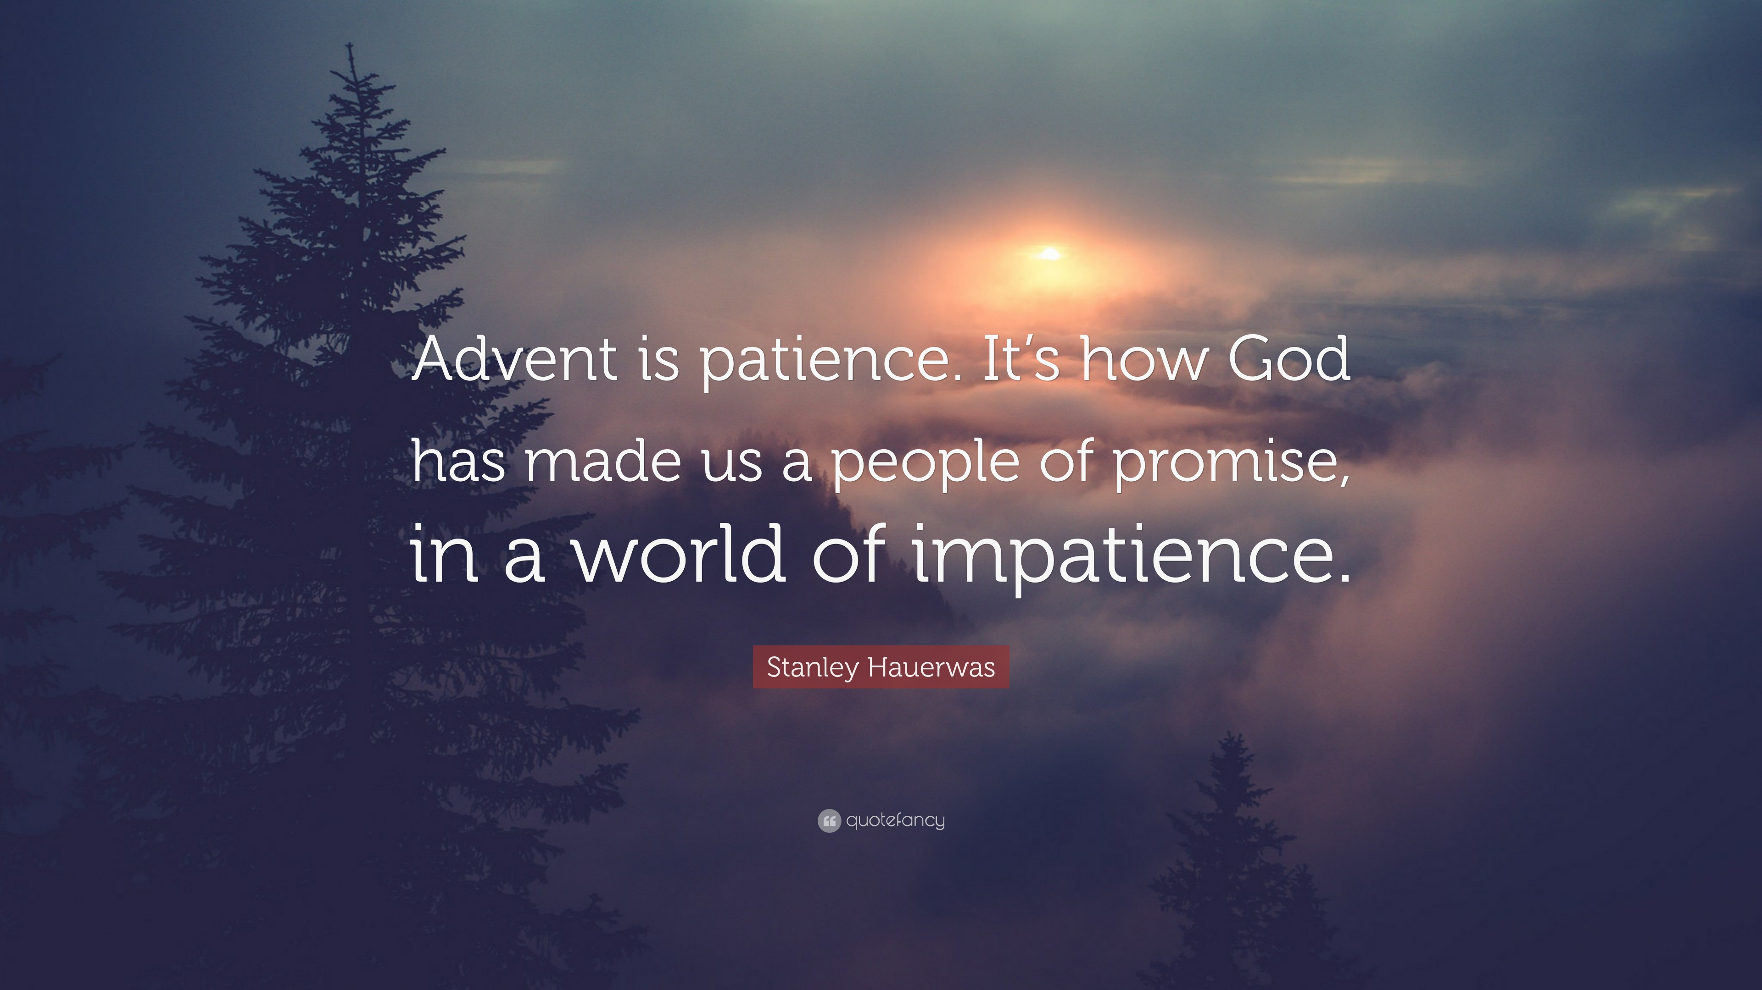
The theme for this half term:
School Mission Statement: Deeply Christian; Open to All
The Equality and Diversity theme for this half term: Religion/Belief
The theme for this week: Advent
Christmas Care Boxes
Click below for the challenges of the day
Advent Quiz | Christianity | 10 Questions
Quiz: How much do you know about Advent? - CBBC
Click for the verses of the day
Careers – Guess my job!
https://youtu.be/L483ZWUjld4
Word of the Day:
Merriam-Webster
Click for Advent prayers
Click for info on Model UN
Watch: What is Advent?
https://youtu.be/nFJKiqtwFvI

Slide 2


Click to go back
Here, Luke records the words of the Angel Gabriel. Gabriel was tasked with giving Mary the news that she was the one chosen to give birth to the Son of God. What a crazy announcement!
Question of the day:
Have you ever had anything really crazy happen in your life? Share it with someone if you can…

Slide 3

Click to go back

Slide 4

Christmas Care Home Boxes
What is it?
Every Tutor group (excluding Year 11) will receive a box that they will have the task of filling for the care home residents. In addition we ask for each tutor to make and all sign a Christmas card. The Headteam will then personally deliver each box to the residents on December 17th!
Notice: Please bring all gifts unwrapped!
Deadline: Wednesday 10th december
Ideas: Socks, hand creams, lip balm, scalfs, treats, crosswords, hair accessory’s, mini puzzles, biscuits, hot chocolate packets etc
Click to go back

Slide 5
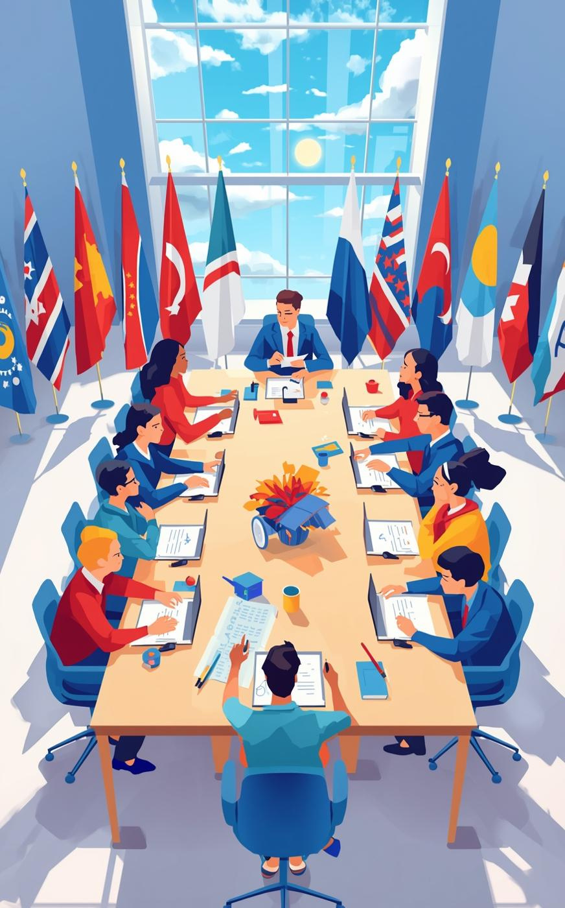
GLOBAL DIPLOMACY INITIATIVE
Model United Nations
Shaping Future Leaders Together

Slide 6



What is Model UN?
An Introduction to Diplomacy –
Model United Nations (MUN) is a simulation where you become a delegate representing a real country. You debate world issues — anything from climate change to global security — and work together to write “resolutions” that solve them.
It’s a mix of debate, teamwork, and strategy, where you learn to think on your feet, negotiate, and speak confidently — all while pretending you’re in a mini-UN.
Think of it like a blend of politics, problem-solving, and performance !

Slide 7

How Model UN Works​ - In 3 Simple Steps
Pick a Country
Debate
Solve Real World Problems

Slide 8


Step 1: Pick a Country 🌐
You’re assigned a country — maybe Japan, Brazil, or Kenya — and you research its real policies and opinions on global issues.
Step 2: Debate Like a Diplomat 🗣️
You join a UN-style meeting and argue your country’s point of view, making speeches, forming alliances, and negotiating deals.
Step 3: Solve the World’s Problems 🕊️
You and other delegates write and vote on resolutions — basically mini world-peace plans you’ve created together!
“Should the international community prioritise space exploration over solving urgent Earth-based problems?”

Slide 9
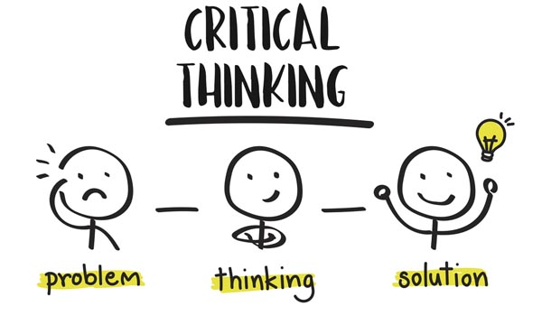




Benefits of Model UN
🌟 Skills You Gain in Model UN –
Public speaking & confidence – presenting ideas clearly to a room of peers
Research & critical thinking – understanding countries, policies, and global issues
Negotiation & diplomacy – finding compromise between conflicting viewpoints
Teamwork & collaboration – working in committees to draft resolutions
Problem-solving under pressure – responding to crises or unexpected developments
Leadership & initiative – guiding debates or forming alliances
Writing & drafting – creating formal resolutions and position papers
Cultural awareness & global perspective – understanding different countries’ priorities
Networking & social skills – connecting with delegates from other schools or countries
Time management & organisation – balancing research, debate, and preparation

Slide 10

UCL
Kings College London
Uni of sussex
“When you’re applying for a degree apprenticeship, the interviewers are looking for maturity, communication, and teamwork — exactly what Model UN gives you. It’s a way to show you’ve practiced leadership in a real, professional context.”
Uni/Apprenticeship Applications
Example Connections
Business / Management apprenticeships: MUN builds the same leadership, strategy, and negotiation skills business apprentices use daily.
Law apprenticeships: Arguing cases, drafting resolutions, and understanding global issues mirrors legal reasoning.
Engineering / Tech apprenticeships: You learn to explain complex issues simply — critical when presenting technical work to non-technical clients.
Public Sector or Civil Service apprenticeships: MUN is direct practice for diplomacy, policy thinking, and ethical decision-making.
Multiple Highly ranked Unis incorporate MUN or similar sims in student life. Starting now could give you a head start....

Slide 11
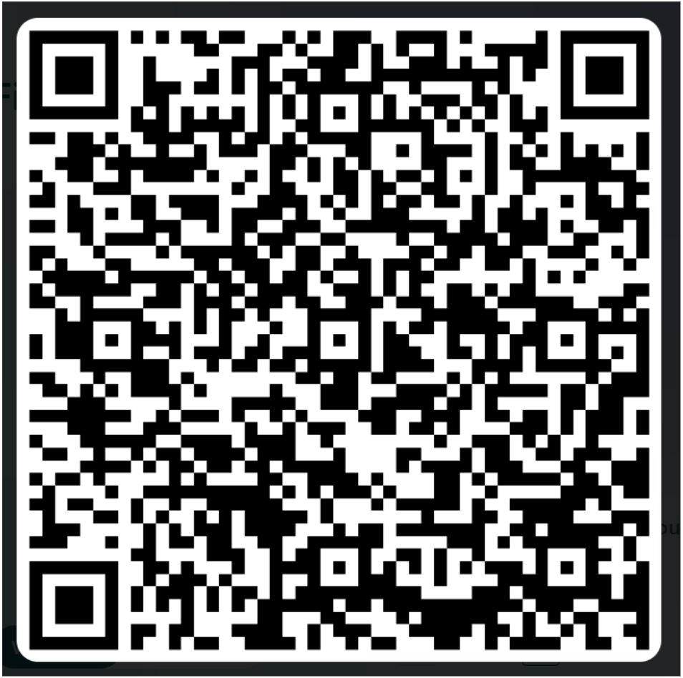

When Is The First Meeting ?
This club will begin on Tuesday the 2nd of December in the Sixth Form Centre after school.
Does this interest you ?
Want to find out more ?
Have any questions for us ?
Click to go back

