Slide 1

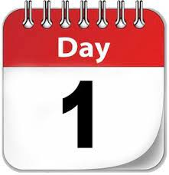

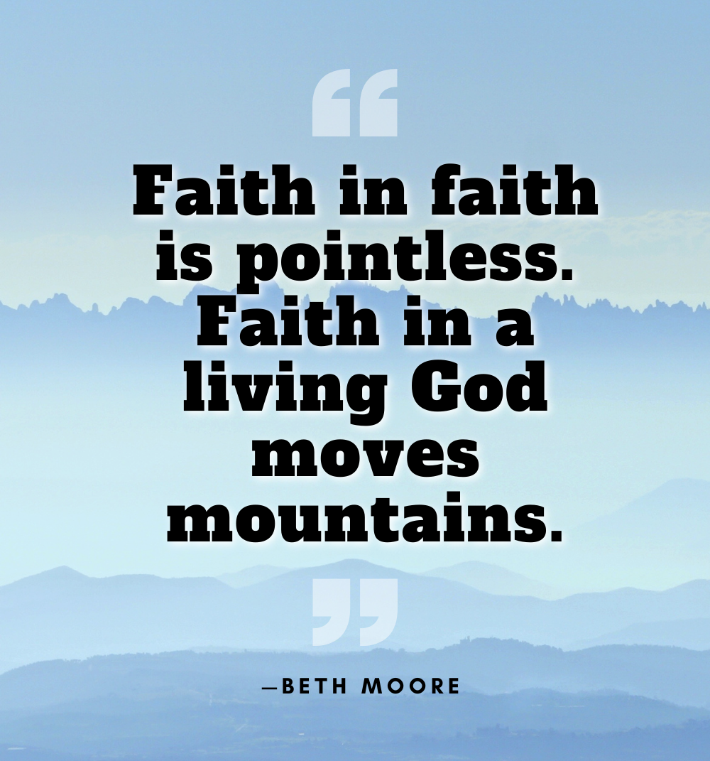
The theme for this half term:
School Mission Statement: Deeply Christian; Open to All
The Equality and Diversity theme for this half term: Religion/Belief
The theme for this week: Faith
Click for the challenges of the day
https://youtu.be/d3cd240A7OQ
https://youtu.be/AiFFG0FQqlM
Click for the verses of the day
Careers – Guess my job!
https://youtu.be/Bb9iBUM_wXA
Click for a prayer
Watch: A story of faith
https://youtu.be/8Vz06vixswc

Slide 2
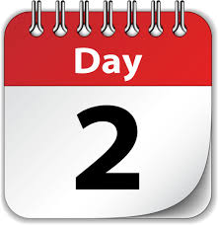

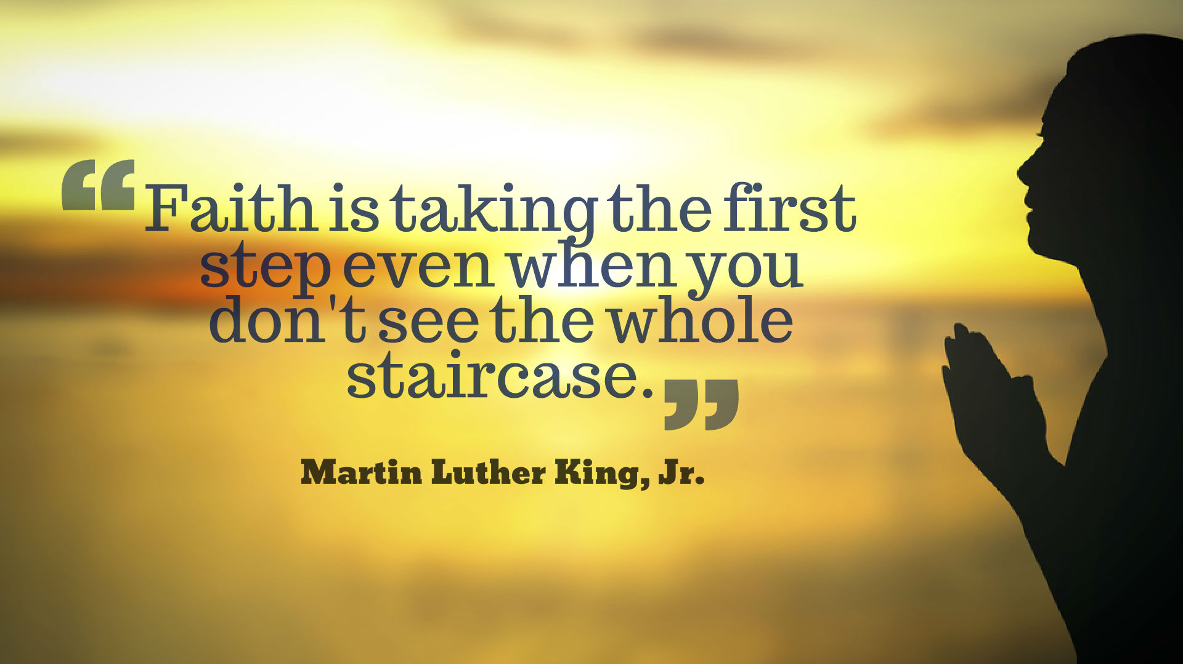

The theme for this half term:
School Mission Statement: Deeply Christian; Open to All
The Equality and Diversity theme for this half term: Religion/Belief
The theme for this week: Faith
Click for the challenge of the day
Click for the verses of the day
Word of the Day:
Merriam-Webster
Click for a prayer
Watch: A story of faith
https://youtu.be/AOK73LZvaZI

Slide 3
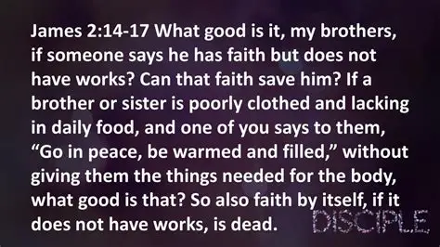
Click to go back
The topic of faith can be tricky. On one hand, God says all we have to do is believe in Him and we will have an eternity with Him. On the other hand, He says that our faith is nothing if we don’t do something with it.
At the end of the day, God can do whatever He wants without us. And this is true. I think it is then even more wonderful then that God chooses to use us.
Question of the day:
How are faith and works together better than just works? Click here for suggestions

Slide 4
Picture these scenarios:
I want to get a good job. I believe in God and I have faith but I don’t prepare my self for the working world. I don’t get any qualifications. I don’t put together a CV. I don’t have a good outfit I can wear to interviews that shows I mean business. I don’t actually apply for any jobs. Instead, I sit at home and pray that God would give me a job and then wait (in faith).
I want to get a good job. I believe in God and I have faith and I prepare myself for the working world. I get qualified. I put together an attractive CV. I get myself an interview outfit that makes me look the business. Then I apply for jobs, pray and wait (in faith)
Which scenario does God bless? 1 or 2?
God blesses us when we do the best we can but also trust Him. He wants the best for us and will help us (He can open and close doors that we can’t) but He will not bless laziness. Do your best and let God do the rest (cheesy but true! ☺)
Click to go back

Slide 5
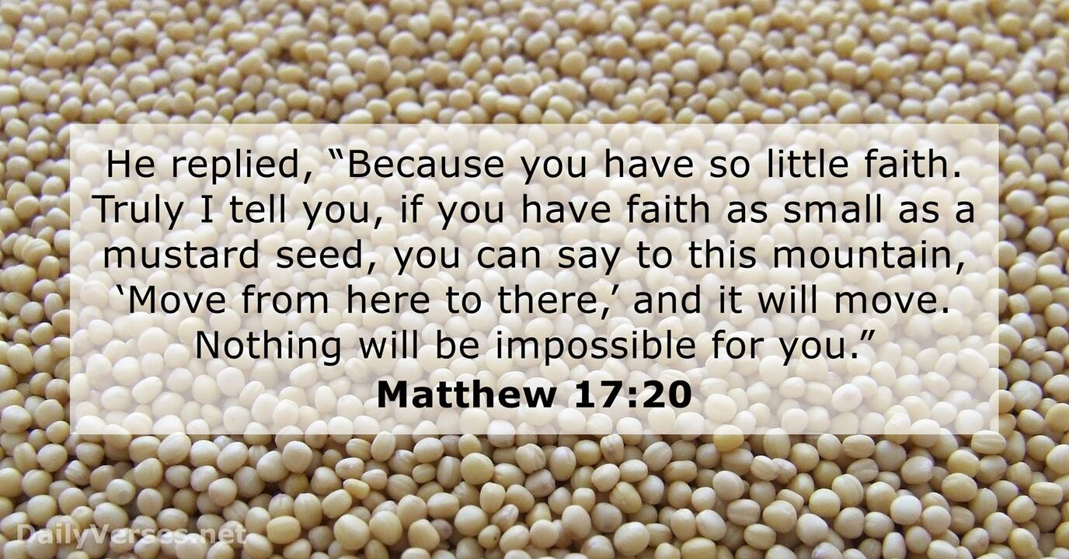
Click to go back
In this story, the disciples had tried to help a person overcome a difficult situation with an unclean spirit but they did not have any impact. They told Jesus about it and His response is what you see on the left in Matthew 17:20.
Question of the day:
In your life, have you ever wanted something but doubted you would get it? What makes us doubt?

Slide 6
Here are four books from the Bible
Can you work them out from their anagrams?
RSVP robe
Proverbs
Click for answers
atlas gain
Galatians
Click to go back
chi lama
Malachi
clue visit
Leviticus

Slide 7
Loving God
When we look at what goes on in our world, it can be difficult to have faith that everything will work out. You have said that having faith does not mean the removal of hardship, but the ability to trust in You to help us through the hardship. You have said that in this world we will still have trouble but that we should ‘take heart’ as You have overcome the world.
Help us to trust You today.
Amen
Click to go back

Slide 8
Almighty God
You have reminded us that having faith also means playing our part. Help us to find the wonderful union between following our dreams and pursuing those things about which we feel passionate and leaving room for You to add the extras that we cannot.
As we work today and interact with those around us, help us to be the best we can be knowing that You will help us be that very person!
Amen
Click to go back

