Slide 1




The theme for this half term:
School Mission Statement: Deeply Christian; Open to All
The Equality and Diversity theme for this half term: Inclusion
The theme for this week: Welcome Back!
Click for the challenge of the day
Click for the verses of the day
Click for encouraging quotes as you start a new year
What do you need to leave behind and what are you looking forward to starting?
Click for a prayer
Watch: A pep talk from the Kid President
https://youtu.be/RwlhUcSGqgs

Slide 2



The theme for this half term:
School Mission Statement: Deeply Christian; Open to All
The Equality and Diversity theme for this half term: Inclusion
The theme for this week: Welcome Back!
Click for the challenge of the day
Click for the verses of the day
Word of the Day
Merriam-Webster
Watch: Value your education…
https://youtu.be/E2aCiIOyRGc
Click for a prayer
Watch Extra: Be motivated…
https://youtu.be/FY4o1MAComU

Slide 3

Click to go back
God’s promise to us if we believe. That He will be with us, strengthen us and help us. You can trust God to be there at all times – it’s what He does!
Start this year with confidence!

Slide 4

Click to go back
God tells us that His love for us is greater and more powerful than any force of evil or harm that could ever come our way. He also tells us that His mercy is new every morning (or every day) meaning we always have a fresh start. God is faithful in these things, even when we are not. But He encourages us to show thew same compassion to others. Will you love rather than hate? Encourage rather than abuse?

Slide 5
Set some goals for the year ahead. Start with the basics (especially if you’re someone who struggles with the small things). Be SMART about them as well.
S = Specific
M = Measurable
A = Achievable
R = Relevant
T = Time Bound
Example of an UN-SMART target: To be better in class (too broad)
Example of a SMART target: To be punctual to every lesson
(This is specific and can be easily measured and achieved)
Leave your goals with your tutor and review them at the end of every term
Click to go back

Slide 6



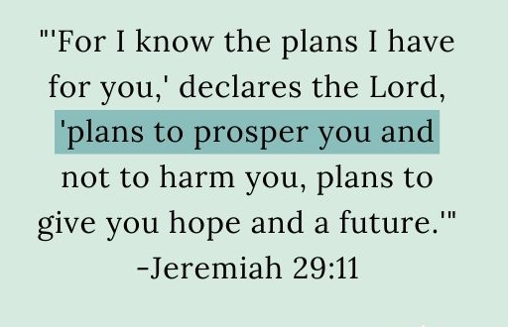
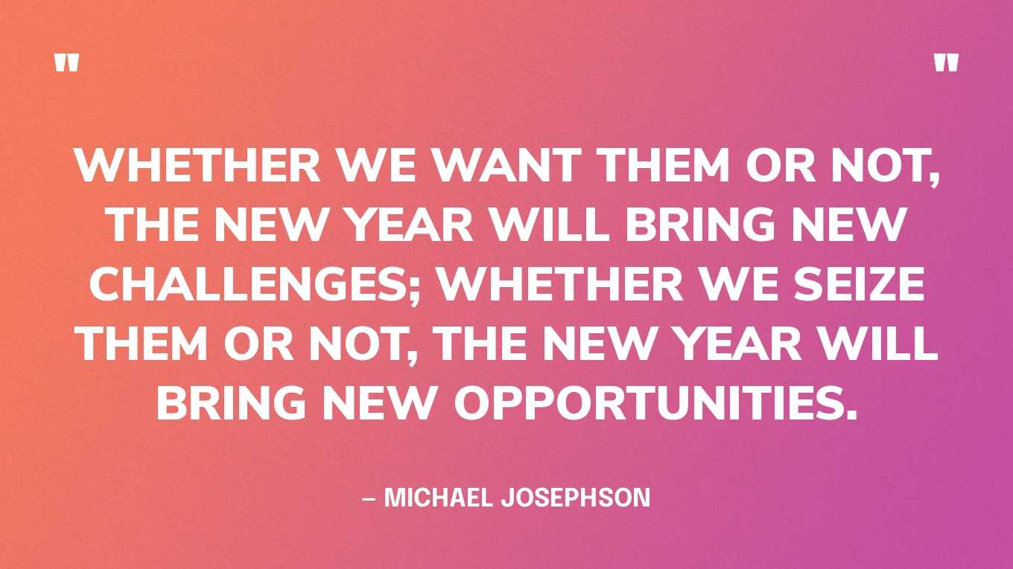
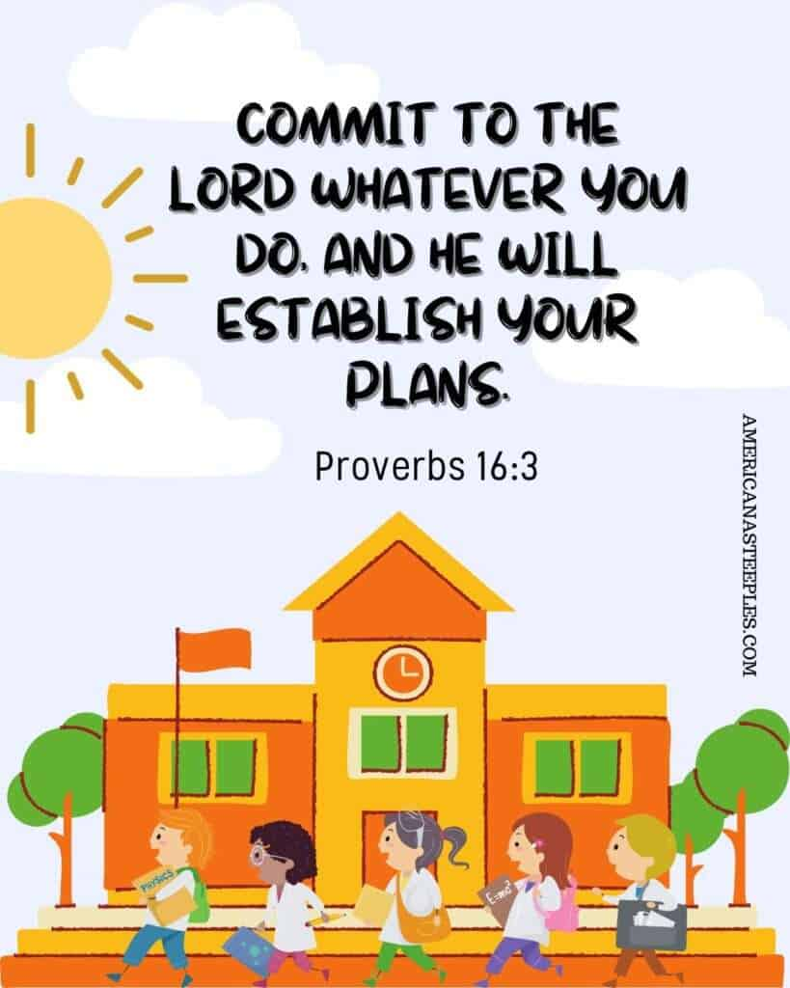

Click to go back

Slide 7
Loving God
We’re at the start of a new academic year. We are looking forward to a fresh start, new challenges and opportunities to try new things. We ask that you would:
Give us strength to start well
Energy to do everything to the best of our abilities
Remind us to be kind and helpful to those around
We pray these things in Jesus’ name
Amen
Click to go back

Slide 8
Dear God
As I step into this new school year, I ask for Your guidance, patience and perseverance. I recognize that challenges may arise and there may be moments when I feel discouraged or overwhelmed, however, in those times, Lord, grant me the strength to endure and the perseverance to press on.
Help me remember that setbacks are opportunities for growth and that obstacles can be overcome with Your grace. May I approach each challenge with a determined spirit, knowing that Your strength is with me and that I can overcome any adversity.
Thank You God for the lessons in patience and perseverance that will shape me into a resilient individual. With Your support, I will face this new school year with determination and joy.
Amen
Click to go back

Slide 9
Can you answer these questions about Holy Trinity School?
In what year did the school actually start, who later opened it and in what year?
The school started taking students in 1967 and was opened by Queen Elizabeth II in 1969
How many students are there in our school and how many in each year group?
As of Sept 2025, there are approx.1400 students at Holy Trinity with 240 in each of the year groups 7 to 10
Click to go back
True or False: Holy Trinity was the first purpose-built comprehensive school in England built by the Church for Church people?
True
Holy Trinity School held a world record for what?
The longest basketball game every played. From 13 to 16 July 2007. 72 hours
Can you name the four houses represented by the colours on your ties?
Canterbury Durham Winchester York

