Slide 1
MISSION STATEMENT: Deeply Christian, Open to All
Our mission is to be a deeply Christian inclusive community which values every individual as a child of God
Welcome to the
Year 7 and 8
Information Evening
Vision Statement: A centre of excellence for learning inspired by Christian values where every person in our school community fulfils their potential.

Slide 2
MISSION STATEMENT: Deeply Christian, Open to All
Our mission is to be a deeply Christian inclusive community which values every individual as a child of God
Key dates for Years 7 & 8
Tuesday 3rd October – INSET day
Wednesday 15th November - Cultural Capital Day 1
Thursday 23rd November & Friday 24th November – INSET days
Wednesday 3rd January – INSET day
Monday 11th March – Year 8 Parents Evening 4-7pm
Friday 22nd March – Cultural Capital Day 2
Monday 25th March - Year 7 Parents Evening 4-7pm
Thursday 4th July & Friday 5th July – Cultural Capital Days 3 & 4
Vision Statement: A centre of excellence for learning inspired by Christian values where every person in our school community fulfils their potential.

Slide 3
Miss S. King Leader of Learning - Maths

Slide 4
MISSION STATEMENT: Deeply Christian, Open to All
Our mission is to be a deeply Christian inclusive community which values every individual as a child of God
Maths
Content
We cover all the main areas of maths in lessons, rotating through topics from:
Number | Geometry and measures
Algebra | Probability
Ratio, proportion and rates of change | Statistics
Year 7 have 8 lessons a fortnight
Year 8 have 7 lessons a fortnight
Vision Statement: A centre of excellence for learning inspired by Christian values where every person in our school community fulfils their potential.

Slide 5
MISSION STATEMENT: Deeply Christian, Open to All
Our mission is to be a deeply Christian inclusive community which values every individual as a child of God
Maths
Groups
We teach Maths in sets, with every class accessing the same content but at an appropriate pace and size of group for them.
We regularly monitor the setting, making changes as necessary
Year 7
X, Y, and Z band
Every band has 4 sets
Year 8
X, Y, and Z band
Every band has 3 sets
Vision Statement: A centre of excellence for learning inspired by Christian values where every person in our school community fulfils their potential.

Slide 6
MISSION STATEMENT: Deeply Christian, Open to All
Our mission is to be a deeply Christian inclusive community which values every individual as a child of God
Maths
Equipment
Maths Equipment Required
Pen + Green pen
Pencil
Ruler
Protractor
Compass
Calculator
Vision Statement: A centre of excellence for learning inspired by Christian values where every person in our school community fulfils their potential.

Slide 7
MISSION STATEMENT: Deeply Christian, Open to All
Our mission is to be a deeply Christian inclusive community which values every individual as a child of God
Maths
Assessment
Students will regularly complete small assessments to check for understanding, and to ensure we can fill in gaps as we go.
These tests will be a mixture of calculator and non-calculator, to help them develop both skills for the papers at GCSE
End of Topic Test:
Roughly 40mins, a few weeks of learning
Periodic Test:
1 hour, all the topics learnt so far
Vision Statement: A centre of excellence for learning inspired by Christian values where every person in our school community fulfils their potential.

Slide 8
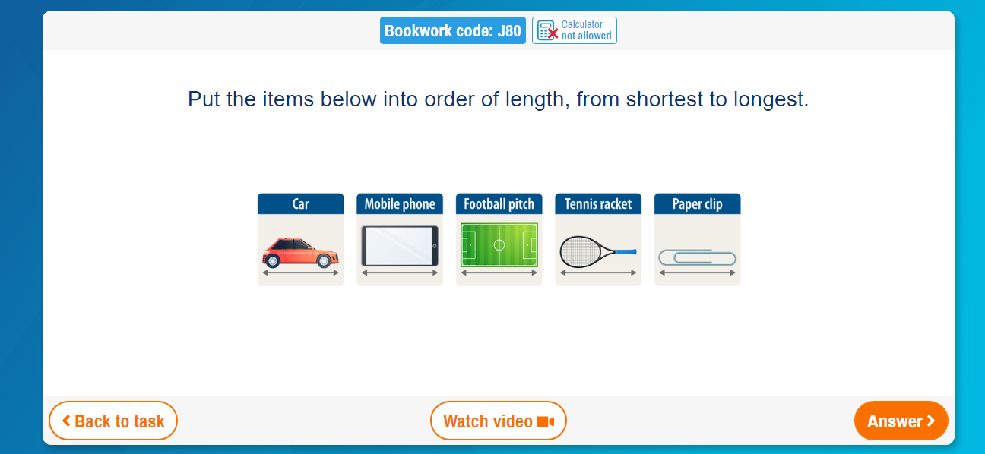
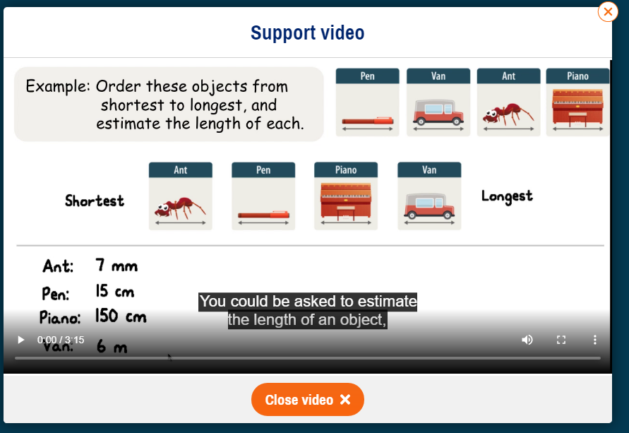
MISSION STATEMENT: Deeply Christian, Open to All
Our mission is to be a deeply Christian inclusive community which values every individual as a child of God
Maths
Homework
Once a week
Vision Statement: A centre of excellence for learning inspired by Christian values where every person in our school community fulfils their potential.

Slide 9
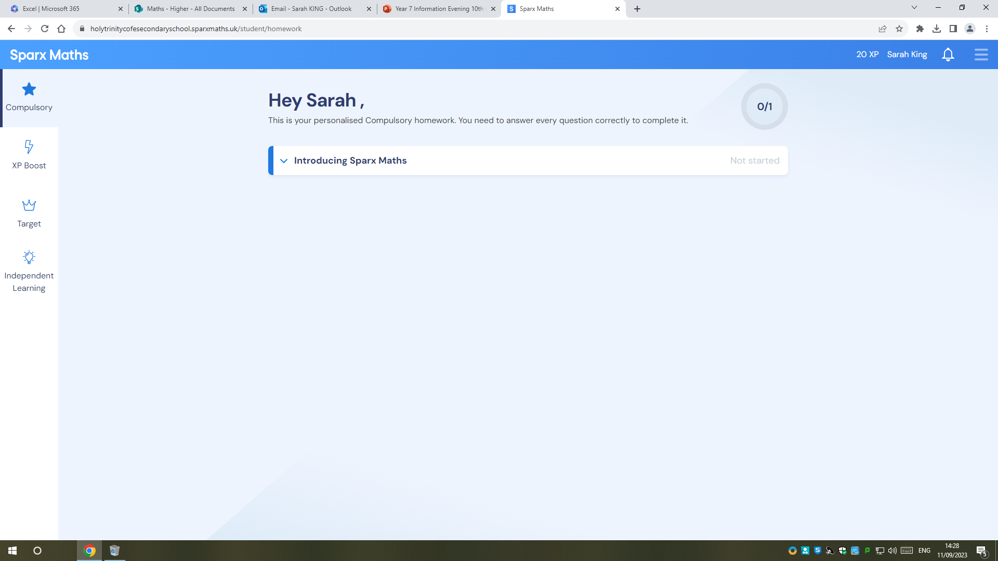
MISSION STATEMENT: Deeply Christian, Open to All
Our mission is to be a deeply Christian inclusive community which values every individual as a child of God
Maths
Homework
Vision Statement: A centre of excellence for learning inspired by Christian values where every person in our school community fulfils their potential.

Slide 10
MISSION STATEMENT: Deeply Christian, Open to All
Our mission is to be a deeply Christian inclusive community which values every individual as a child of God
Maths
Afterschool Support
Maths Hub
Wednesdays
3:15-4:15pm
Room 194
Vision Statement: A centre of excellence for learning inspired by Christian values where every person in our school community fulfils their potential.

Slide 11
Mrs C. King Leader of Learning - English

Slide 12
What is Bedrock?
English Homework
Individualised online learning platform
Improving the literacy of all abilities
Self-marking
Encourages reading and develop tier 2 vocabulary
Students get points depending on what they do and how well
Twice-weekly homework: allow at least 24 hours between each session
All students have been given their login details and should have started by now.
Notes:
Notes:
Sometimes it limits how much a student does
When students first log on they complete a test which determines what they start with
End of unit test
Everything they do is logged in detail

Slide 13
An Example Bedrock Page:
English
Notes:
Progress = what your child is currently working at – red – amber –green faces
Words learned
What units covered
Badges and certificates

Slide 14
English
Notes:
Stress: National Literacy Trust impact on wellbeing – boys especially benefit from reading
GCSE high level texts – need to be used to reading whole texts

Slide 15
English
Reading 20 minutes a day
= 1.8 million words per year
= scores in 90th percentile
Reading 1 minute a day
= 8000 per year
= scores in 10th percentile
Notes:
90th percentile – do better than 90% of other people – puts in stronger position for next steps (exams, college work etc)

Slide 16
How You Can Support Your Child’s Reading
English
Get them to talk about what they are reading.
Ensure they bring a book to school.
Get them to read 15-20 minutes a day.
Have books at home.
Model reading.
Got a reluctant reader?
Let them choose their book/magazine etc
encourage use of different types of books (audio, graphic etc)
quick reads like Barrington Stoke are good for students who struggle
link books with films
Notes:
Students with 10 books at home more likely to go to university

Slide 17
Reading at HTS
English
Weekly library lesson.
Students should have a reading book as part of their daily equipment.
Silent reading takes place in tutor times and English lessons start with 10 minutes of reading.
It’s important students stick with the same book rather than grabbing random books each day.

Slide 18
Accelerated Reader
English
Students complete a termly STAR test to determine their reading level: e.g. 2.6-4.3.
The books they read should be within this range to ensure the right amount of challenge.
At the end of each book they complete a quiz – ideally within 48 hours.
Students should aim to achieve 85% across their quizzes.
Students can quiz at home via the website and at school.
Notes:
Explain ZPD – lower end is easiest; a guide and not a reading age

Slide 19
Miss K. Mangat Leader of Learning - Science Miss D. Rees Leader of KS3 Science

Slide 20
MISSION STATEMENT: Deeply Christian, Open to All
Our mission is to be a deeply Christian inclusive community which values every individual as a child of God
An Overview to Science
​​ | Biology​​ | Chemistry​​ | Physics​​
Key Stage 3​​ | Cell Biology and Organisation​​ Infection and Disease​​ Bioenergetics​​ Genetics and evolution​​ Ecology​​ | Particles​​ Properties of matter​​ Chemical Reactions​​ Chemical Analysis​​ Earth Chemistry​​ | Energy​​ Electricity​​ Forces​​ Waves​​
Year 9​​ | Cell Biology​​ Transfer of substances across a cell​​ Human Organisation​​ Non-communicable diseases​​ | Structure of the atom​​ Quantitative Chemistry​​ Ionic and Metallic Bonding​​ Energy Changes​​ | Principles of Energy conservation principles of Electricity​​ Principles of Particles​​
Year 10​​ | Cell Division​​ Plant Organisation​​ Communicable Diseases​​ Photosynthesis​​ Respiration​​ | The Periodic Table​​ Reacting Masses​​ Covalent Bonding​​ Properties of Matter​​ Chemical Changes​​ Electrolysis​​ Composition of the Earths Atmosphere​​ | Energy transfers when heating​​ Electrical Resistors and Domestic uses of electricity​​ Radioactivity​​ Motion​​
Year 11​​ | Human nervous system​​ Hormonal Control​​ Reproduction​​ Genetics and evolution​​ Ecology​​ | The rate and extent of chemical change​​ Organic Chemistry​​ Purity of substances ​​ Use of Earths Resources​​ | Magnetism and electromagnetism​​ Forces and Motion​​ Energy transfers through waves​​
Key Stage 5​​ | This knowledge will feed into and build upon at A Level or BTEC Science​​
Vision Statement: A centre of excellence for learning inspired by Christian values where every person in our school community fulfils their potential.
Notes:
Year 7: Introduce and develop scientific skills (mixed ability groups).
Year 8: Develop Scientific Understanding
(mixed ability groups).
Year 9:Start Our GCSE course (Top sets will be a future Triple Science pathway for GCSE)
Year 10&11: Our Formal GCSE years (We will set all groups)

Slide 21
MISSION STATEMENT: Deeply Christian, Open to All
Our mission is to be a deeply Christian inclusive community which values every individual as a child of God
Science Year 7
- Groupings (mixed ability)
- Topic rotation (Biology, Chemistry, Physics)
Biology | Chemistry | Physics
1. Movement and cells 2. Interdependence and plant reproduction 3. Variation and human reproduction | 1. Particles 2. Separating mixtures 3. Acids and alkalis | 1. Speed and gravity 2. Voltage and resistance 3. Sound and light
Vision Statement: A centre of excellence for learning inspired by Christian values where every person in our school community fulfils their potential.

Slide 22
MISSION STATEMENT: Deeply Christian, Open to All
Our mission is to be a deeply Christian inclusive community which values every individual as a child of God
Science Year 8
- Groupings (mixed ability)
- Topic rotation (Biology, Chemistry, Physics)
Biology | Chemistry | Physics
1. Breathing and digestion 2. Respiration and photosynthesis 3. Evolution and inheritance | 1. Elements 2. Reactions 3. Climate and Earth resources | 1. Forces and pressure 2. Electromagnets 3. Energy
Vision Statement: A centre of excellence for learning inspired by Christian values where every person in our school community fulfils their potential.

Slide 23
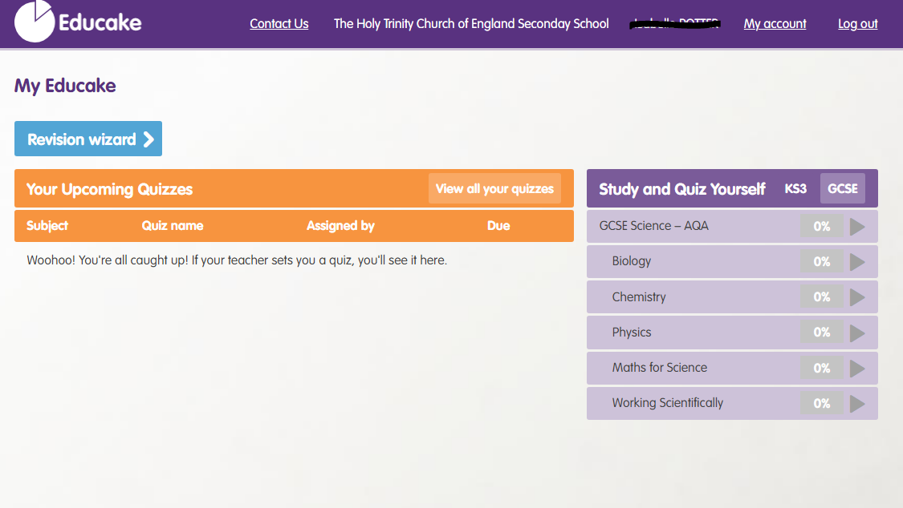
MISSION STATEMENT: Deeply Christian, Open to All
Our mission is to be a deeply Christian inclusive community which values every individual as a child of God
Homework
Homework - Educake
Vision Statement: A centre of excellence for learning inspired by Christian values where every person in our school community fulfils their potential.

Slide 24
MISSION STATEMENT: Deeply Christian, Open to All
Our mission is to be a deeply Christian inclusive community which values every individual as a child of God
Science
Revision and independent work - Kerboodle
Vision Statement: A centre of excellence for learning inspired by Christian values where every person in our school community fulfils their potential.

Slide 25
MISSION STATEMENT: Deeply Christian, Open to All
Our mission is to be a deeply Christian inclusive community which values every individual as a child of God
Science
Revision: Kerboodle
Year 7
Year 8
Vision Statement: A centre of excellence for learning inspired by Christian values where every person in our school community fulfils their potential.

Slide 26
MISSION STATEMENT: Deeply Christian, Open to All
Our mission is to be a deeply Christian inclusive community which values every individual as a child of God
Science
Assessment – Year 7
End of topic assessments – MCQ
End of term assessments
Autumn | Topic Bio1, Chem1, Phys1
Spring | Topic Bio1, Chem1, Phys1, Bio2 Chem2 and Phys2
Summer | Topic Bio1, Chem1, Phys1, Bio2, Chem2, Phys2, Bio3, Chem3, Phys3
Vision Statement: A centre of excellence for learning inspired by Christian values where every person in our school community fulfils their potential.

Slide 27
MISSION STATEMENT: Deeply Christian, Open to All
Our mission is to be a deeply Christian inclusive community which values every individual as a child of God
Science
Assessment – Year 8
End of topic assessments – MCQ
End of term assessments
Autumn | Topic Bio4, Chem4, Phys4
Spring | Topic Bio4, Chem4, Phys4, Bio5, Chem5 and Phys5
Summer | Topic Bio4, Chem4, Phys4, Bio5, Chem5, Phys5, Bio6, Chem6, Phys6
Vision Statement: A centre of excellence for learning inspired by Christian values where every person in our school community fulfils their potential.

Slide 28
Mrs K Meaney SENDCO

Slide 29
Supporting Students with Different Learning Needs
A range of barriers to learning:
Learning difficulties - dyslexia, dyspraxia, processing difficulties, moderate learning difficulties
Communication issues – speech and language, social communication, autism
Difficulties with focus and attention
Physical or sensory issues
Emotional or mental health difficulties

Slide 30
Provisions for Specific Needs
In class adjustments – Learning Guides, teacher support, LSAs
Small group support
1:1 mentoring and support
Support from outside agencies
After Half Term:
SENDCo Drop-ins on alternate Monday afternoons – bookable 15 minute slots

Slide 31
Ms C. Perry Year Leader – Year 7

Slide 32
MISSION STATEMENT: Deeply Christian, Open to All
Our mission is to be a deeply Christian inclusive community which values every individual as a child of God
Extra – Curricular Activities
Vision Statement: A centre of excellence for learning inspired by Christian values where every person in our school community fulfils their potential.

Slide 33
EXTRA CURRICULAR
MUSIC CLUBS
MONDAY 3.10-4.00
ORCHESTRA
WEDNESDAY 3.10-4.00
UKULELE/ KEYBOARD CLUB
WEDNESDAY TUTOR TIME (WEEK A)
SINGING GROUP
SUMMER TERM
KS3 PERFORMING ARTS SHOWCASE

Slide 34
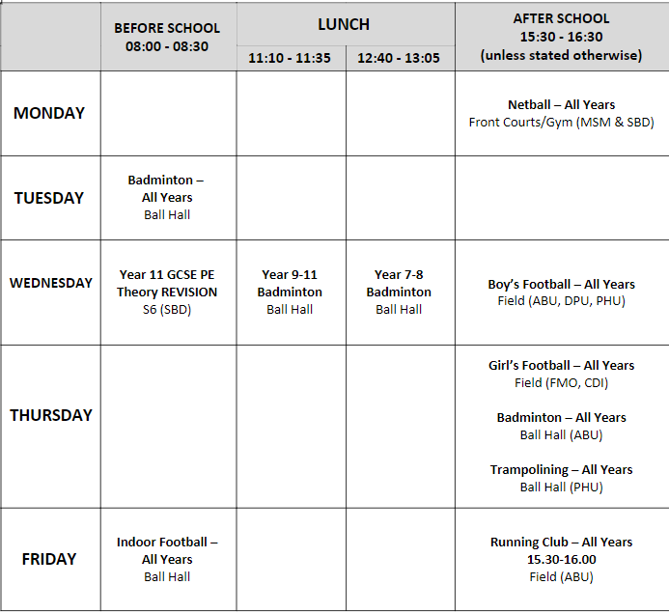
Extra-Curricular Sports Clubs
Sports Clubs will start from Monday 11th September.
What do I wear?
Before school and lunch time clubs – change into trainers.
After school clubs – change into PE kit and trainers/boots.
How do I sign up?
No need to sign up. Just turn up to the Ball Hall.
Each tutor room will have a copy of the timetable to put on their wall.

Slide 35
MISSION STATEMENT: Deeply Christian, Open to All
Our mission is to be a deeply Christian inclusive community which values every individual as a child of God
Reports
We introduced a new reporting system at KS3 as a result of conducting parent surveys last year.
A soft report will come out during the first half of the year.
The first area it will highlight is attendance & punctuality; highlighting how many days have been missed, the percentage of lessons attended on time and total learning lost.
Vision Statement: A centre of excellence for learning inspired by Christian values where every person in our school community fulfils their potential.

Slide 36
MISSION STATEMENT: Deeply Christian, Open to All
Our mission is to be a deeply Christian inclusive community which values every individual as a child of God
The 'soft' Report
The second area it will highlight is attitude to study, highlighting focus; work rate and homework against 4 different categories (Excellent, Good, Concern, Serious Concern).
Intervention with students after these reports will focus on improving attitudes to learning by removing barriers to progress.
Vision Statement: A centre of excellence for learning inspired by Christian values where every person in our school community fulfils their potential.

Slide 37
MISSION STATEMENT: Deeply Christian, Open to All
Our mission is to be a deeply Christian inclusive community which values every individual as a child of God
The 'detailed' Report
The second 'detailed' report will come during the second half of the year.
It will have a more detailed focus on progress and future potential and include some improvement comments from staff.
Vision Statement: A centre of excellence for learning inspired by Christian values where every person in our school community fulfils their potential.

Slide 38
MISSION STATEMENT: Deeply Christian, Open to All
Our mission is to be a deeply Christian inclusive community which values every individual as a child of God
Parents Evening
As well as two reports sent home during the year there will also be an opportunity to speak to teachers during a 'consultation evening'.
Year 8 parents evening will take place on Monday 11th March.
Year 7 parents evening will take place on Monday 25th March.
These are online events held through a web platform called
School Cloud.
They are more accessible to a wider range of parents and carers than running it live as phones or computers can be used to hold these meetings, also allowing multiple parent/carers to be in different locations.
The cut-off function has also ensured a parity/equity of access to teachers that in-school evenings often failed to secure.
Vision Statement: A centre of excellence for learning inspired by Christian values where every person in our school community fulfils their potential.

Slide 39
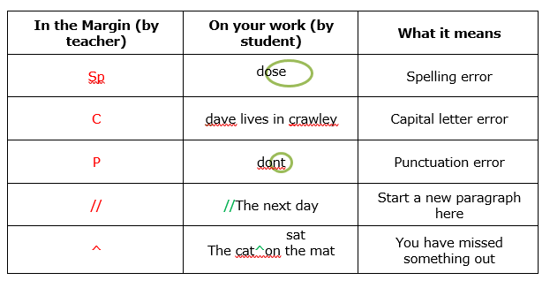
MISSION STATEMENT: Deeply Christian, Open to All
Our mission is to be a deeply Christian inclusive community which values every individual as a child of God
Feedback - Marking
Positive – Highlighting what is good about a piece of work
Improvement – What the student can do to improve
Action – The student asked to do something (usually produced in green pen).
Vision Statement: A centre of excellence for learning inspired by Christian values where every person in our school community fulfils their potential.

Slide 40
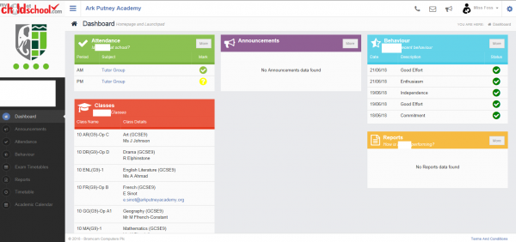
MISSION STATEMENT: Deeply Christian, Open to All
Our mission is to be a deeply Christian inclusive community which values every individual as a child of God
Monitoring your child's attendance
All schools in West Sussex use a system called Bromcom to record and monitor attendance.
Bromcom has an app for parents called My Child At School (MCAS).
This allows you to monitor attendance throughout the school day.
Year 8 parents already have access to this app. Year 7 parents will receive further details within the next week, including a user guidance & an activation code
Vision Statement: A centre of excellence for learning inspired by Christian values where every person in our school community fulfils their potential.

Slide 41
Mr P.Hunt Year Leader – Year 8

Slide 42
MISSION STATEMENT: Deeply Christian, Open to All
Our mission is to be a deeply Christian inclusive community which values every individual as a child of God
Homework
Homework can build good study habits and reinforce learning.
Encourage your child to check Class Charts every evening.
Consider how to manage the use of devices in the evening.
Study Studio runs on Mon-Thurs until 4.10pm.
Vision Statement: A centre of excellence for learning inspired by Christian values where every person in our school community fulfils their potential.

Slide 43
MISSION STATEMENT: Deeply Christian, Open to All
Our mission is to be a deeply Christian inclusive community which values every individual as a child of God
Homework & Absence
We use Class Charts for homework, rewards & sanctions.
We use Study Bugs for reporting absence from school.
There is an app that students & parents can download onto a phone.
Vision Statement: A centre of excellence for learning inspired by Christian values where every person in our school community fulfils their potential.

Slide 44
MISSION STATEMENT: Deeply Christian, Open to All
Our mission is to be a deeply Christian inclusive community which values every individual as a child of God
Homework
How long is long enough?
Vision Statement: A centre of excellence for learning inspired by Christian values where every person in our school community fulfils their potential.

Slide 45
MISSION STATEMENT: Deeply Christian, Open to All
Our mission is to be a deeply Christian inclusive community which values every individual as a child of God
Key Stage 3 passport
By the end of Year 9 students will have been given the opportunity to participate in a range of activities outside of the classroom to develop their knowledge, skills and understanding.
Each year there are 4 Cultural Capital Days, one in November, one in March and two in July, which involve a range of activities :
· Team Building and Resilience days
· Historical and Cultural visitor attractions including:
Places of worship, Museums, Theatres, Castles
· Natural attractions including:
Brighton Beach, South Downs, Tilgate Park
· Subject based trips including:
Art, Design, Business and Tourism, Psychology
Vision Statement: A centre of excellence for learning inspired by Christian values where every person in our school community fulfils their potential.

Slide 46
MISSION STATEMENT: Deeply Christian, Open to All
Our mission is to be a deeply Christian inclusive community which values every individual as a child of God
Key Stage 3 passport
The hope is that by the end of Year 9 all students will have experienced a range of visits, travelled by coach and train and be given the opportunity to take part in a residential.
All booking information will be shared with parents /carers electronically and all payments are accessed on Scopay.
Whilst most events and trips take place during the school day parental permission is not required. However, for any activities considered to have an element of adventure, permission will be required, and this will be given through Scopay.
Vision Statement: A centre of excellence for learning inspired by Christian values where every person in our school community fulfils their potential.

Slide 47
Mrs S. Whelan Pastoral Leader

Slide 48
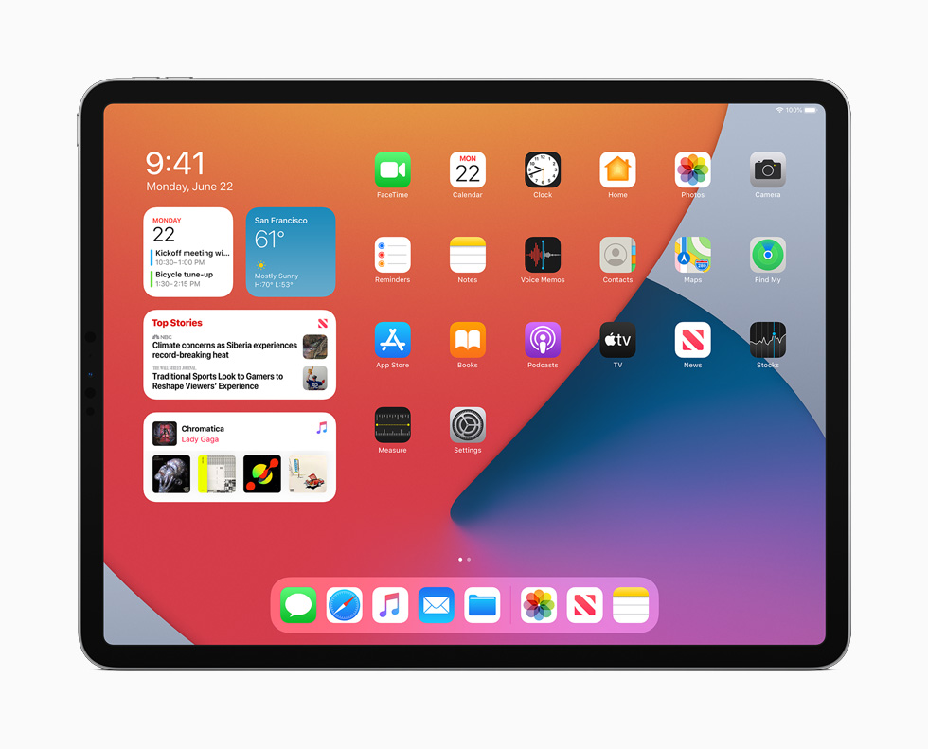
MISSION STATEMENT: Deeply Christian, Open to All
Our mission is to be a deeply Christian inclusive community which values every individual as a child of God
iPads for Years 7 & 8
Vision Statement: A centre of excellence for learning inspired by Christian values where every person in our school community fulfils their potential.

Slide 49
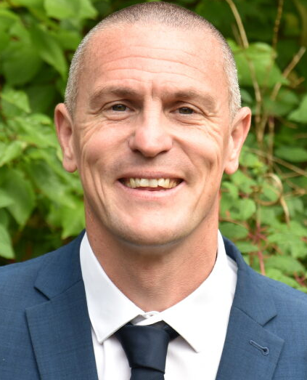
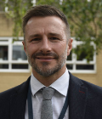
Safeguarding Team
DSL and Senior Mental Health Lead:
​Mr Andy Webster
Safeguarding Manager (On Duty DSL)
Mr Kevin Green (Mon and Tue)
Mrs Alison White (Wed – Fri)
DDSL(s):​
Mr Andrew Cook (DHT)
Mr Richard Mullineux (AHT)
Mr Alex Sheppard (AHT)
Headteacher: Reverend Chrissie Millwood
Nominated Safeguarding Governor:​ Canon Julia Peaty
Chair of Governors:​ Dr Michelle Leach

Slide 50
MISSION STATEMENT: Deeply Christian, Open to All
Our mission is to be a deeply Christian inclusive community which values every individual as a child of God
If you are worried about safety or
well-being, please contact one of
the Safeguarding Team
or
e-mail: safeguarding@holytrinitycrawley.org.uk
text: 07720 340227
click the Confide button at the bottom of the school computer screen
Vision Statement: A centre of excellence for learning inspired by Christian values where every person in our school community fulfils their potential.

Slide 51
The 3 rules – Ready, Respectful, Safe
MISSION STATEMENT: Deeply Christian, Open to All
Our mission is to be a deeply Christian inclusive community which values every individual as a child of God
Ready - being ready, able and willing to learn.
E.g. attendance/punctuality, uniform equipment.
Respectful - all about us working together to ensure we all behave with care, courtesy, consideration and respect for others.
Respecting each other and respecting the rules.
Respecting own and each others’ property.
Safe - all about how we can ensure we work together to keep us safe.
Keep your hands and feet to yourself.
One way system
Uniform
Vision Statement: A centre of excellence for learning inspired by Christian values where every person in our school community fulfils their potential.

Slide 52
The 3 rules – Ready, Respectful, Safe
MISSION STATEMENT: Deeply Christian, Open to All
Our mission is to be a deeply Christian inclusive community which values every individual as a child of God
These classroom routines will help to ensure that your children are ready, respectful and safe.
For any students who are not ready to learn, not being respectful, or being unsafe in the classroom; teachers will use the Rs to help get them back on track.
Vision Statement: A centre of excellence for learning inspired by Christian values where every person in our school community fulfils their potential.

Slide 53
The 6 Rs
MISSION STATEMENT: Deeply Christian, Open to All
Our mission is to be a deeply Christian inclusive community which values every individual as a child of God
REWARD while you will be reminded about our expectations you will also be rewarded for following these first-time and for working hard.
Vision Statement: A centre of excellence for learning inspired by Christian values where every person in our school community fulfils their potential.

Slide 54
The 6 Rs
MISSION STATEMENT: Deeply Christian, Open to All
Our mission is to be a deeply Christian inclusive community which values every individual as a child of God
Reminder
Reinforcement
Refocus
Removal
Repair
REWARD
Vision Statement: A centre of excellence for learning inspired by Christian values where every person in our school community fulfils their potential.

Slide 55
Changes to detentions
MISSION STATEMENT: Deeply Christian, Open to All
Our mission is to be a deeply Christian inclusive community which values every individual as a child of God
As well as making changes to how we reward students, we are also making significant changes to detentions this year. This is so where students get it wrong, we can help them to get it right next time.
Vision Statement: A centre of excellence for learning inspired by Christian values where every person in our school community fulfils their potential.

Slide 56
Uniform non-negotiables
MISSION STATEMENT: Deeply Christian, Open to All
Our mission is to be a deeply Christian inclusive community which values every individual as a child of God
Students must be appropriately dressed at the beginning of the lesson.
Blazers should be worn when students arrive to and leave a lesson.
They may be removed (at a teacher’s discretion) during the lesson but should be on the backs of chairs.
Shirt tucked in
Tie on
Appropriate footwear (no trainers)
No PE kit, hoodies or other clothing and jewellery not permitted
Full details of our uniform policy are on the website
Vision Statement: A centre of excellence for learning inspired by Christian values where every person in our school community fulfils their potential.

Slide 57
MISSION STATEMENT: Deeply Christian, Open to All
Our mission is to be a deeply Christian inclusive community which values every individual as a child of God
Closing Prayer
Loving God,
Teach us to respect the Dignity of each other,
so we can be a Community where all are valued and feel they can belong.
As we learn together so help us grow in Wisdom,
so that we may bring Hope to the world in which we live.
Amen
Vision Statement: A centre of excellence for learning inspired by Christian values where every person in our school community fulfils their potential.

