Slide 1
Year 13 Parent Information Event
MISSION STATEMENT: Deeply Christian, Open to All
Our mission is to be a deeply Christian inclusive community which values every individual as a child of God
Wednesday 20th of September 2023
Vision Statement: A centre of excellence for learning inspired by Christian values where every person in our school community fulfils their potential.

Slide 2
Welcome
MISSION STATEMENT: Deeply Christian, Open to All
Our mission is to be a deeply Christian inclusive community which values every individual as a child of God
Welcome to the Year 13 Parent Information Event
Vision Statement: A centre of excellence for learning inspired by Christian values where every person in our school community fulfils their potential.

Slide 3
Why are you here?
MISSION STATEMENT: Deeply Christian, Open to All
Our mission is to be a deeply Christian inclusive community which values every individual as a child of God
We want to develop parental engagement in the Sixth Form.
Sixth Form is very different to lower school – we want you to understand what your son/daughter will experience.
Find out how you can help support them.
Vision Statement: A centre of excellence for learning inspired by Christian values where every person in our school community fulfils their potential.

Slide 4
Sixth Form Staff
MISSION STATEMENT: Deeply Christian, Open to All
Our mission is to be a deeply Christian inclusive community which values every individual as a child of God
Mr Berry | Assistant Headteacher and Head of Sixth Form
Miss Ramos de Carvalho | Sixth Form Learning Mentor
Mrs Crossley | 6th Form Pastoral Administrator
Vision Statement: A centre of excellence for learning inspired by Christian values where every person in our school community fulfils their potential.

Slide 5
Year 13 Form Tutors
MISSION STATEMENT: Deeply Christian, Open to All
Our mission is to be a deeply Christian inclusive community which values every individual as a child of God
Year 13
13B | Miss S Munda Mon, Thu, Fri Mrs C Stevens Tue, Wed | smunda@holytrinitycrawley.org.uk And cstevens25@holytrinitycrawley.org.uk
13C | Mr A Hall Smith | asmith60@holytrinitycrawley.org.uk
13D | Mrs S Killick | skillick@holytrinitycrawley.org.uk
13W | Mrs A Ousalem | aousalem@holytrinitycrawley.org.uk
13Y | Miss S Benhamed | sbenhamed@holytrinitycrawley.org.uk
Vision Statement: A centre of excellence for learning inspired by Christian values where every person in our school community fulfils their potential.

Slide 6
What Sixth Form looks like
MISSION STATEMENT: Deeply Christian, Open to All
Our mission is to be a deeply Christian inclusive community which values every individual as a child of God
Timings of the day:
All students are expected to be in for 8.45 each day.
There is an assembly on a Monday, and tutor time the remainder of the week.
Tutor time is extremely important.
Vision Statement: A centre of excellence for learning inspired by Christian values where every person in our school community fulfils their potential.

Slide 7
Results/destinations
MISSION STATEMENT: Deeply Christian, Open to All
Our mission is to be a deeply Christian inclusive community which values every individual as a child of God
Top achievers include:
Jane Booth, A*,A,A, Cambridge to Study Archaeology
Holly Smith, A*A, Distinction, A, University of Portsmouth to study Geography
Peter Kennedy, A, B, B* and B to study Sport and Exercise Sciences
Laila Welling Performing Arts Extended Diploma D*D*D, University of Chichester Musical Theatre (Music)
Approximately 80% placed with their first choice offer
We are proud of all of our students for what they achieved last year
Vision Statement: A centre of excellence for learning inspired by Christian values where every person in our school community fulfils their potential.

Slide 8
What Sixth Form looks like
MISSION STATEMENT: Deeply Christian, Open to All
Our mission is to be a deeply Christian inclusive community which values every individual as a child of God
Students are permitted to leave site during the day, and may leave after their last lesson.
However, they should ensure they return to school/lessons on time.
This is a privilege not a right – students with poor attendance, punctuality, behaviour or progress can expect to remain on site for longer.
Students are also welcome to work on site in between lessons.
Vision Statement: A centre of excellence for learning inspired by Christian values where every person in our school community fulfils their potential.

Slide 9
What Sixth Form looks like
MISSION STATEMENT: Deeply Christian, Open to All
Our mission is to be a deeply Christian inclusive community which values every individual as a child of God
Each student does 3-4 subjects.
3 is a minimum.
Each subject has 9 lessons a fortnight, so a student should have approximately 13/14 lessons out of 25 a week.
Students without a 4 in English Language or Math will resit this.
Vision Statement: A centre of excellence for learning inspired by Christian values where every person in our school community fulfils their potential.

Slide 10
GCSE Maths and English resits
MISSION STATEMENT: Deeply Christian, Open to All
Our mission is to be a deeply Christian inclusive community which values every individual as a child of God
These are a government requirement.
Many university courses require an English 4.
Exam dates:
English language paper 1: Tuesday 7 November 2023.
Mathematics paper 1: Wednesday 8 November 2023.
English language paper 2: Thursday 9 November 2023.
Mathematics paper 2: Friday 10 November 2023.
Mathematics paper 3: Monday 13 November 2023.
Vision Statement: A centre of excellence for learning inspired by Christian values where every person in our school community fulfils their potential.

Slide 11
REACH
MISSION STATEMENT: Deeply Christian, Open to All
Our mission is to be a deeply Christian inclusive community which values every individual as a child of God
For the first time this year, Sixth Form students also have REACH on their timetable (one lesson per week).
This is personal and social education. It is the same principle as that studied in the lower school, but with more young adult themes.
Mental health, budgeting, student finance, careers education etc.
Vision Statement: A centre of excellence for learning inspired by Christian values where every person in our school community fulfils their potential.

Slide 12
Exams
MISSION STATEMENT: Deeply Christian, Open to All
Our mission is to be a deeply Christian inclusive community which values every individual as a child of God
Like with GCSEs, A Level exams will be sat at the end of Year 13 (3 exams per subject).
Some subjects have coursework, but most don’t.
BTEC/Vocational subjects are a mixture of internally-assessed coursework and exams.
Without wanting to put pressure on our young people – this year really counts.
Vision Statement: A centre of excellence for learning inspired by Christian values where every person in our school community fulfils their potential.

Slide 13
Coursework
MISSION STATEMENT: Deeply Christian, Open to All
Our mission is to be a deeply Christian inclusive community which values every individual as a child of God
BTEC/Vocational coursework is an important feature of the course.
There are very strict deadlines and guidelines about how much feedback students can be given / how much they can continue to submit/edit their work.
Teachers at HTS are very good at contacting parents for students at risk of not meeting deadlines!
Vision Statement: A centre of excellence for learning inspired by Christian values where every person in our school community fulfils their potential.

Slide 14
LEAP FROM YEAR 12 TO YEAR 13
MISSION STATEMENT: Deeply Christian, Open to All
Our mission is to be a deeply Christian inclusive community which values every individual as a child of God
https://www.netsixthform.co.uk/resources/view/the-leap-from-year12-to-year-13
Vision Statement: A centre of excellence for learning inspired by Christian values where every person in our school community fulfils their potential.

Slide 15
6th form RPE days
MISSION STATEMENT: Deeply Christian, Open to All
Our mission is to be a deeply Christian inclusive community which values every individual as a child of God
Government requirement that all students have religious education up to the age of 18.
All other years in Holy Trinity - provision is through regular lessons
In 6th form entitlement hours are combined into whole days. This year: 15/11/23, 22/3/24 & 4/7/24
Vision Statement: A centre of excellence for learning inspired by Christian values where every person in our school community fulfils their potential.

Slide 16
6th form RPE days – what can you expect?
MISSION STATEMENT: Deeply Christian, Open to All
Our mission is to be a deeply Christian inclusive community which values every individual as a child of God
Over the two years, RPE days will cover a variety of worldviews:
The aim is these will be off site.
Vision Statement: A centre of excellence for learning inspired by Christian values where every person in our school community fulfils their potential.

Slide 17
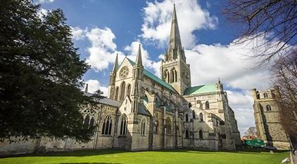
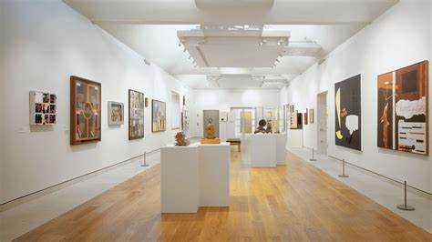
6th form RPE days – what can you expect?
MISSION STATEMENT: Deeply Christian, Open to All
Our mission is to be a deeply Christian inclusive community which values every individual as a child of God
Art Gallery
Place of Worship
Planetarium
Theatre
Vision Statement: A centre of excellence for learning inspired by Christian values where every person in our school community fulfils their potential.

Slide 18
Differences between Year 11/13
MISSION STATEMENT: Deeply Christian, Open to All
Our mission is to be a deeply Christian inclusive community which values every individual as a child of God
Greater independence required – more work and more time to do it
Private study facilities on site
More challenging work – a big step up from KS4 to KS5
Resilience a necessity
Discuss their plan with them
You can help
Vision Statement: A centre of excellence for learning inspired by Christian values where every person in our school community fulfils their potential.

Slide 19
Sixth Form Expectations
MISSION STATEMENT: Deeply Christian, Open to All
Our mission is to be a deeply Christian inclusive community which values every individual as a child of God
Students must arrive at 8.45 each day.
They can leave site in-between lessons but should sign in/out.
Dress code/lanyards
Mobile phones/headphones
Leaders of the school community
Late detention on a Thursday afterschool
Vision Statement: A centre of excellence for learning inspired by Christian values where every person in our school community fulfils their potential.

Slide 20
Dates for your diary
MISSION STATEMENT: Deeply Christian, Open to All
Our mission is to be a deeply Christian inclusive community which values every individual as a child of God
Event
GCSE Retakes
Parents’ evening
Mock Interview Event, Thales
PPEs
INSET days
Final exams
Cultural Diversity Days
A level and BTEC Results day
Date
w/c 07/10/23
6/12/23
14/11/23
22/01/24 to 02/02/24
3/10/23,
23/11/23&24/11/23
03/01/24
14/5/24*(provisional)
20/11/23, 8/4/24
15/8/24
Vision Statement: A centre of excellence for learning inspired by Christian values where every person in our school community fulfils their potential.

Slide 21
Parents’ Evening
MISSION STATEMENT: Deeply Christian, Open to All
Our mission is to be a deeply Christian inclusive community which values every individual as a child of God
Parents’ evening 6/12/23
This is online, via the platform Schoolcloud. You will be sent details to book virtual appointments to your email address.
Students cannot book appoints on their own – they can only be sent to a parent email address. If you know you will not be able to attend, please contact the tutor in advance who will arrange a meeting.
Vision Statement: A centre of excellence for learning inspired by Christian values where every person in our school community fulfils their potential.

Slide 22
Assessment - Progress Reports
MISSION STATEMENT: Deeply Christian, Open to All
Our mission is to be a deeply Christian inclusive community which values every individual as a child of God
Wed 8th November 2023
Wed 7th February 2024
Wed 15th May 2024
Wed 3rd July 2024
Reports will be sent out around these dates
Vision Statement: A centre of excellence for learning inspired by Christian values where every person in our school community fulfils their potential.

Slide 23
What you can do to support
MISSION STATEMENT: Deeply Christian, Open to All
Our mission is to be a deeply Christian inclusive community which values every individual as a child of God
Support with attendance and punctuality.
If your son/daughter is absent from school please contact Attendance –
the study bugs app on the website
attendance@holytrinitycrawley.org.uk or 01293 652971.
Ensure your contact details are up-to-date. Staff will contact you with any issues (and praise).
Please get in touch with us if there is anything to discuss. Please contact tutors in the first instance.
Vision Statement: A centre of excellence for learning inspired by Christian values where every person in our school community fulfils their potential.

Slide 24
Attendance/punctuality
MISSION STATEMENT: Deeply Christian, Open to All
Our mission is to be a deeply Christian inclusive community which values every individual as a child of God
This is the single biggest factor affecting progress and achievement.
Students who are present and punctual will achieve even if they do the bare minimum.
Students who miss lessons easily fall behind and it can be very hard to catch up again.
It is a challenge to catch up in Year 13.
Get it right the first time.
Vision Statement: A centre of excellence for learning inspired by Christian values where every person in our school community fulfils their potential.

Slide 25
Part-time jobs/Driving lessons
MISSION STATEMENT: Deeply Christian, Open to All
Our mission is to be a deeply Christian inclusive community which values every individual as a child of God
We fully appreciate many students want to be independent and have a part-time job.
However please be mindful that this doesn’t impact school/homework/revision.
No student should work during the school day (8:45-3:10).
Hours should also not exceed 12 a week.
Similarly, driving lessons are not permitted during the school day. Only tests are – this will be an authorized absence if we are alerted in advance.
Vision Statement: A centre of excellence for learning inspired by Christian values where every person in our school community fulfils their potential.

Slide 26
UCAS
MISSION STATEMENT: Deeply Christian, Open to All
Our mission is to be a deeply Christian inclusive community which values every individual as a child of God
(Universities and Colleges Admissions Service). This is the system for students applying to university.
We expect around 2/3 of our students to go to university, but encourage all to register/apply.
By now, students should have written their personal statement and uploaded this to Unifrog.
Predicted grades have been shared with students and each student is being given these on paper on Monday. Students should use these grades to inform their research – what courses/universities to apply to.
Vision Statement: A centre of excellence for learning inspired by Christian values where every person in our school community fulfils their potential.

Slide 27
Unifrog
MISSION STATEMENT: Deeply Christian, Open to All
Our mission is to be a deeply Christian inclusive community which values every individual as a child of God
Vision Statement: A centre of excellence for learning inspired by Christian values where every person in our school community fulfils their potential.

Slide 28
Unifrog
MISSION STATEMENT: Deeply Christian, Open to All
Our mission is to be a deeply Christian inclusive community which values every individual as a child of God
Vision Statement: A centre of excellence for learning inspired by Christian values where every person in our school community fulfils their potential.

Slide 29
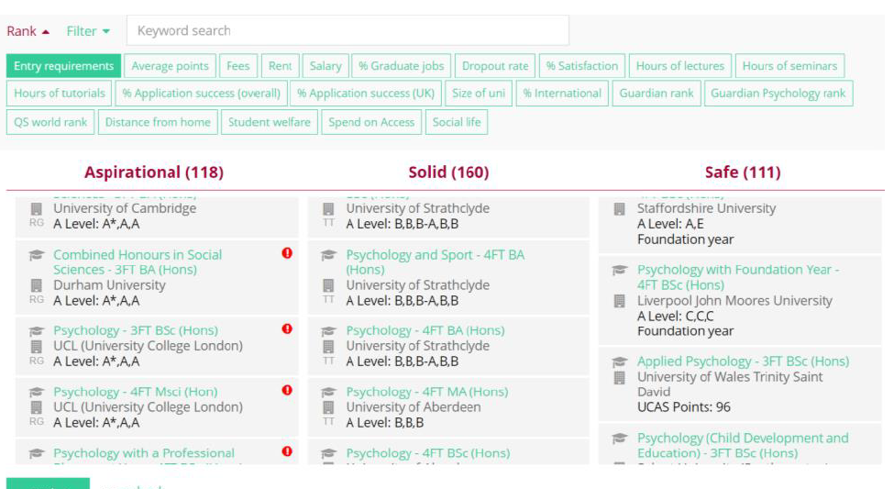
Unifrog
MISSION STATEMENT: Deeply Christian, Open to All
Our mission is to be a deeply Christian inclusive community which values every individual as a child of God
Vision Statement: A centre of excellence for learning inspired by Christian values where every person in our school community fulfils their potential.

Slide 30
UCAS Deadlines
MISSION STATEMENT: Deeply Christian, Open to All
Our mission is to be a deeply Christian inclusive community which values every individual as a child of God
HTS internal deadline to complete their UCAS application by Friday 24th November
UCAS applications need to be checked by the school before being sent off – this takes time. Late applications always result in a backlog – in school and at university.
After January applications will be consider late by UCAS
Vision Statement: A centre of excellence for learning inspired by Christian values where every person in our school community fulfils their potential.

Slide 31
UCAS Deadlines
MISSION STATEMENT: Deeply Christian, Open to All
Our mission is to be a deeply Christian inclusive community which values every individual as a child of God
Once students submit their 5 choices they will begin to get offers to choose from. However, these are done on a ‘first come first serve’ basis by each university.
Evidence shows that students who get their application in early receive lower offers than ones who apply later.
Universities can afford to be more selective as they start to fill their places.
Vision Statement: A centre of excellence for learning inspired by Christian values where every person in our school community fulfils their potential.

Slide 32
UCAS
MISSION STATEMENT: Deeply Christian, Open to All
Our mission is to be a deeply Christian inclusive community which values every individual as a child of God
Students will initially pick 5 choices, and then narrow this down to two:
Firm and Insurance choices
Insurance choices are very important – this acts as a safety net should students get lower grades than expected. Must be lower entry requirements than Firm.
Vision Statement: A centre of excellence for learning inspired by Christian values where every person in our school community fulfils their potential.

Slide 33
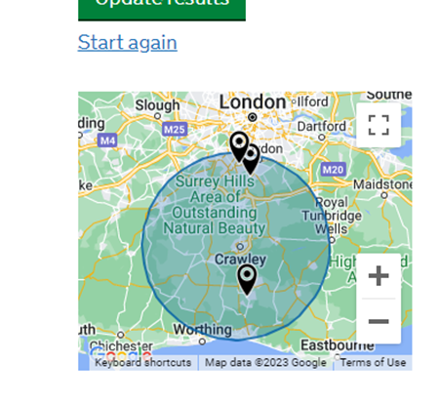
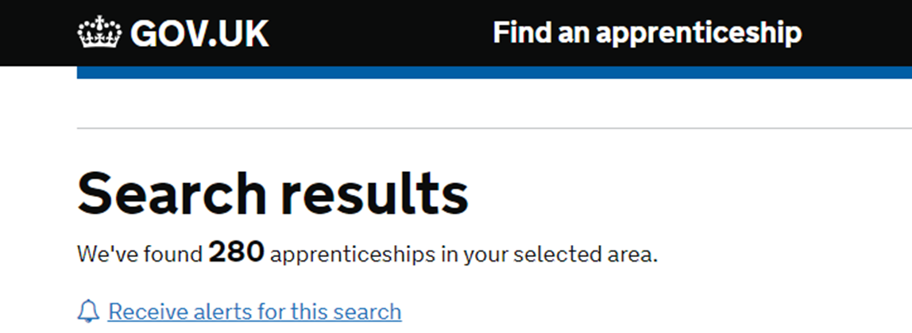
Next Steps
MISSION STATEMENT: Deeply Christian, Open to All
Our mission is to be a deeply Christian inclusive community which values every individual as a child of God
HTS2024
3 Degree level apprenticeships within 20 miles – accountancy, Science and retail
Vision Statement: A centre of excellence for learning inspired by Christian values where every person in our school community fulfils their potential.

Slide 34
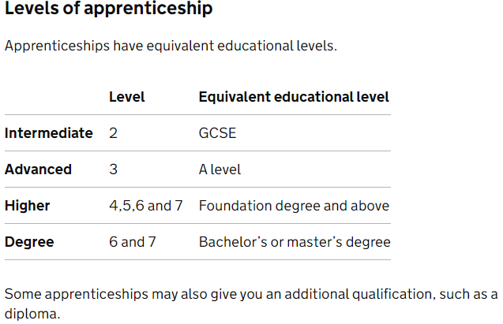
Apprenticeships
MISSION STATEMENT: Deeply Christian, Open to All
Our mission is to be a deeply Christian inclusive community which values every individual as a child of God
We expect some of our students to begin an apprenticeship next year.
Apprenticeships combine practical job training with study.
Vision Statement: A centre of excellence for learning inspired by Christian values where every person in our school community fulfils their potential.

Slide 35
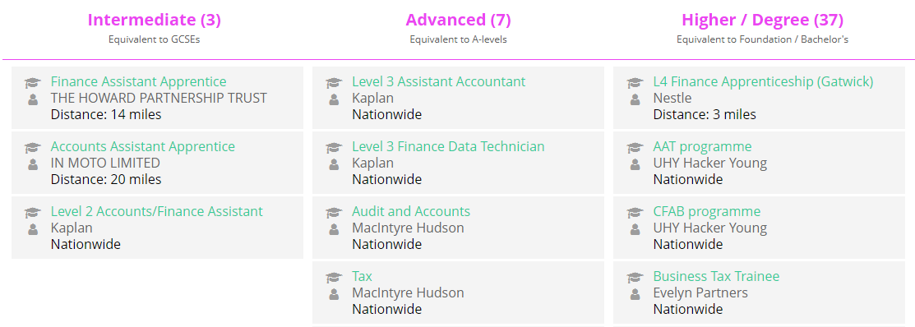
Apprenticeships
MISSION STATEMENT: Deeply Christian, Open to All
Our mission is to be a deeply Christian inclusive community which values every individual as a child of God
Students can research apprenticeships on Unifrog too.
Vision Statement: A centre of excellence for learning inspired by Christian values where every person in our school community fulfils their potential.

Slide 36
Apprenticeships
MISSION STATEMENT: Deeply Christian, Open to All
Our mission is to be a deeply Christian inclusive community which values every individual as a child of God
You can also search for apprenticeships on the Gov.uk website: https://www.gov.uk/apply-apprenticeship
Applications are made directly to the company – Unifrog/Gov.uk link to these websites/application forms.
Vision Statement: A centre of excellence for learning inspired by Christian values where every person in our school community fulfils their potential.

Slide 37
PiXL resources
MISSION STATEMENT: Deeply Christian, Open to All
Our mission is to be a deeply Christian inclusive community which values every individual as a child of God
There are a number of ‘Parent Pamphlets’ produced by an external organization called PiXL. These will be shared with this presentation.
Preparing for Post 16 Education
Post-18 Pathways
Explaining the UCAS process
Preparing for University Applications
Apprenticeships – an alternative to university.
Preparing to apply for an apprenticeship
Preparing for PPEs
Vision Statement: A centre of excellence for learning inspired by Christian values where every person in our school community fulfils their potential.

Slide 38
Exams
MISSION STATEMENT: Deeply Christian, Open to All
Our mission is to be a deeply Christian inclusive community which values every individual as a child of God
There is also a parent pamphlet on preparing for exams/PPEs. Other things that help:
Starting revision early
Positive mental health / self care
Importance of private study time (at school and at home)
Taking PPEs seriously
Acting on feedback etc
Vision Statement: A centre of excellence for learning inspired by Christian values where every person in our school community fulfils their potential.

Slide 39
In summary
MISSION STATEMENT: Deeply Christian, Open to All
Our mission is to be a deeply Christian inclusive community which values every individual as a child of God
This might sound like a lot, but:
We have high expectations of all of our students
Your son/daughter is in safe hands.
Vision Statement: A centre of excellence for learning inspired by Christian values where every person in our school community fulfils their potential.

Slide 40
Our School Prayer
Father God,
Teach us to respect the dignity of each other,
So that we can be a community where all are valued and feel they belong.
As we learn together, so help us to grow in wisdom,
So that we may bring hope to the world in which we live.
Amen.

Slide 41
Thank you for your time this evening
MISSION STATEMENT: Deeply Christian, Open to All
Our mission is to be a deeply Christian inclusive community which values every individual as a child of God
Please feel free to stay behind if you have any questions
Vision Statement: A centre of excellence for learning inspired by Christian values where every person in our school community fulfils their potential.

